Slide 1
APPLICATION THREAT MODELLING FOR an online learning PLATFORM
Raftopoulos Marios
MPKED24034
University of Piraeus
05/03/2025

Slide 2
Contents
1. Intro and Methodology
2.Application Analysis - DFDs
3. STRIDE - Threat Identification
4. DREAD – Threat Ranking
5. OWASP ASVS – Mitigations
6. Conclusion and Next Steps

Slide 3
Threat Modeling Methodology
• Decompose the Application
• STRIDE Threat Categorization
• DREAD Risk Assessment
• OWASP ASVS Security Controls

Slide 4
APPLICATION OVERVIEW
Key Elements:
Users: Student, Teacher
Web Client: the platform between users and server
Web Server: Business logic, authentication, authorization, …
Database: Stores User’s Data (username/password, grades, …)
File Storage: Stores lectures, assignments, …
Security Boundaries: 1) Between the public internet and the web client/ web server, 2) Between the web server and the database / file system

Slide 5
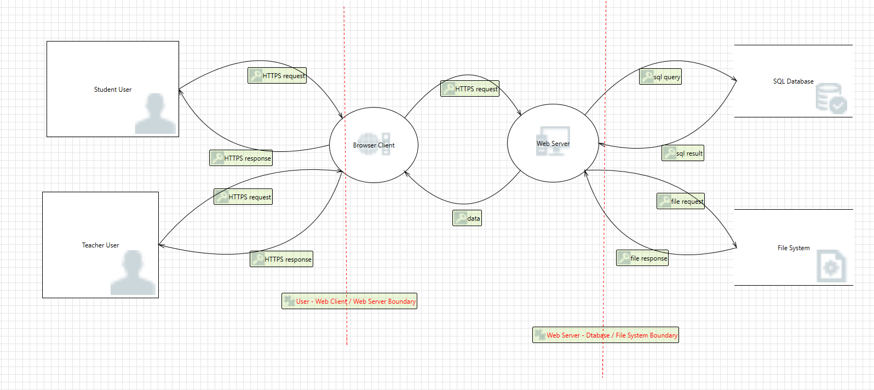
High-Level DATA FLOW DIAGRAM

Slide 6
STRIDE Threat Categorization
• Spoofing: Authentication Threats
• Tampering: Integrity Threats
• Repudiation: Non-Repudiation Threats
• Information Disclosure: Confidentiality Threats
• Denial of Service: Availability Threats
• Elevation of Privilege: Authorization Threats

Slide 7
THREAT EXAMPLES
Spoofing: Teacher User Spoofing
Tampering: SQL injection
Repudiation: Insufficient Logging
Information Disclosure: Unauthorized File Access
Denial of Service: Large File Upload
Elevation of Privilege: Teacher User Escalation

Slide 8
DREAD Risk Scoring
Damage Potential (D): Impact on data & operations
Reproducibility (R): How easy the attack can be repeated
Exploitability (E): Difficulty of executing the attack
Affected Users (A): Number of users impacted
Discoverability (D’): Likelihood of discovering the vulnerability

Slide 9
Threat DREAD Scoring
• Teacher Spoofing: Critical (41.5 DREAD Score)
• SQL Injection: Critical (40.5 DREAD Score)
• Insufficient Logging: High (34 DREAD Score)
• Unauthorized File Access: High (35.5 DREAD Score)
• Large File Upload : Critical (40.5 DREAD Score)
• Teacher Escalation: High (39.5 DREAD Score)
Damage + Reproducibility + Exploitability + Affected Users + Discoverability = DREAD Score
Scale: 0-10 for each category
DREAD Score Scales:
Low= 0-10, Medium=11-24, High=25-39, Critical=40-50

Slide 10

OWASP ASVS Security CATEGORIE Mapping
• V2 Authentication - Secure password policies, brute force protection
• V3: Session Management - Secure session handling, secure tokens
• V4: Access Control – RBAC, least privilege
• V5: Input Validation - Preventing SQL Injection, prepared statements,
• V7: Logging & Monitoring - Audit logging, anomaly detection
• V11: Business Logic – Business logic security – rate limits
• V12: File Uploading –maximum file size, file integrity

Slide 11
THREAT MAPPING
Threat | STRIDE | Damage | Reproducability | Exploitability | Affected Users | Discoverability | DREAD SCORE | RISK | ASVS Categories
Teacher User Spoofing | Spoofing | 9 | 7.5 | 5 | 10 | 10 | 41.5 | Critical | V2 (Authentication ), V3 (Session Management)
SQL Injection | Tampering | 10 | 7.5 | 5 | 10 | 8 | 40.5 | Critical | V5(Validation, Sanitization and Encoding)
Insufficient Logging | Repudiation | 10 | 5 | 5 | 6 | 8 | 34 | High | V7 (Error Handling & Logging)
Unauthorized File Access | Information Disclosure | 5 | 7.5 | 5 | 10 | 8 | 35.5 | High | V4 (Access Control)
Large File Upload | Denial Of Service | 10 | 7.5 | 5 | 10 | 8 | 40.5 | Critical | V12 (File Upload), V11.1 (Business Logic)
Teacher User Escalation Of Privilege | Elevation of Privilege | 9 | 7.5 | 5 | 10 | 8 | 39.5 | High | V4 (Access Control)

Slide 12
OWASP ASVS Security MITIGATIONS
V2: Authentication ->
V2.4 Credential Storage -> ASVS V2.4.1: Χρήση αλγορίθμων hashing
V2.2 General Authenticator Security -> ASVS V2.2.1: Rate limiting, CAPTCHA
V3: Session Management - >
V3.2 Session Binding -> ASVS V3.2.1: μοναδικά και τυχαία session Ids
V5: Validation, Sanitization and Encoding ->
V5.3 Output Encoding and Injection Prevention -> ASVS V5.3.4 Parameterized queries, prepared statements for database calls.
V5.1 Input Validation -> ASVS V5.1.3 Verify that all input is validated using positive validations ( allow lists)
V7: Error Handling and Logging ->
V7.1 Log Content -> ASVSV7.1.4 Καταγραφή όλων των απαραίτητων στοιχείων που επιτρέπουν μελλοντικό investigation ( userIDs, events , Ips, Timestamps, …)
V7.3 Log Protection -> ASVSV7.3.3 Protect logs from unauthorized access
V4: Access Control Verification ->
V4.1 General Access Control Design -> ASVS V4.1.3 least privilege
V4.1 General Access Control Design -> ASVS V4.1.2 RBAC
V4.2 Operational Level Access Control-> ASVS V4.2.1 IDOR protection
V11: Business Logic ->
V11.1 Business Logic Security -> ASVS V11.1.4 rate limiting/ for requests like file uploads
V12 File and Resources Verification ->
V12.1 File Upload -> ASVS V12.1.1 don’t accept large files that could cause dos
V12.2 File Integrity -> ASVS V12.2.1 validate the file type

Slide 13
Phased Implementation Strategy
Phase 1: Immediate Fixes (Critical and High Dread Score Threats)- Secure passwords, rate limiting, SQLi prevention, access control measures
Phase 2: Hardening and Enhancements – MFA, WAF, centralized logging (SIEM systems), strengthen previous measures
Phase 3: Monitoring and Improvement- code reviews, alerting, penetration testing, secure code guidelines and continuous improvements

Slide 14
Conclusion
Comprehensive threat modeled an application using OWASP, STRIDE, and DREAD
Prioritized risks based on severity
Applied OWASP ASVS controls for mitigation
Implemented a phased security plan

Slide 15

THANK YOU!

