Slide 1

Final
Summary
of C GUI Calculator
Calculating various term
Presentation
📍 North South University
📞 +8801970980064

Slide 2
CSE115 Section 4 | Project Group 9
C GUI Calculator
A Scientific Calculator Using C and GTK+ 3
Md. Rafi Sarkar
2522795642
Ainul Huque
2521763642
Md. Hasibul Halim
2524375642
Md. Ahasanul Hasan Kabir
2524716642
Md. Rahat Sarkar
2413522642

Slide 3




C GUI Calculator Summary
Executive Summary
  Purpose: Create a user-friendly calculator with a clean Graphical User Interface (GUI)
  Features:
    Basic arithmetic operations
    Scientific functions (trigonometric, etc.)
  Goal: Accuracy, simplicity, and efficiency for all users
  Learning Outcomes: GUI design, event handling, input validation

Slide 4
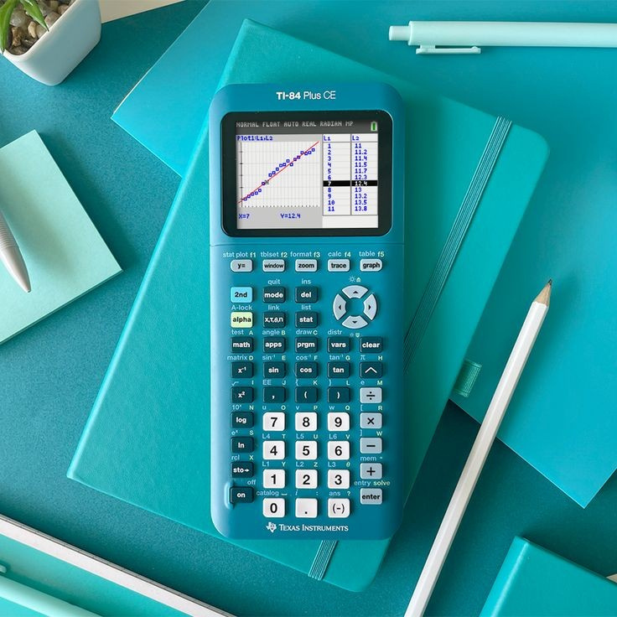
C GUI Calculator Summary
PROJECT OVERVIEW
🧮 What We Built
A complete scientific calculator application with graphical interface
💻 Technology Stack
C Programming Language + GTK 3 GUI Framework
🎯 Purpose
Learn GUI programming, algorithms, and team collaboration
Our calculator performs both basic arithmetic and advanced scientific functions with intelligent error handling

Slide 5

C GUI Calculator Summary
KEY
FEATURES
➕ Basic Operations
📊 Scientific Functions
  Addition, Subtraction
  Multiplication, Division
  Exponentiation (^)
  Trigonometry (sin, cos, tan)
  Square root, Logarithms
  Natural logarithm
🧠 Smart Features
🖱️ User Interface
  Complex expressions
  Parentheses support
  Error handling
  Intuitive button layout
  Keyboard shortcuts
  Clear error messages

Slide 6


C GUI Calculator Summary
PROGRAM
ARCHITECTURE
🧠 Math Brain
📺 Calculator Display
Parses and evaluates mathematical expressions using the Shunting Yard algorithm
GTK+ entry widget showing current input and results with right-aligned text
🔘 Button Handler
🗄️ Memory Manager
Processes all button clicks and keyboard input with smart auto-clear behavior
Dynamic stacks and proper memory cleanup to prevent crashes and leaks

Slide 7
Why It Matters
C GUI Calculator Summary
The Shunting Yard Algorithm
  Input: 2 + 3 * 4
  Computer sees: Which operation first?
  Algorithm converts to: 2 3 4 * +
  Result: 14 (not 20!)
Real Example
Handles operator precedence
Manages parentheses correctly
Processes functions properly
Enables complex expressions
sin(30) + cos(60) * 2
↓ Converts to ↓
30 sin 60 cos 2 * +
= 1.5

Slide 8

Smart Data Structures
🏗️ Token System
📚 Dynamic Stacks
Breaks "sin(30)+2" into:
sin | ( | 30 | ) | + | 2
Automatically resize as needed:
• Number stack for calculations
• Token stack for parsing
💾 Calculator State
🔍 Lexical Analyzer
Remembers:
• Current input
• Last error message
• UI state flags
Identifies:
• Numbers (including decimals)
• Operators and functions
• Parentheses and special chars

Slide 9


Robust Error Handling
Common Errors We Catch
Smart Solutions
  5 ÷ 0 → "Division by zero"
  √(-4) → "Cannot take square root of negative"
  tan(90°) → "Tangent undefined at 90°"
  log(0) → "Logarithm undefined for zero"
  ((2+3) → "Mismatched parentheses"
  Domain checking before calculations
  Clear error messages for users
  Graceful recovery without crashes
  Input validation at every step
  Memory safety with proper cleanup
Our calculator never crashes – it always provides helpful feedback

Slide 10
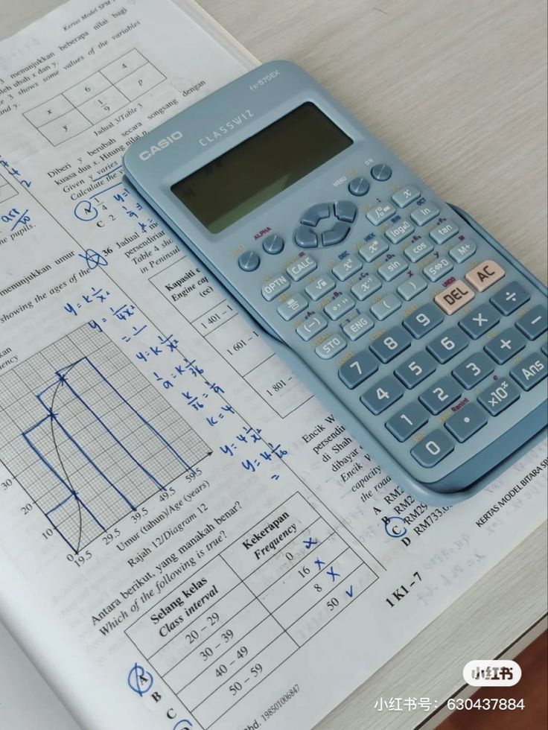
Calculator
In Action
C GUI Calculator Summary
📊 Basic Math
🧮 Complex Expressions
5 + 3 = 8
10 - 4 = 6
7 * 8 = 56
15 / 3 = 5
2^4 = 16
(5 + 3) * 2 = 16
10 + 2 * 3 = 16
2^3^2 = 512
sin(30) + cos(60) = 1
sqrt(9) + log(10) = 5
🔬 Scientific Functions
sqrt(16) = 4
sin(30) = 0.5
cos(60) = 0.5
log(100) = 2
ln(2.718) ≈ 1

Slide 11
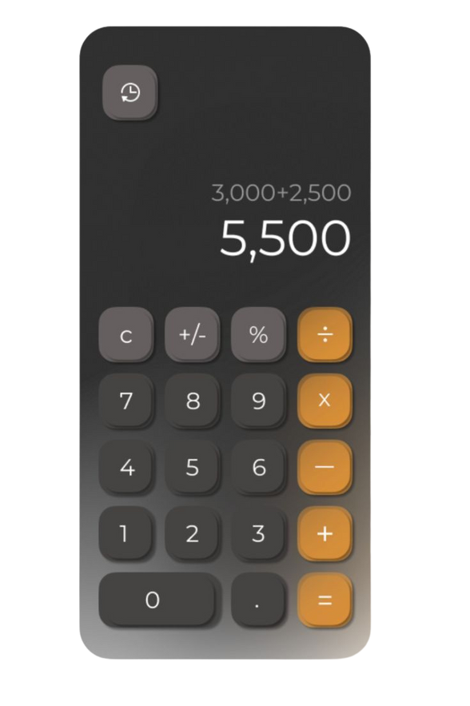
C GUI Calculator Summary
User Experience Design
🎨 Clean Interface
⌨️ Keyboard Support
  Familiar calculator layout
  Large, readable display
  Consistent button sizes
  Professional styling
  Enter key for calculations
  Backspace for corrections
  Number keys work directly
  Operator keys supported
🧠 Smart Behavior
🌐 Cross-Platform
  Auto-clear after results
  Continue calculations with operators
  Right-aligned text display
  Error state handling
  Works on Windows
  Runs on macOS
  Compatible with Linux
  GTK+ 3 portability

Slide 12
Challenges We Overcame
C GUI Calculator Summary
🚧 Technical Challenges
👥 Team Challenges
Expression Parsing
Problem: Understanding "2+3*4" = 14
Solution: Implemented Shunting Yard algorithm
Memory Management
Problem: Preventing crashes and leaks
Solution: Dynamic arrays with proper cleanup
GUI Design
Problem: Making it look professional
Solution: Studied GTK+ documentation thoroughly
Code Coordination
Problem: 5 people, one codebase
Solution: Git version control workflow
Task Division
Problem: Splitting work effectively
Solution: Modular architecture design
Testing & Debugging
Problem: Finding edge cases
Solution: Systematic testing approach

Slide 13


C GUI Calculator Summary
Project Success!
What We Accomplished
  Built a fully functional scientific calculator
  Implemented complex algorithms from scratch
  Created an intuitive user interface
  Achieved robust error handling
  Developed cross-platform compatibility
Personal Growth
This project bridged the gap between theoretical computer science and practical application development. We're proud of creating a tool that's both functional and educational!

Slide 14

C GUI Calculator Summary
THANK YOU!
Scan the QR code if your are interested.

