Slide 1

Mini UPS Demonstration
Using Diode
Presented By: Group 4

Slide 2
CONTENTS
Motivation
Theory
Circuit Components
Methodology
Circuit Diagram & Simulation
Results & Calculation
Discussion & Future Improvements
Conclusion

Slide 3

MOTIVATION
Power cuts are unpredictable: Even a brief interruption can reset microcontrollers, corrupt stored data
IoT & smart devices are vulnerable: Sensors, smart home hubs, and medical monitors require uninterrupted power to function correctly
Cost-effective resilience: A simple diode-capacitor-battery circuit can provide reliable backup at minimal cost compared to commercial UPS units.
Foundation for real-world power systems: Understanding this small circuit builds the basic for designing larger, industrial-grade UPS and power backup systems

Slide 4
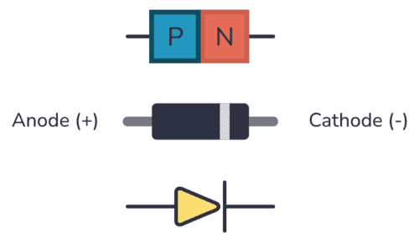
Theory: Diode Working Principle
A diode is a two-terminal semiconductor device that allows current to flow in only one direction — from Anode (+) to Cathode (−)
It is made of a P-N junction: the P-side has majority positive holes and the N-side has majority electrons
Forward Bias: When positive voltage is applied to the anode, the junction barrier breaks down and current flows freely; a silicon diode has a 0.7V forward voltage drop
Reverse Bias: When negative voltage is applied to the anode, the junction widens and blocks current flow entirely — this is the key property used in our circuit

Slide 5
Circuit Components
DC Power Supply (12 V) – main source
DC Battery (9 V) – backup source
Diodes (2 × 1N4007) – for automatic source selection
Capacitor (1000 µF, electrolytic) – for charge storage and smooth transition
5mm LED – as the load
Connecting Wires – for circuit connections
Multisim Software – for simulation and analysis

Slide 6
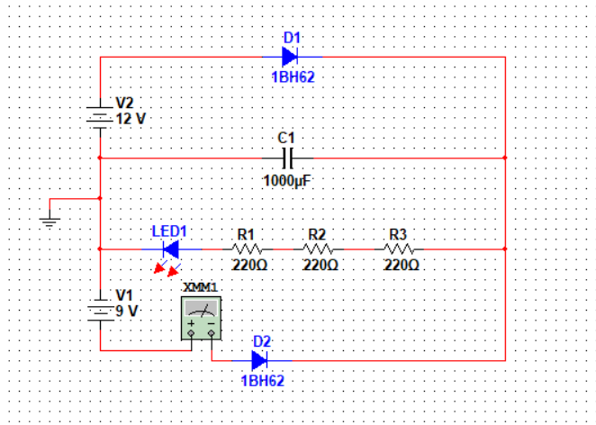
METHODOLOGY
Simulation First: The circuit was first built and tested on Multisim software to verify theoretical calculations before physical construction
Normal Mode: The 12V main supply was switched ON — Diode 1 conduct current, powering the LED and the capacitor charged up fully
Backup Mode: The main supply switch was turned OFF, the capacitor power the load, keeping the LED on and then Diode 2 takes over, voltage dropped below 9V, seamlessly switching to battery power
Data Collection: Output voltage, LED current, and battery current were measured and recorded for both Normal Mode and Backup Mode
Comparison: Theoretical calculated values were compared against simulation results to verify accuracy and understand any discrepancies
Observation: The diodes ensured no reverse current flowed, the capacitor provided a smooth transition, and the system switched automatically without any manual intervention
Circuit Diagram

Slide 7
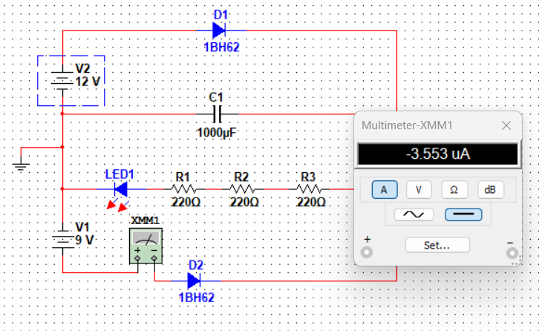
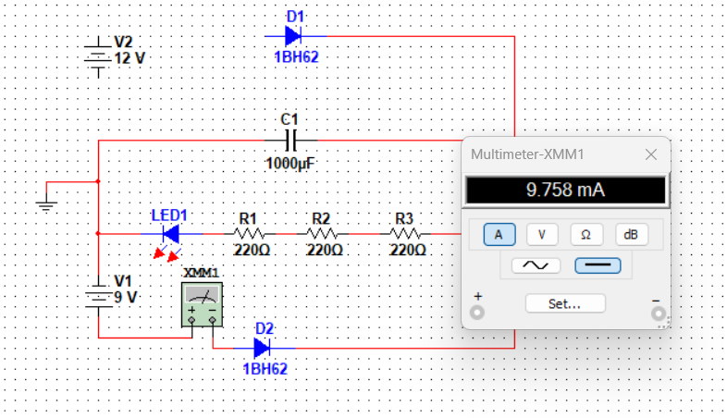
Simulation: Circuit Behavior
Normal Mode (12V On)
Backup Mode (9V On)

Slide 8
Results & Analysis
Backup Mode (9V ON):
Output Voltage: ( 9V - 0.7V = 8.3V )
Resistor Voltage: ( 8.3V - 2V = 6.3V )
Battery Current: Same as LED current (battery powers load).
Normal Mode (12V ON):
Output Voltage: ( 12V - 0.7V = 11.3V )
Resistor Voltage: ( 11.3V - 2V = 9.3V )
Battery Current: 0mA (diode reverse-biased, blocks battery).
Mode | Output Voltage | Battery Current (theoretical value) | Battery Current (simulation value)
12V (On) | 11.3V | 0 mA | 3.55 uA
9V (ON) | 8.3V | 9.7 mA | 9.7588 mA

Slide 9



Discussion: Project Reflections
Advantages
Limitations
Improvements
Compact and cost-effective.
Output voltage ripple during high loads.
Integrate a battery charging circuit.
Automatic, near-instantaneous switchover
No battery charging mechanism
To reduce power loss use MOSFET
Scalable concept
Diode will drop 0.7 volt will reduce efficiency
Upgrade to recharegable battery and larger capacitor

Slide 10
CONCLUSION
The Mini UPS circuit successfully demonstrated uninterrupted power delivery by intelligently combining a 12V main supply, a 9V backup battery, and a 1000µF capacitor
The two diodes effectively managed automatic source selection blocking reverse currents and enabling seamless switchover without any manual control
The capacitor acted as a short-term energy buffer, bridging the gap between the main supply cutoff and the battery taking over, preventing any sudden interruption to the load
Experimental results closely matched theoretical calculations, validating the circuit design and reinforcing the reliability of diode-capacitor based backup systems
This project highlights that small, well-chosen components can create efficient, reliable power solutions a foundational concept in power electronics and embedded systems design

Slide 11
THANK YOU ☺
For your attention. Please feel free to ask any questions you may have. We are here to answer them and engage in a productive discussion

