Slide 1
WGMS
Web-Based Guest Management System

Slide 2
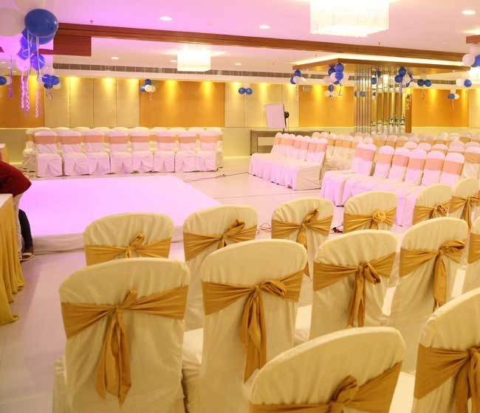
Introduction
Wedding planning involves organizing large numbers of guests, invitations, and event arrangements. Managing this information manually can be time-consuming and prone to errors. A web-based system can simplify the process by providing a centralized platform where hosts can manage guests, track RSVPs, and organize seating arrangements.

Slide 3
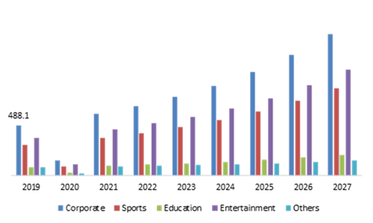
Problem Statement
Difficulty updating guest information
Loss or duplication of guest data
Poor RSVP response tracking
Inefficient communication with guests
Time-consuming manual processes
Event Management Market Size, Statistics & Analysis by 2027

Slide 4

Project Objectives
Develop a web-based guest management platform
Store and manage guest information using a database
Enable RSVP tracking through a website
Assist with seating arrangement management
Generate guest and attendance reports

Slide 5
System Methodology (SDLC)
Requirement Analysis
System Design
Website Development
Database Integration
Testing
Deployment
Analysis
Design
Development
Testing
Deployment

Slide 6
System Architecture
Presentation Layer – HTML, CSS, JavaScript UI
Application Layer – Logic and request handling
Database Layer – Supabase/Firebase
Presentation Layer
Application Layer
Database Layer

Slide 7
Expected Outcomes
Organized digital guest management platform
Reduced manual work and errors
Improved RSVP tracking
Simplified seating planning
Easy browser-based access

Slide 8
Project Timeline
Requirement Analysis – 1 Week
System Design – 1 Week
Development – 3 Weeks
Testing – 1 Week
Deployment – 1 Week
Analysis
System Design
Developement
Testing
Deployment
Week 1
Week 2
Week 5
Week 7

Slide 9
Future Enhancements
Mobile-responsive design
QR code guest check-in
SMS invitation system
Multiple event management
Real-time analytics dashboard

Slide 10
Colclusion
The Web-Based Wedding Guest Management System will provide an efficient and modern solution for managing wedding guests. By integrating HTML, JavaScript, and a DBMS, the system will allow hosts to manage guest information, track attendance, and organize seating arrangements effectively through a user-friendly websit

