Slide 1
Statistical Investigation of
Diabetes Risk Factors and Prediction
STA 281 — Statistical Methods and Probability | CEP
Submitted to: Md. Shohel Babu, Coordinator & Assistant Professor, Southeast University
GROUP MEMBERS
768
9
M. Rafi-Ur-Rahman Alif · 2024100000006
Patients
Variables
Hridoy Chandra Das · 2024100000019
T.M. Shahriyar Kabir · 2024100000026
34.90%
0.4960
T.M. Ornima Akter · 2024100000042
Diabetic
Glucose–Outcome r
Date of Submission: 29 September 2026

Slide 2
SECTION 1 — DATA
Dataset Overview & Preprocessing
Pima Indians Diabetes Dataset • Python / Google Colab
768
9
0
34.90%
Observations
Variables
Null entries
Diabetic
VARIABLES
PREPROCESSING
Pregnancies • Glucose • BloodPressure
SkinThickness • Insulin • BMI
DiabetesPedigreeFunction • Age • Outcome
• Missing values checked with df.isnull().sum()
• No null entries reported in the loaded dataset
• Zero values in Glucose, BMI, BloodPressure and Insulin treated as missing information
• Central-value replacement was used before analysis
Outcome: 0 = Non-diabetic | 1 = Diabetic
The report notes that zero clinical measurements are physiologically implausible and would distort statistics if untreated.
STA 281 | CEP | Southeast University
2

Slide 3
SECTION 1 — STATISTICS
Descriptive Statistics
Core metrics for Glucose, BMI, Age and Insulin (n = 768)
VARIABLE
MEAN
MEDIAN
MODE
VARIANCE
STD. DEV.
Glucose
121.68
117.00
99, 100
928.07
30.46
BMI
32.43
32.05
30.1
47.34
6.88
Age
33.24
29.00
22
138.30
11.76
Insulin
141.75
102.50
102.5
7938.96
89.10
• Glucose: mean 121.68 > median 117.00 → mild right skew.
• BMI: mean 32.43 and median 32.05 are close → roughly symmetric; many patients are in the obese range.
• Age: mean 33.24 > median 29.00 → right-skewed with a younger main cohort.
• Insulin: very large variance/SD and strong right skew; repeated 102.50 reflects preprocessing.
STA 281 | CEP | Southeast University
3

Slide 4
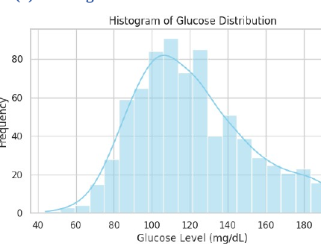
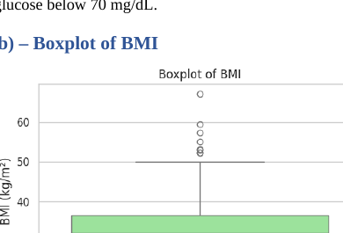
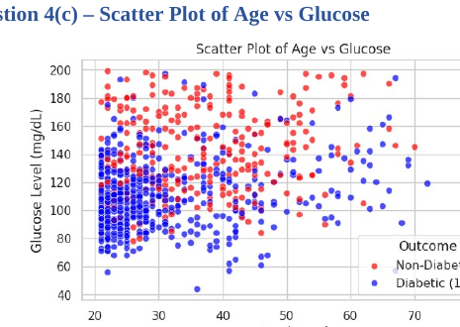
SECTION 1 — VISUALIZATION
Distributions & Relationships
Figures reproduced from the submitted report
Glucose: approximately bell-shaped but right-skewed; BMI shows upper outliers; Age–Glucose is weak positive (r = 0.2689).
STA 281 | CEP | Southeast University
4

Slide 5
SECTION 2 — PROBABILITY
Probability & Bayes' Theorem
Diabetes probability updated using glucose thresholds
CONDITIONAL PROBABILITY
BAYES' THEOREM
34.90%
32.94%
P(D | G>150) =
[P(G>150 | D) × P(D)] / P(G>150)
P(D)
P(Glucose > 130)
39.18%
18.23%
20.96%
63.64%
P(G>150 | D)
P(G>150)
P(D ∩ G)
P(D | G)
75.00%
High glucose > 130 mg/dL raises the observed probability from 34.90% to 63.64%.
Posterior P(D | G>150)
The posterior rises from 34.90% to 75.00% after observing glucose > 150 mg/dL; 25% of these patients are still non-diabetic.
STA 281 | CEP | Southeast University
5

Slide 6
SECTION 2 — DISTRIBUTIONS
Binomial, Normal, Exponential & CLT
Probability models used in the report
BINOMIAL
NORMAL
n = 12, p = 0.31
μ = 125, σ = 30
P(X=4) = 23.49%
P(X≥4) = 53.81%
P(X≤4) = 69.68%
P(X<100) = 20.23%
P(100<X<140) = 48.91%
P(X>150) = 20.23%
Expected X = 3.72
Symmetric tails
EXPONENTIAL
CLT
λ = 0.5
μ = 120, σ = 15, n = 40
E[X] = 2.00 time units
P(X>3) = 22.31%
SE = 2.3717
Z = 2.1082
P(X̄<125) = 98.25%
Memoryless model
Sample mean ≈ Normal
The report uses these models for group composition, glucose risk ranges, emergency-arrival waiting times, and sampling-mean inference.
STA 281 | CEP | Southeast University
6

Slide 7
SECTION 3 — INFERENCE
Confidence Interval & Hypothesis Testing
95% CI, Z-tests and Welch's two-sample comparison
95% CI — MEAN GLUCOSE
WELCH'S t-TEST — DIABETIC vs NON-DIABETIC
n = 64 | x̄ = 130.00 | σ = 18
Variable Non-Diabetic Diabetic Difference
Glucose 110.62 ± 24.70 142.30 ± 29.49 +31.68
BMI 30.85 ± 6.50 35.40 ± 6.59 +4.55
Age 31.19 ± 11.67 37.07 ± 10.97 +5.88
2.25
1.9600
Standard Error
Critical Z
125.59 – 134.41
95% CI (mg/dL)
14.9921
< 0.001
Glucose t
p-value
The interval is entirely above the 120 mg/dL reference mean used in the report.
All three comparisons are statistically significant at α = 0.05.
STA 281 | CEP | Southeast University
7

Slide 8
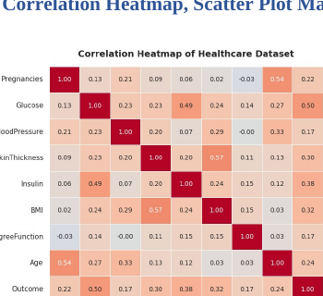
SECTION 4 — CORRELATION
Pearson Correlation Analysis
Relationships among clinical variables and diabetes outcome
KEY PAIRS
Insulin ↔ Glucose
0.4900
Moderate
Age ↔ BloodPressure
0.3251
Weak–Moderate
Glucose ↔ BMI
0.2362
Weak–Moderate
Outcome correlations
Glucose 0.4960
Insulin 0.3771
BMI 0.3156
Age 0.2384
Pregnancies 0.2219
Report Figure 5 — Correlation heatmap
STA 281 | CEP | Southeast University
8

Slide 9
SECTION 4 — REGRESSION
Simple Linear Regression: Age → Glucose
Model fitted to quantify the linear relationship
MODEL
Glucose = 98.5216 + 0.6966 × Age
0.6966
0.2689
Slope β₁
Correlation r
0.0723
3.45e−14
R²
p-value
Age has a statistically significant positive relationship with glucose, but explains only 7.23% of glucose variation.
Interpretation: about +0.70 mg/dL glucose per additional year of age on average; individual values vary widely.
STA 281 | CEP | Southeast University
9

Slide 10
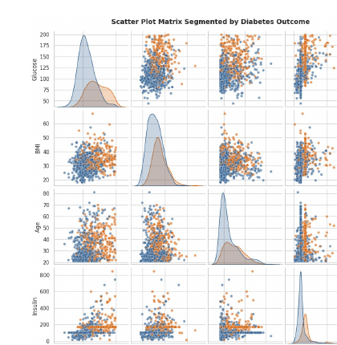
SECTION 4 — RISK FACTORS
Risk Factor Strength & Statistical Dashboard
Glucose shows the strongest observed association with Outcome
CORRELATION WITH OUTCOME
Glucose
0.4960
Insulin
0.3771
BMI
0.3156
SkinThickness
0.2951
Age
0.2384
Pregnancies
0.2219
BloodPressure
0.1745
Pedigree
0.1738
Report Figure 6 — Scatter plot matrix segmented by Outcome
The report classifies Glucose as the primary risk factor; Insulin, BMI, SkinThickness, Age and Pregnancies as moderate; BloodPressure and DiabetesPedigreeFunction as minor.
STA 281 | CEP | Southeast University
10

Slide 11
SUMMARY — ALL PHASES
Key Findings Across the Project
From data preparation to inference, correlation and regression
PHASE 1 — DATA
PHASE 2 — PROBABILITY
768 patients • 9 variables
No null entries reported
Zero clinical values treated as missing information
P(D) = 34.90%
P(D|Glucose>130) = 63.64%
Bayes posterior at >150 = 75.00%
PHASE 3 — INFERENCE
PHASE 4 — REGRESSION
95% CI = [125.59, 134.41] mg/dL
Z-test: Glucose > 120 supported
Welch tests: Glucose, BMI, Age differ
Insulin–Glucose r = 0.4900
Age–Glucose r = 0.2689
Age explains 7.23% of glucose variation
Overall: Glucose is consistently the clearest statistical signal associated with diabetes status in this dataset.
STA 281 | CEP | Southeast University
11

Slide 12
CONCLUSION
Statistical Investigation of
Diabetes Risk Factors and Prediction
01
Glucose — Primary Risk Factor
02
Group Differences
Highest correlation with Outcome (r = 0.4960). Probability of diabetes rises to 63.64% for glucose >130 mg/dL and to 75.00% for >150 mg/dL.
Diabetic patients show higher mean Glucose (+31.68 mg/dL), BMI (+4.55 kg/m²) and Age (+5.88 years); all Welch t-tests are significant.
03
Age — Significant but Weak Predictor
04
Limitations & Next Step
Age has a positive slope of 0.6966 mg/dL/year and p < 0.001, but R² = 7.23%, so age alone explains little individual variation.
Associations do not prove causation; groups overlap; zero-valued measurements required preprocessing. A multivariable logistic model is identified in the report as a natural next step.
Group 2 | STA 281 | Southeast University | Submitted: 29 September 2026
STA 281 | CEP | Southeast University
12

