Slide 1
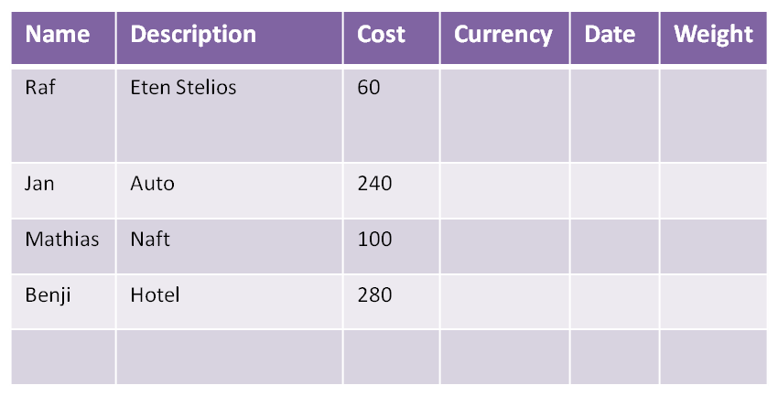
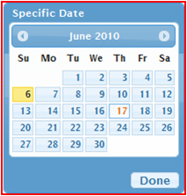
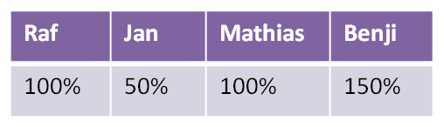
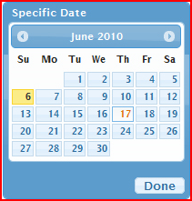
Language
EN
Country
BE
Currency
€
COODLE
Currency, Date en Weight slechts na aanvinken checkbox
Home
Welcome back, Jan!
Fill in your new costs underneath
Schuift telkens naar beneden (dus op elk moment slechts
1 +teken zichtbaar)
Ook als lijn gevuld is (3 basis velden), wordt een nieuwe regel getoond
How it works
?? Telkens alle reeds ingevulde regels tonen, of aparte grid onderaan page ??
FAQ
About
Telkens bij toevoeging nieuwe regel, wordt de data opgeslagen in MySQL
Participants:
Calculate!
Gewichten slechts na aanvinken checkbox
Home
How it works
FAQ
About

Slide 2
public long newProject()
public long testUserExists(String userName)
public String testUserExists(long userId)
public long newUser(String userName)
public void setUserWeight(String userName)
public void setUserWeight(long userId)
public long newCost(long projectId, long userId, money cost, long currency, Date date, long[] weights)
public void updateCost(long CostId, long projectId default null, long userId default null, money cost default null, long currency default null, Date date default null, long[] weights default null)
public object[] loadProject(ipAddress)
OR
public long findProjectId(ipAddress)
public object[] loadProject(projectId)
public String[] loadUsers (long projectId) // also return userIds!!
public boolean calculate (long projectId) // hierna terug loadProject (op Id?)
public object[] recalculate(long projectId) // of hetzelfde als hierboven, bijhouden in DB welk algoritme??
public object[] loadProposal(long projectId)
public boolean mailProposal(long projectId)
New table: weights (1-to-many with costs: each cost has a weight for each user)
New table: currencies (€, $, £, ...)
track ip + store with each project
add due date to project
?? Ruby on Rails

Slide 3
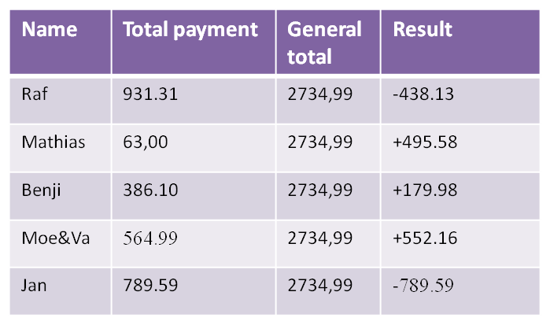
Language
EN
Country
BE
Currency
€
Home
How it works
FAQ
About
Home
These are the total costs,
and a proposal to divide them:
How it works
FAQ
About
Vake betaalt 552,16 aan Jan.
Mat betaalt 237.43 aan Jan.
Mat betaalt 258.15 aan Raf
Benji betaalt 179.98 aan Raf.
Make new proposal
email@dom.com
Send by email
PDF
Excel / ODS / cvs
Text

