Slide 1
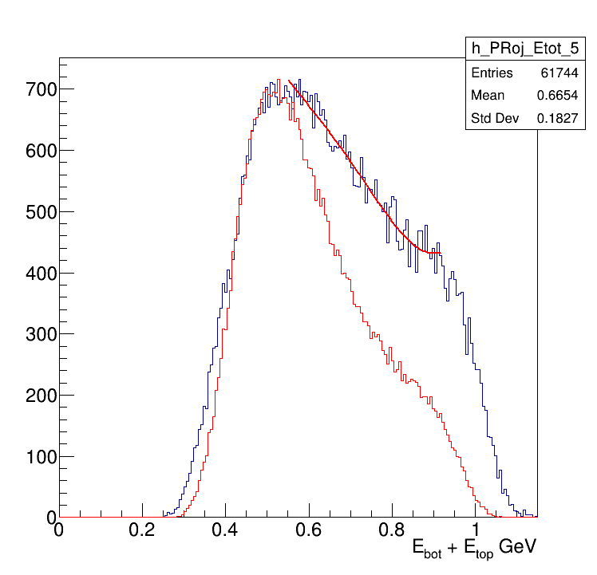
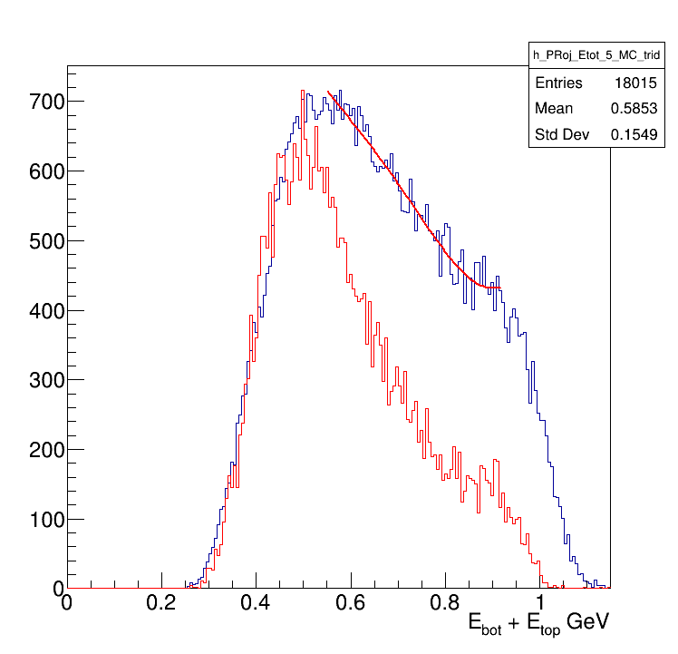
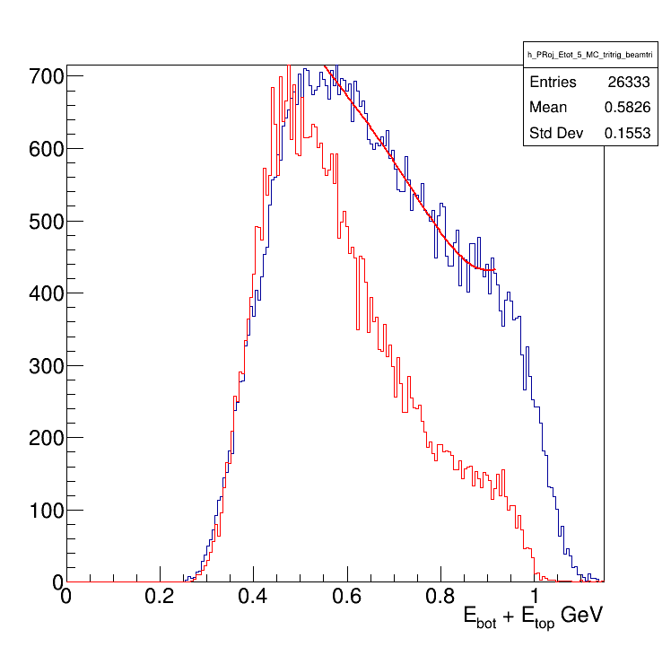
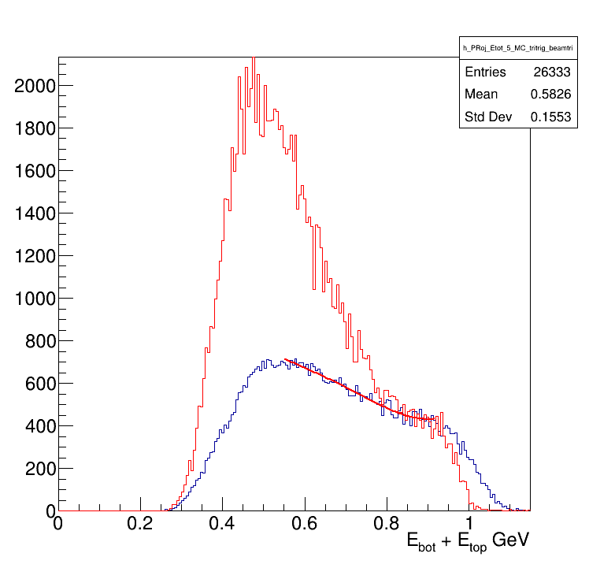
Data vs MC_BH
Data vs MC_tritrig
Data vs MC_tritrig_beamtri
Data vs MC_tritrig_beamtri
Left and right are the same thing,
Just left: MC scaled to match
Data and MC maximum values,
Right: MC is scaled to match data at 0.9 GeV

Slide 2
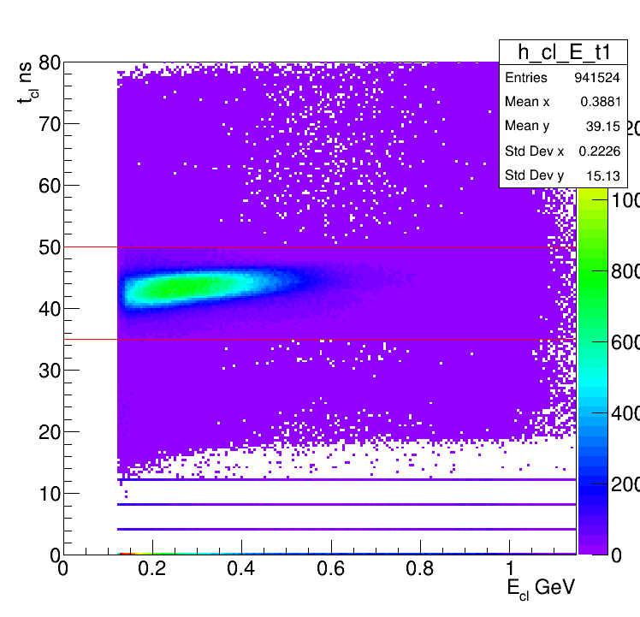
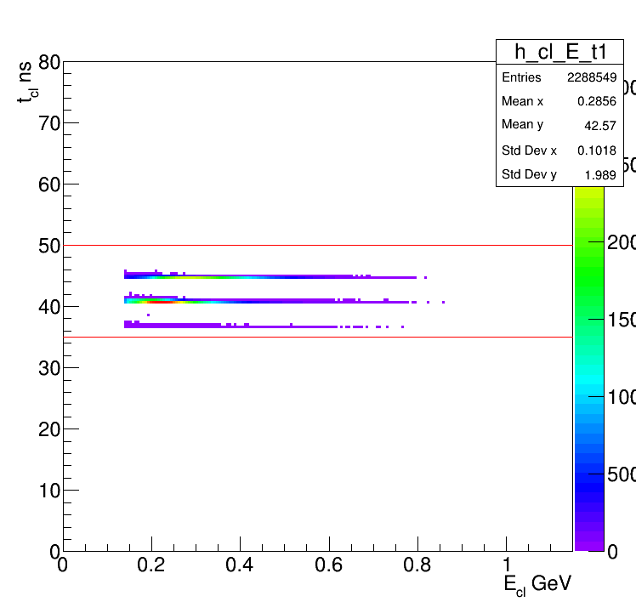
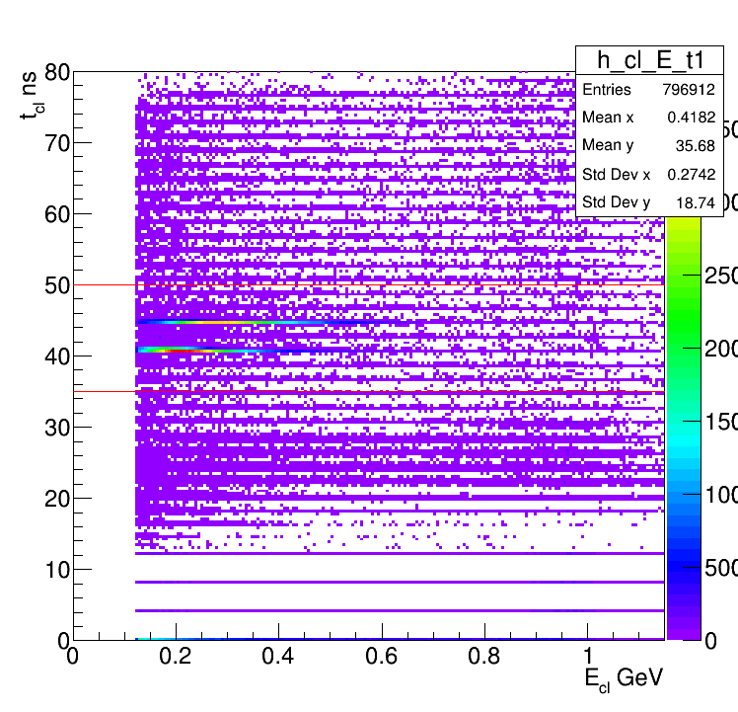
cl_time vs cl_Energy
Data
MC BH
MC TriTrig Beam tri

