Slide 1
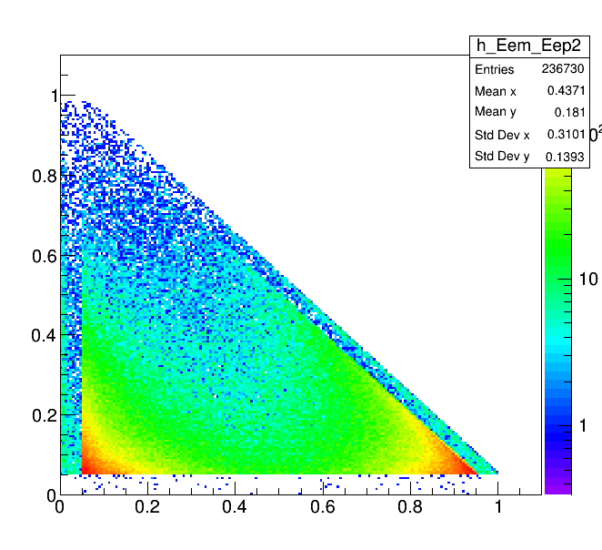
E_e+ (GeV)
E_e- (GeV)
Positron energy cut (E > 50 MeV)

