Slide 1
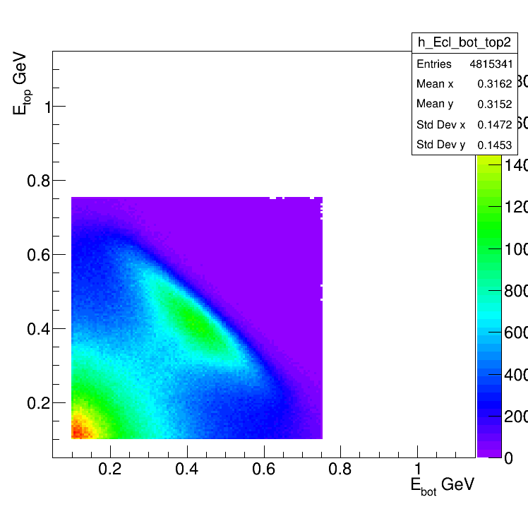
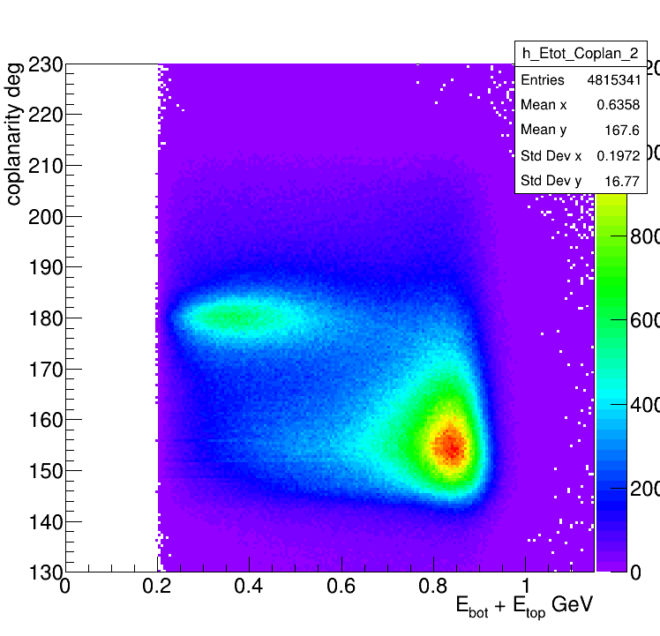
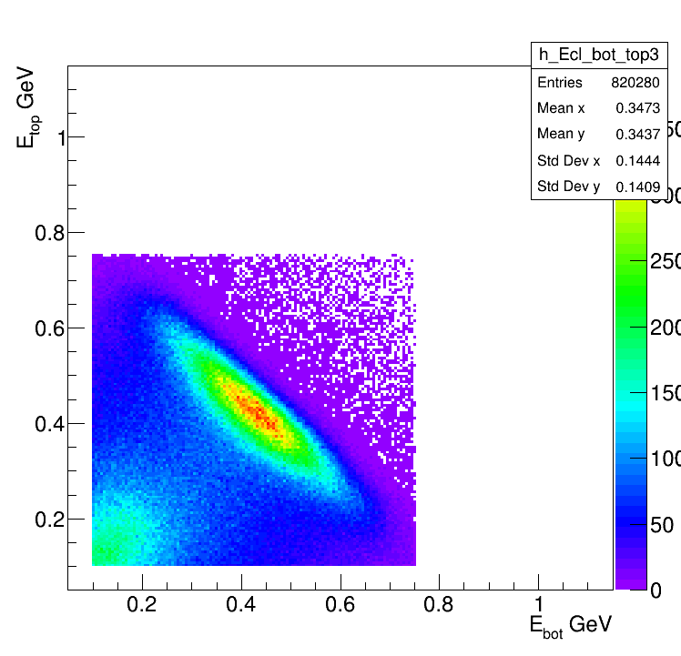
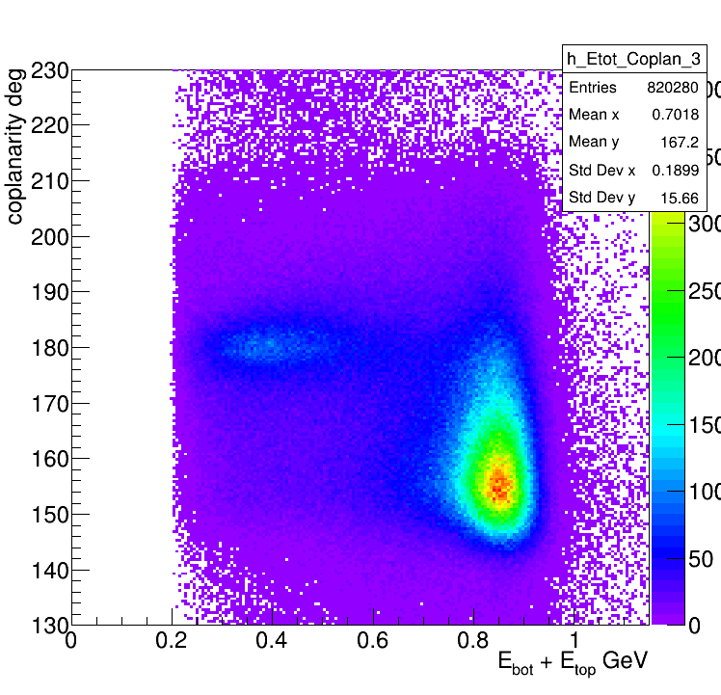
At least one cluster in the bottom and one in the top of Ecal
Time difference < 4 ns
All combinations
All combinations
In Fiducial
In Fiducial

Slide 2
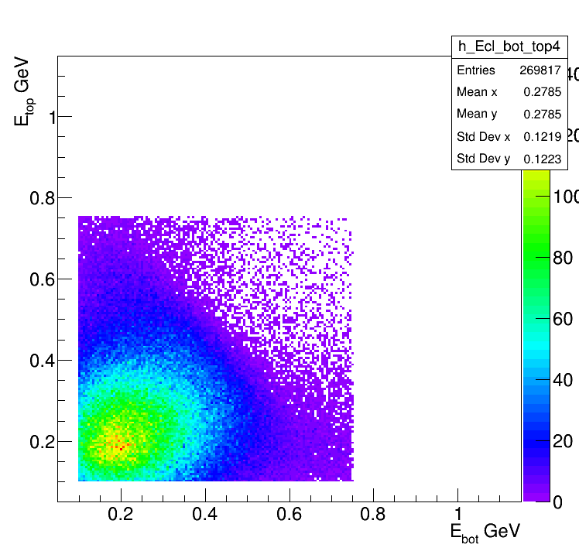
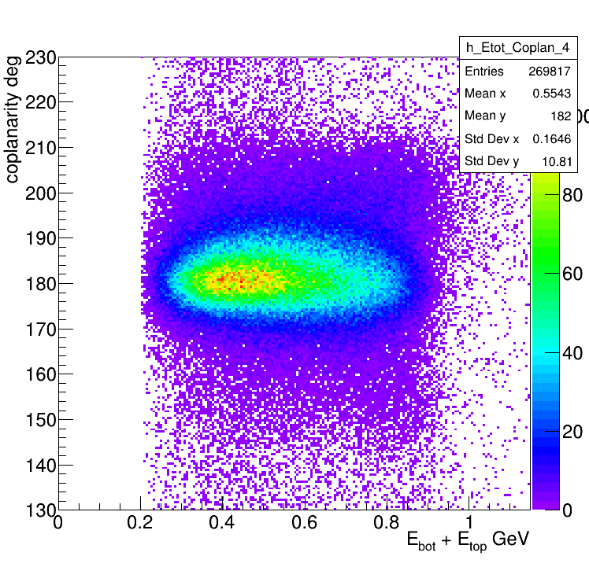
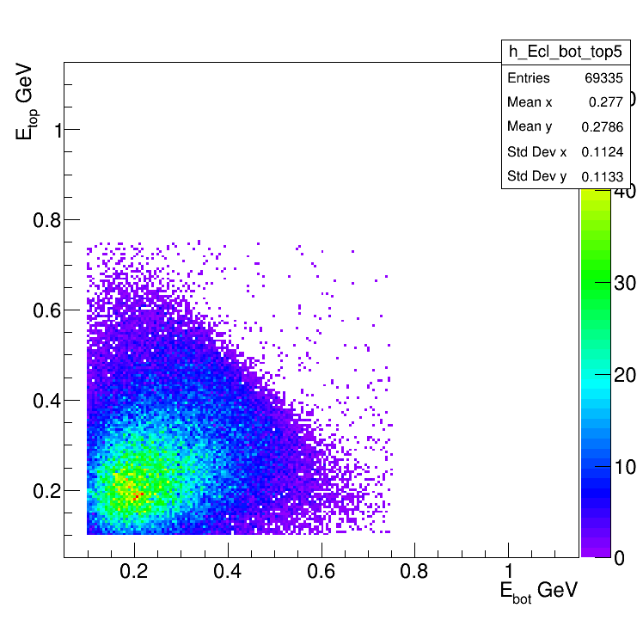
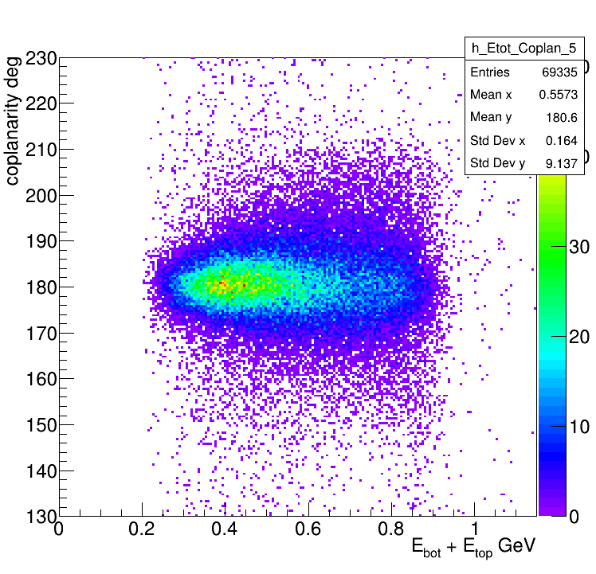
In addition to previous constrains: At least 1 bottom track, 1 top track,
1 neg track and 1 pos track
All combinations
All combinations
As one can see this cleans our
sample a lot. And we have a
domination of coplanar events
In Fiducial
In Fiducial

Slide 3
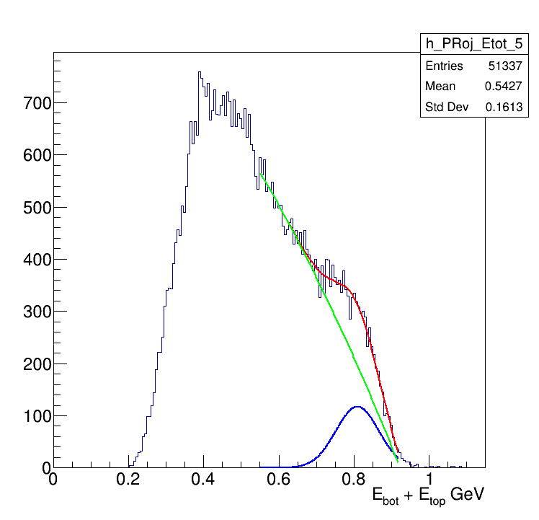
Fit in the fiducial region
Supposedly trident's peak.
To get an estimate how much are they, one should
Know the background behavior in HPS acceptance.
Now Bradley is working to generate only BH events
That should tell us what should be the BH shape.
This is just a simple fit where as a background a
Pol3 was chosen.

Slide 4
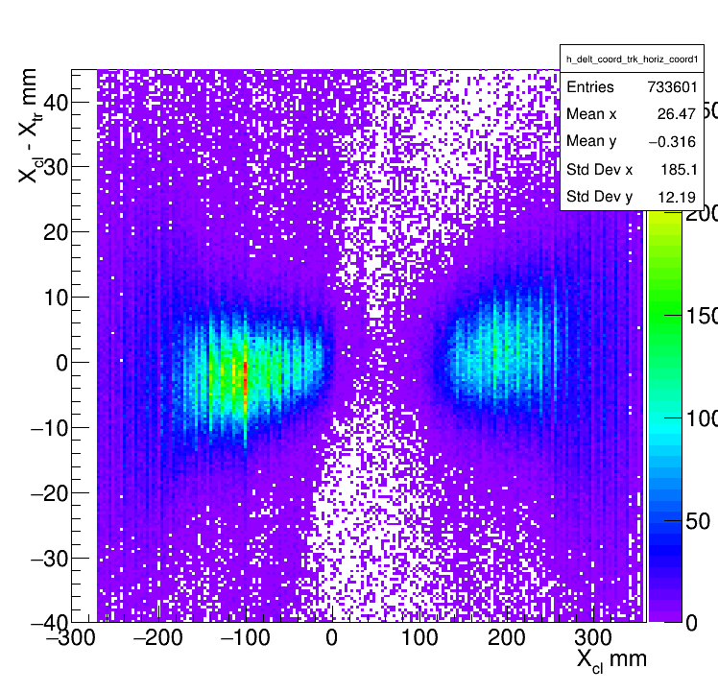
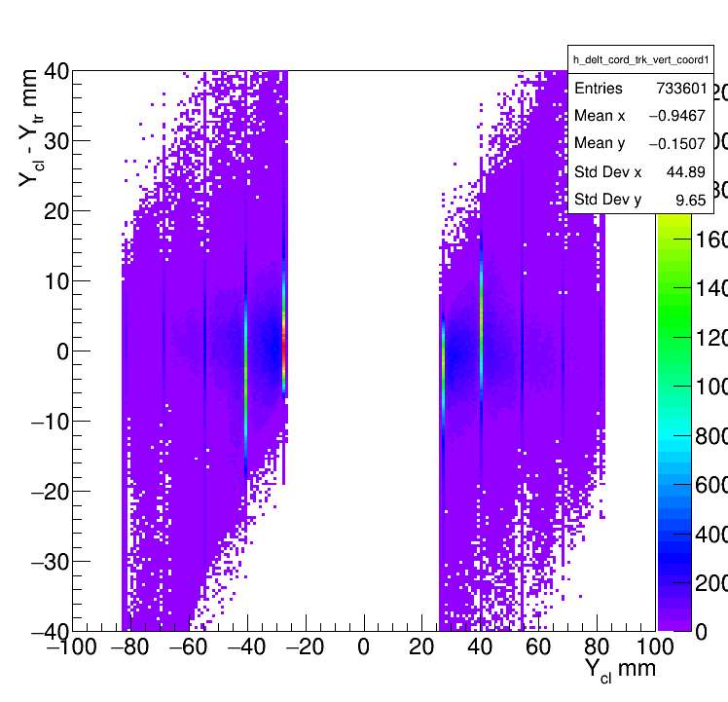
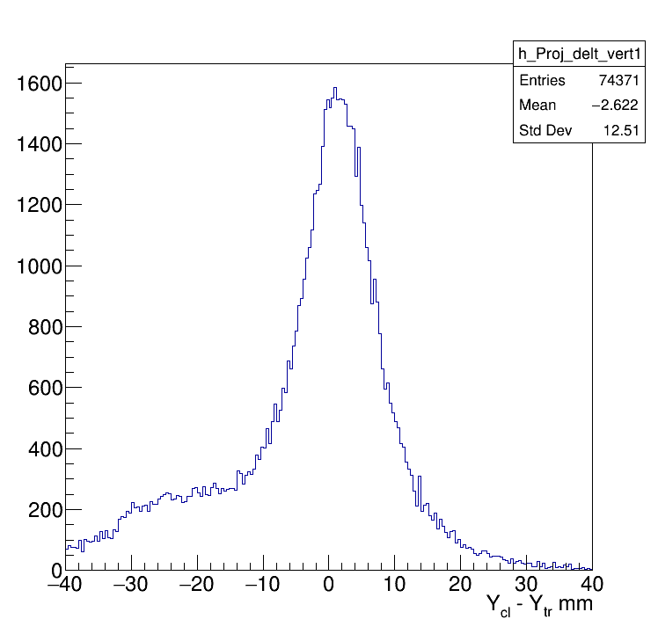
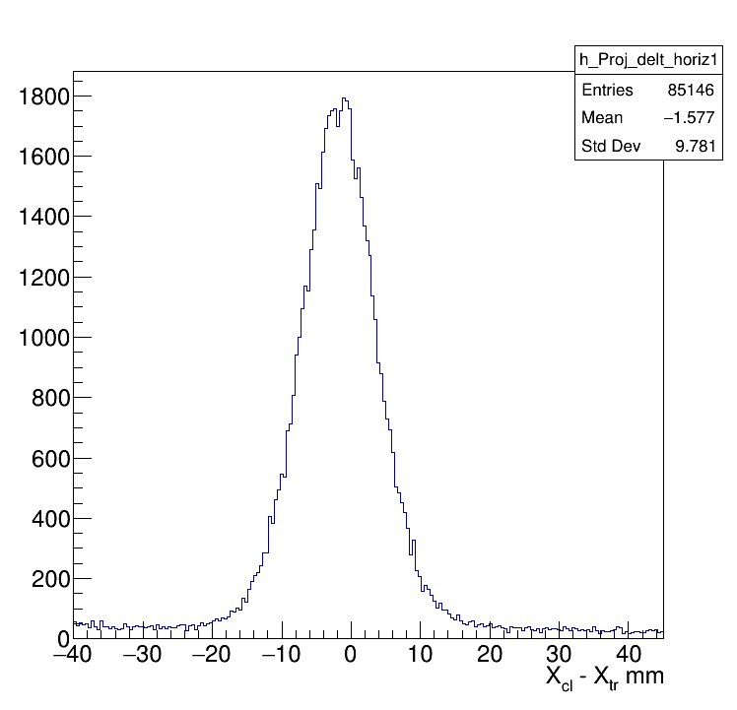
Additional figures: Cluster-track Matching figures
Horizontal Matching
Vertical Matching
The background is quite
small in horizontal matching,
and there is some
background in vertical
matching.

Slide 5
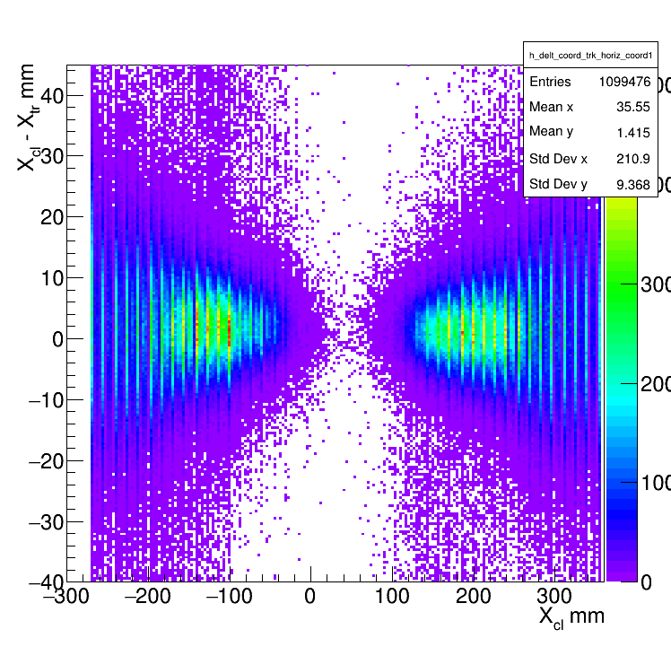
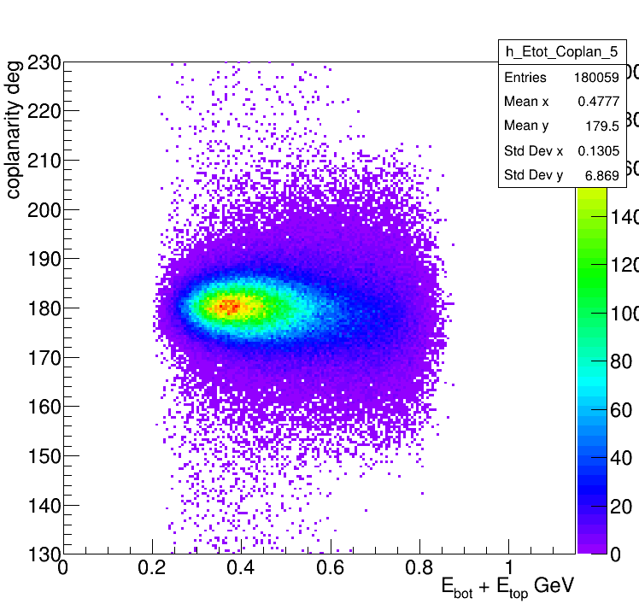
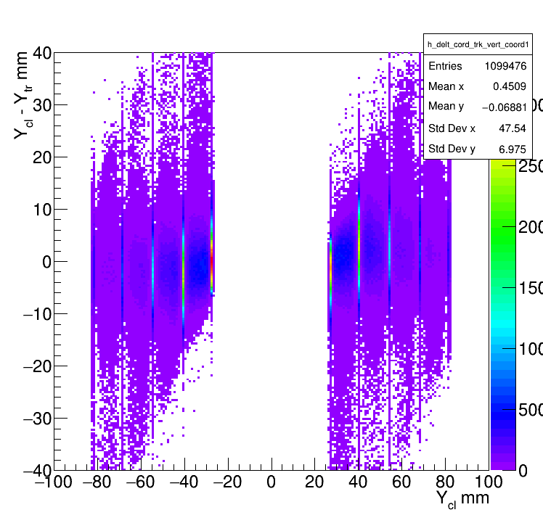
All combinations
Horizonta Matching
In Fiducial
Vertical Matching

Slide 6
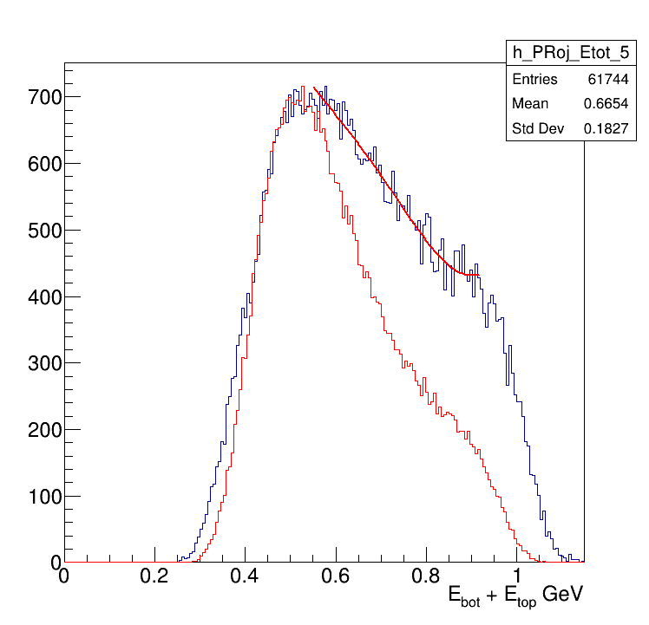
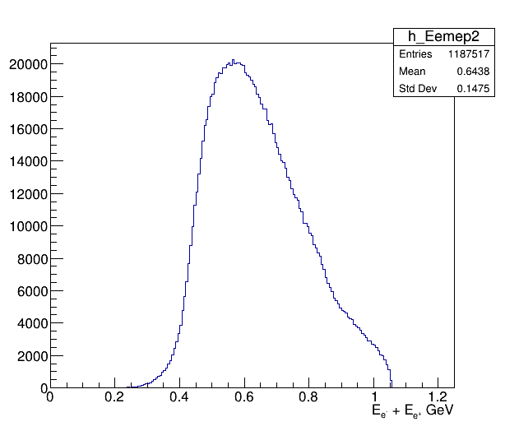
MC is only Bethe Heitler
TriTrig and Data
MC doesn't go up to beam energy.
Now will study kinematics of missing
events at the generator level.
Data
MC BH
BH Slic

Slide 7
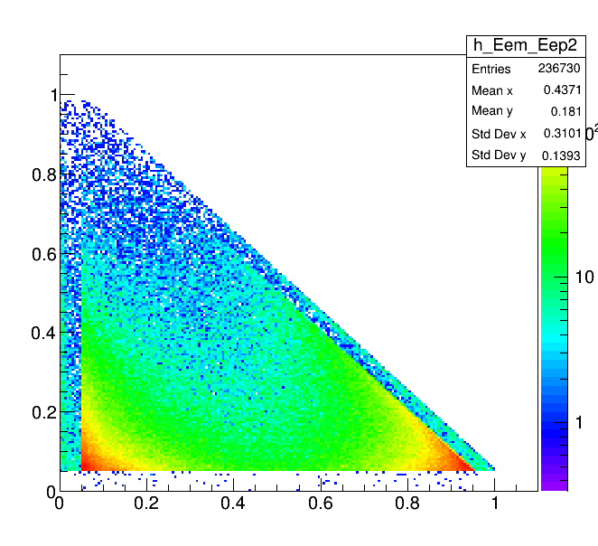
This was changed from the regular run card
0d0 = eftot ! minimum energy for f+
plus at least one f-
What does this cut mean exactly?
0.050 = ef ! minimum E for f+ and at
least one f-
One can see the effect of the cut on e+,
but in all events there is at least on e-
that has energy above 50 MeV, so effectively
this shouldn't cut any event
What the discontinuity correspond to?

Slide 8
Backups

Slide 9
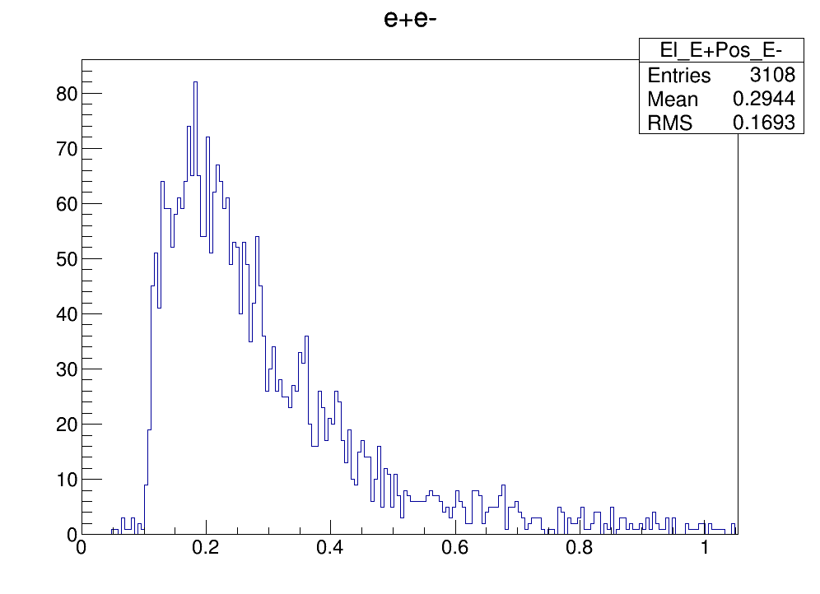
As one can see at the generator level
there are events having energy sum
close to the beam energy
Image from Bradley
E_e- + E_e+ GeV

