Slide 1
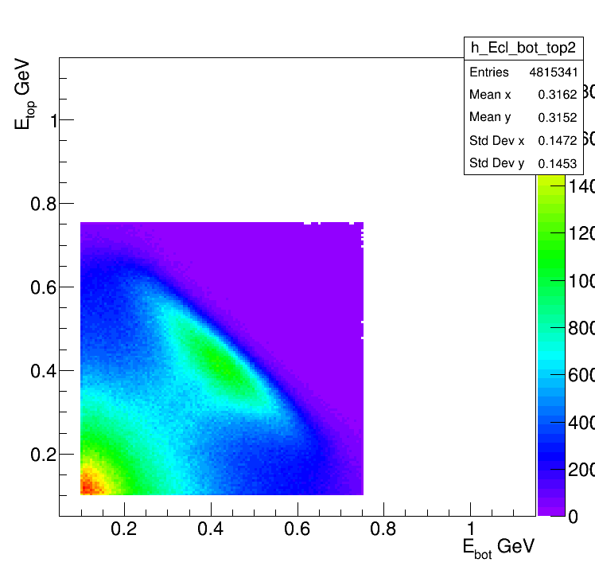
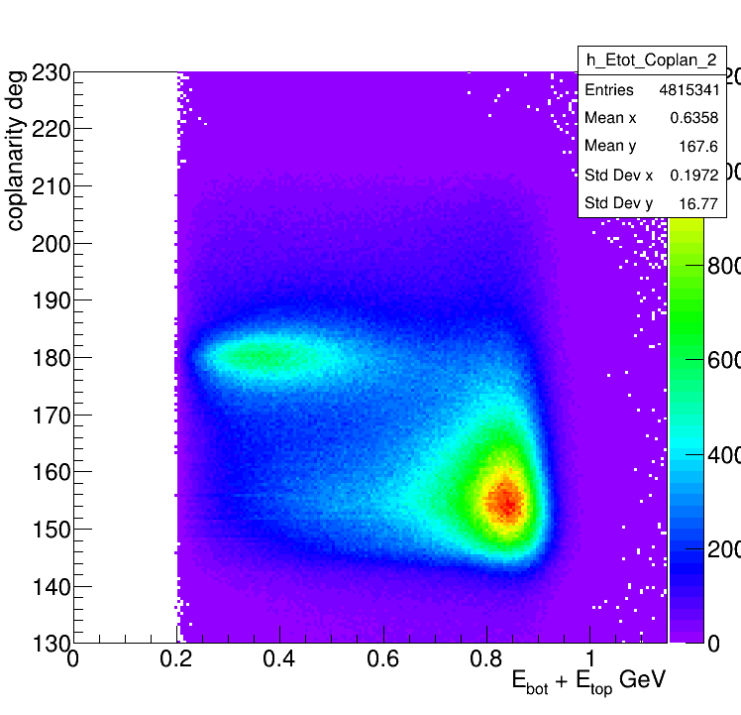
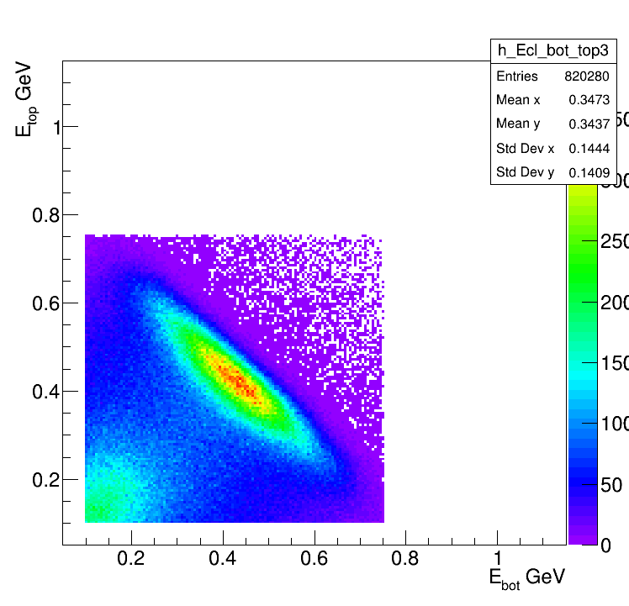
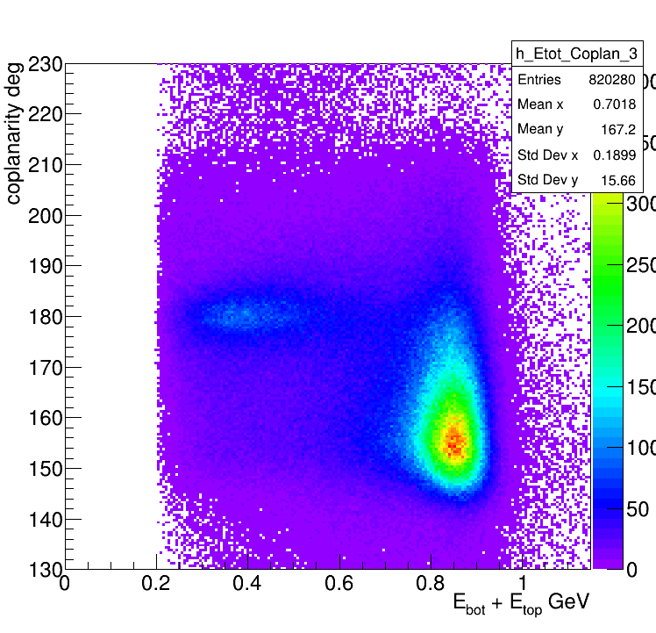
At least one cluster in the bottom and one in the top of Ecal
Time difference < 4 ns
All combinations
All combinations
In Fiducial
In Fiducial

Slide 2
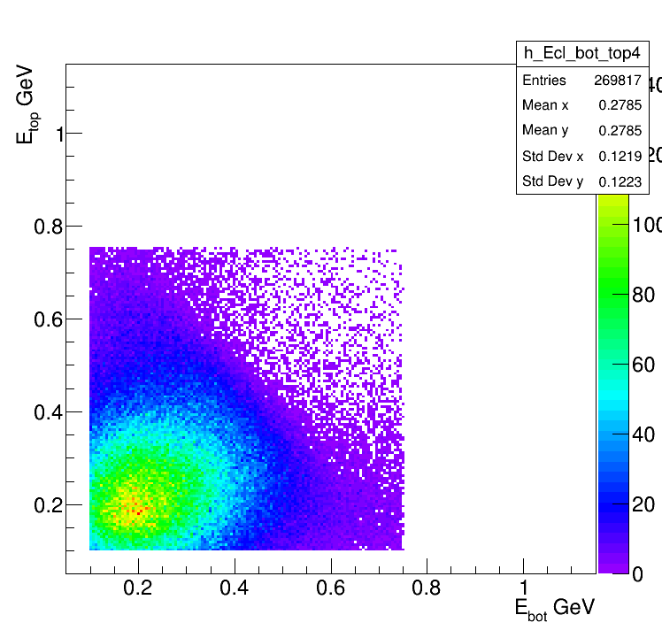
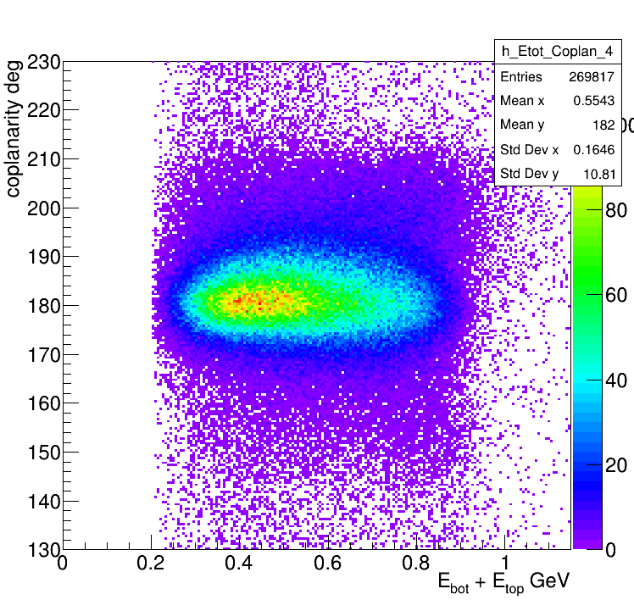
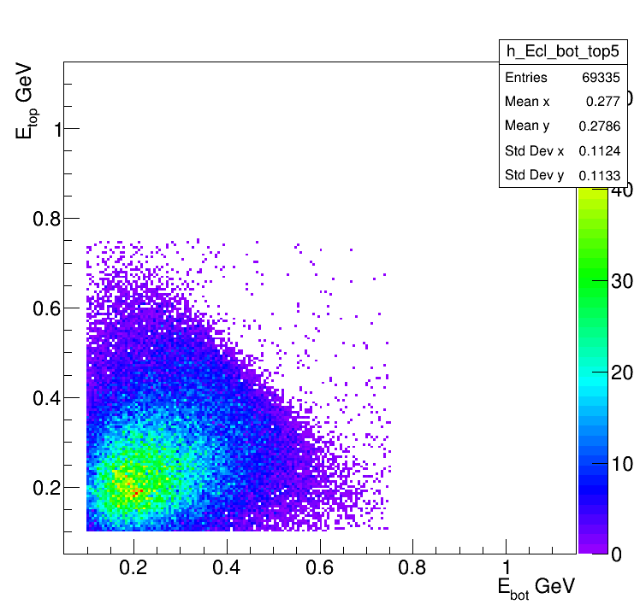
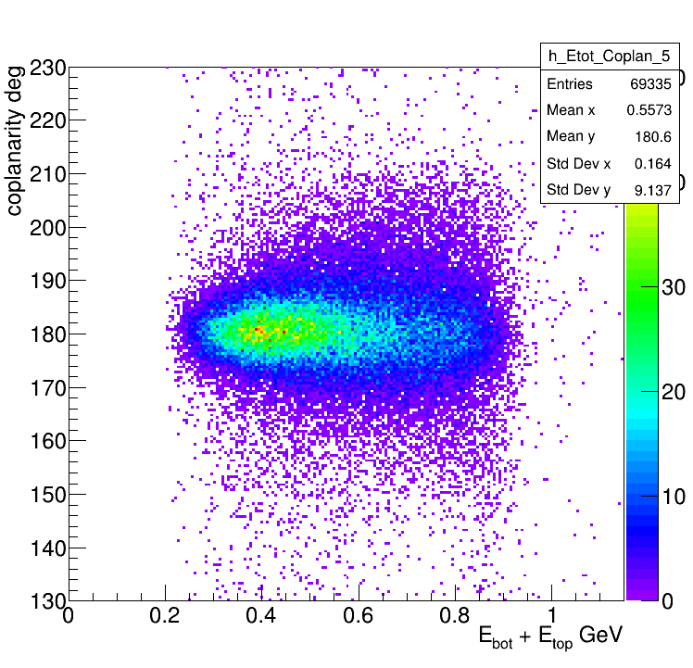
In addition to previous constrains: At least 1 bottom track, 1 top track,
1 neg track and 1 pos track
All combinations
All combinations
As one can see this cleans our
sample a lot. And we have a
domination of coplanar events
In Fiducial
In Fiducial

Slide 3
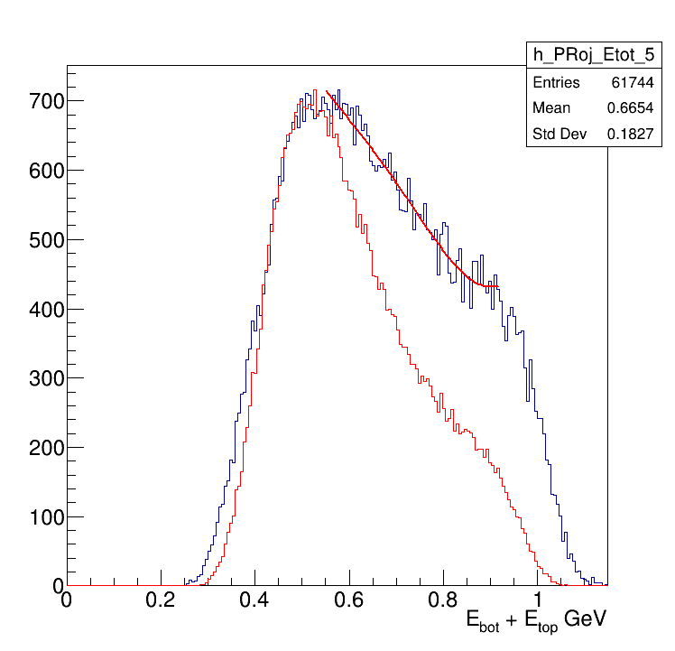
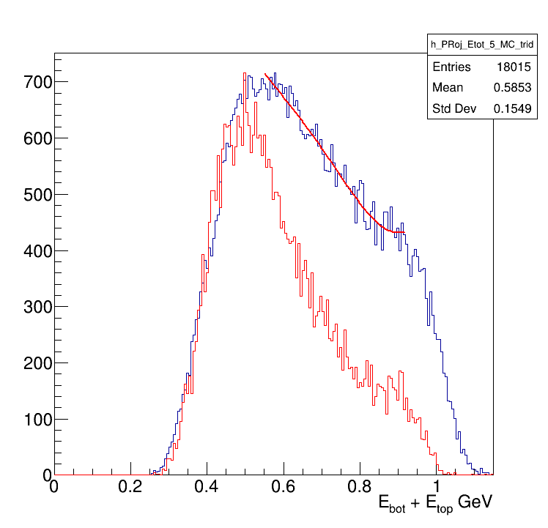
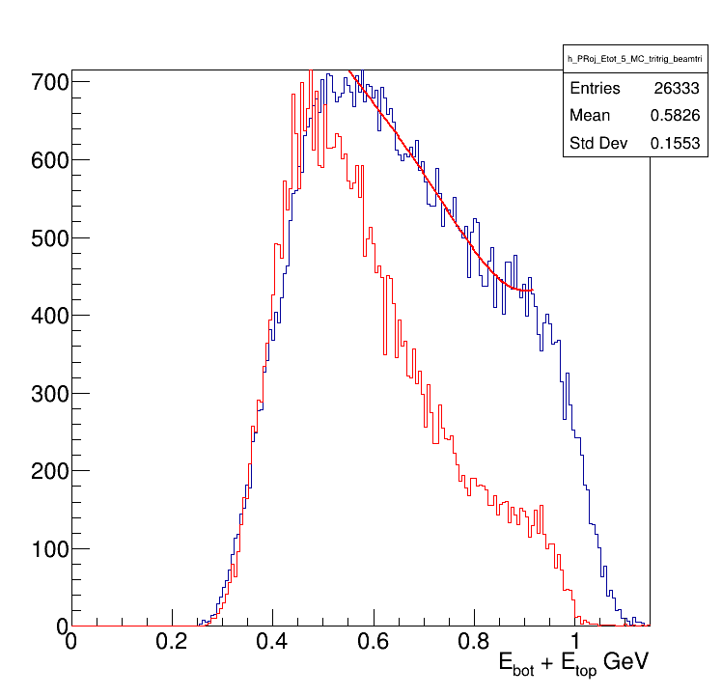
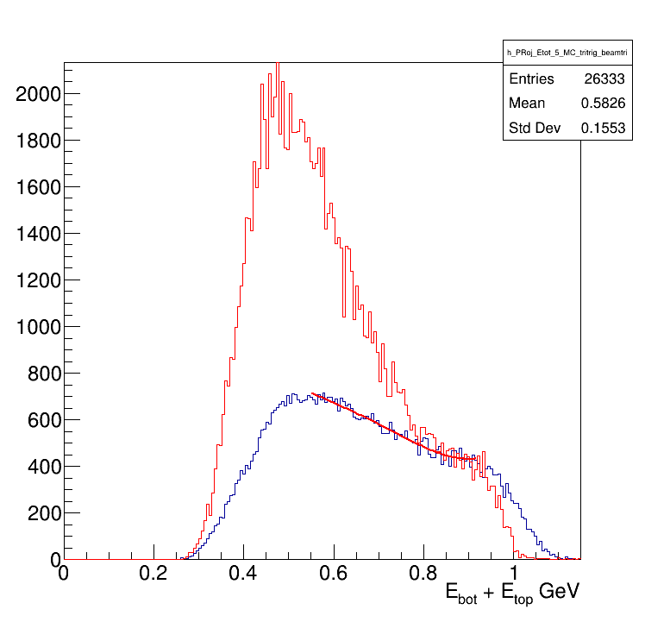
Data vs MC_BH
Data vs MC_tritrig
Data vs MC_tritrig_beamtri
Data vs MC_tritrig_beamtri
Left and right are the same thing,
Just left: MC scaled to match
Data and MC maximum values,
Right: MC is scaled to match data at 0.9 GeV

Slide 4
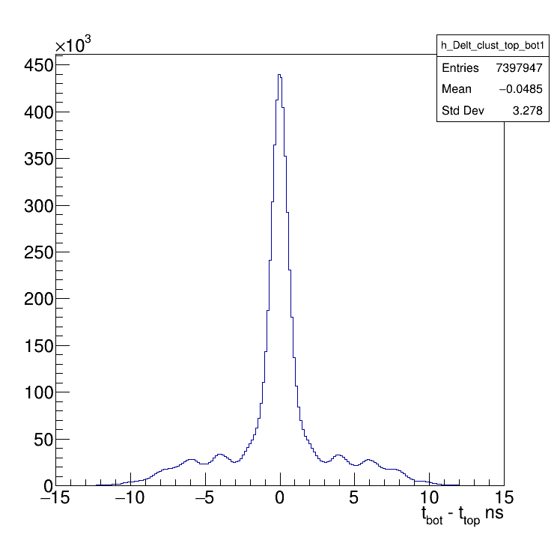
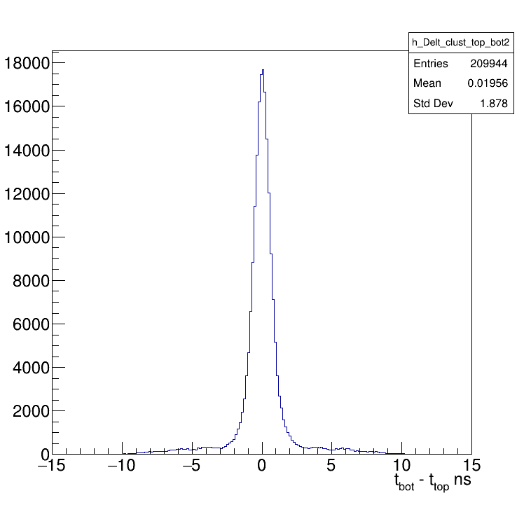
Used events that have at least
1 bot 1 top clusters
1 bot 1 top 1 neg 1 pos tracks
To clean events samples, only events that have
1 bot clust 1 top clust 1 neg 1 pos 1 bot 1 top track

Slide 5
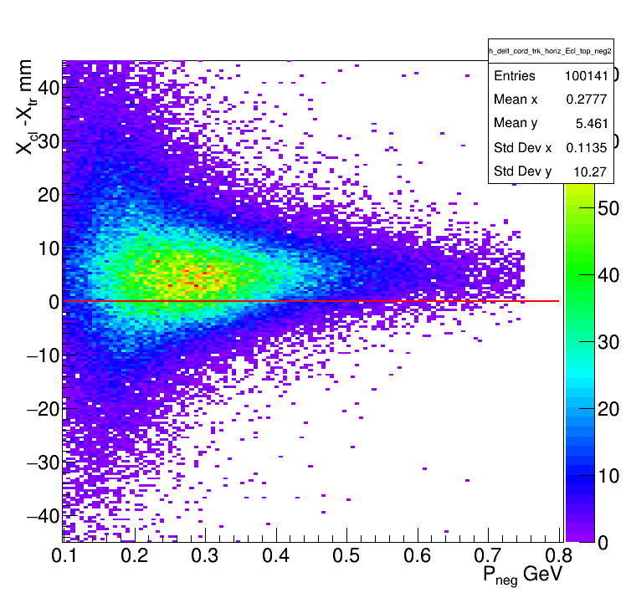
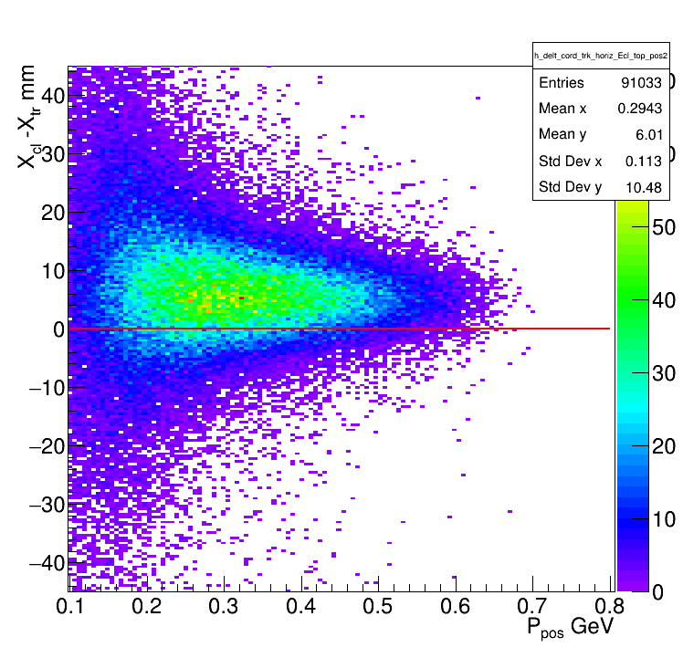
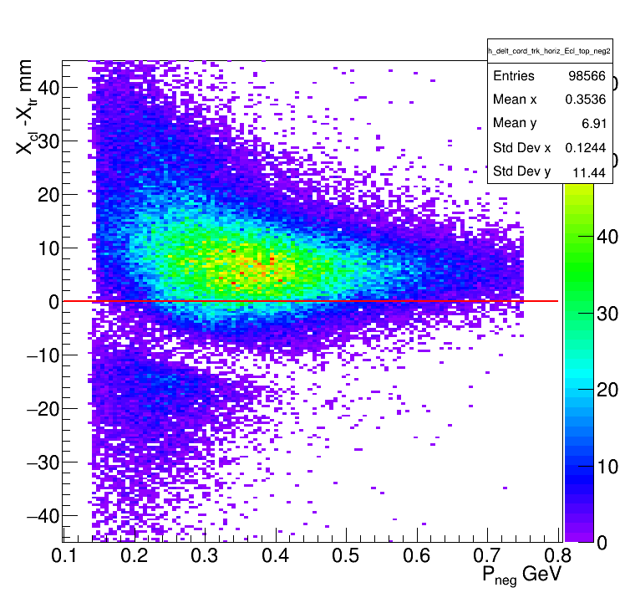
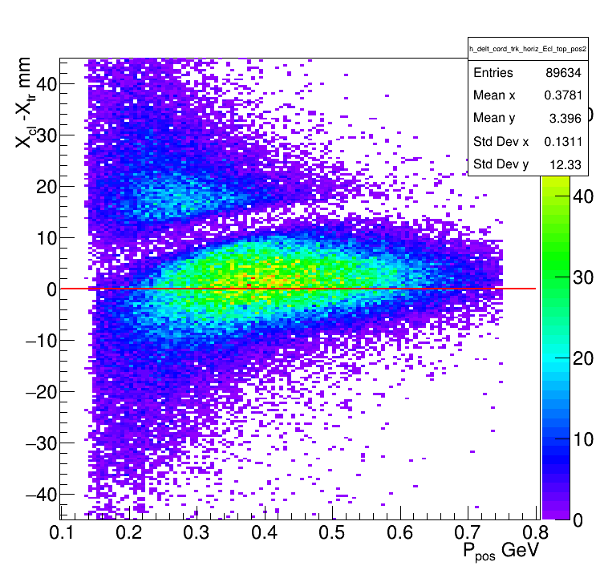
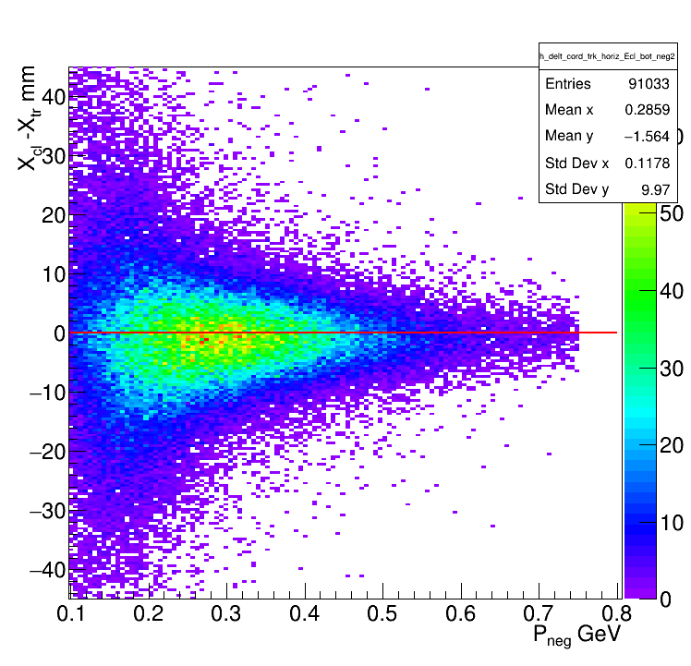
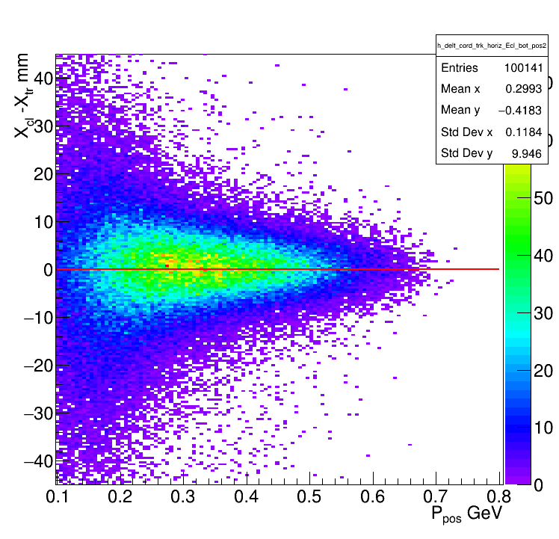
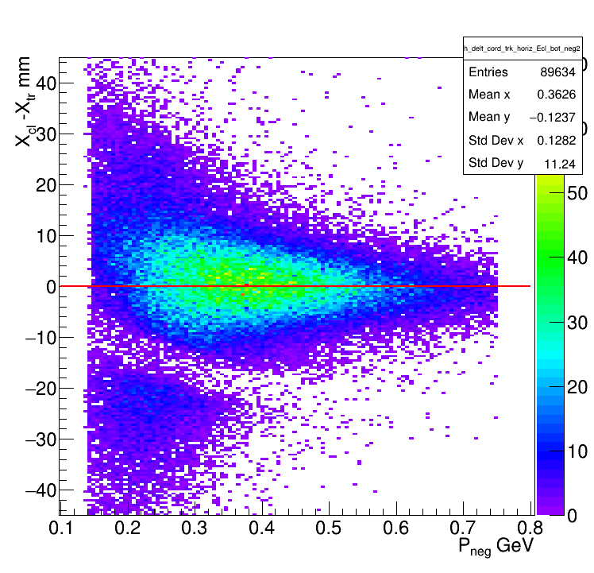
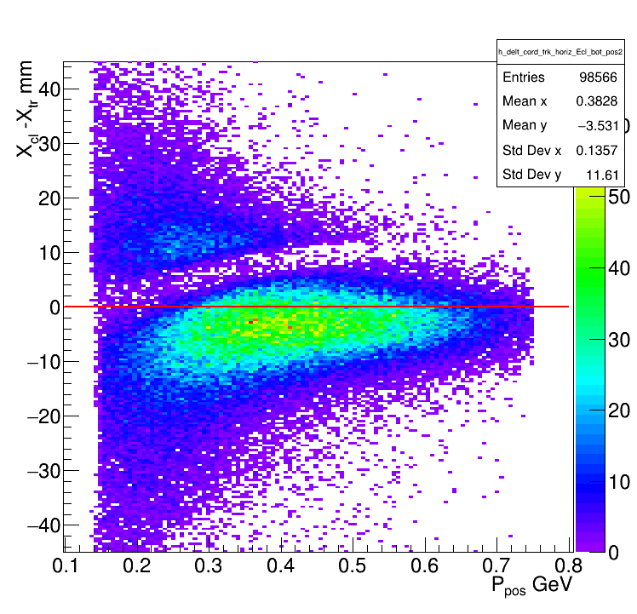
Negatives
Positives
Negatives
Positives
Top
Bottom

Slide 6
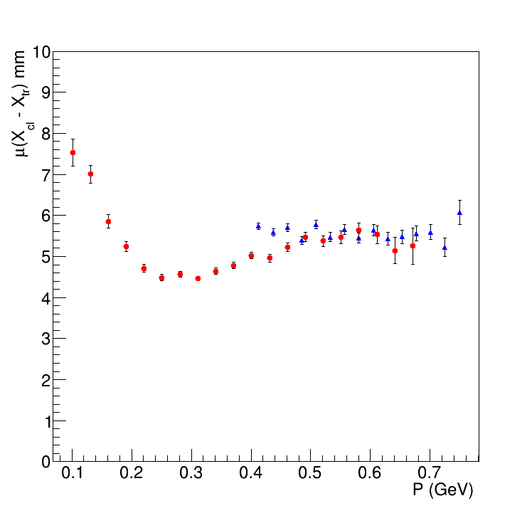
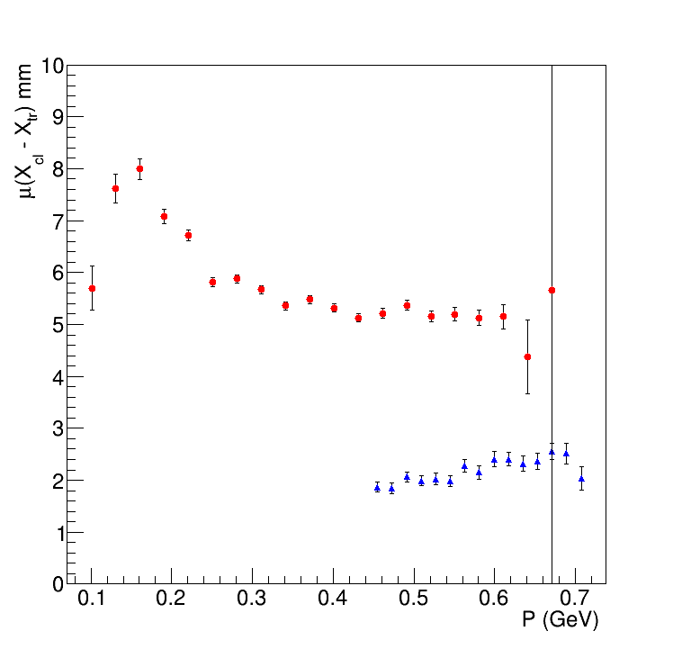
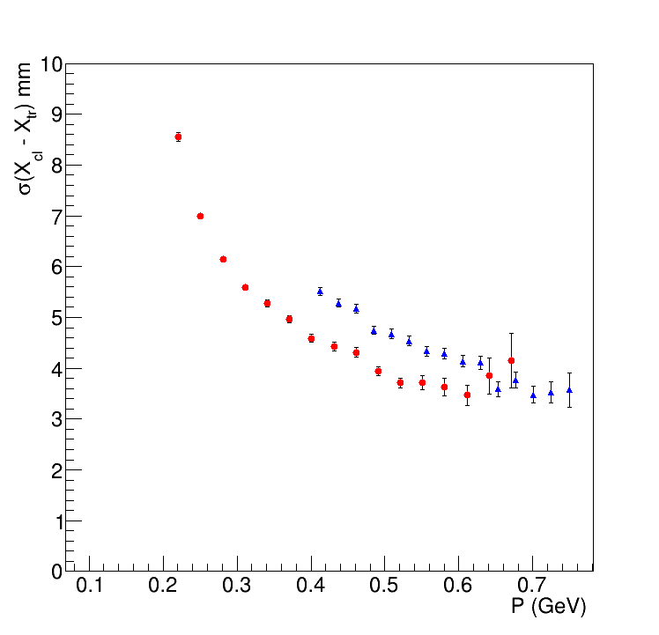
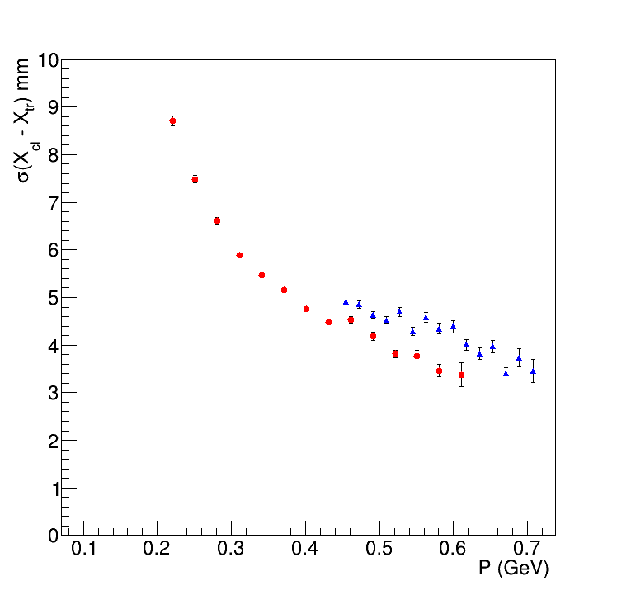
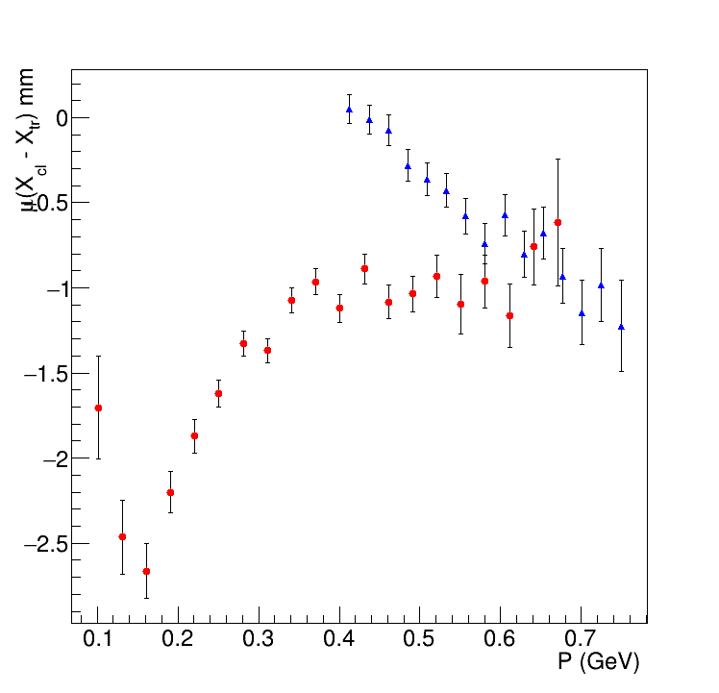
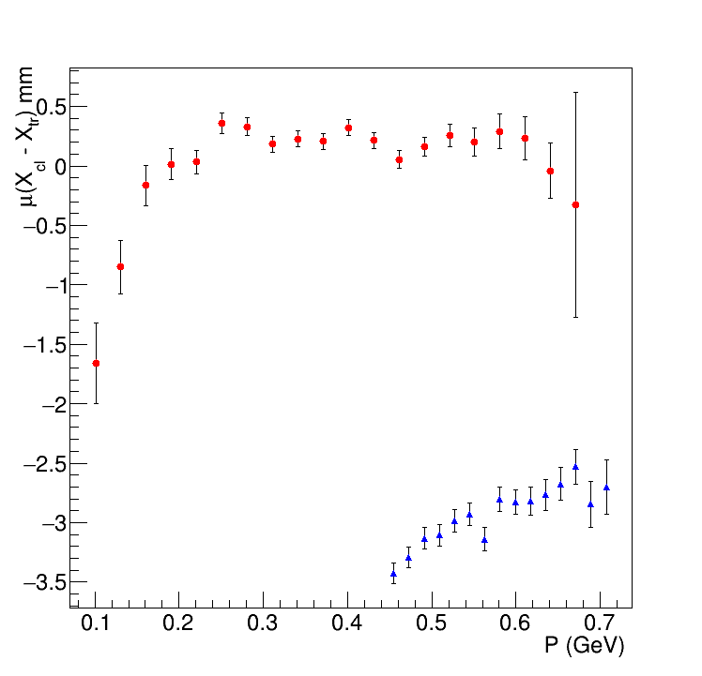
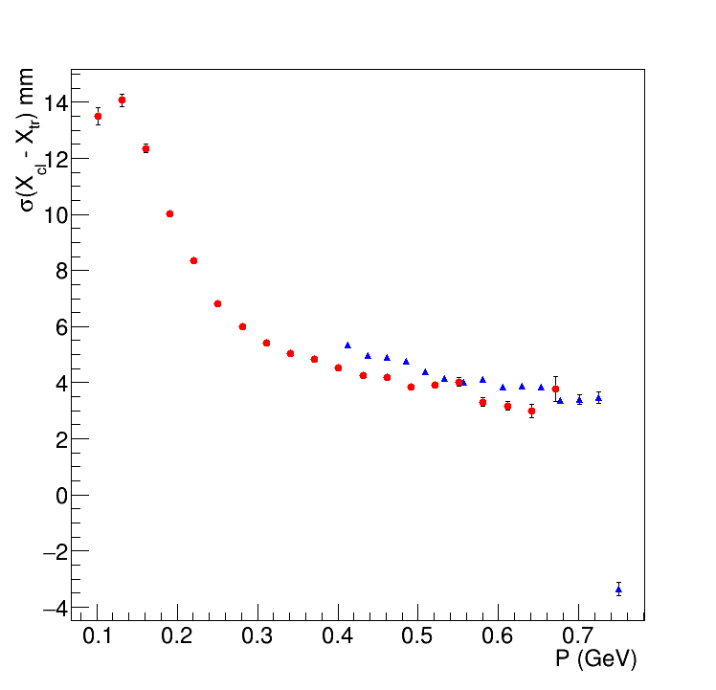
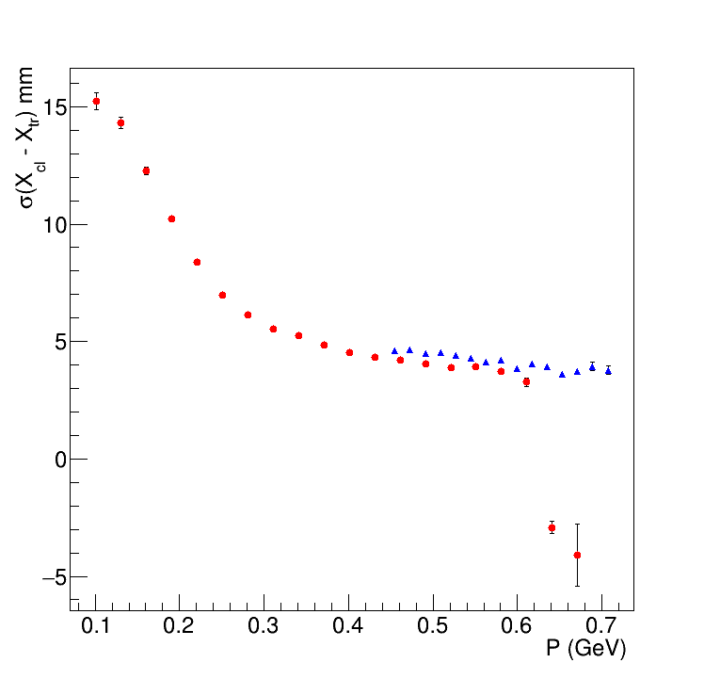
Negatives
Positives
Negatives
Positives
Uncorr_Cust
Top
corr_Cust
Bottom

