Slide 1
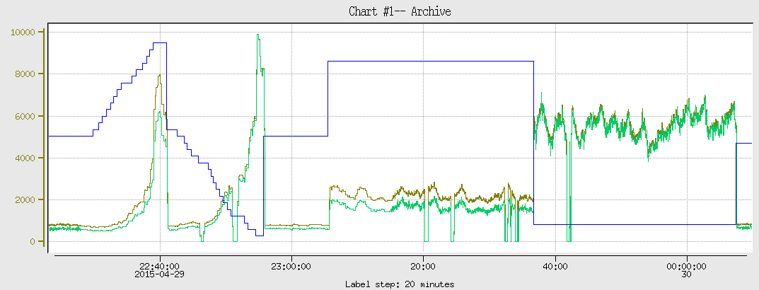
1st Collimator Scan on Apr 29
5.082
Collimator
Col. Top is closer to beam
HPS_SC
HPS_t
Col. bottom is closer to beam
4.97
Proportion between HPS_t and HPS_SC changes depending from which side the collimator
approaches to the beam.
The center is calculated as 5.022. then collimator moved down and up by 0.049” == 1.2446mm.
This corresponds to the collimator positions of 5.071 and 4.973.
Probably the center of the collimator is calculated not correctly, because rates 3 times differ with
These positions.

Slide 2
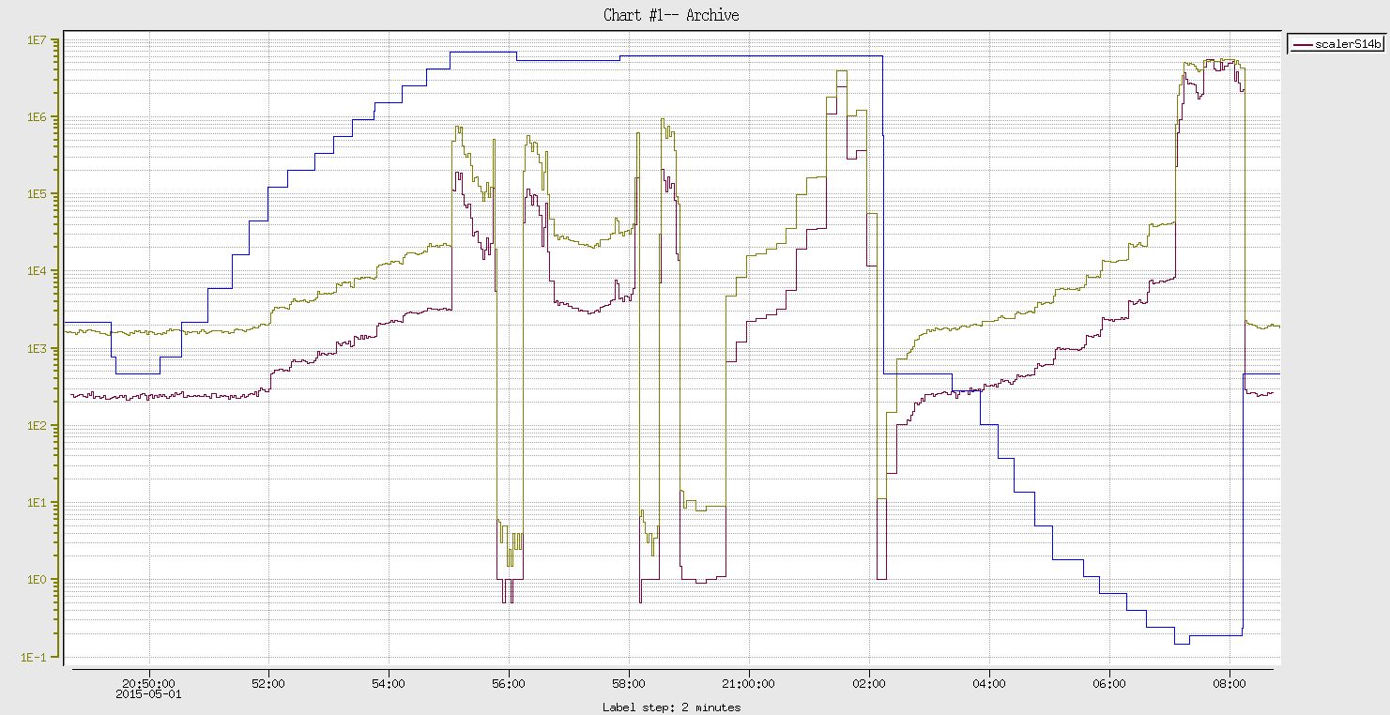
2nd Collimator Scan on May 1
Beam is touching
the edge?
Collimator
5.096
HPS_SC
HPS_t
4.960
This tells the collim. center to be at 5.028
Hole size = (5.096 – 4.96)*25.4 = 3.4544 mm

Slide 3
This seems is not in agreement with Apr 29 measurement,
because Bottom edge of the collimator showed higher rates
one Halo counters, whereas this numbers show bottom edge
was further from the beam.
We were thinking that the collimator is 3mm, and with this in mind we put it about 250um form
the beam, but now since looks it is 3.45 mm, the 250 um will translate into more than 400 um.

Slide 4
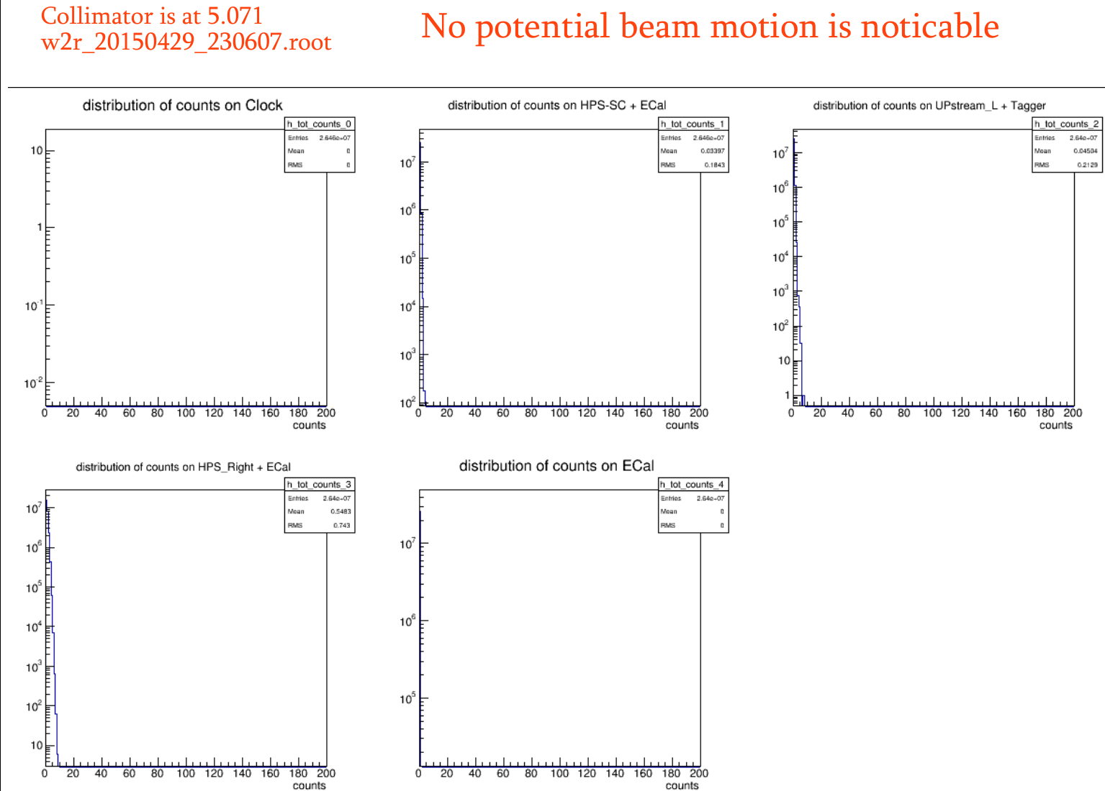

Slide 5
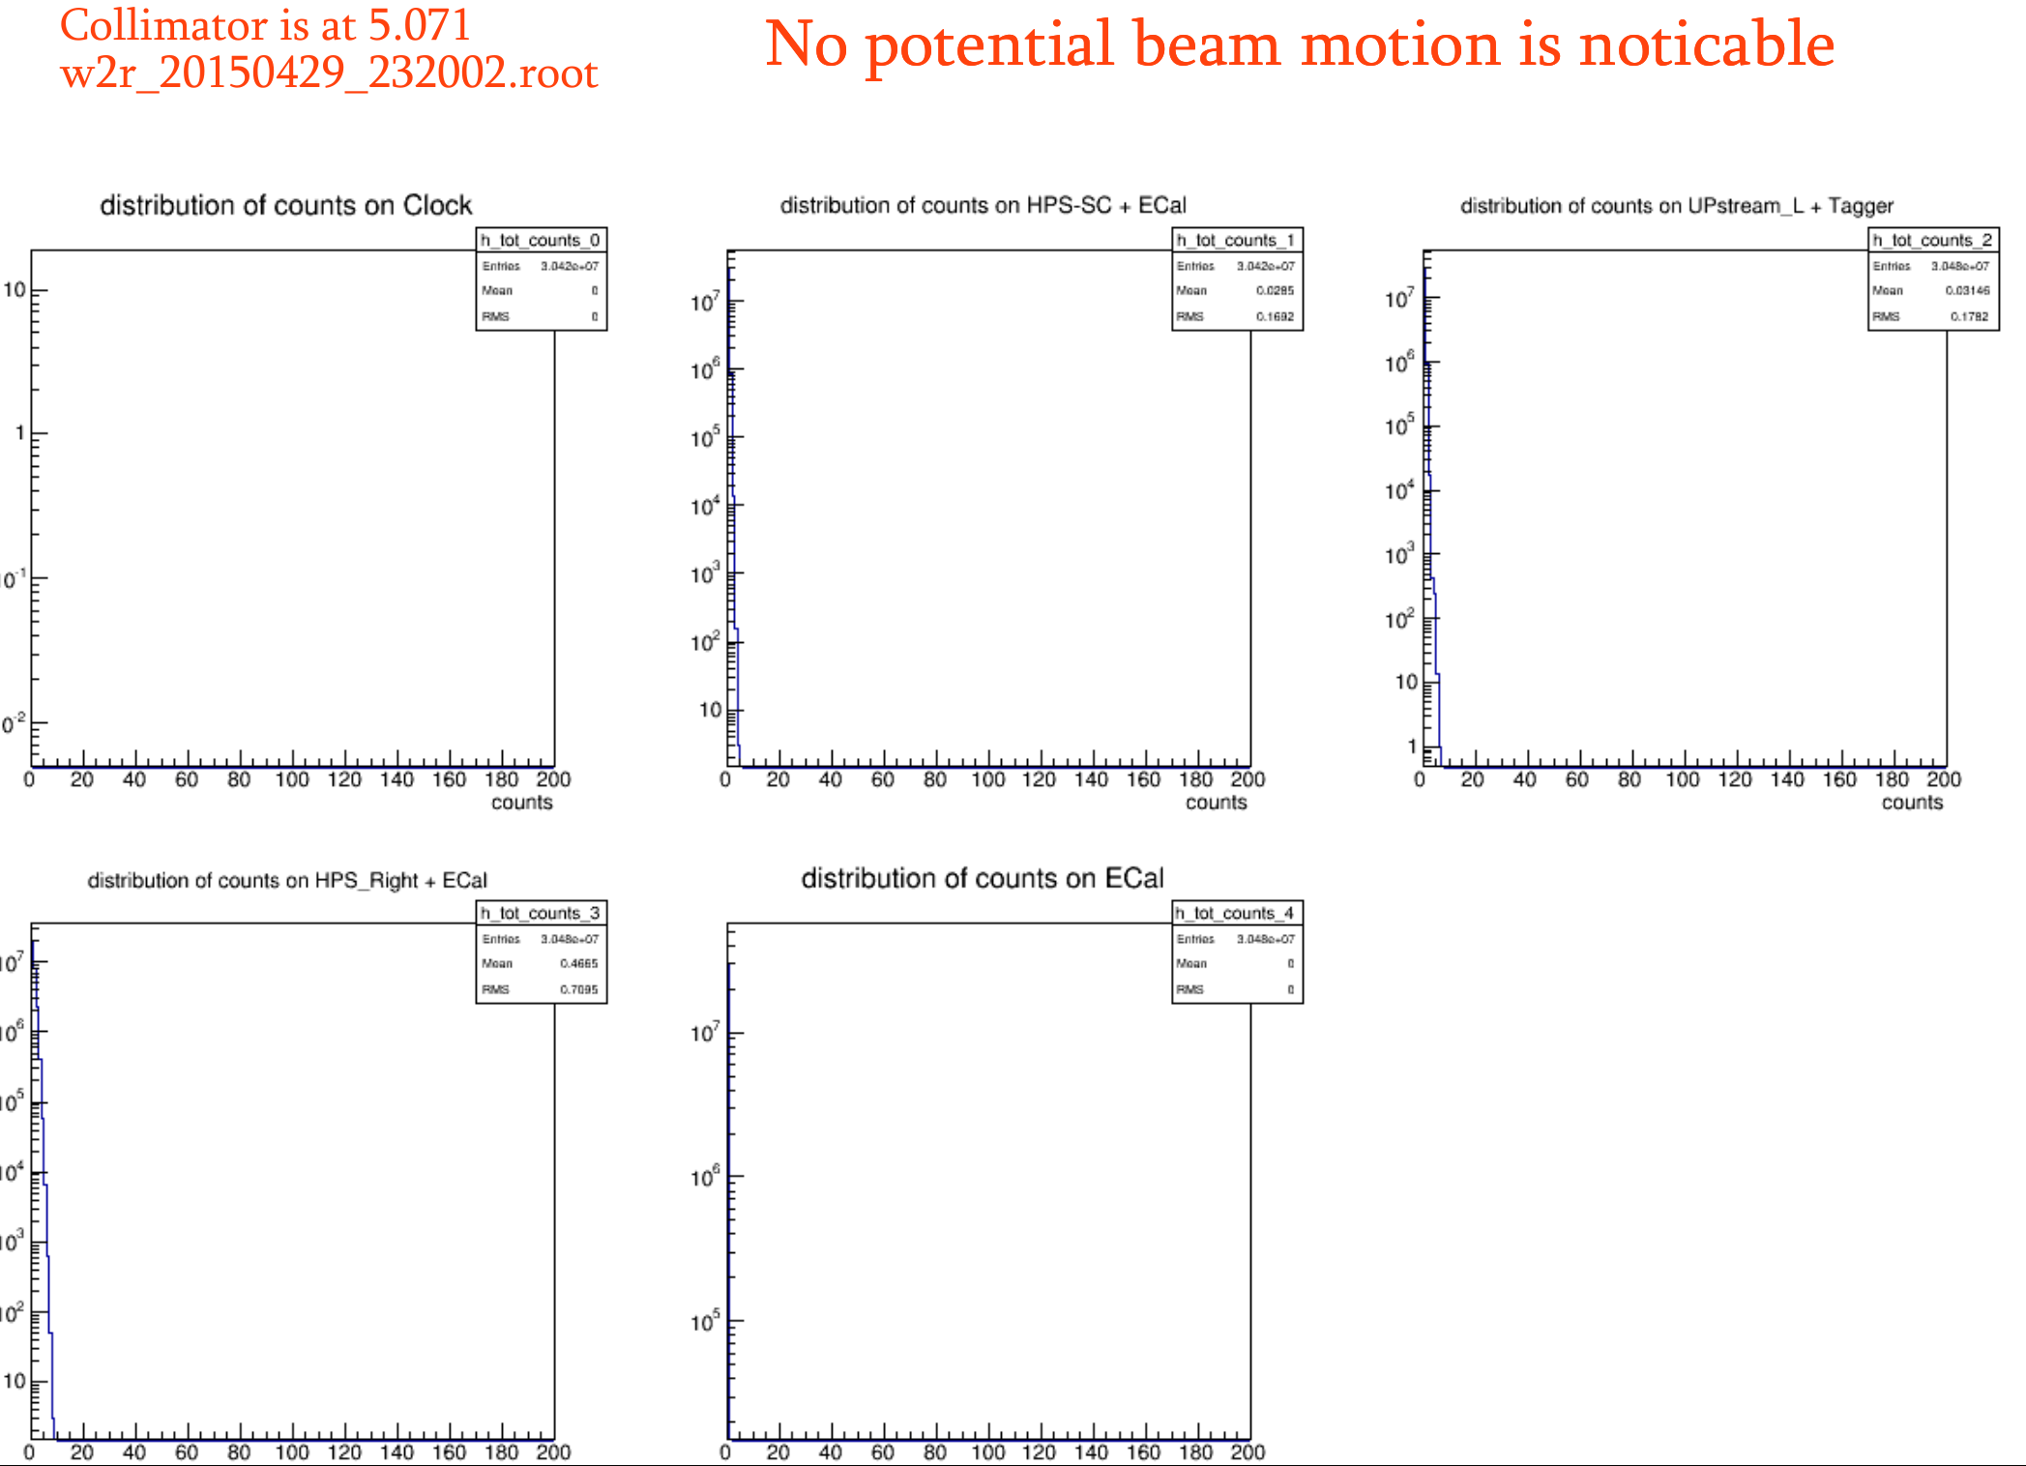

Slide 6
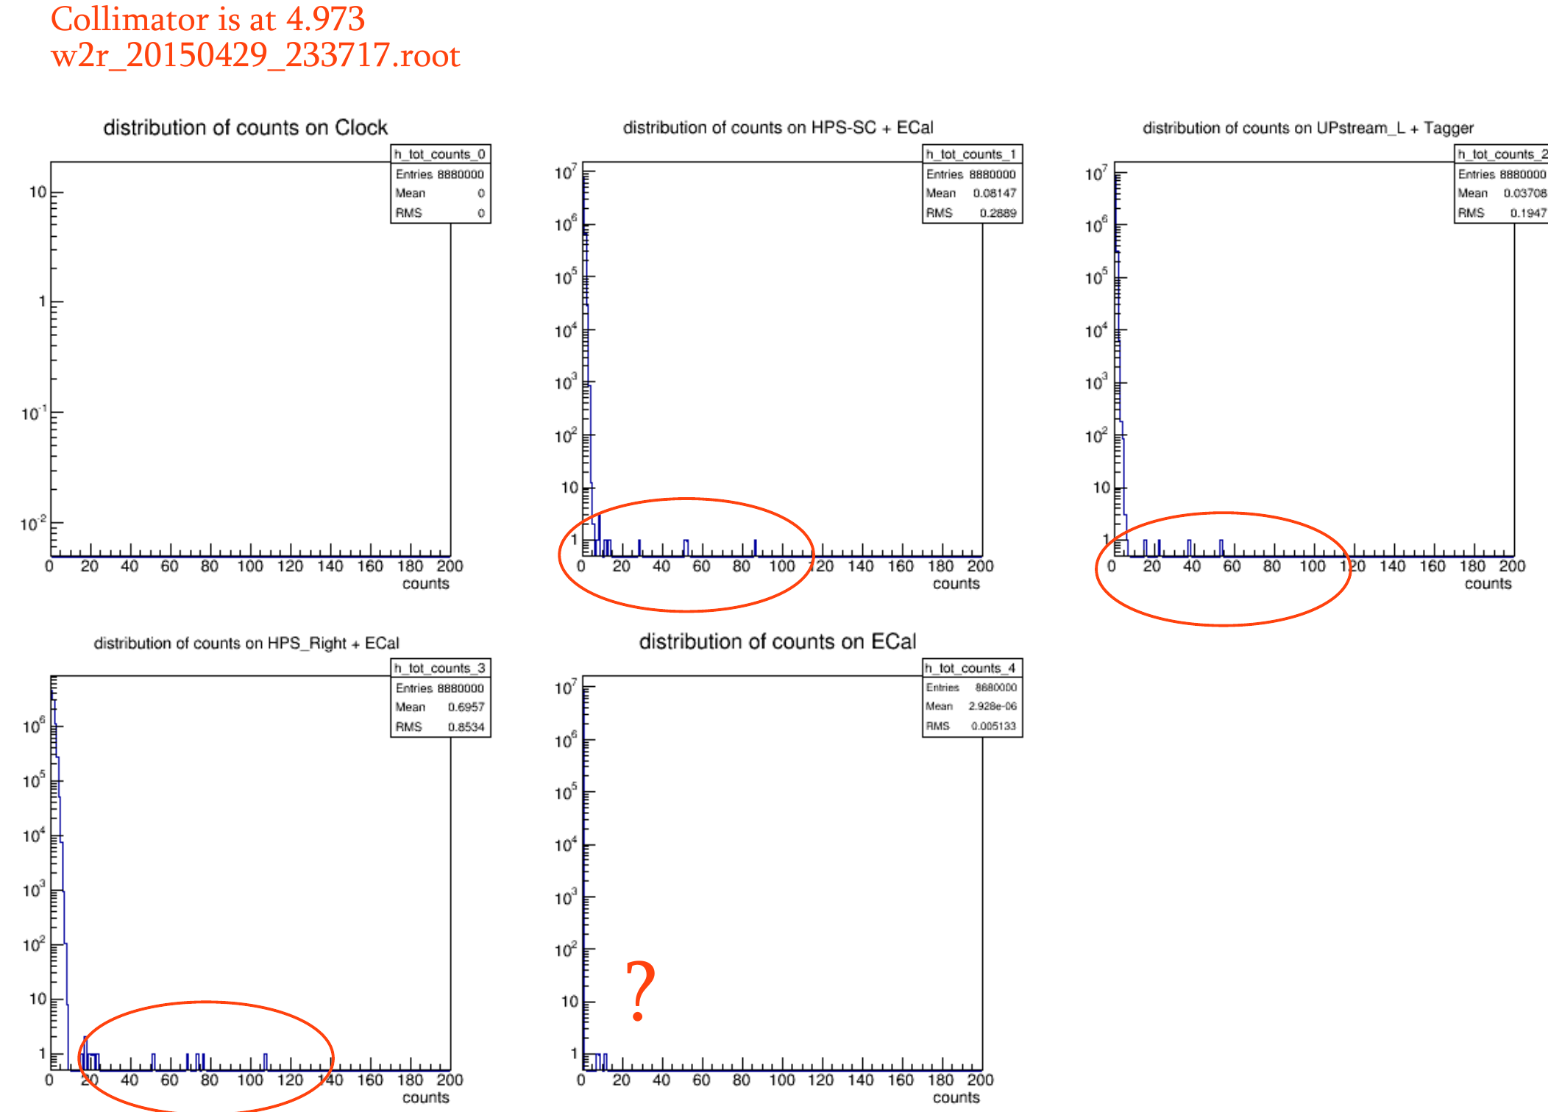

Slide 7
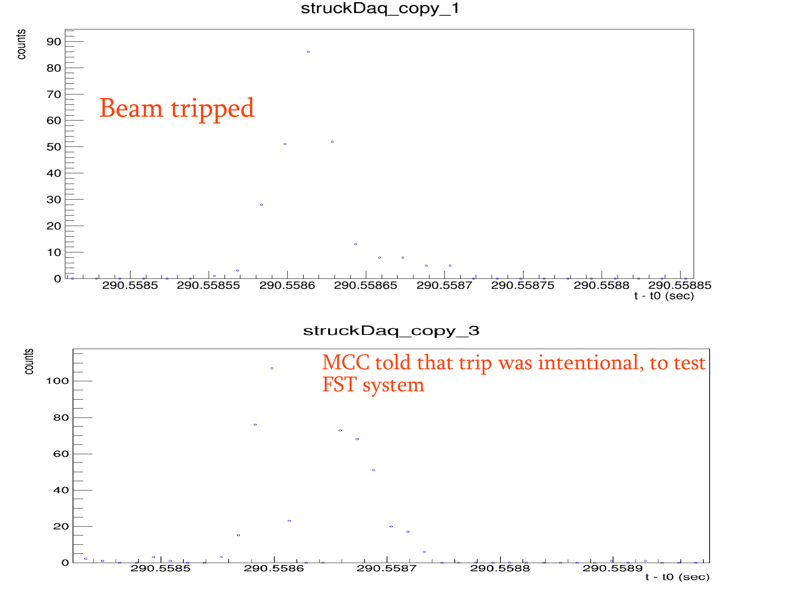
≈6MHz

Slide 8
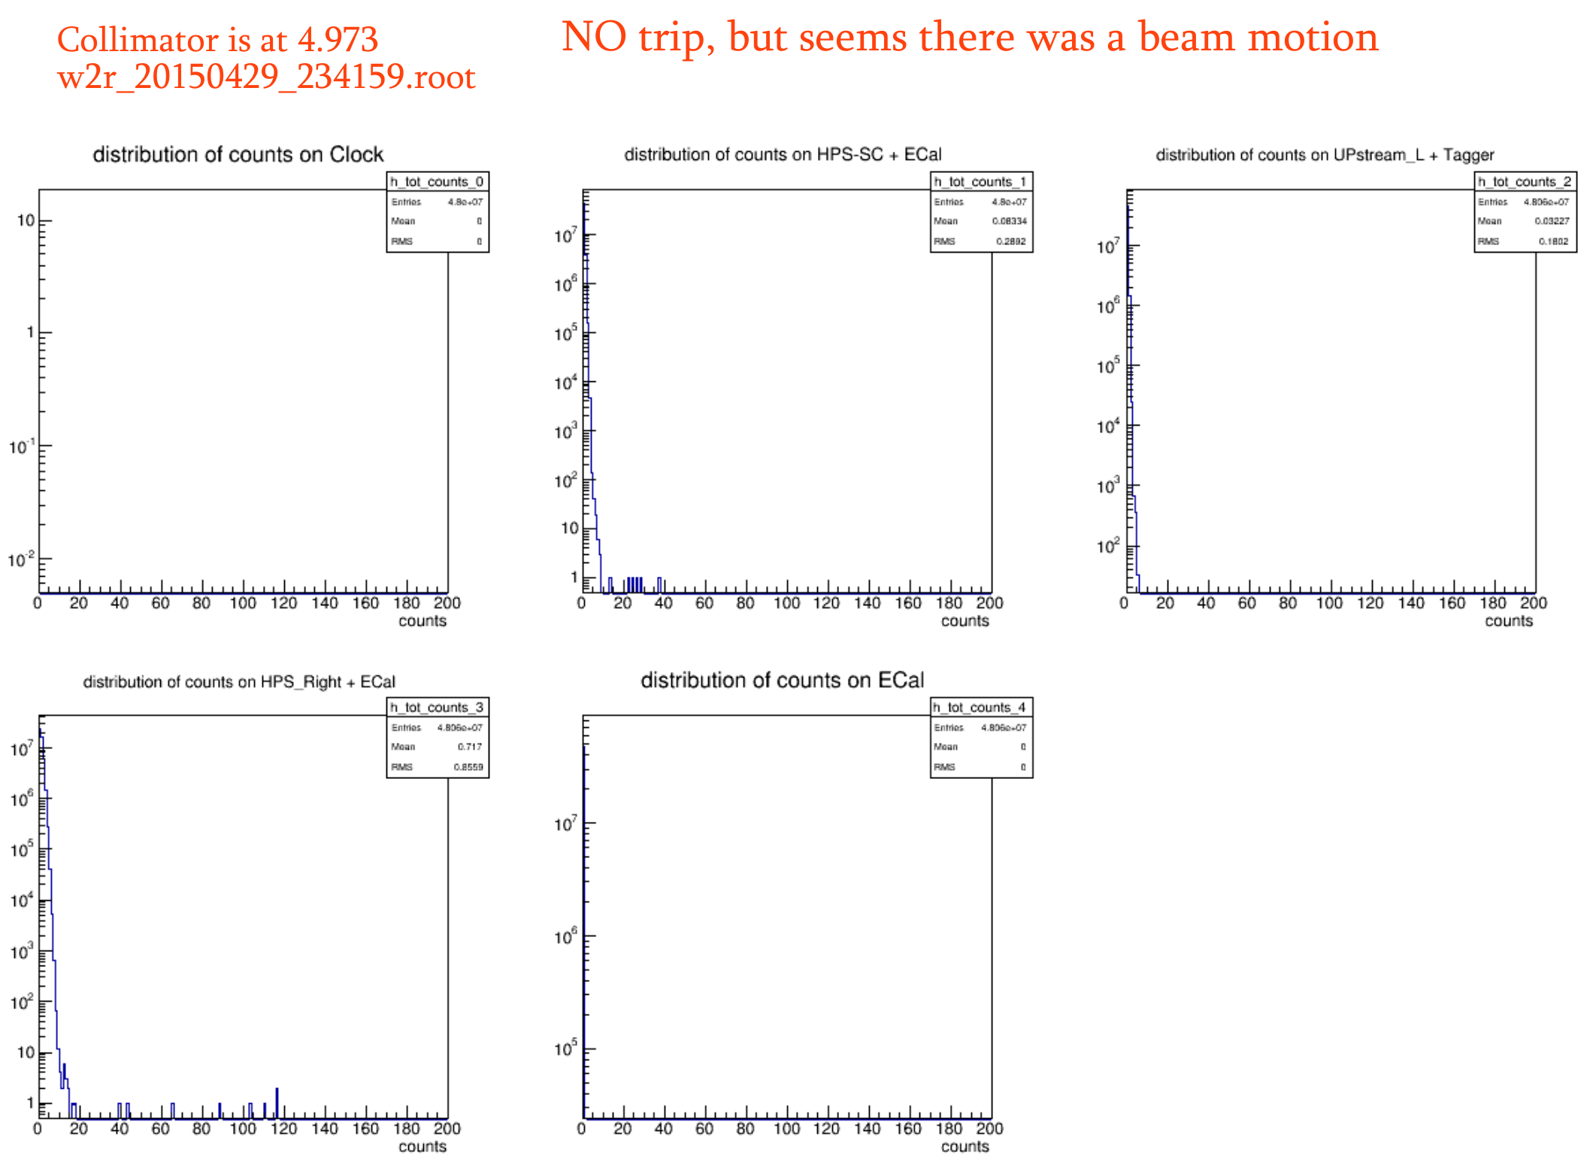

Slide 9
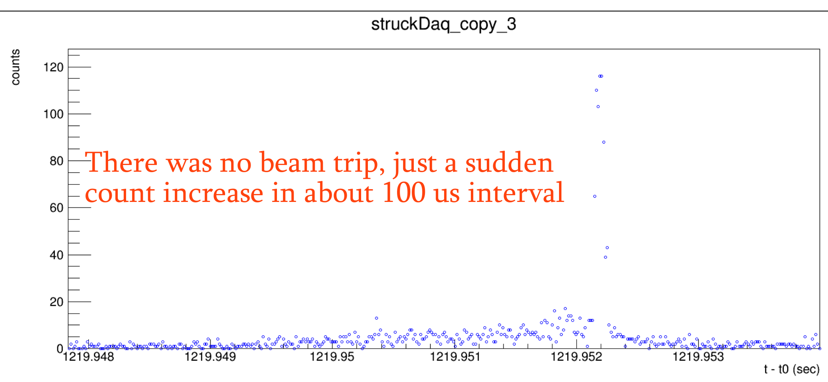
Collimator is at 4.973
≈8MHz

Slide 10
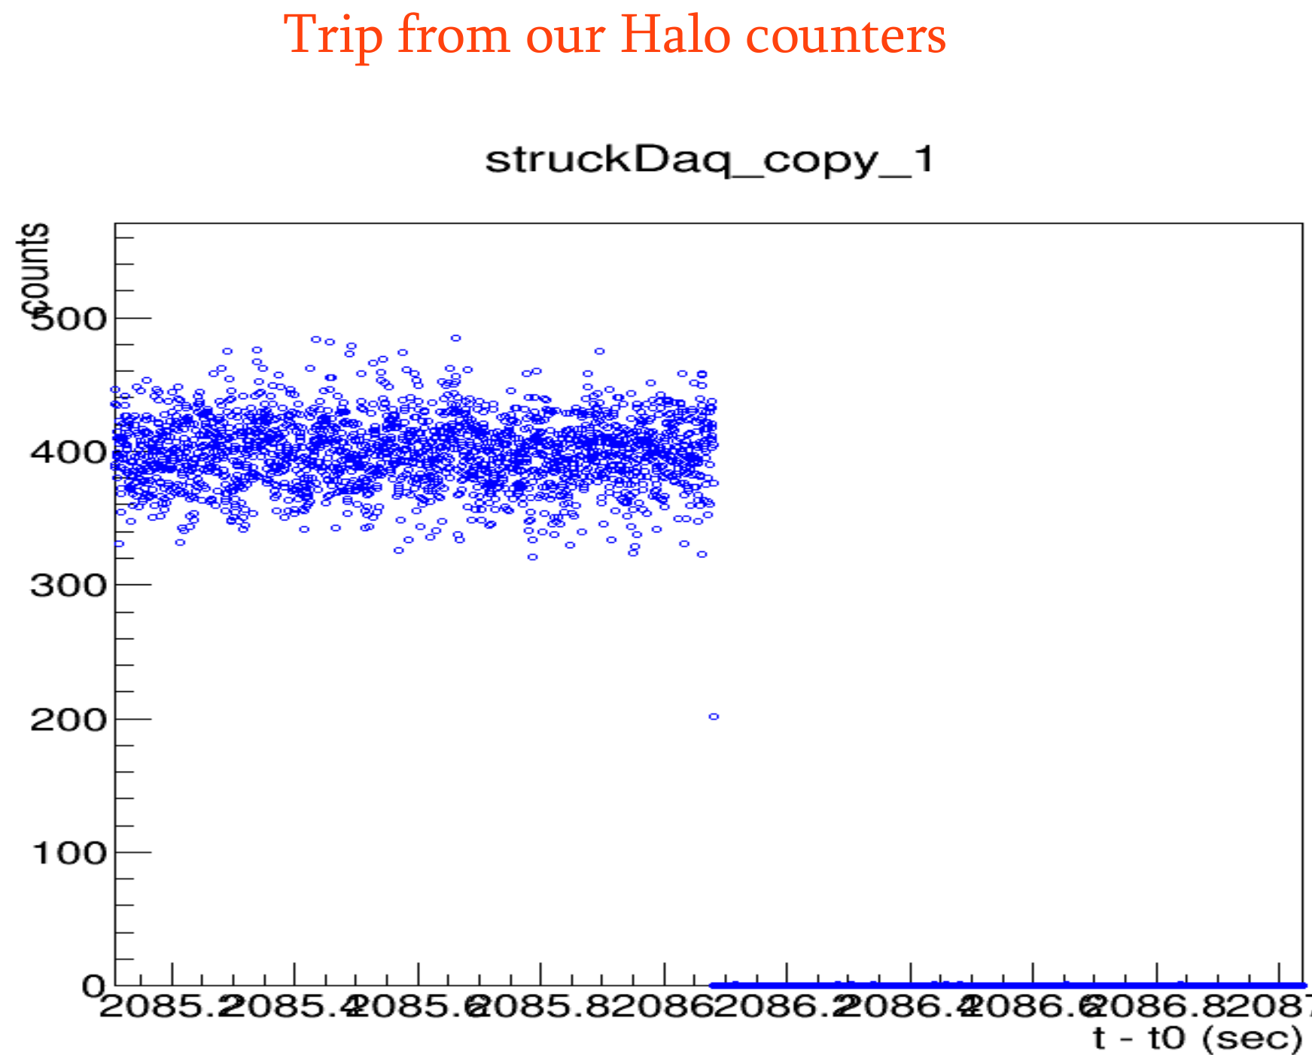
Dwell time is 500 us
With target

Slide 11
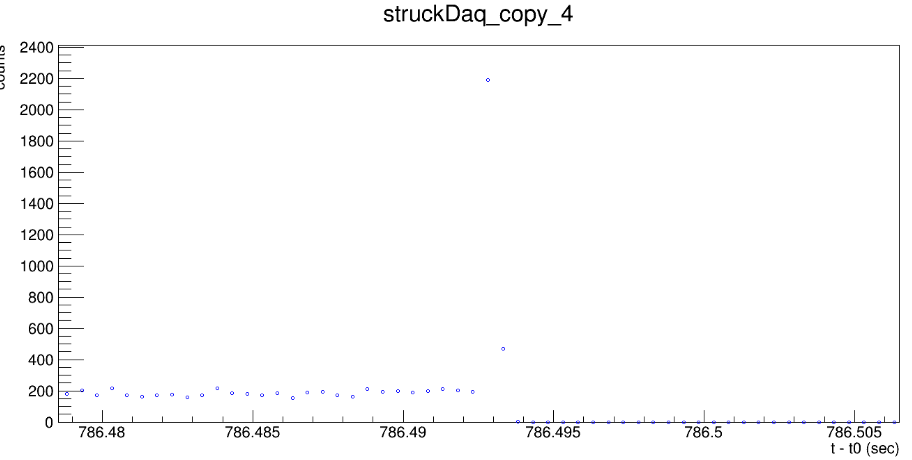
Trip from our Halo Counters

Slide 12
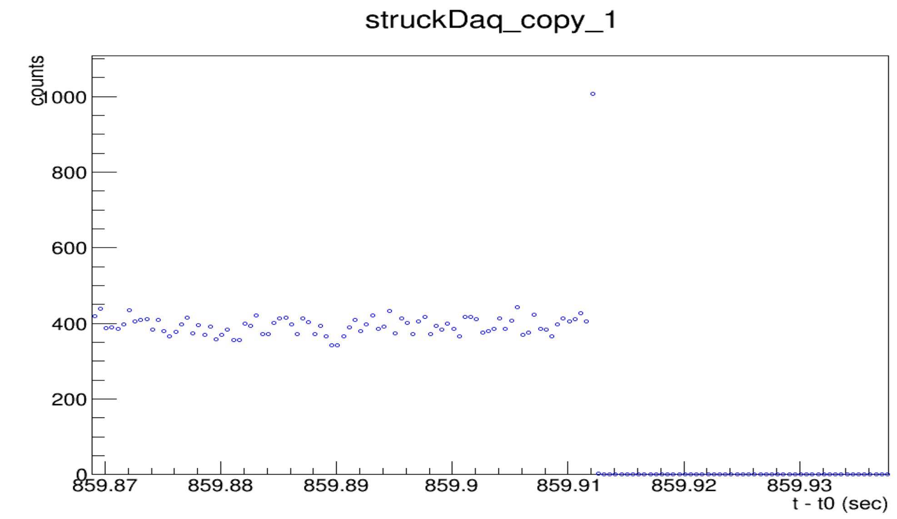
Our BLM tripped

Slide 13
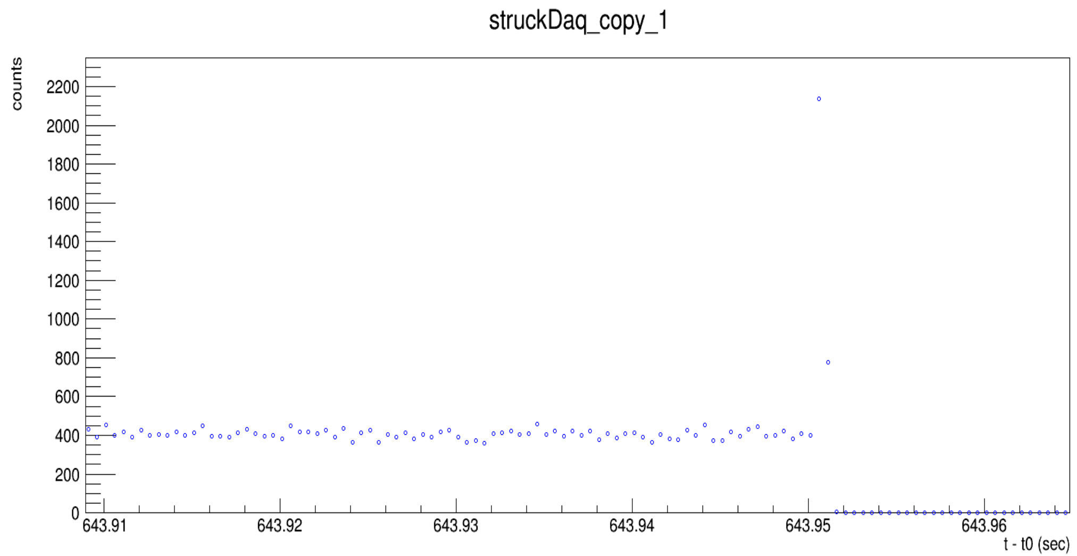
RF Tripped

Slide 14
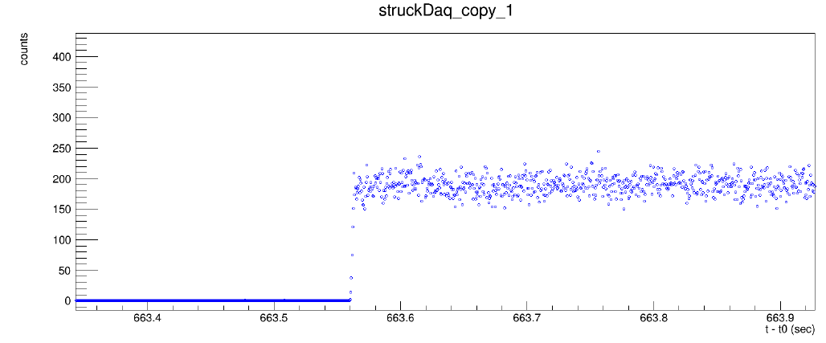
Recoveries especially with the 1.05 GeV beam always looked fine

Slide 15
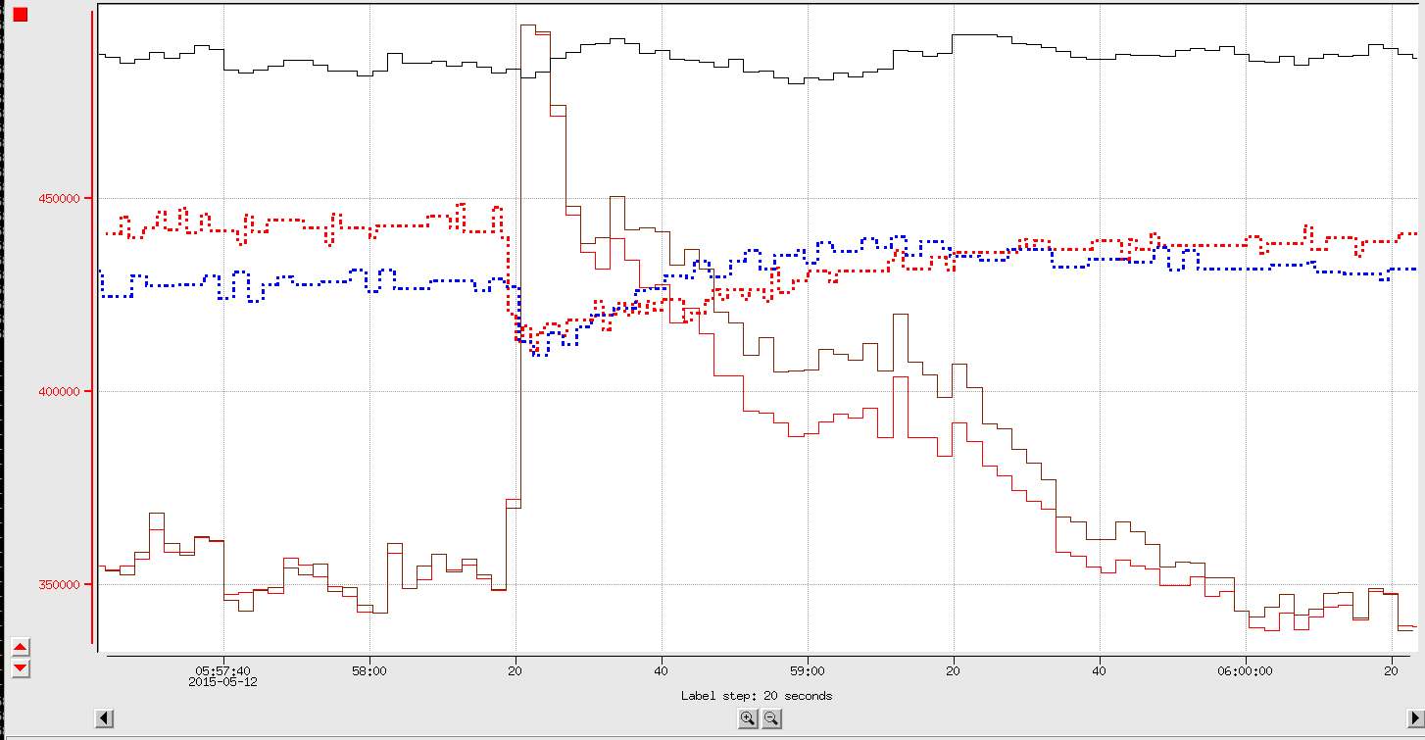
Maurik Mentioned in one of Wed. Meetings
Fcup (Around 50nA)
2C21_Y
2H02_Y
HPS_t
HPS_SC

Slide 16
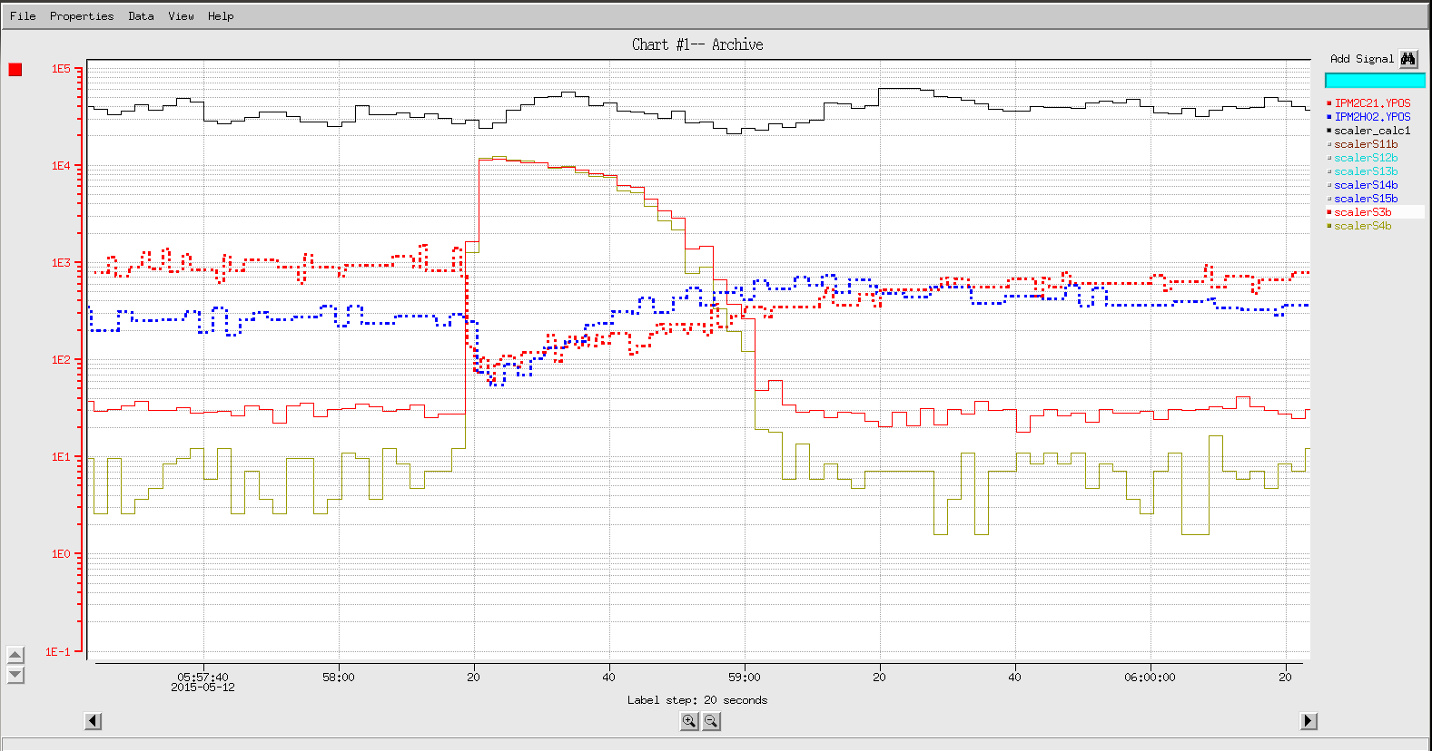
In the downstream part rate increase is more dramatic
FCup
Halo counters are in Log Scale
2C21_Y
2H02_Y
Upstream_R
Upstream_L

Slide 17
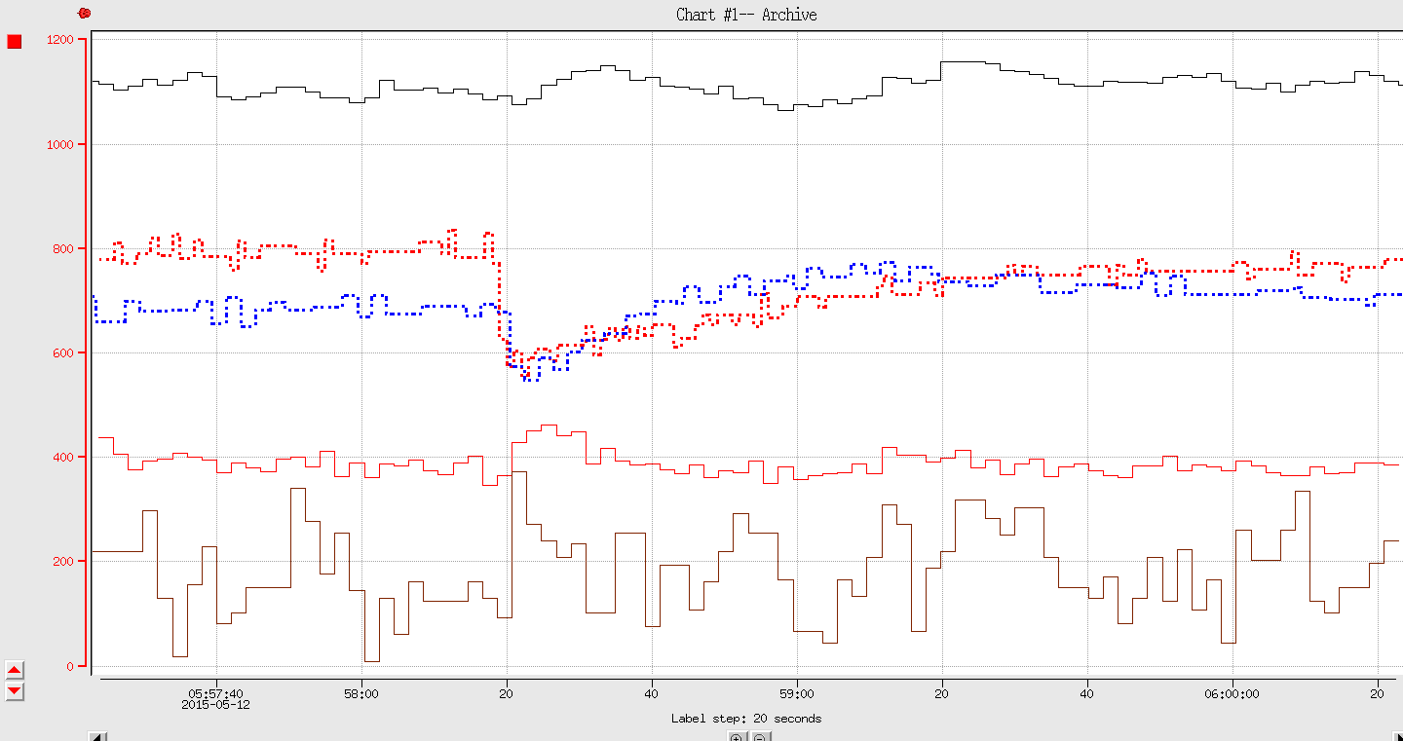
HPS_L and HPS_R didn't sense anything
HPS_Right
HPS_Left

Slide 18
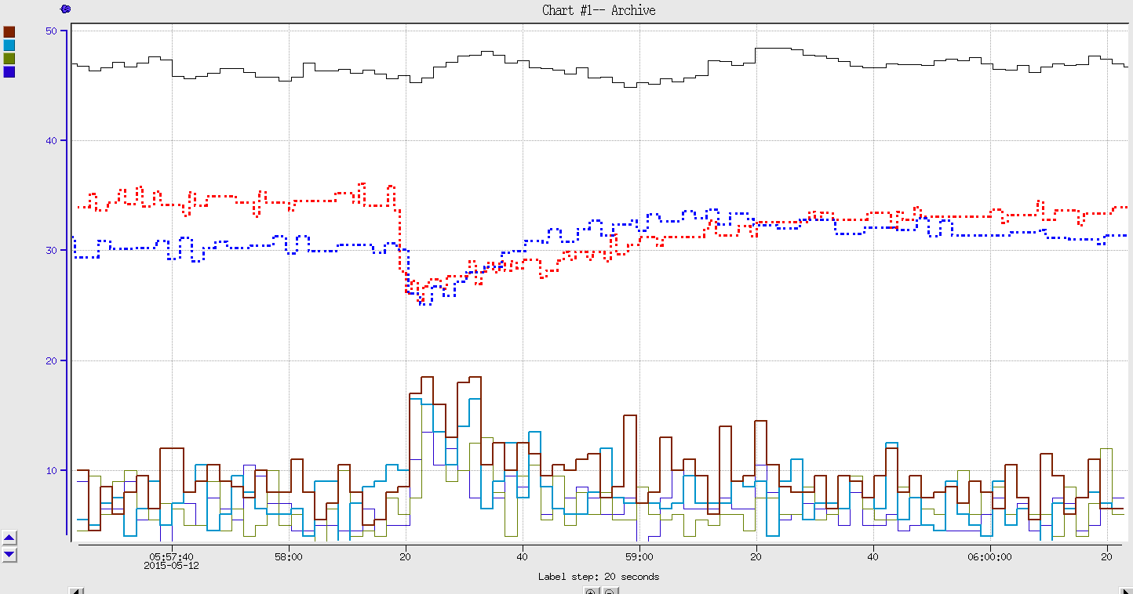
Neither downstream counters sense it
A small increase

Slide 19
Backup

Slide 20
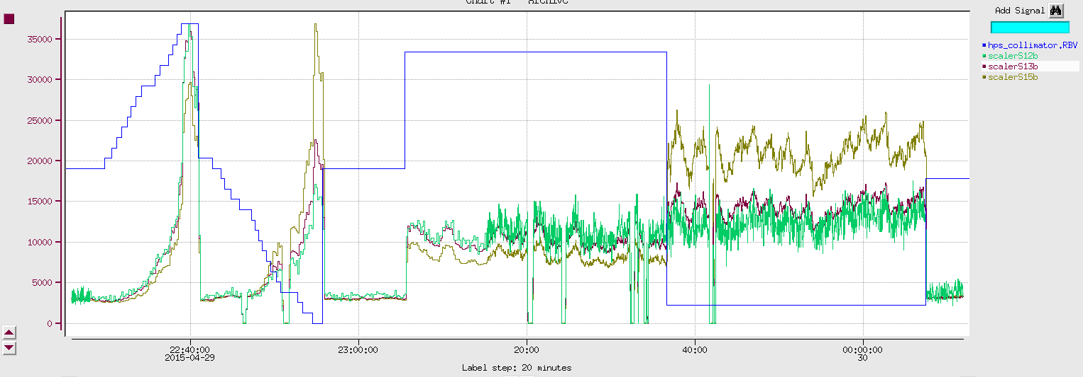
Proportion between counters is different depending on Collimator position.
Then the questions is what is the best counter that will tell where is the collimator center

Slide 21
5.022
5.028
1.244mm
5.071
4.973
1.244mm

