Slide 1
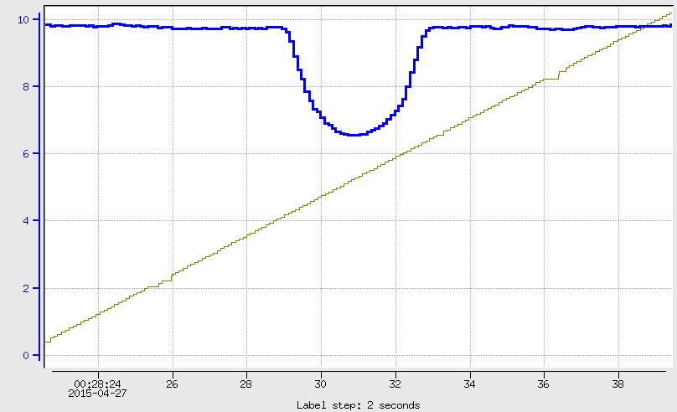
Fcup current
Scan with 10 nA beam
Harp_2H02A pos

Slide 2
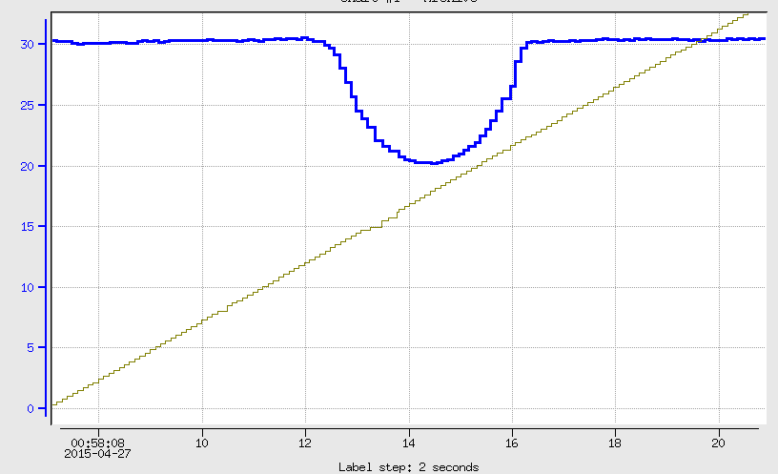
Fcup current
Scan with 30 nA beam
Harp_2H02A pos

Slide 3
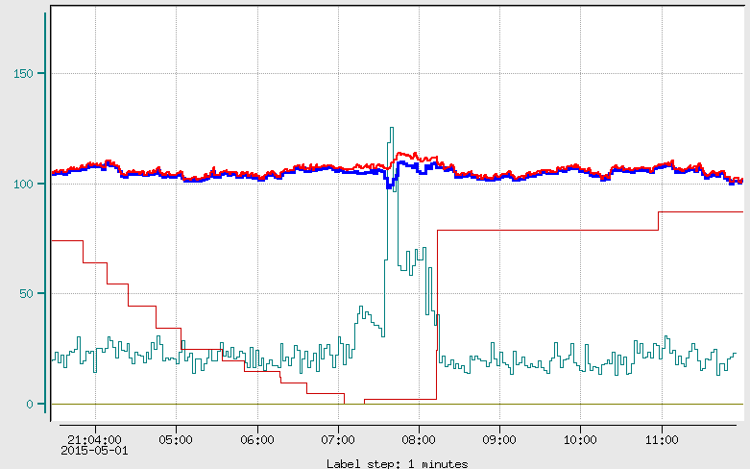
Collimator Scan
2C24A BPM Current
Fcup current
HPS Halo counters are saturated, therefore downstream were used. Rates are low, but anyway they shown a clear increase
of rates when FCUP and BPM currents deviate from each other
Downstream counter rate
Collimator Position

Slide 4
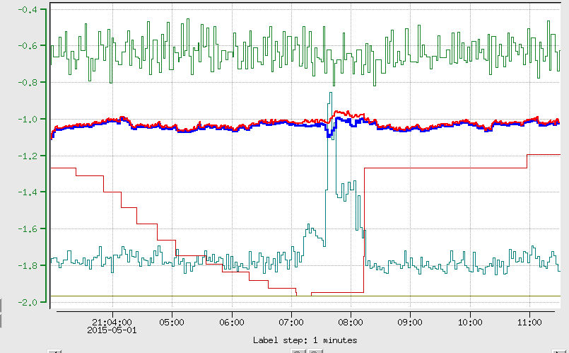
Same as previous slide, only 2H02 BPM Y coordinate is added. It doesn't
Really show noticeable position change
2H02 BPM Y

Slide 5
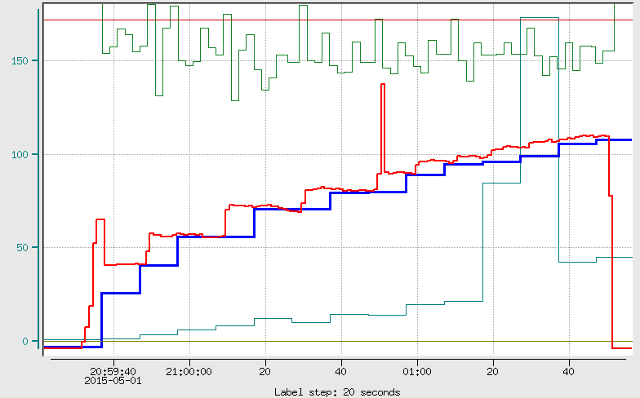
Beam recovery from the trip
Collimator is at 5.09 (touching the beam from the top)
Collimator
2H02 BPM Y pos
BPM current
FCup current
Downstream
counter

Slide 6
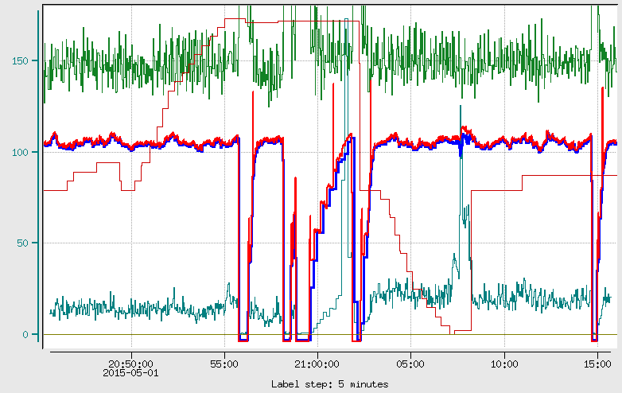
The same thing with a large time interval
Except two intervals indicated in previous slides, seems there is not disagreement
Between Fcup and BPM current

Slide 7
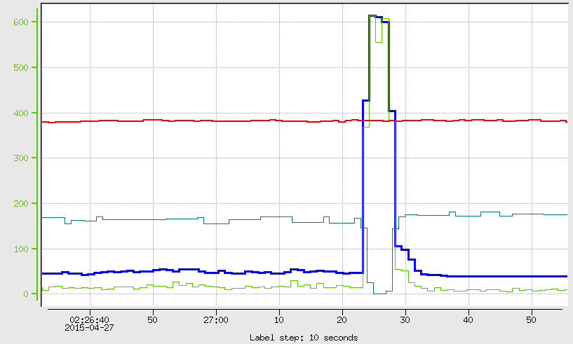
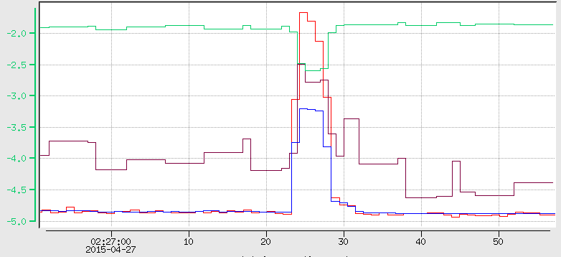
Fcup current increases about 10 times, Downstream also increases, goes up to 760, It is
probably isn't saturated. So not Sure how to understand this.
Might it be somehow the beam escapes the beam blocker, or hit's it on a corner, therefore
current suddenly increases 10 times. Looks like 8cm shift is enough for the Beam to hit
FCup (See next Slide).
Downstream Halo counter(760 Hz)
BPM.X
BPM.Y (-0.12 mm)
Fcup (11 nA)
BPM.Y (-0.3 mm)
Fcup (0.9 nA)

Slide 8
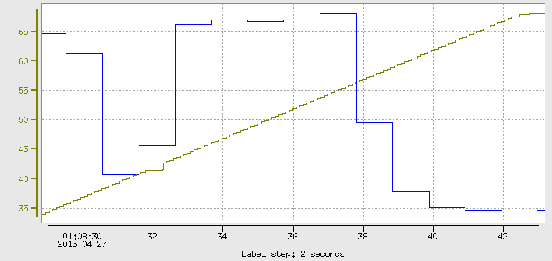
Might it be that the beam hits the corner (left/right or bottom/top) of Beam blocker?
FCup
Blocker
Normal beam
Bended beam
≈8cm
Fcup
≈8cm
Blocker Pos

Slide 9
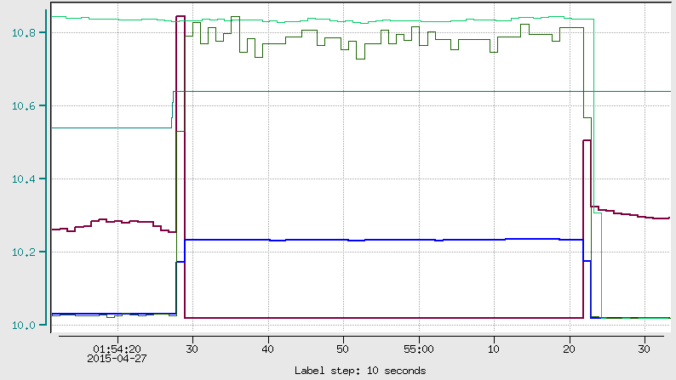
It looks like harp wire was driven into the middle of the beam. That caused saturations of HPS counters. Downstream counters increased from 5-6 to 1200. And Not sure how, Fcup
reading increased from 0.8 up to 10.
IPM2C24A current (≈100 nA)
Downstream Halo counter (≈1200 Hz)
harp_2H02A.RBV
HPS_SC(≈50K)
FCup(≈10 nA)

Slide 10
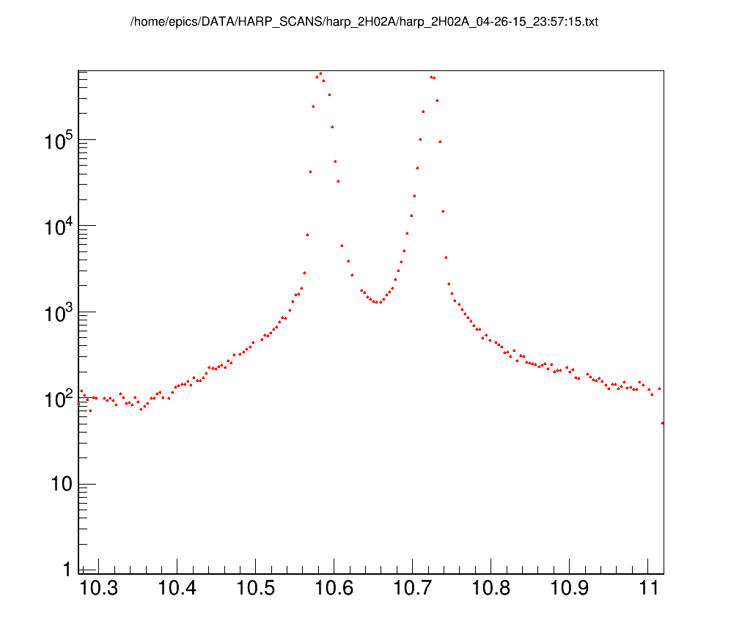
10.57
2H02A Motor Pos (cm)

Slide 11
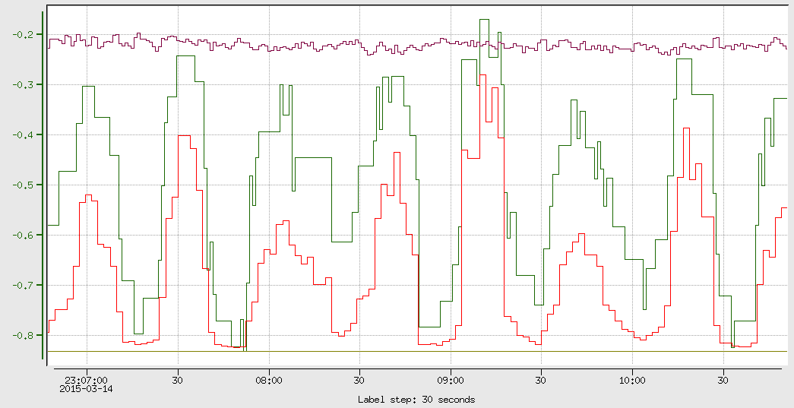
IPM2c24A (100 nA)
IPM2c24A.YPOs
IPM2c24A.YPOs
Upstr. R

