Slide 1
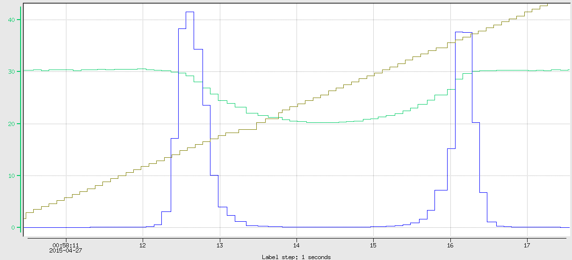

Slide 2


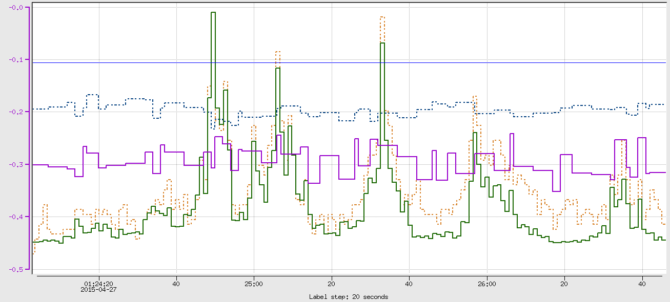

FCUP scaler (Hz)
2H02.XPOS(mm)
10.55 (cm)
HPS_SC (Hz)
2H02.YPOS (mm)

Slide 3

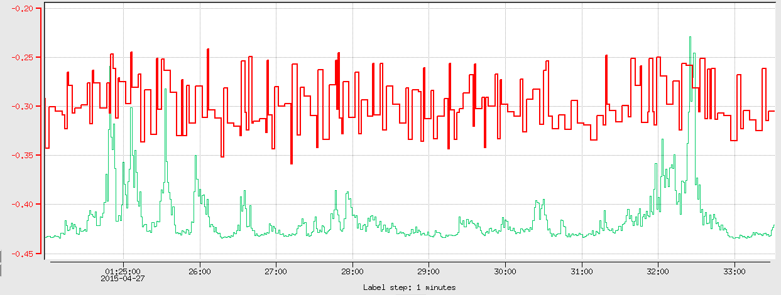
HPS_SC Hz
2H02 BPM.Y(mm)

Slide 4
Beam Blocker
Beam Blocker
FCup
FCup
Beam is not interacting with any material
before the beam blocker
A fraction of the beam has interacted with a
harp wire

Slide 5


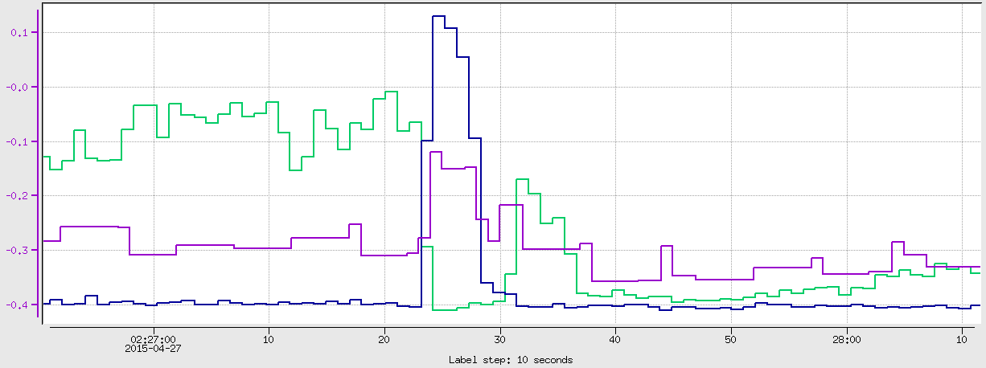
HPS_SC(Hz)
Dwnstr.Bot(Hz)
2H02.Y(mm)

Slide 6


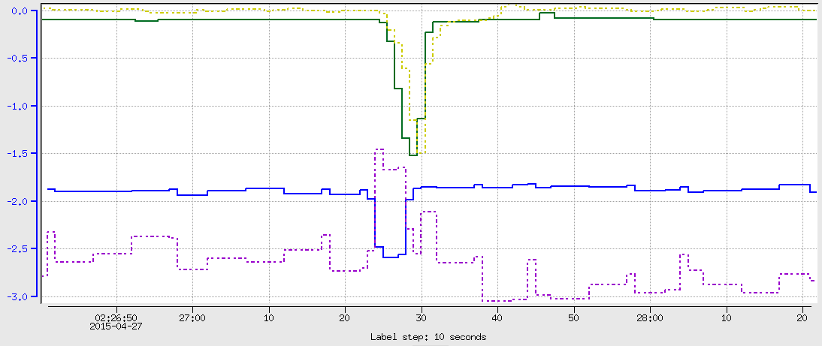
2C24.Y(mm)
2H02.Y(mm)
2C24.X(mm)
2H02.X(mm)

Slide 7
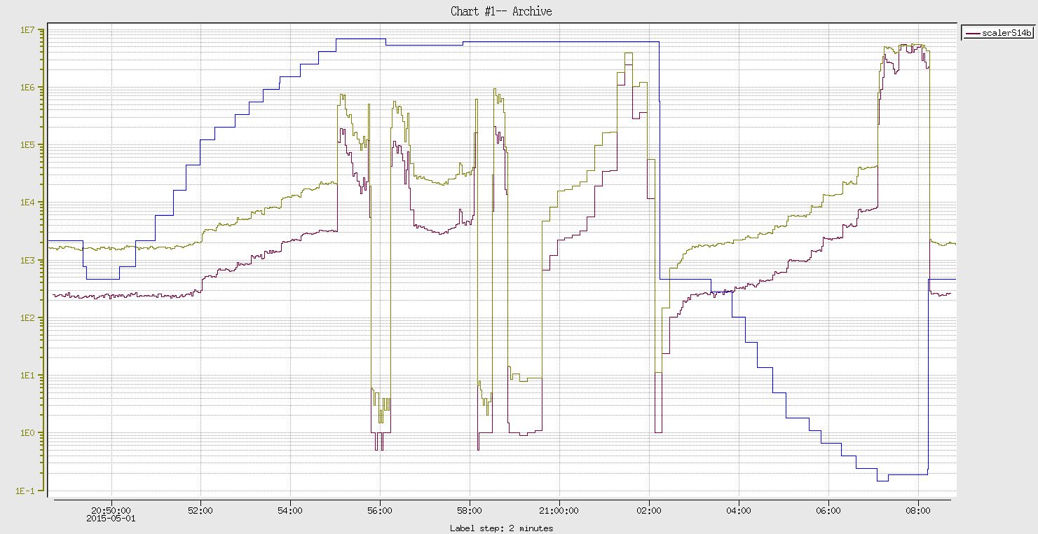
Beam is touching the edge
Collimator
5.096
HPS_SC
HPS_t
4.960
This tells the collim. center to be at 5.028
Hole size = (5.096 – 4.96)*25.4 = 3.4544 mm

Slide 8
