Slide 1
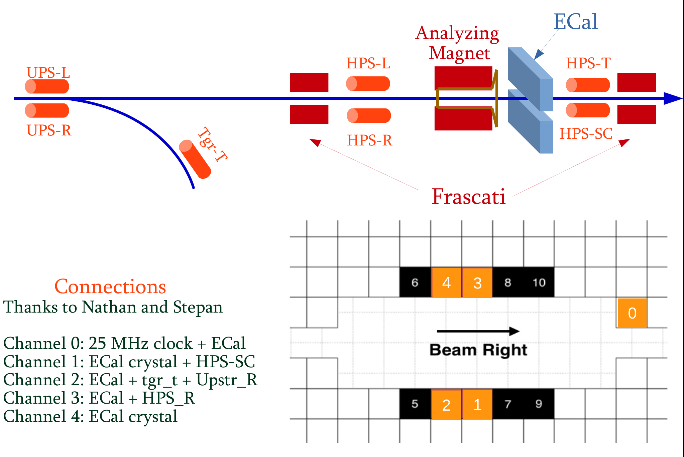
Beam-pipe
Ecal channels: Orange represent
channels that are written in into
the file. Numbers represent scaler
Channel number

Slide 2
