Slide 1
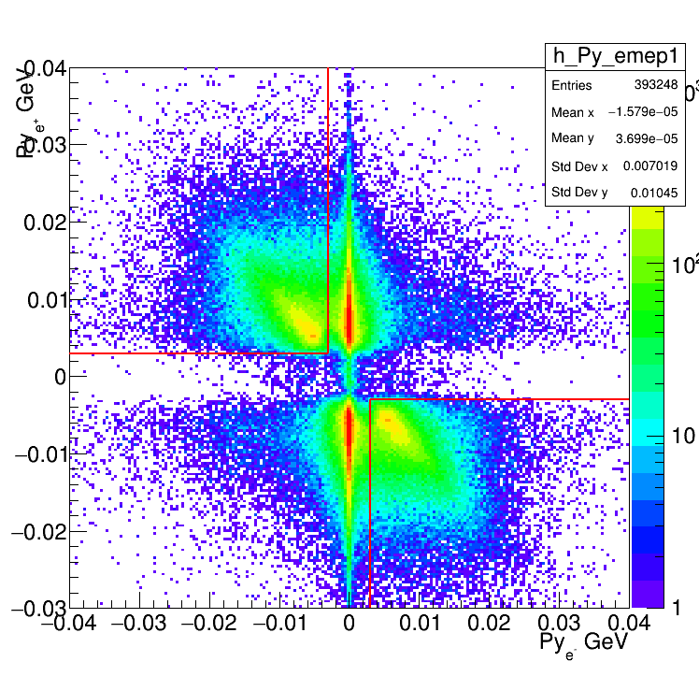
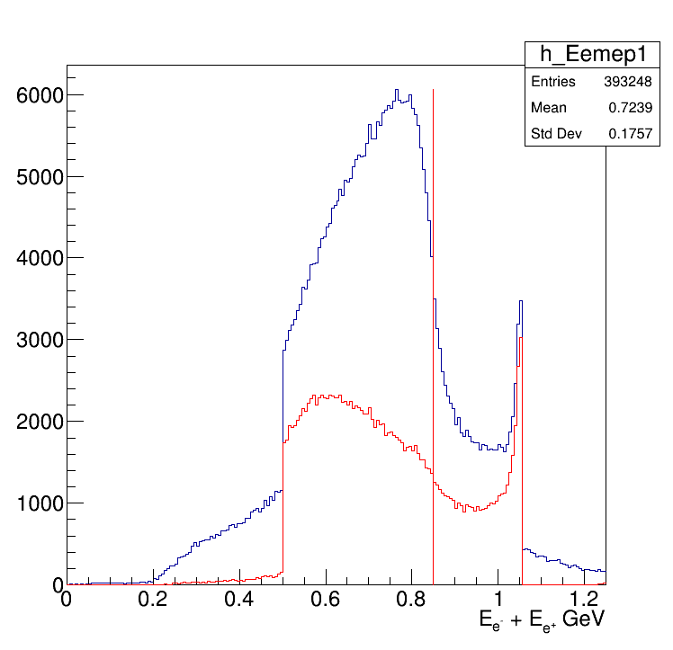
Trident id: 622
Has 3 children 2e- and 1 e+

Slide 2
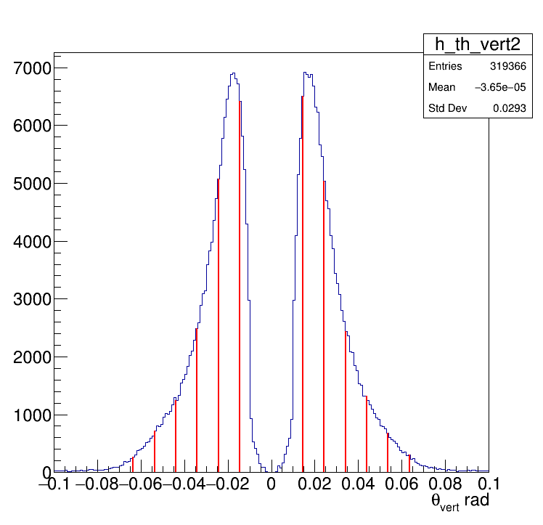
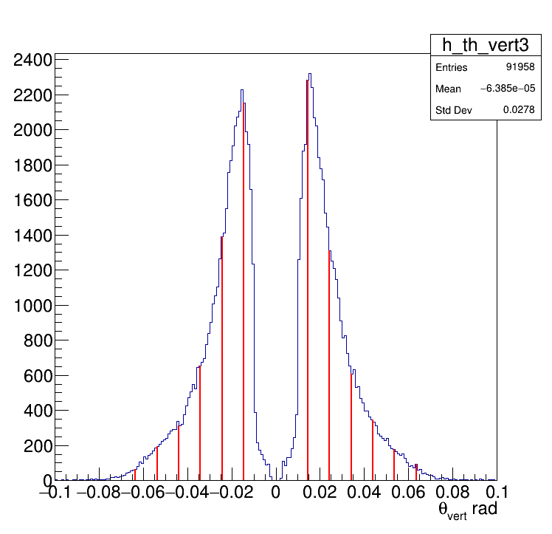
All Events
E_e- + E_e+ > 0.85 GeV
According to simulations, about half of tridents events are on 1st Ecal row

