Slide 1
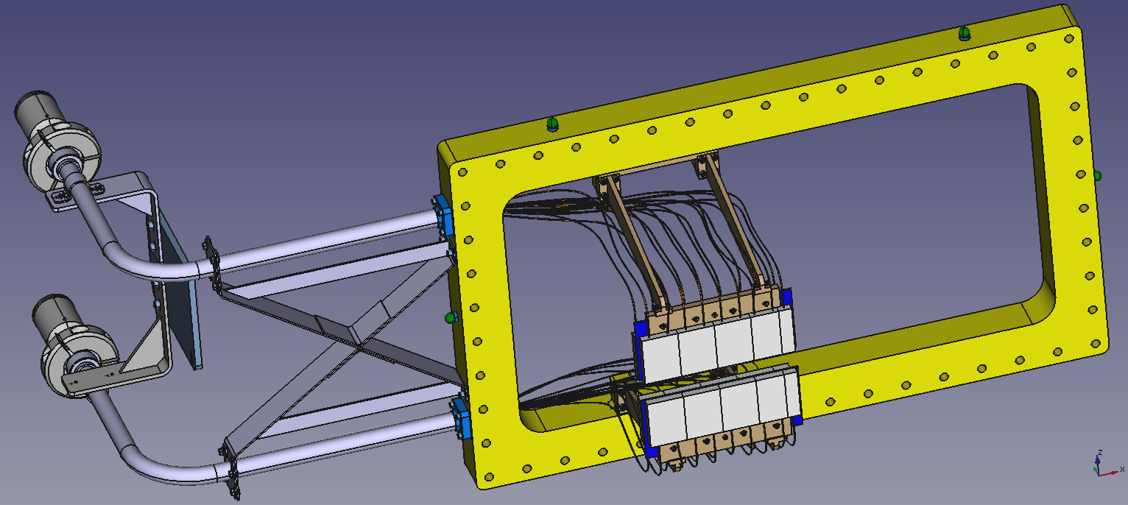
50 mm Al. flange
WLS fibers
PMT Housing
Survey marker
Fiber transport
tubes
2mm thick carbon
fiber plate
Scintillators

