Slide 1


Article Review
A Machine Learning System for Precipitation Estimation Using Satellite and Ground Radar Network Observations
Oscar Ramirez Moguel, Rafsan Al Amin, and Sepehr Fekri

Slide 2

TABLE OF CONTENTS
01
02
03
04
05
Introduction
Methodology
Results
Discussion
Conclusion
1

Slide 3

01
Introduction
2

Slide 4
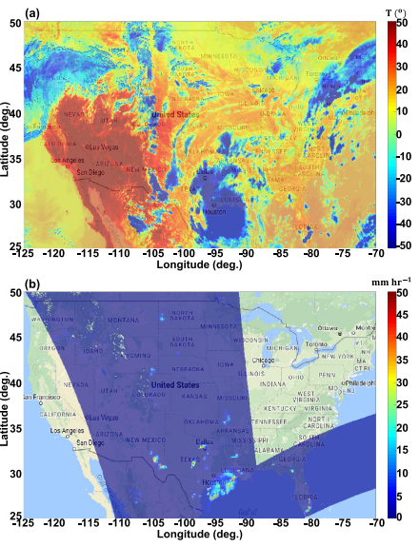
Introduction
Title: A Machine Learning System for Precipitation Estimation Using Satellite and Ground Radar Network Observations.
  Authored by: Haonan Chen, V. Chandrasekar, Robert Cifelli, and Pingping Xie.
  Year of Publication: 2019
  Proposes a machine-learning-based data fusion system
  Combines satellite observations with ground radar measurements
  Aims to improve satellite-based precipitation estimates
a) IR brightness temperatures b) PMW-based rainfall retrievals
3
CHEN et al.

Slide 5
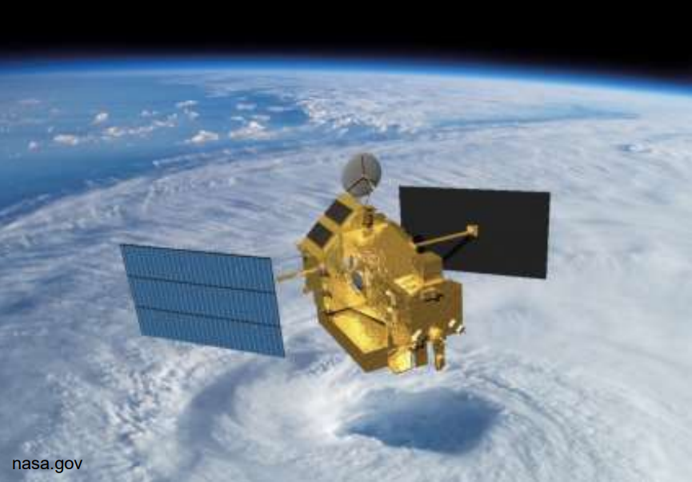
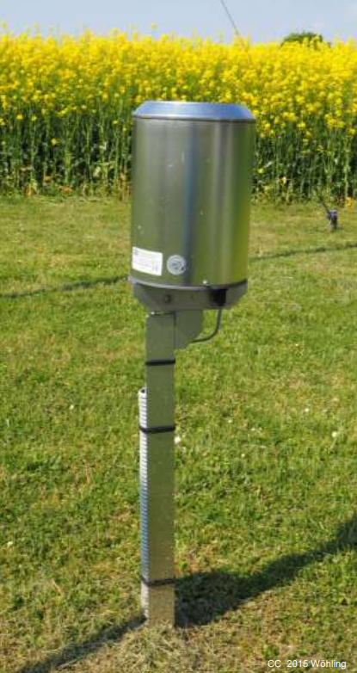
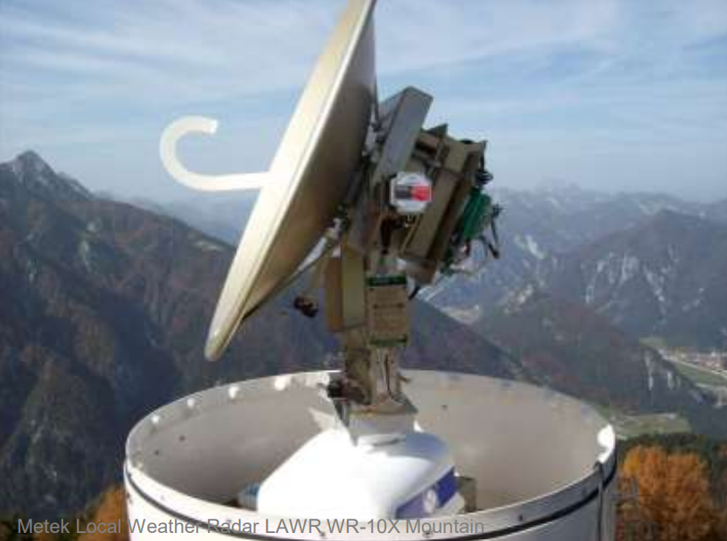
Introduction
Why is it important to improve satellite-based precipitation estimates?
Precipitation plays a key role in understanding the water cycle
It is a critical input for climate, hydrological, and weather forecast models
  Methods of measuring precipitation
  Conventional meteorological stations (rain gauges)
  Meteorological radars
  Satellites: geostationary infrared (IR) and passive microwave (PMW) measurements
4

Slide 6
Introduction
Combination of weather radar data and satellite data for better precipitation estimates
Weather Radar
Advantages:
High-resolution area coverage
High temporal resolution
Microphysics information (internal storm structure and raindrop size)
Drawbacks:
Limited spatial coverage.
Satellite
Advantages:
Near-global coverage
IR-based algorithms - adequate for convective rainfall
PMW-based measurements – more physically based / more accurate
Drawbacks:
Spatio-temporal sampling gaps
IR-based algorithms are not adequate for stratiform/warm-top rainfall
PMW-based measurements have low temporal resolution
5

Slide 7
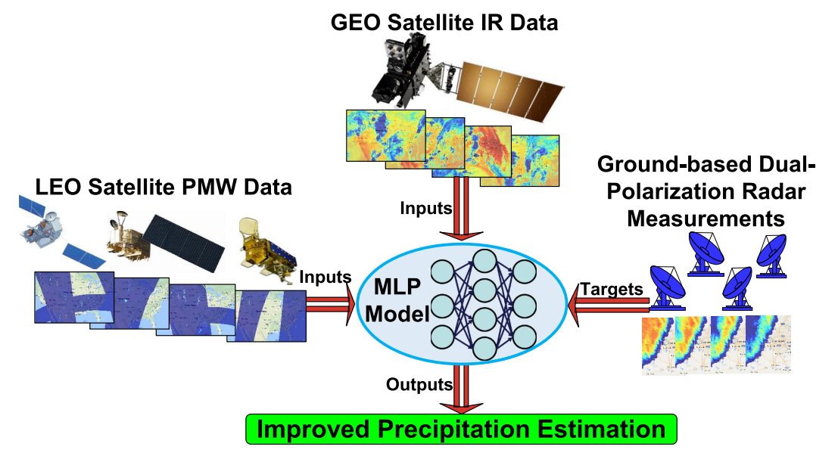
Introduction
*IR = Infrared
*PMW = Passive Micro-Wave
Objective:
To introduce an innovative machine learning-based mechanism to improve spaceborne precipitation retrievals by incorporating dual-polarization measurements from a ground-based radar network
Key ideas:
Designing a machine learning system for satellite-based precipitation estimation
Using combined IR + PMW satellite data as inputs
Using ground-based dual polarization radar measurements as training targets
6
CHEN et al.

Slide 8
02
Methodology
7

Slide 9
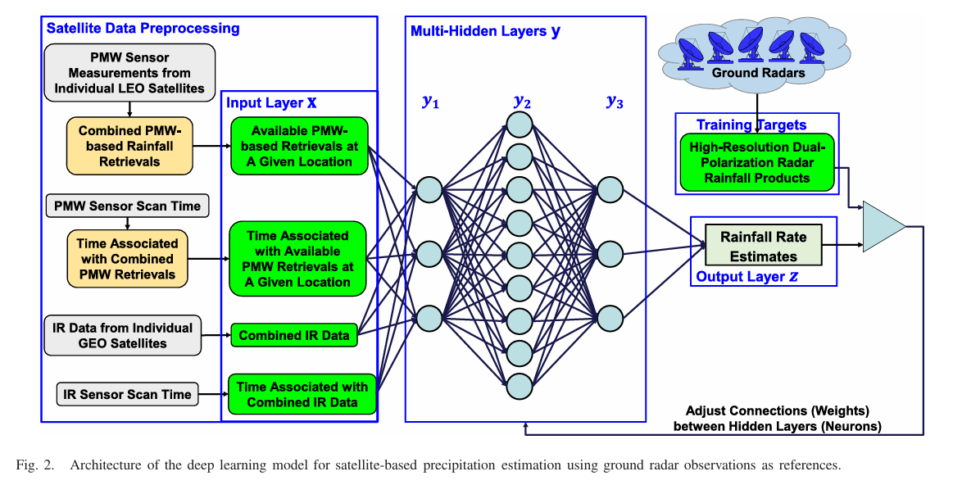
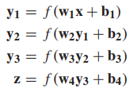
Methodology
Machine Learning Model
Multi-Layer Perceptron (MLP): deep-learning model used to process the satellite data and produce precipitation estimates.
Architecture: multiple layers of artificial neurons; input data (satellite IR and PMW) pass through several hidden layers before generating the output (precipitation estimates).
  Training: the MLP is trained in a supervised way, using high-quality ground radar rainfall estimates as target labels.
CHEN et al.
8

Slide 10
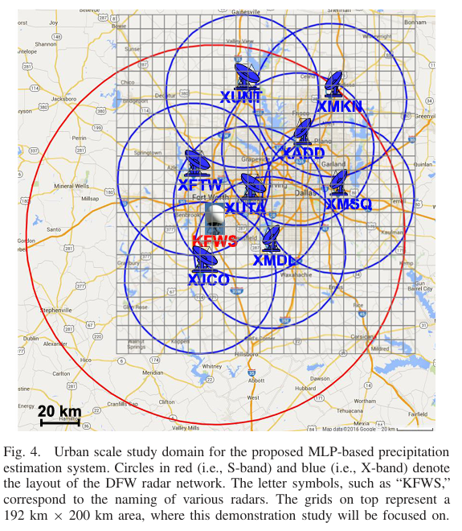
Methodology
Inputs
1. Satellite Data
                Infrared (IR) data
                from geostationary satellites (e.g., Himawari-8, GOES)
                Passive Microwave (PMW) data
                from Low Earth Orbit (LEO) satellites (e.g., NOAA, MetOp satellites).
                2. Radar Data
                Ground Radar Data (Target Labels)
The machine learning model learns:
“Given this IR and PMW signal pattern, radar said rainfall was X mm/hr.”
Dallas–Fort Worth Radar Network
CHEN et al.
9

Slide 11



Methodology
IR & PMW Satellite Observation
Truthing with Ground Radar Data
10

Slide 12
Methodology
IR vs PMW Comparison
Feature | IR | PMW
Frequency | Very frequent (every 30 min) | Rare (every 3–6 hours)
Accuracy | Low to medium | High
What it Detects? | Cloud-top temperature | Actual raindrops & ice inside the cloud
CHEN et al.
10

Slide 13
Methodology
Ground Radar Network Data
High-resolution dual-polarization radars
(X-band + S-band, DFW network)
Provides near-surface, minute-by-minute rainfall estimates
Used as ground-truth labels to train the ML model
Captures storm structure, raindrop size distribution, and intensity
CHEN et al.
11

Slide 14
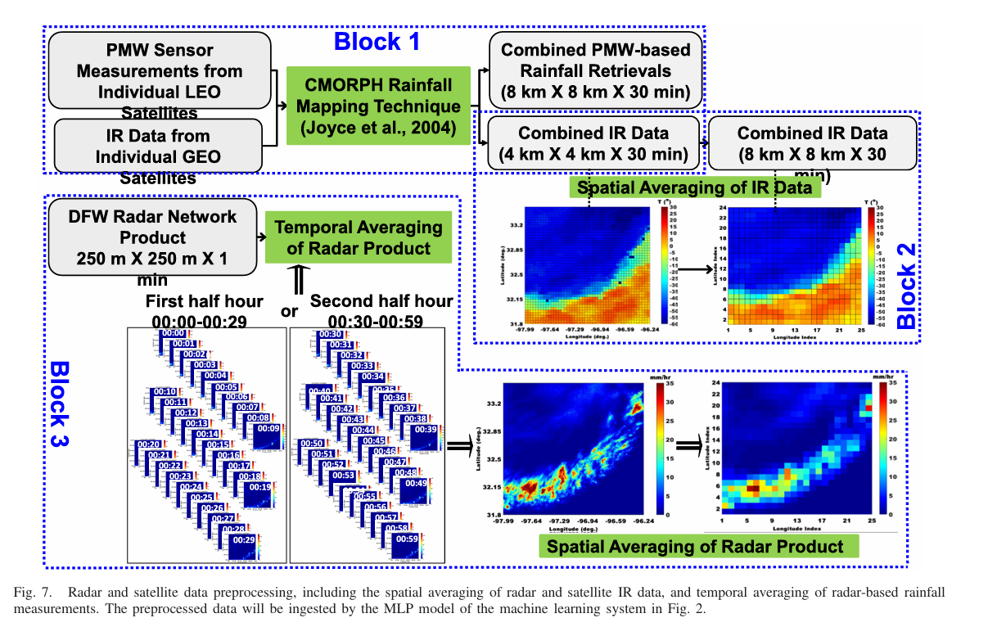
Methodology
CHEN et al.
Preprocessing and Data
Fusion
Everything have to match PMW spatial resolution: 8 km × 8 km.
📌 Radar (250 m → 8 km)
(1 min → 30 min) (Upscaling)
📌 IR (4 km → 8 km) (30 min→ 30 min) (Upscaling)
📌 PMW (already 8 km) No change
(3hour→ → → 30 min)
*Upscaling = making things more coarse (less detailed)
12
Notes:
Combining satellite data (IR + PMW) with ground radar data to produce better rainfall estimates than any single source can give.
Super Simple Analogy
Imagine trying to estimate rainfall by:
Looking at the clouds (IR)
Checking humidity + raindrop signatures (PMW)
Asking a friend who is standing outside with an umbrella (Radar)
During training:
Radar = expert friend
IR + PMW = students
ML = the classroom
After learning:
Even without your friend (radar), the student (ML model) can now guess rainfall very accurately.
That’s data fusion.

Slide 15
Methodology
If PMW is not available at time T:
look at PMW from −1.5 hours to +1.5 hours
→ all available PMW data in that 3-hour window
Feed those values + the time difference as input to ML model
CHEN et al.
13

Slide 16
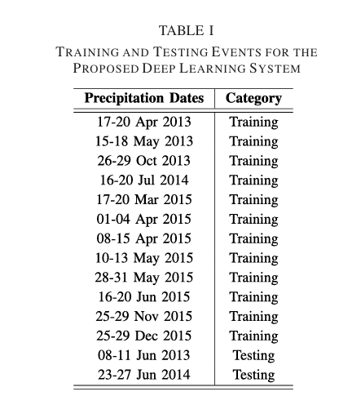
Methodology
Training & Testing Events
Training Dataset
      12 storm events from 2013–2015
      Covers a wide range of:
        Seasonal conditions
        Storm intensities
        Different rainfall patterns
      Provides ~960 hours of data for model learning.
      Radar rainfall used as ground truth during training
Testing Dataset
2 completely unseen events
Used only to evaluate model performance.
Ensures the model can generalize to new storms.
Compared against:
  Radar rainfall
  CMORPH products
CHEN et al.
14

Slide 17

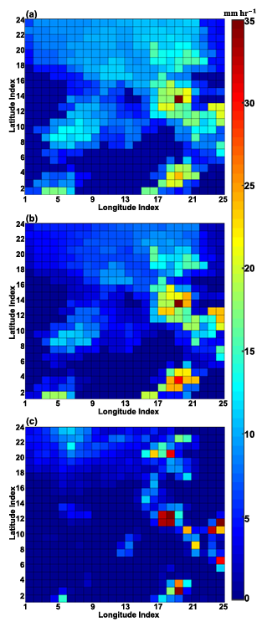
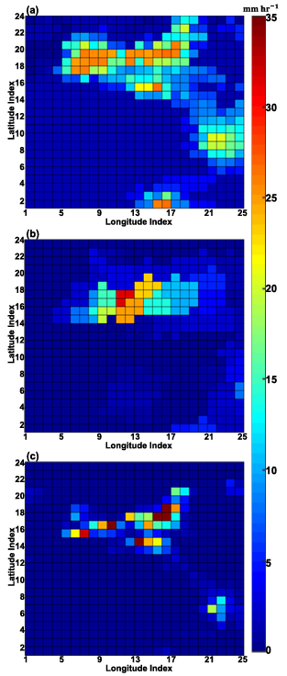
Results
MLP:
Left. Precipitation products on June 24, 2014, at 23:00 UTC
At this time frame, the combined PMW-based retrievals are available in the area
Right. Precipitation products on June 25, 2014 at 19:00 UTC
At this time frame, the combined PMW-based retrievals are not available in the area
CMORPH:
                CMORPH and the MLP model could capture the overall rainfall pattern
                Time difference inputs allow the MLP to mimic CMORPH motion vectors
Ground Radar (truthing):
CHEN et al.
15

Slide 18
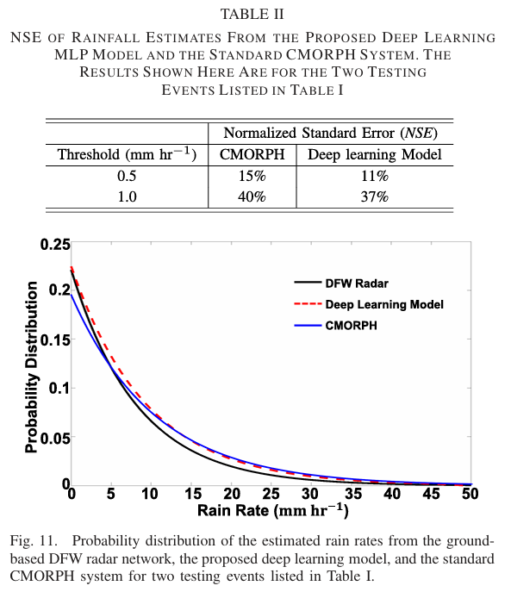

Results
E_{R} = Number of rainy pixels from models
R_{R} = Number of rainy pixels from radars (ground truth)
Closer to zero = Better performance
MLP product outperforms the CMORPH product in two thresholds.
16
CHEN et al.

Slide 19
Conclusion & Observation
*DFW : Dallas–Fort Worth Radar Network
                Main Findings:
                MLP model estimates precipitation from satellite data
                Performance is very similar to CMORPH product
                Time difference as input enables motion tracking
                Limitations & Future Work:
                Trained only on local DFW observations → Need data from other regions for generalization
                Simple architecture (only 3 hidden layers) → Modern architectures (CNN, ConvLSTM)
                Basic evaluation metrics → Could use more comprehensive metrics
                Processing Power and Time Requirement
                Strengths:
                Flexible - can be used wherever radar networks exist
                Well-documented procedure that can be followed
                Novel approach: time tags replace motion vectors
17

Slide 20

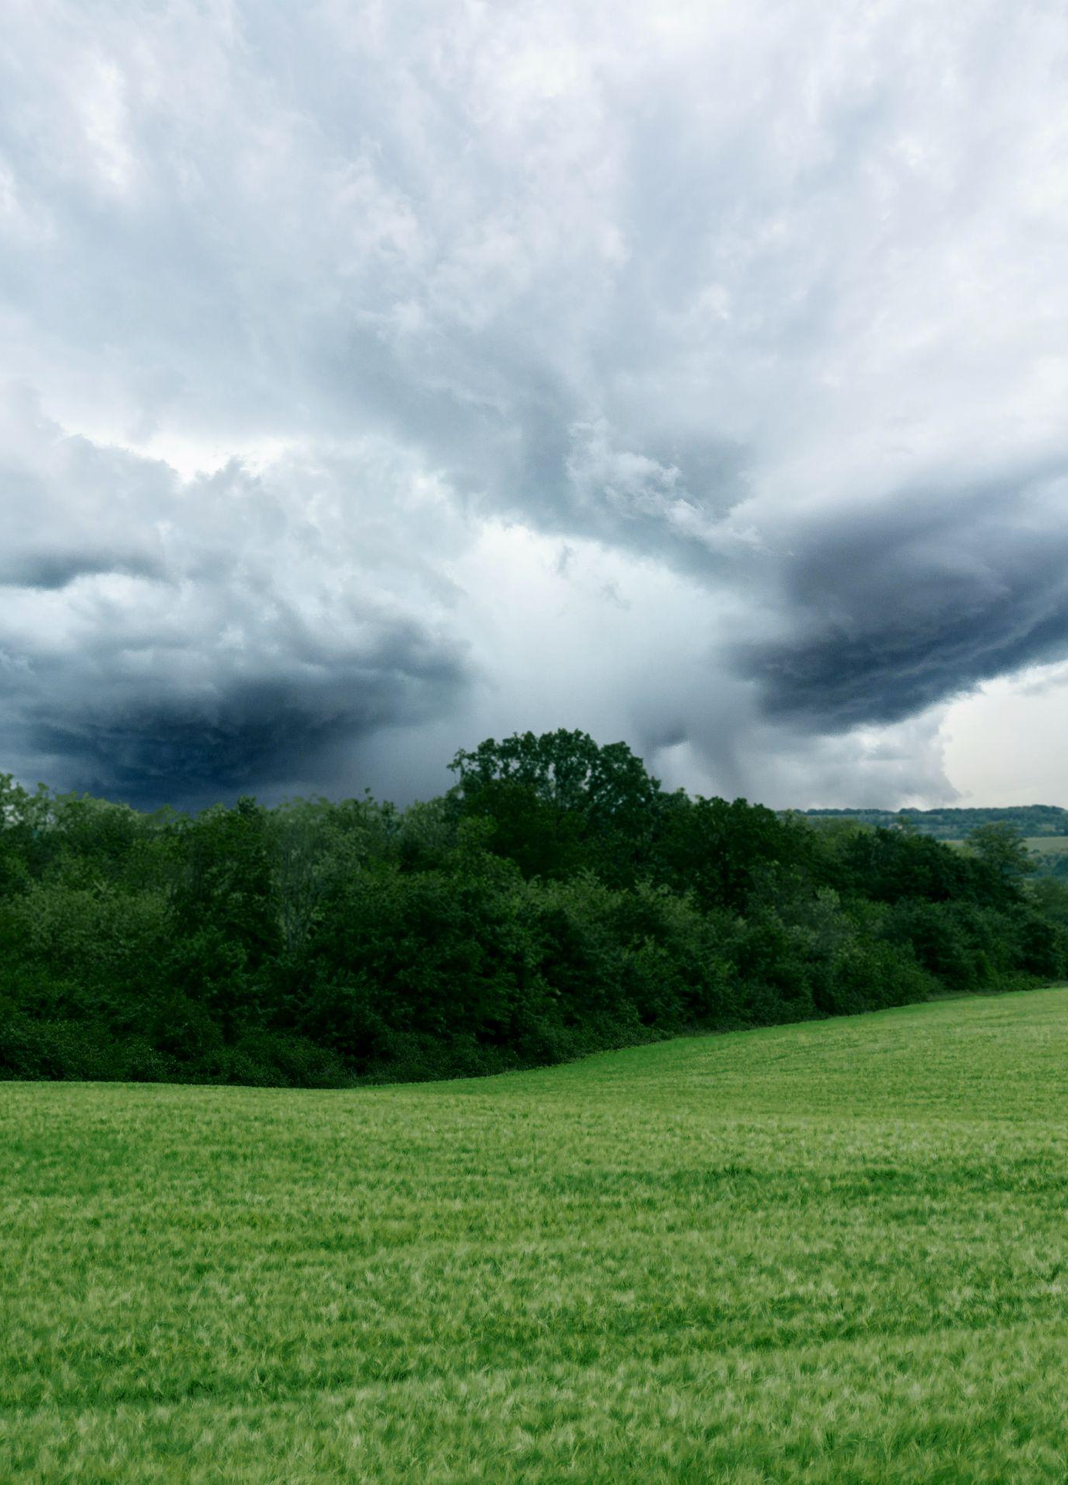
Thank you for your attention

