Slide 1







CARLA: codebase setup
config
models
envs
A tested Catan rules engine, the RL tooling around it, and ready-to-fill interfaces for every workstream
engine
gui
rl
agents · eval
ECSE 552 · Catan Advanced Reinforcement Learning Agent · branch “setup”
Notes:
Summary of the first setup session: the rules engine is complete and tested; everything the other workstreams need has a working first version or a documented interface.

Slide 2


At a glance
399
64k
100%
4.4k
tests passing
rule invariants, replays, envs, models
decisions per second
on one CPU core, in pure Python
heuristic bot vs. random
won 80 of 80 games
lines of source
plus 1.8k lines of tests · CI green
Rules engine
Full 4-player base game: deterministic, snapshot-able, logged
RL tooling
Experiment configs, Gym and self-play envs, action masks, observations
Interfaces for every workstream
Models, PPO, bots, evaluation and GUI can now start in parallel
Notes:
Four numbers that summarise the state of the repository, then the three things that were delivered.

Slide 3


One repo, four workstreams, clean boundaries
models
policy networks (torch)
rl
PPO, rollouts, training (torch)
eval
games, tournaments, CIs
gui
Arcade viewer and play
Owner
Engine
RL
envs
observations, masks, rewards
agents
bot interface and baselines
config
typed YAML experiment configs
Models
Eval & bots
GUI
engine
rules · state · legal actions · logs (Python standard library only)
Shared
Each layer imports only from the layers below it; torch appears only in models and rl.
Notes:
Colours show which workstream owns each package. The engine has no dependencies at all, so it can be optimised or reused without touching anything else.

Slide 4
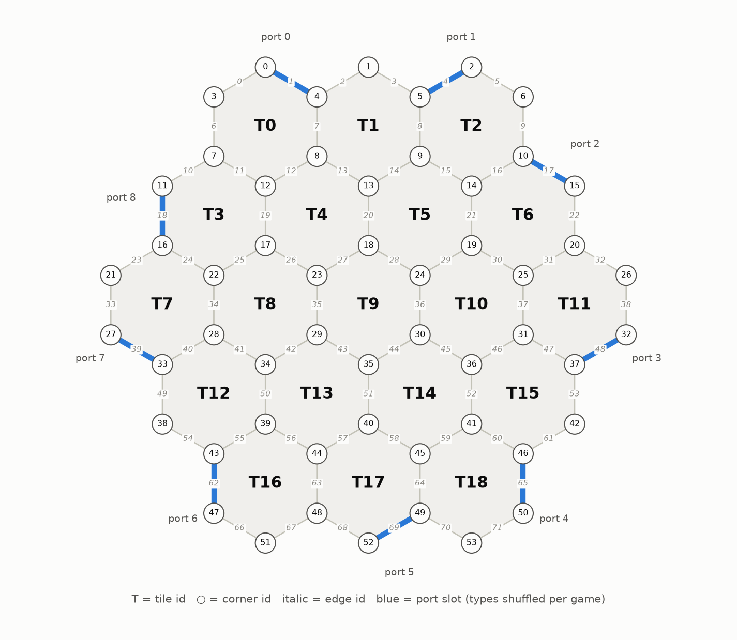





A from-scratch Catan engine
Full base rules
Setup draft, production with bank shortage, robber and discards, building, maritime trade, all development cards, Longest Road with cuts, Largest Army
Exact legal actions
Enumerated at every step from 332 pre-built actions; they become the policy's masks
Snapshot · restore · clone
Cheap full copies of a game for search methods
Deterministic
Same seed, same game; the RNG is stable across Python versions
Fast
About 64k decisions/s on one core, 166 games/s on 4 processes
Fixed board graph: 19 tiles · 54 corners · 72 edges · 9 ports. These ids are used everywhere.
Notes:
The engine implements the official 4-player rules except player-to-player trading, whose interface is already defined. 399 tests include a 200-game sweep that checks every rule invariant after every move.

Slide 5
Each turn is an explicit state machine
end turn → next seat
SETUP
settlement + road ×8
PRE_ROLL
roll or play a card
roll ≠ 7
MAIN
build · trade · buy · play
10 VP
GAME_OVER
10 VP or turn limit
Road Building card
roll 7
knight
DISCARD
over 7 cards: discard half
MOVE_ROBBER
move it and steal
ROAD_BUILDING
place 2 free roads
The seat that must decide can differ from the seat whose turn it is: after a 7, every player with more than 7 cards discards, one card per decision.
Notes:
Explicit phases make legal actions easy to enumerate and make every decision a single environment step. Knights and Road Building interrupt the turn and return to the phase they came from.

Slide 6


Every game is logged and replayable
Play
seed + config give a Game; every decision and its chance outcome (dice, card drawn, card stolen) is kept
Save
GameRecord as .json or .json.gz (about 22 KB per game) plus a readable .txt log
Load any position
record.replay(k) rebuilds the exact state after step k; per-step hashes catch any divergence
Why it matters
== Turn 1 | P0 ==
#17 P0 rolls 3+4 = 7
#18 P0 moves the robber to tile 10 (ore 4)
P0 steals ore from P2
#19 P0 ends the turn
$ carla replay game.json.gz --step 18
→ board, hands and VP right after #18
Reproduce any bug from a log file
Imitation-learning datasets come for free
The GUI replay viewer reads the same format
Old logs still load after engine changes, or fail loudly
Notes:
Logs store outcomes, not just the seed, so replays stay exact even if the random number generator changes. The text log numbers every step so a position can be loaded by its number.

Slide 7


Each decision: a few small, masked heads
corner · 54
build settlement / city
The contract between workstreams
Observation
Per-node arrays for tiles, corners and edges, seats relative to the actor, own hand, public event stream. No coordinates, so graph models are rotation-invariant.
edge · 72
build road
tile · 19 → victim · 4
move the robber
type
15 action types
Masks
11 boolean arrays. 2-D masks make dependent heads exact, e.g. which victims depend on the chosen tile.
dev · 5 → resource(s)
play a development card
resource · 5
discard one card
Proven
Masks match legal actions exactly (brute-force test); sampled actions are always legal and probabilities sum to 1.
give · 5 → get · 5
trade with the bank
Notes:
The policy first picks an action type, then only the heads that type needs. Masks remove illegal choices at every head, so a policy can never pick an illegal move.

Slide 8

Baselines, evaluation and speed
80 / 80
games won by the heuristic bot against three random bots
95% confidence interval: 95.4% to 100% (Wilson)
Tournaments
Seeded and seat-rotating; any number of workers gives identical results
Bots
Random and greedy heuristic baselines, picked by name
Notes:
The heuristic bot is a meaningful benchmark and imitation-learning teacher: it beats random play every time, and four heuristic bots split wins evenly by seat. The Gym environment runs about 3,800 learner steps per second.

Slide 9


Done vs. next, per workstream
Engine
RL
Models
Eval & bots
GUI
Done
Done
Done
Done
Done
Full base rules
Logs and replay to any step
Snapshots and rule-invariant tests
Gym and self-play envs
Masks, observations, rewards
GAE, rollouts, checkpoints
Masked action distribution
MLP baseline
Random and heuristic bots
Tournaments with CIs
Board geometry
Interface stub
Next
Next
Next
Next
Next
Domestic trading (interface ready)
PPO update
Async rollout workers
Opponent pool
GNN board encoder
Set attention
Belief module (GRU)
Trade decoder
Stronger heuristics
Plots for the report
Trade metrics
Arcade replay viewer
Human play
Notes:
Every 'next' item already has a stub with its interface and a TODO in the code, so each workstream can start immediately without waiting on the others.

Slide 10

Getting started
Open items
# install (use --extra cu130 on the RTX workstation)
uv sync --extra cpu --extra dev
pytest -n auto
carla simulate --games 5 --save runs/games
carla replay runs/games/game_0000.json.gz --step 120
carla tournament --config configs/bots.yaml
carla train configs/smoke.yaml
Run uv lock once and commit uv.lock
Review and merge setup into main
Each workstream picks up its TODOs (README status table)
Decide whether the rules PDF stays in the repo
README.md documents the layout, the three contracts and the conventions.
Notes:
Everything runs from the carla command. The README is the single source of documentation.

