Slide 1

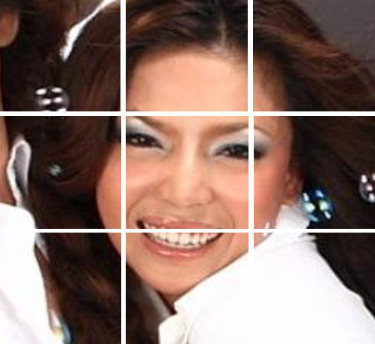
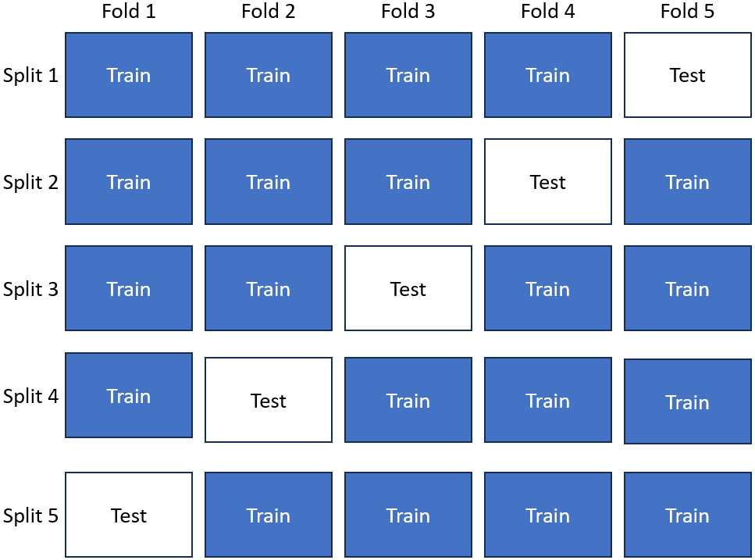
Image Input
Resize
224 × 224
Pre-processing
Feature Extraction
Concatenation
Feature Fusion
80:20
Train-Test Split
 |  | + |  |  | +
100%
Full Dataset
 |  | ---
 |  | ---
 |  | ---
80%
20%
Face Features
Emotion Features
Age Features
Training Set
Test Set
Model Training
Test Set
↓
Prediction
Testing
(on Test Set)
Performance Evaluation
20%
MinMaxScaler
(Optional)
↓
PCA
(Optional)
↓
Classifier
Hyperparameter
Tuning
(Grid Search)
Classifier Training
(with best params)
Best Classifier Model
Accuracy
Precision
Recall
F1-Score
Confusion Matrix
Stratified 5-Fold Cross-Validation

