Slide 1
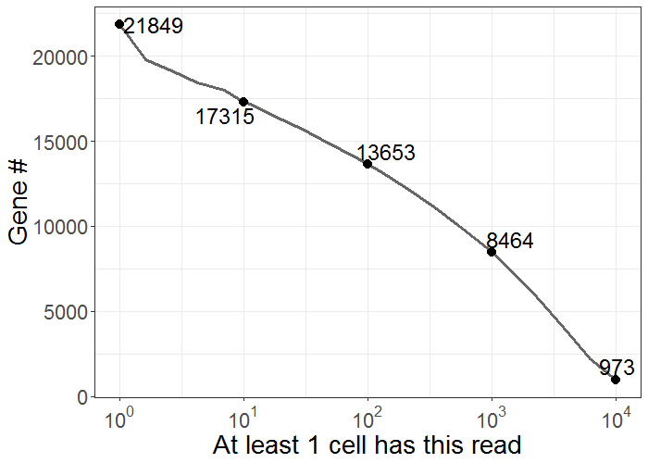
Number of genes detected in at least X% cells with at least K number of reads
Genes/cells
Number of genes detected in at least one cell
Any gene
X % cells
N genes | 5% | 25% | 50% | 75% | 95%
1 | 4862 | 2913 | 1859 | 1165 | 539
2 | 3184 | 1709 | 994 | 503 | 182
5 | 2179 | 1147 | 620 | 246 | 75
10 | 1806 | 910 | 480 | 153 | 42
20 | 1522 | 745 | 376 | 101 | 24
50 | 1160 | 560 | 274 | 65 | 11
100 | 908 | 441 | 201 | 49 | 9
500 | 489 | 210 | 76 | 19 | 2
1000 | 346 | 139 | 39 | 11 | 1
5000 | 86 | 19 | 3 | 1 | 0
10000 | 24 | 4 | 1 | 0 | 0
K reads
Number of cells that have K genes detected with at least X number of reads
Example: 25% of cells had at least 910 genes detected with at least 10 counts
Cells
Same gene
X % cells
X reads
N cells | 1 | 5 | 10 | 50 | 100
1 | 553 | 553 | 553 | 551 | 551
5 | 553 | 553 | 552 | 546 | 542
10 | 553 | 552 | 551 | 532 | 523
50 | 553 | 545 | 518 | 444 | 408
100 | 552 | 510 | 466 | 373 | 348
500 | 532 | 325 | 269 | 159 | 111
1000 | 446 | 167 | 122 | 41 | 21
5000 | 22 | 3 | 2 | 0 | 0
N genes | 5% | 25% | 50% | 75% | 95%
1 | 6578 | 1020 | 261 | 74 | 13
2 | 5488 | 683 | 168 | 46 | 9
5 | 4366 | 414 | 88 | 19 | 2
10 | 3556 | 287 | 56 | 10 | 1
20 | 2824 | 207 | 31 | 4 | 1
50 | 1918 | 148 | 19 | 2 | 0
100 | 1378 | 100 | 12 | 1 | 0
500 | 558 | 33 | 4 | 0 | 0
1000 | 349 | 15 | 3 | 0 | 0
5000 | 43 | 3 | 1 | 0 | 0
10000 | 12 | 1 | 0 | 0 | 0
K genes
K reads
Example: 545 cells had at least 50 genes detected with at least 100 counts
Example: 287 specific genes were detected with at least 10 counts in 25% of cells

