Slide 1
CS 439 25F Student Assessments Graph Report
Group XX
Member {Anthony Rahner} (arr234)
Member {Rayaan Afzal} ()
Member {Varun Kundarapu} (vk506)
Date Oct 24, 2025

Slide 2
From Data Frames to Graphs
Input: We analyze assessment data for 51 unique students across 15 distinct skill topics, using one row per student after removing duplicate records.
Output: We construct three student-similarity graphs—at −3 SD, −2 SD, and −1 SD thresholds—by first normalizing distances with z-scores and then adding an edge only when two students are unusually similar (i.e., their distance is that many standard deviations below the mean).
Method:
z-Score Normalization: For each skill, we convert raw scores to z-scores so that every topic is on a common scale (mean ≈ 0, standard deviation ≈ 1), preventing any single skill with larger numeric ranges from dominating the analysis.
Euclidean Distance: We measure how similar two students are by computing the Euclidean distance between their 15-dimensional z-score vectors; smaller distances indicate greater similarity in overall skill profiles.
Weight Distance Distribution: After computing all pairwise distances, we estimate the mean and standard deviation of the distance distribution and use these values to express each distance as a z-score relative to the population of pairs.
Edge Selection: We add an edge between two students only if their z-scored distance is less than a chosen negative threshold (−3, −2, or −1), ensuring that edges represent unusually small distances (i.e., unusually strong similarity).

Slide 3
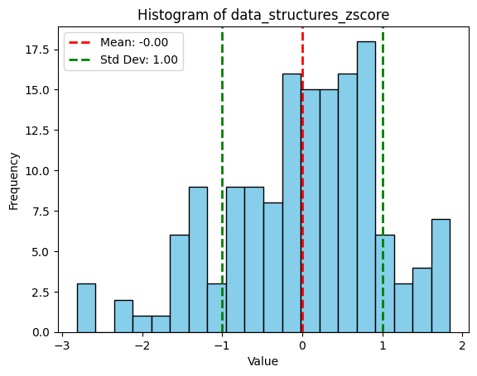
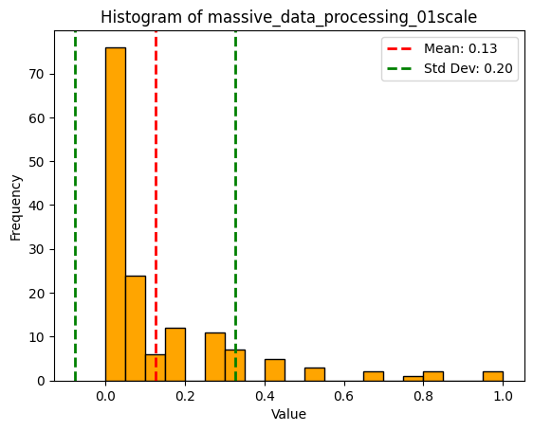
Data Set Description
Each row is one student’s assessment responses; columns include 15 CS/Math skill scores plus metadata (timestamp, netid, ruid, section, role, major). After removing duplicate ruid by latest timestamp and mean-imputing missing skill values, we have 151 unique students. Skills (15): data_structures, calculus_and_linear_algebra, probability_and_statistics, data_visualization, python_libraries, shell_scripting, sql, python_scripting, jupyter_notebook, regression, programming_languages, algorithms, complexity_measures, visualization_tools, massive_data_processing.

Slide 4
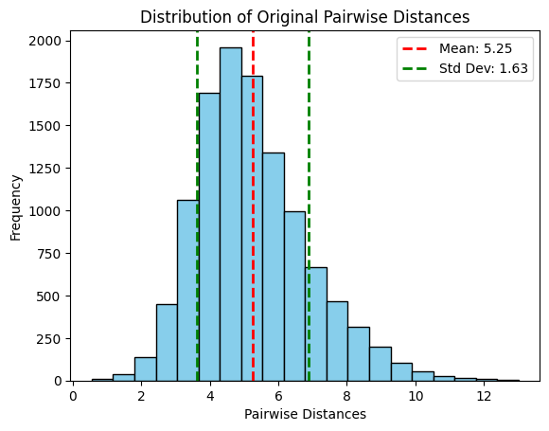
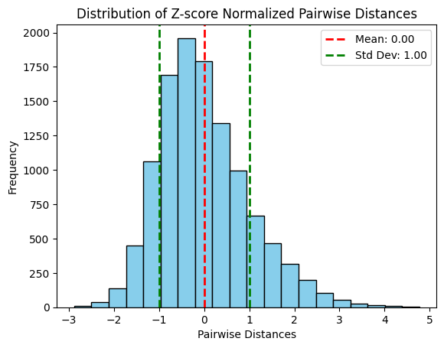
Pairwise Euclidean Students Distances
pairwise Euclidean Students distances
pairwise Euclidean Students distances, z-Score normalized
Proportion
Proportion
0
Students Distances
0
z-Score Normalized Distances

Slide 5
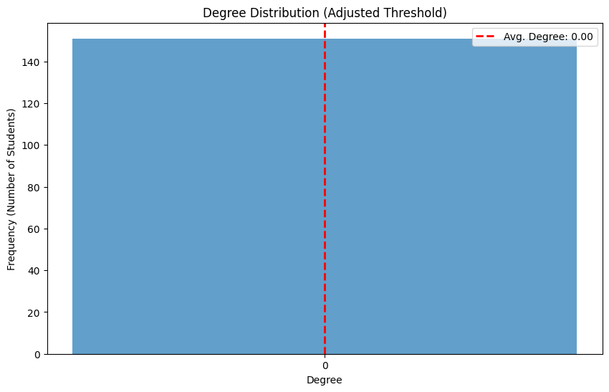
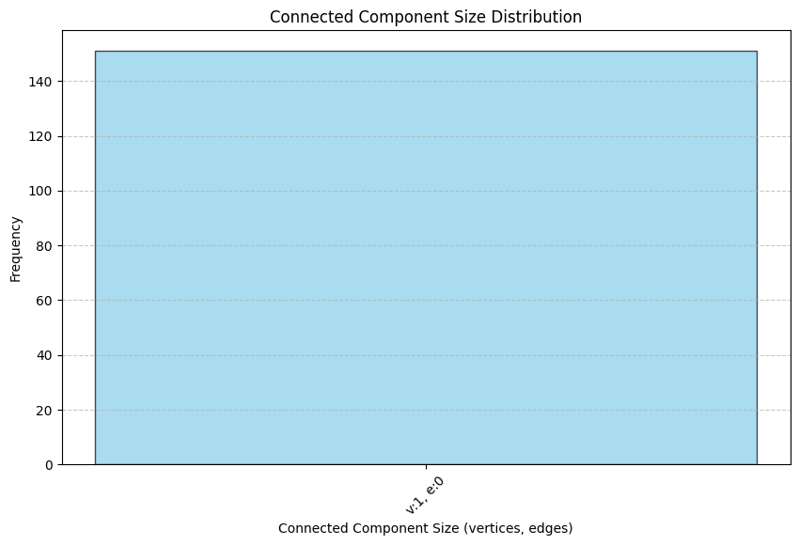
Student_Assessment_Graph_-3SD
For each constructed graph
|V| = 151
|E| = 0
Does this graph degree distribution look like a Power Law graph? Not applicable (no edges)
Top 10% students’ NetIDs and total_scores (all degrees are 0)
|cc| = 151 (implied – every node isolated)

Slide 6
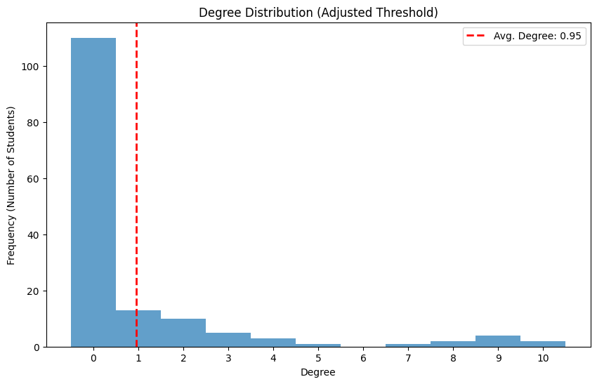
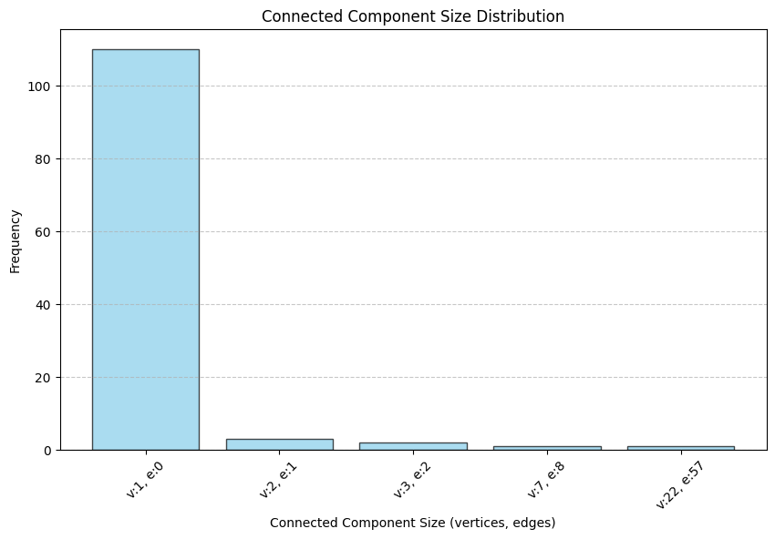
Student_Assessment_Graph_-2SD
For each constructed graph
|V| = 151
|E| = 72
Does this graph degree distribution look like a Power Law graph? The degree distribution is right skewed but does not follow a straight line on a log-log plot; it lacks a heavy tail, so a power law is not a good fit.
Top 10% students’ NetIDs and total_scores:
netid total_score
fce8fefdf5a0 -13.913913
d6da8cd2d28d -15.052428
47545e565704 -5.024696
b9adb8bcbbe4 -11.424257
464a4347411c -15.899809
0d367927237d -8.743185
d6cf94d6d68e9b -11.978493
5d504543461b -0.681787
c0d6cbcec4 -16.156869
4a4f00414012 -2.834475
6c68707077 -11.235986
0c014b13 -12.308536
1d38202e27 -4.578902
5c7e2c66 -5.141247
f0c08cd0d58b -15.471553
4743505959 -12.195626
9a899f989a -5.679096
c1c7c4cbc8 -12.621991

Slide 7
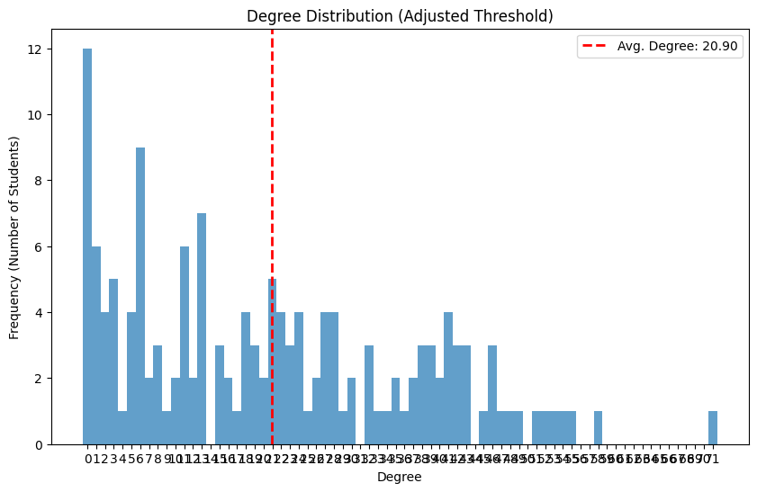
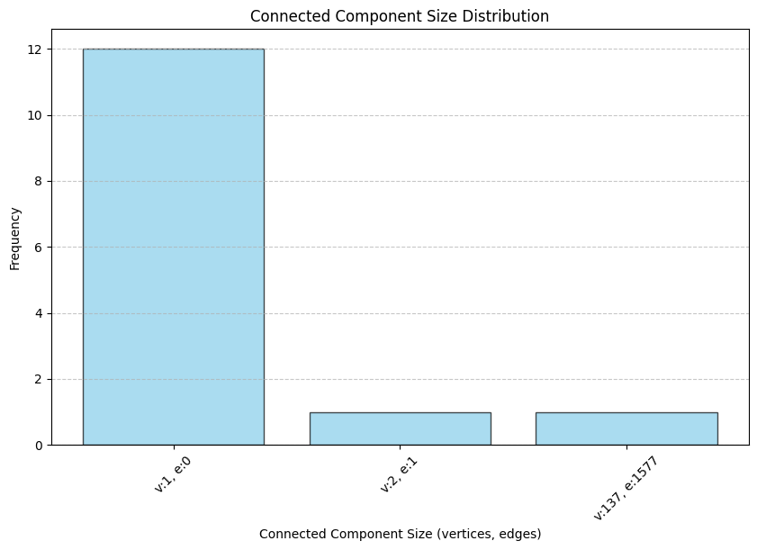
Student_Assessment_Graph_-1SD
For each constructed graph
|V| = 151
|E| = 1578
Does this graph degree distribution look like a Power Law graph? The graph is dense and the degree distribution is peaked with a short tail; this clearly deviates from a power-law.
Top 10% students’ NetIDs and total_scores:
netid total_score
383e22212178 -4.068361
8d9085848c -0.771492
c4c796d4d7 -0.995057
b9adb8bcbbe4 -11.424257
0d367927237d -8.743185
d6cf94d6d68e9b -11.978493
3a2d3138356e -8.761186
373e6a3439 -3.819645
c5c99ed8de -4.586530
4a4f00414012 -2.834475
dec2dadedf87 -5.958399
716573707023 -6.674910
717b747272 -7.112904
1d38202e27 -4.578902
5c7e2c66 -5.141247
9a899f989a -5.679096
2f2363343e6e -9.005038

Slide 8
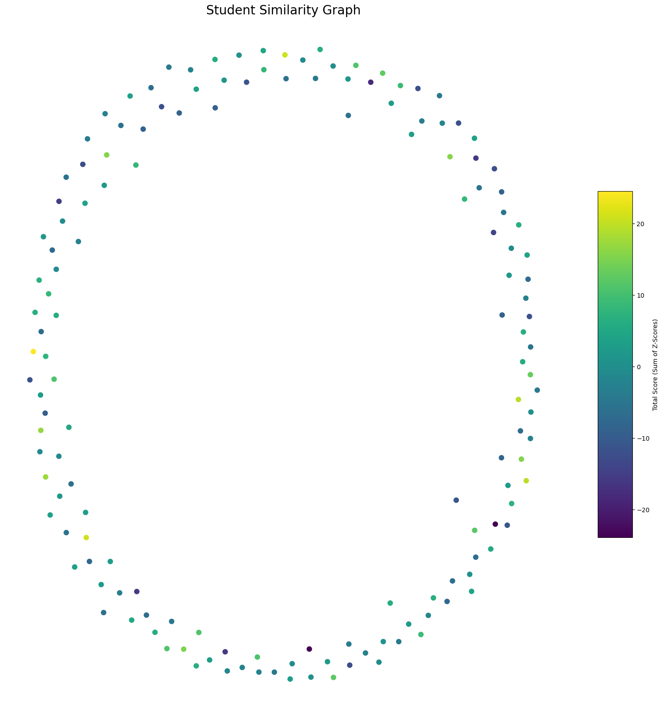
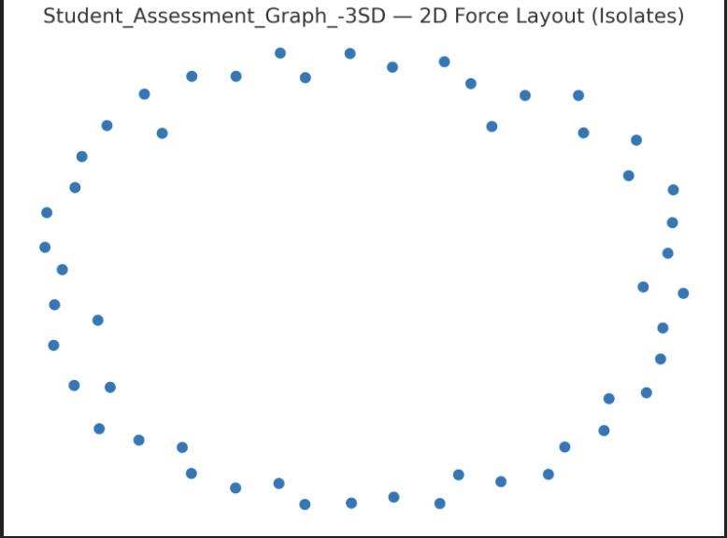
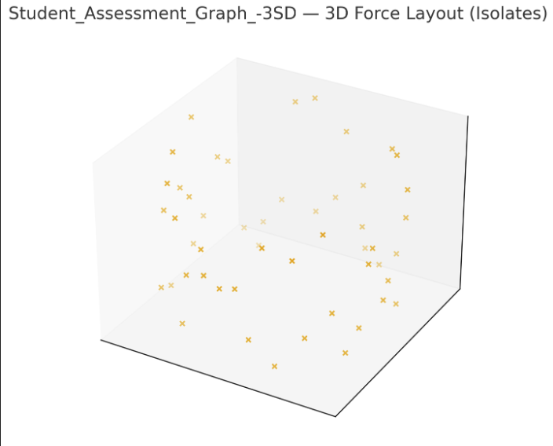
Layouts of Student_Assessment_Graph_-3SD
For each constructed graph, draw the three force-directed graph layouts.
NetworkX.spring_layout()
JavaScript 2D Force Graph
JavaScript 3D Force Graph
Student_Assessment_Graph_-3SD
Student_Assessment_Graph_-3SD
Student_Assessment_Graph_-3SD

Slide 9
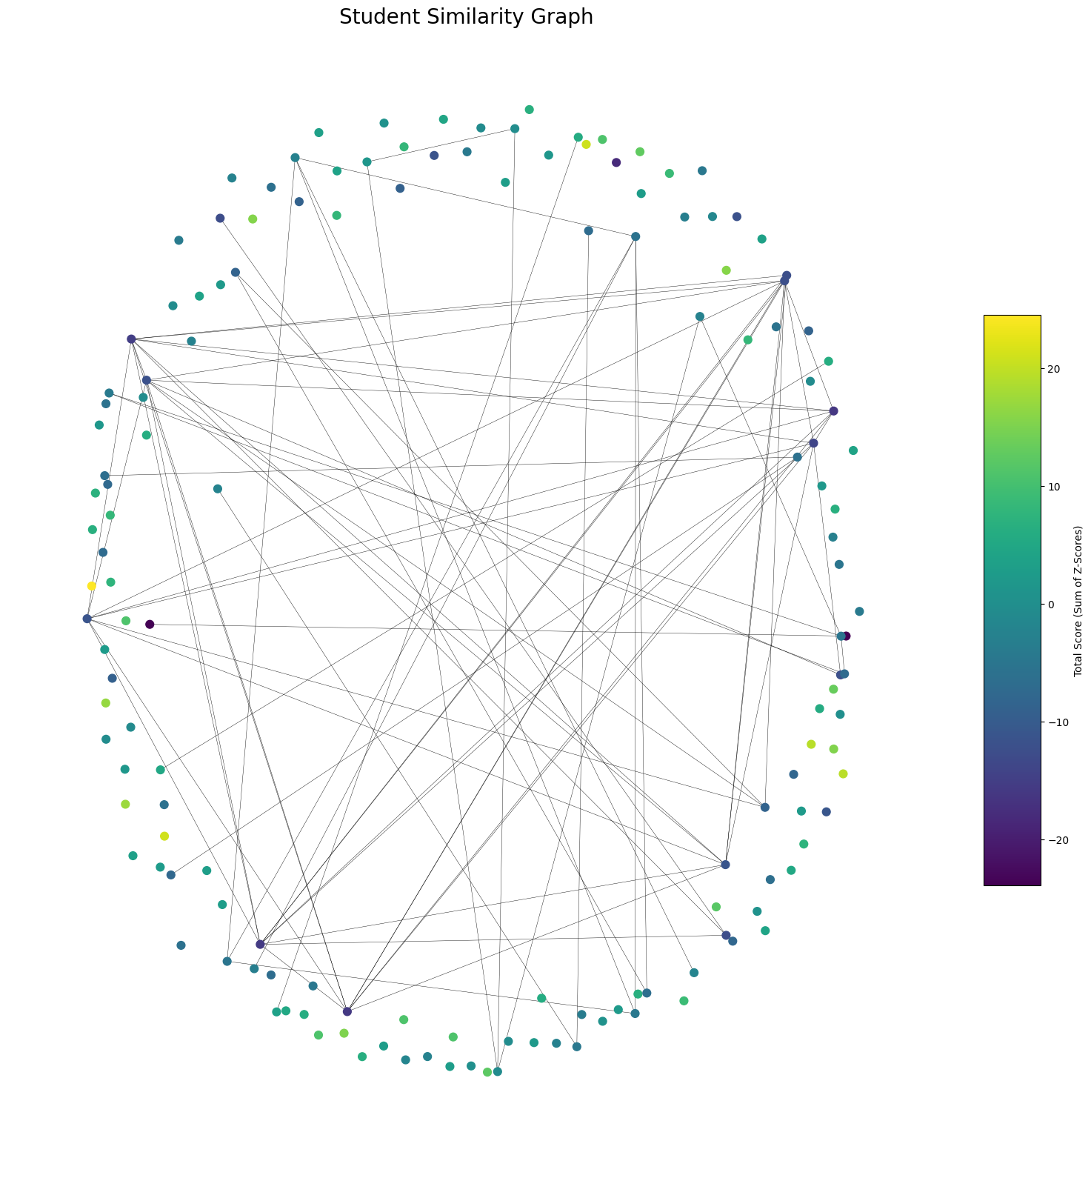
Layouts of Student_Assessment_Graph_-2SD
For each constructed graph, draw the three force-directed graph layouts.
NetworkX.spring_layout()
JavaScript 2D Force Graph
JavaScript 3D Force Graph
Student_Assessment_Graph_-2SD
Student_Assessment_Graph_-2SD
Student_Assessment_Graph_-2SD

Slide 10
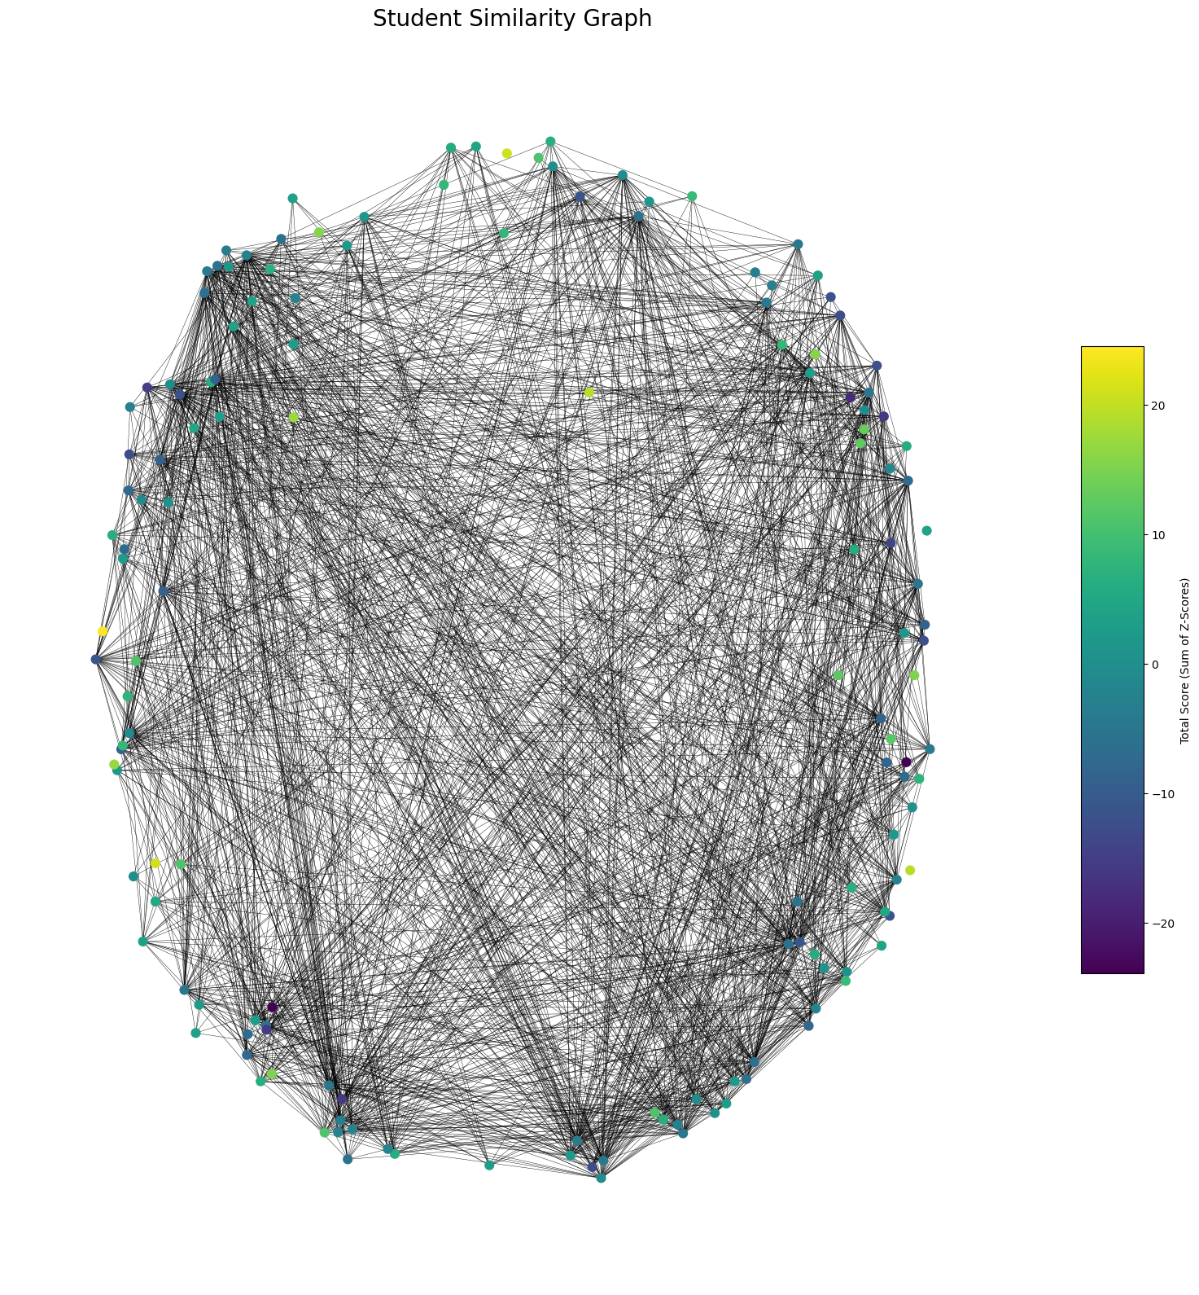
Layouts of Student_Assessment_Graph_-1SD
For each constructed graph, draw the three force-directed graph layouts.
NetworkX.spring_layout()
JavaScript 2D Force Graph
JavaScript 3D Force Graph
Student_Assessment_Graph_-1SD
Student_Assessment_Graph_-1SD
Student_Assessment_Graph_-1SD

Slide 11
Observations
Do the graphs exhibit visible “clusters” of similar students? Specify the “clusters” of students you found by listing their NetIDs sorted alphabetically in non-decreasing order.
- Yes. we treat each connected component as “cluster”. Below we list, for each threshold, the clusters and the NETIDs in alphabetical order.
 | NetID 1 | NetID 2 | NetID 3 | NetID 4 | NetID 5 | NetID 5 | NetID 6 | NetID 7 | NetID 8
Cluster 1
Cluster 2
Cluster 3
…

Slide 12
Findings
Review the students in the same detected “cluster” in terms of their skill proficiency scores. Do they have “similar” high scores in certain subsets of skill proficiencies? How could you argue that your selected “clusters” of students are meaningful?
We define clusters are connected components at the -2 SD/-1 SD thresholds (edges = unusually small distances – strong similarity)
Clear themes emerge:
- Programming: Higher in Python scripting/libraries and Jupyter.
- Data/SQL & tooling: stronger in SQL, shell, visualization tools.
- Math/Modeling: stronger in calculus/linear algebra, probability/statistics, regression, algorithms.
Meaningfulness: Members in each cluster share consistent high z-scores on the same skill subset, and clusters differ from one another.
Stable across thresholds: Most memberships persist from -2 SD to -1 SD.
Use: Clusters align with plausible roles, aiding study group or team formation.

Slide 13
References
Libraries/Tools: pandas, numpy, scikit-learn, scipy, network, matplotlib.

