Slide 1
The Effect of Solar Flares on the VLF Radio Waves transmitted in the Ionosphere
A basic understanding
-Sharad Khanal

Slide 2
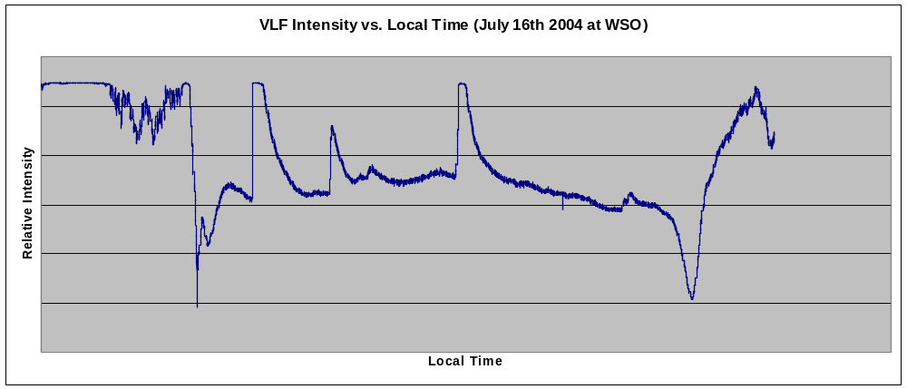
SIDs and SID Monitor Program
Sudden Ionospheric Disturbance (SID)
  Sudden increase in ion density in the ionosphere due to solar flares
Graph: A typical SID data plot

Slide 3
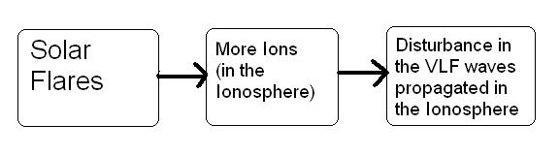
SIDs and SID Monitor Program
Monitor SIDs by monitoring VLF waves transmitted through the ionosphere
BASIC IDEA
  Monitoring the VLF waves means monitoring the ion disturbances in the ionosphere
However, the disturbances could be caused by other phenomena such as gamma ray bursts as well.

Slide 4
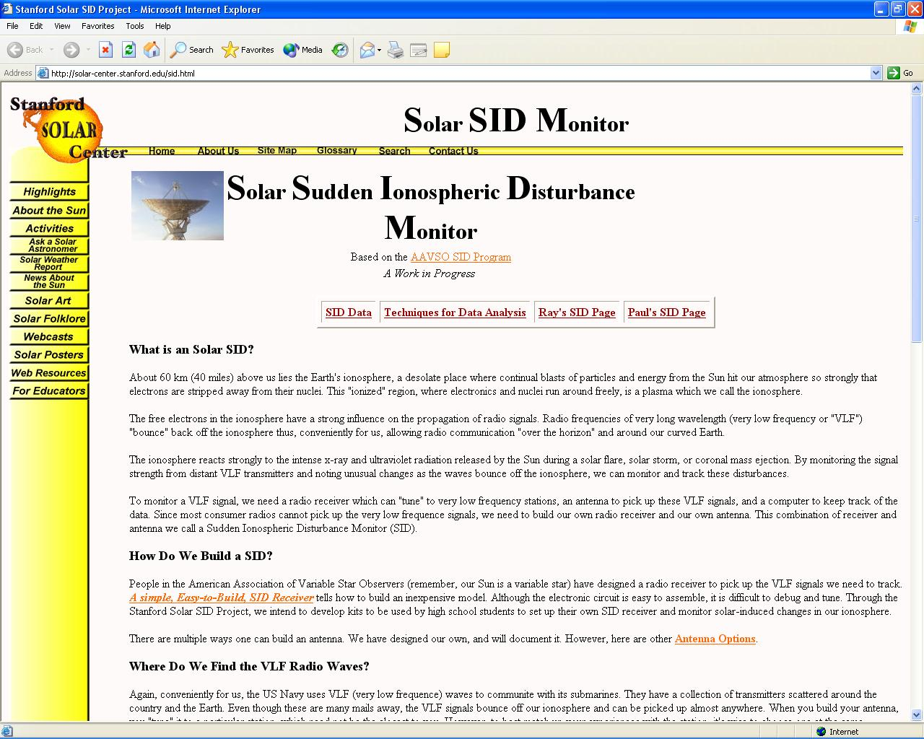
The SID detector and all that
All the details on the webpage
www.solar-center.stanford.edu/sun/sid.html

Slide 5
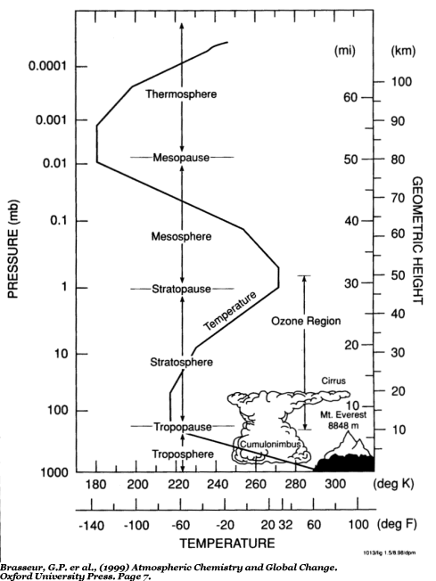
The Ionosphere
Layers of atmosphere
  Troposphere (8-15 kms)
  Stratosphere (-50 kms)
  Mesosphere (-85 kms)
  Thermosphere (-600 kms)
  Ionosphere (70 kms - )

Slide 6
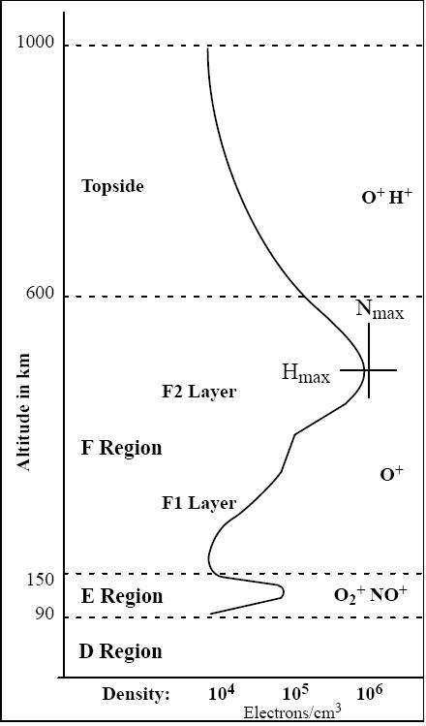
Ionosphere – Regions
Different Regions of the Ionosphere
  D (70 - 90 kms, ionized by X-rays 0.1-1 nm)
  E (100 - 120 kms, ionized by EUV 80-103 nm and X-rays 1-20 nm )
  F (forms F1 and F2 layers during the day) (ionized by EUV 20-80 nm)
http://www.sel.noaa.gov/info/Iono.pdf

Slide 7
Ionosphere – D Layer Properties
70-90 kms (Parts of Stratosphere, Mesosphere and Thermosphere)
Temperature – about 190 K
Ionization Properties –
  Usually about 1000 electron/cm³
  Ions present – O⁺, N₂⁺, O₂⁺, NO⁺

Slide 8
Ionosphere – D Layer Properties
Photo-Chemical Reactions
  Photo Ionization
    O + hv → O ⁺ + e⁻ hv = 13.6 eV
    N₂ + hv → N₂⁺ + e⁻ hv = 15.6 eV
    O₂ + hv → O₂⁺ + e⁻ hv = 12.1 eV
  Molecular Ionization
    O⁺ + O₂ → O₂⁺ + O
    O⁺ + N₂ → NO⁺ + N
    N₂⁺ + O → NO⁺ + N
  Recombination
    NO⁺ + e⁻ → N + O
    O₂⁺ + e⁻ → O + O
    N₂⁺ + e⁻ → N + N
Present during the day – however, very low ionization 1000 e⁻/m³ compared to 100,000 e⁻/m³ in E layer and 1,000,000 e⁻/m³ in the F layers.

Slide 9
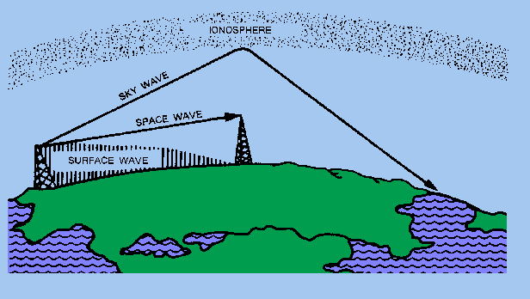
Transmission of VLF through the Ionosphere
Radio waves reflected by the Ionosphere – acts like a mirror (because ions present in the Ionosphere)
http://www.tpub.com/neets/book10/40c.htm

Slide 10
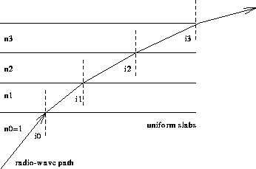
Transmission of VLF through the Ionosphere
The waves are refracted by the differently ionized layers in the ionosphere – the combination of this refractive effects results in the reflection of the radio waves
http://www.ferzkopp.net/~aschiffler/Personal/Thesis/node8.html

Slide 11
The Plasma Frequency
or the Maximum Useable Frequency (MUF) is the largest frequency that can be reflected by the ionosphere at vertical incidence
f_{N} = 9√N_{m} where,
  f_{N} = MUF
  N_{m} = Ion Density
Ultimately depends on the ion density in the ionosphere

Slide 12
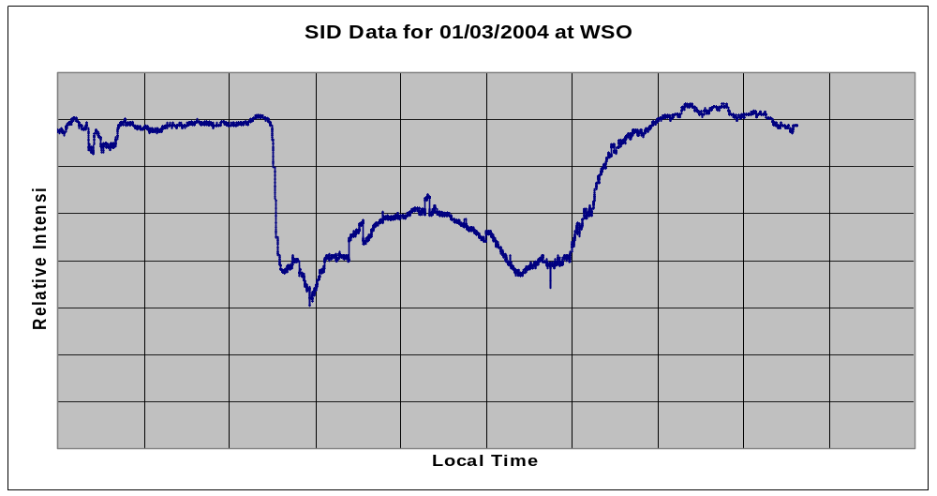
Transmission of VLF through the Ionosphere – regular day
When VLF transmitted, D layer is unable to reflect the wave as the ion density is not enough
So penetrates the D-layer, and reflects off the E and F layers
Loses energy while penetrating the D-layer
Graph: A typical SID data plot

Slide 13
Transmission of VLF through the Ionosphere – regular night
At night, the D-layer disappears and only the F layer and sporadic E-layers are present
The signal strength increases as the wave no longer has to go through the D-layer
Graph: A typical SID data plot

Slide 14
Transmission of VLF through the Ionosphere – during a SID
During a SID, a highly ionized D-layer forms in the Ionosphere
The ionization is now enough to reflect the VLF
Moreover, the wave does not have to lose its energy going through an extra ionized layer

Slide 15
Why –ve intensity?
Maybe due to the interference pattern?

Slide 16
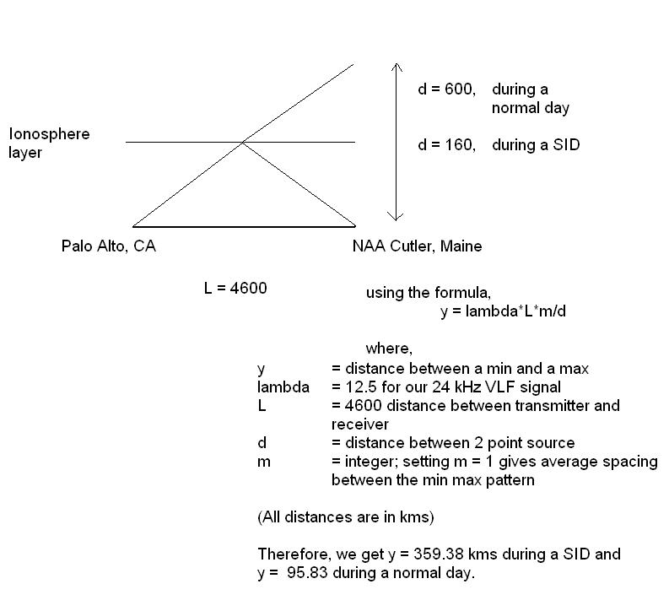
Why –ve intensity?

Slide 17
Why –ve intensity?
Therefore, a simple interference pattern does not explain the inversed signals recorded
Possible causes?
  Signal Detector Design
  Phase changes upon reflection in the Ionosphere

