Slide 1
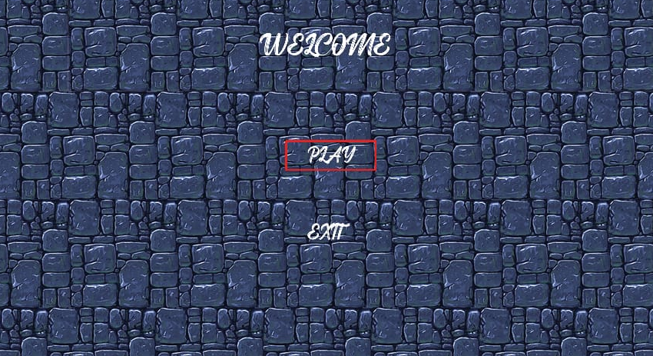
ESCAPE Hatch
Hit up and run !

Slide 2
ESCAPE Hatch
How to play and Rules ??

Slide 3
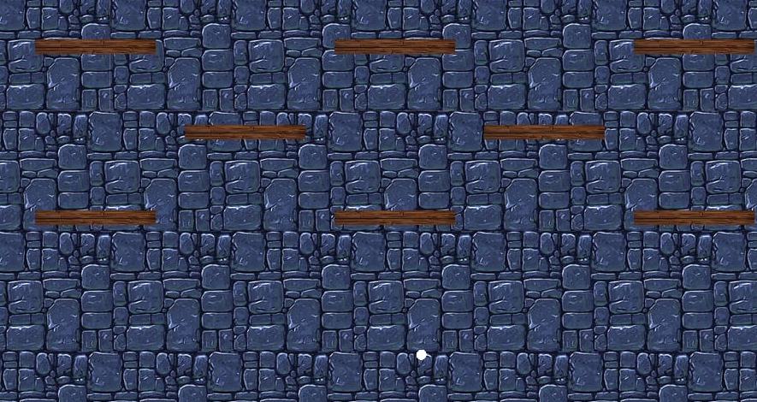
OUR COMPANY
A start-up game development company.

Slide 4
OUR EVOLUTION
29/10/22
30/10/22
2/11/22
4/11/22
We don't know about SFML
We Know somewhat the basics of SFML
We were able to learn some plugins for SFML
We managed to make our first full game for our company

Slide 5
WHAT SETS US APART?
Team work
strong competition
Insisting

Slide 6
—SOMEONE FAMOUS
“The world as we have created it is a process of our thinking. It cannot be changed without changing our thinking.
.”

Slide 7
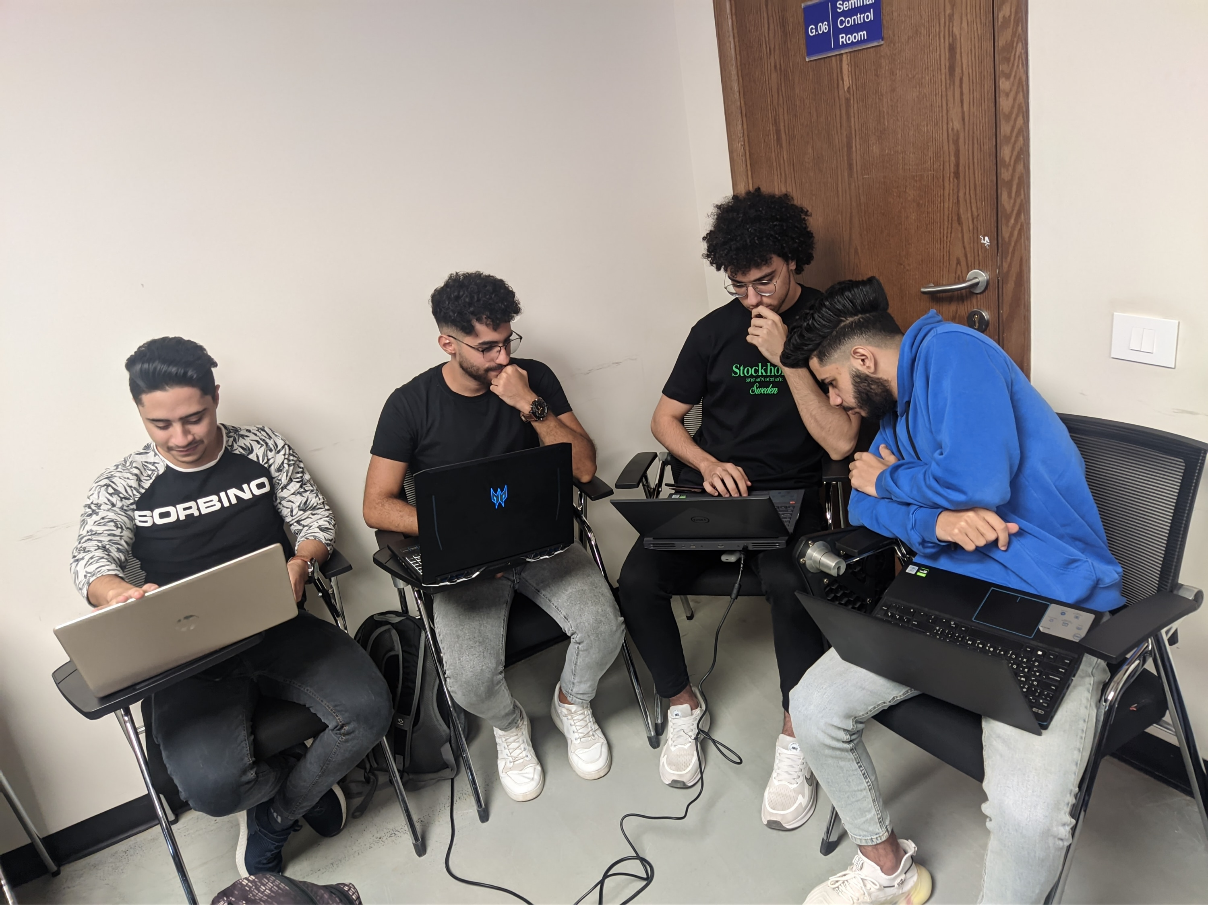
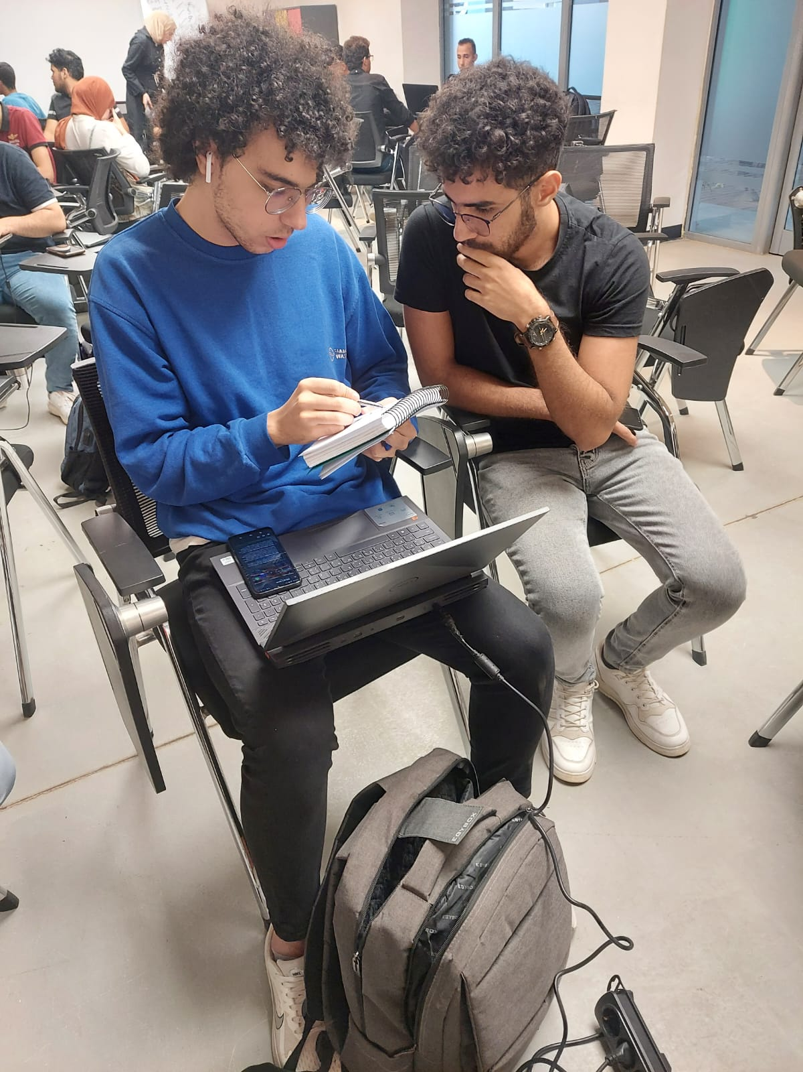
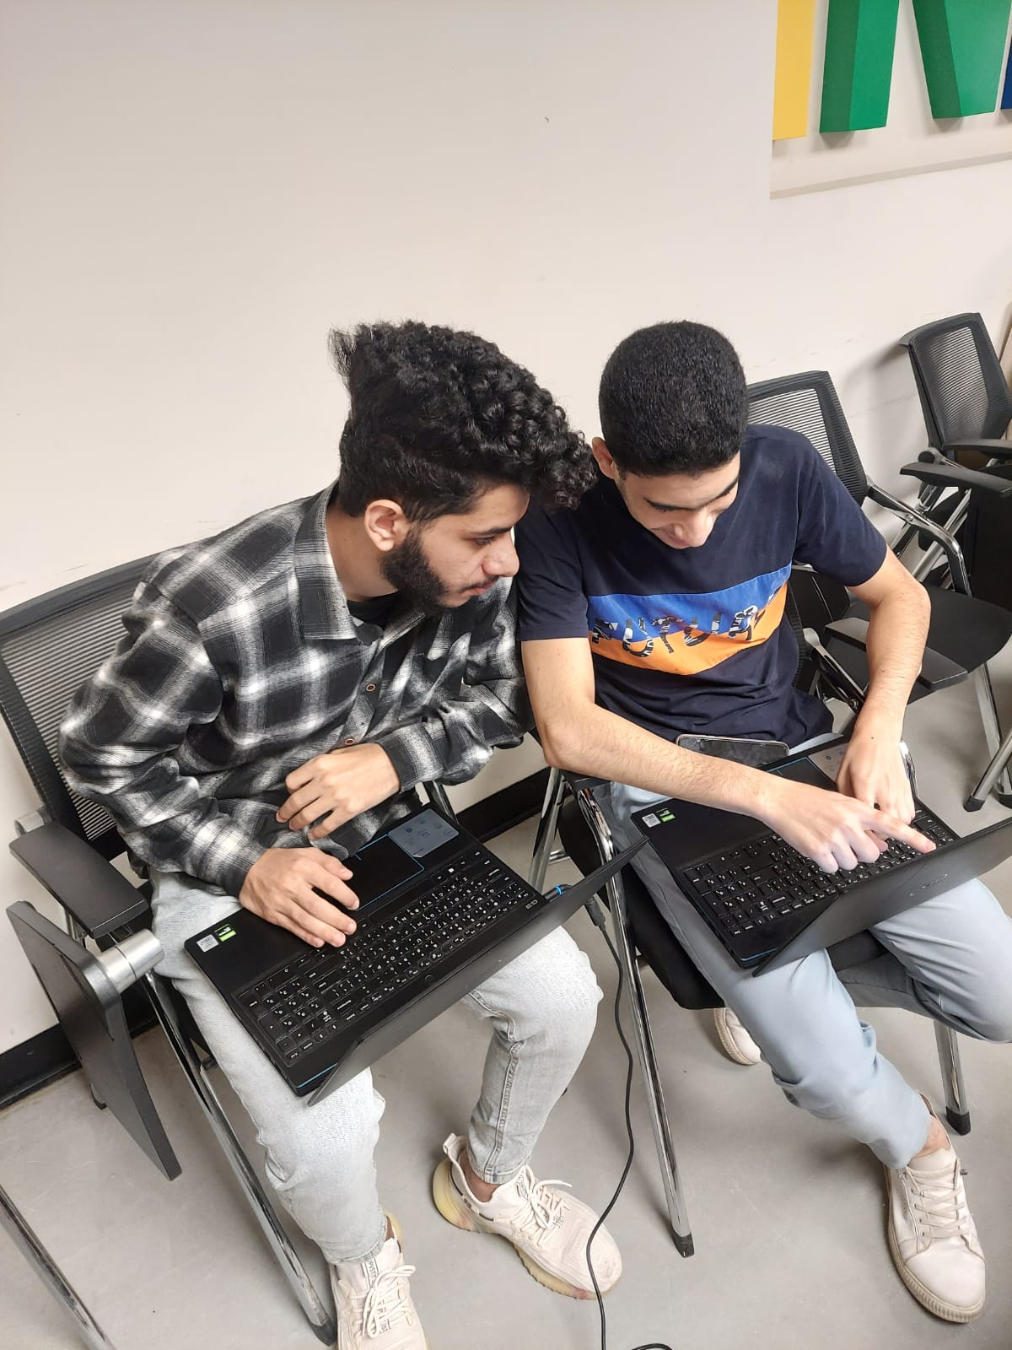
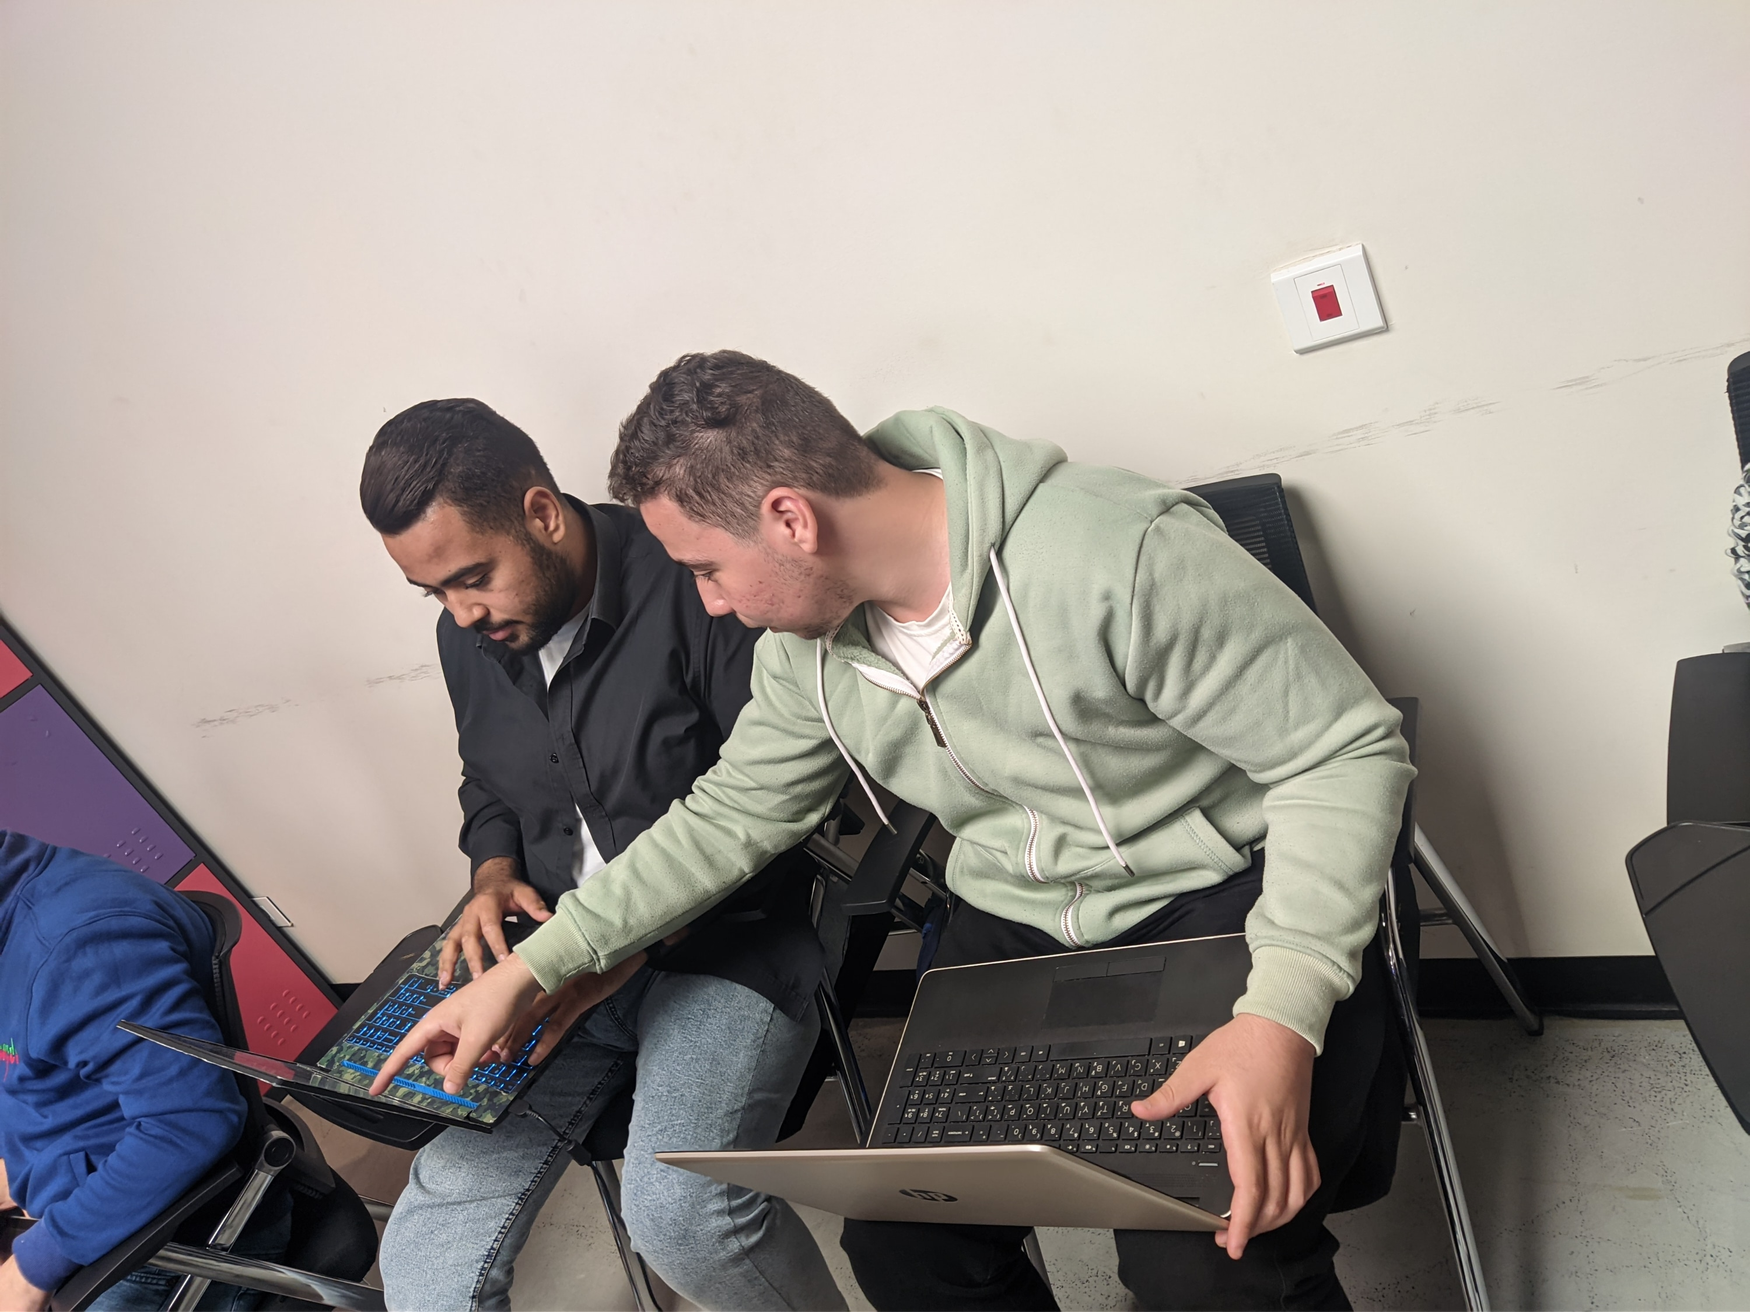
Team vibes

Slide 8
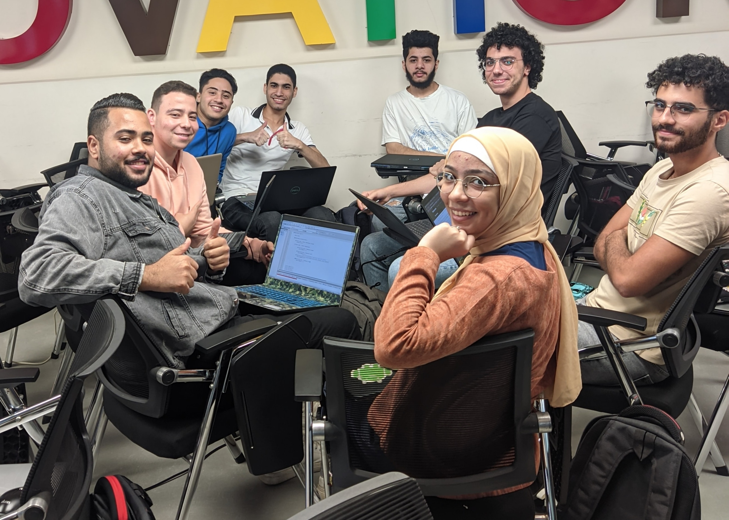
A PICTURE ALWAYS REINFORCES THE CONCEPT
Dead Nine

Slide 9
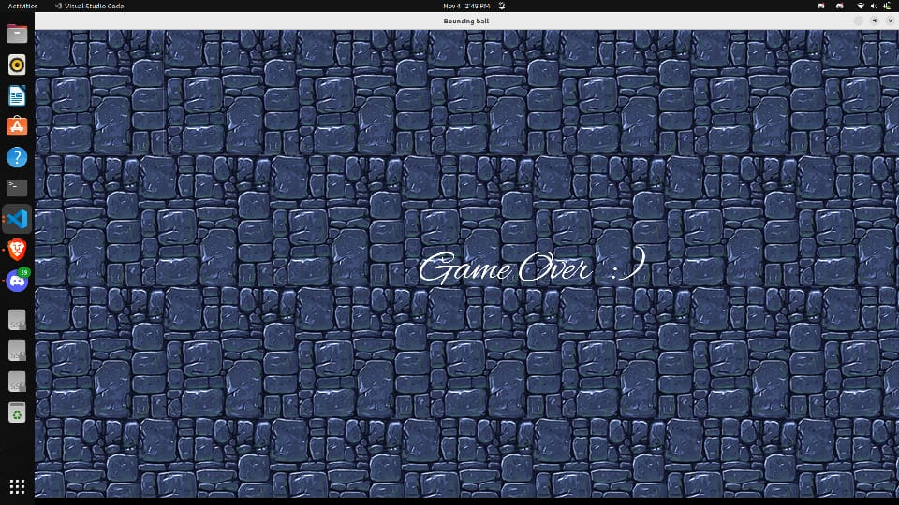
THANKS!
Dead Nine
always in deadline !

