Slide 1
Space invaders
An Unfaithful Recreation

Slide 2
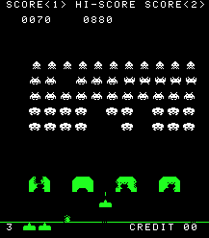
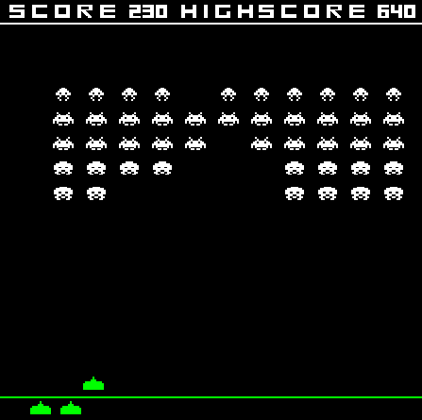
Why space invaders using opengl
Original
Video games are a significant part of my life.
My Version

Slide 3



Why space invaders using opengl
Finding a balance between challenge and comfort.

Slide 4
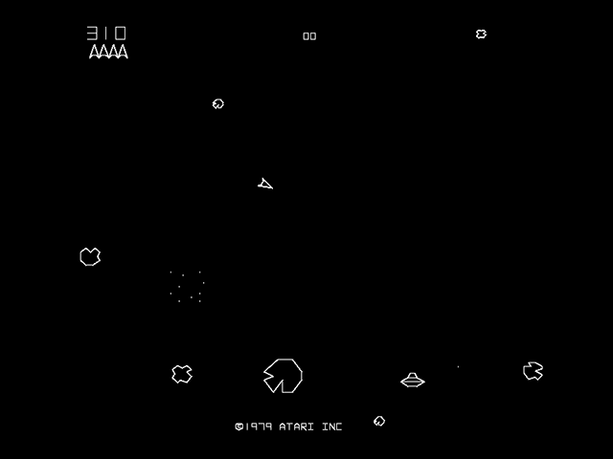
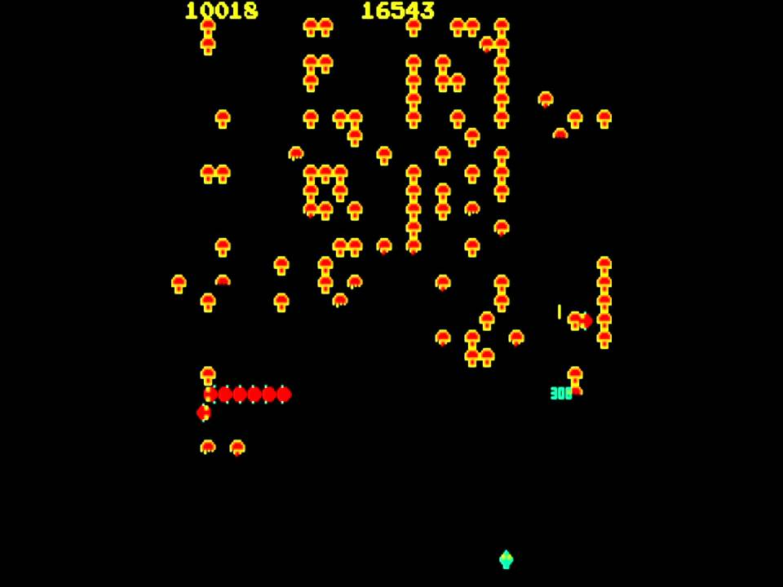
Why space invaders using opengl
Taking a step back.

Slide 5
Technique
Using Project 2 and 3 as a Base
Bitmaps
Sending Information to Buffer
Fragment Shader and Vertex Shader
Animation
Collision Detection

