Slide 1
Twitter Sentiment Analysis
Raghul Somineni Raghupathy
RSR379
N11371498

Slide 2
Objectives
Setting up the environment for the data storage and process.
Extraction of live twitter feed by establishing a connection with Twitter’s API.
Storage and processing of data on Hadoop. (filtering and restructuring)
Creation of tables on Hadoop to hold the twitter and also to provide an interface for simple querying for the users.
Sentiment Analysis based on a keyword.
Visualization of the sentiment analysis.
Usage of Hadoop concepts.

Slide 3
Technologies Used
HortonWorks Hadoop on VM workstation player.
PuTTY – For remotely accessing the guest system from windows.
FileZilla (FTP Software) – For secure transfer of files across systems.
Flume – Available apache service for efficiently collecting, aggregating, moving large amounts of data.
Hadoop - Open-Source software framework for storing data and running applications on clusters of commodity hardware. It provides massive storage.
Hadoop Distributed File System (HDFS) – Distributed file system that provides high-performance access to data across Hadoop clusters.
Hive – Data warehouse software project built on top of Hadoop for providing data summarization, query, and analysis.
MapReduce – Programming model and an associated implementation for processing and generating big data sets with a parallel, distributed algorithm on a cluster.

Slide 4
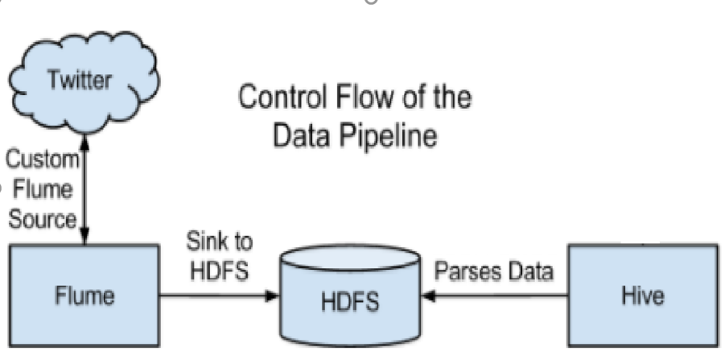
Data Flow

Slide 5
IMPLEMENTATION
Step 1: Creating the twitter application at www.dev.twitter.com.
After the creation of the app, we get access to four pieces of key information:
API Key
API Secret
Access Token
Access Token Secret
These values are needed to connect flume agent to Twitter’s API for data access.

Slide 6
IMPLEMENTATION
Step 2: Installing and Configuring Flume
Initially tried to configure flume in a normal installation of ubuntu on VM Player. This required installation of all the necessary packages needed to run flume. This has been explained in detail in section 3.2 of the report.
With the installation of HortonWorks platform on VM Player. Installation of Flume was easy. Also, it came with all the packages that were necessary for twitter analysis.
Now to set up the flume agent. The flume.conf file which was included in the installation needed to be edited to include Twitter Application’s Access token.
The screenshot of the same is shown in next slide.

Slide 7
IMPLEMENTATION
The ConsumerKey, consumerSecret, accessToken and accessTokenSecret have to be replaced with those obtained in step 1.
This authenticates the flume agent to access the twitter API and extract depending on the keyword provided in the said file.
TwitterAgent.sinks.HDFS.hdfs.path is the one that points to the NameNode and is the location in HDFS where the tweets will go.
The next slide is got the screenshot with highlighted regions were changes were made.

Slide 8
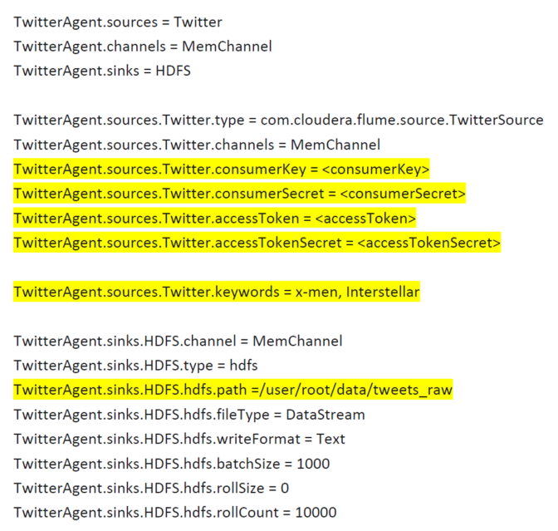
IMPLEMENTATION
Configuration of Flume.

Slide 9
IMPLEMENTATION
Step 3: Twitter Data Extraction using Flume
First I would like to mention that I used two reference files for the sake of analysis:
Dictionary file has all the positive, negative and neutral words.
Time_zone_map has mapping with time zones to countries. This will help us identify the country from a tweet.
Before running the flume agent use the Hadoop mkdir command to create the necessary directories to hold the twitter data.
The flume agent is started by running the command:

Slide 10
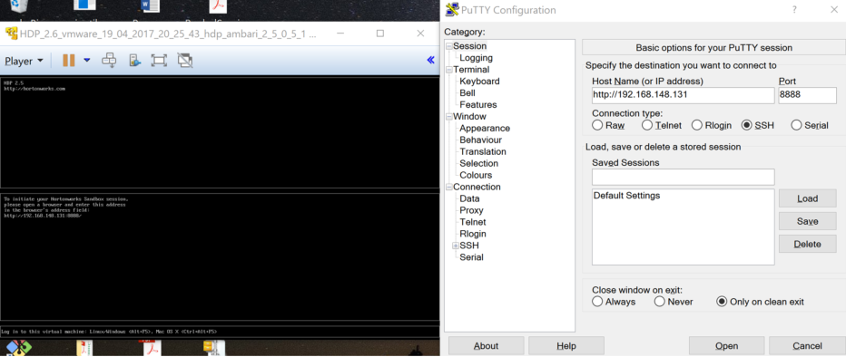
IMPLEMENTATION
Step 4: Running Hive Scripts.
In order to run Hive Scripts, we have to configure the PuTTY on windows host system to point to the CentOS on VM player. This can be done easily by just mentioning the IP Address and Port Number on the PuTTY configuration pop-up.

Slide 11
IMPLEMENTATION
All the necessary scripts have been loaded onto a file tweets.sql.
With the PuTTY connection active, we can see the root prompt of the guest OS.
The Scripts can be run with the command: hive –f tweets.sql.
The scripts run with the following objectives:
Create table for the incoming data (Data Definition scripts)
Conversion of raw twitter data into tabular format. (includes cleaning up the data)
Use the dictionary to compute the sentiment of each tweet by analyzing the number of positive, negative and neutral words in a tweet. Based on this number, the sentiment of the tweet is decided.
Creation of a new table that includes the sentiment for each tweet.

Slide 12
IMPLEMENTATION
Step 5: Installing Hortonworks ODBC connectors.
This is to basically get the processed data to the windows host system for further visualization. This is basically done by selecting ODBC source on windows as HortonWorks. Explained in-detail on the report.
Step6: Visualization of Data on Excel
In order to set the data source as Hortonworks platform, I had to set the data source as the same. The option for this would be found under Data tab of the Excel.

Slide 13
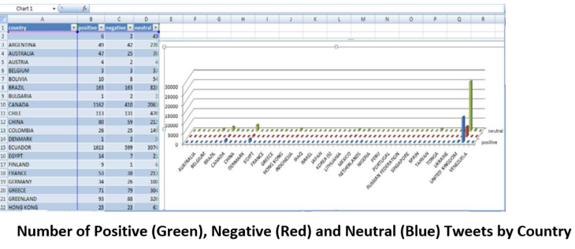
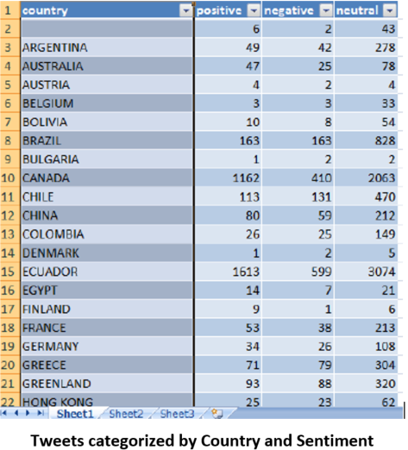
Visualization Results

Slide 14
ISSUES
The major issue was the environment set-up which includes setting Hadoop, flume etc.
Initially I had not used Hortonworks with its CentOS bundled Hadoop system, but had manually set up flume, Hadoop, java and other required packages. This worked for a while, I could retrieve the data and was working on processing it when my system gave up on me. I had to uninstall the whole VM Player and had to set up the whole thing again. Only this time it never worked.
After that, I tried to change the tech being used. So, I considered and tried using HDInsight, which is a cloud distribution on Microsoft Azure. Even this failed me. I couldn’t set up the environment properly.
I also tried using spark and MLib, but I couldn’t go through with it as I wanted to finish the one I put down on proposal first.
For the short time that it did work, one of the major issues was cleaning up the raw twitter data for further analysis.

Slide 15
THANK YOU.!

