Slide 1

Eco-Loop
Building Agents
A live autonomous closed loop: an open-source LLM reads a running EnergyPlus building,
reasons over comfort · energy · carbon through MCP, and steers it in real time.
Theme: Clean & Green Tech / Smart Automation
PS Category: Software
Student: Sujal Sakhare
PS ID: [ enter ]
Student ID: [ enter ]

Slide 2




01
The Idea
THE PROBLEM
Buildings are ~40% of global energy use, yet Building Management Systems run rigid fixed schedules — blind to live weather, occupancy and grid carbon.
WHY IT'S NOVEL
Local LLM in the loop No cloud, no API cost — runs fully offline.
Self-correcting Prior-hour comfort violations + .err tail feed the next prompt.
THE SOLUTION
A local open-source LLM (qwen2.5:7b) becomes the building's energy manager. Every simulated hour it reads live EnergyPlus sensors over an MCP tool bus and injects next-hour set-points into the running simulation.
sense → summarise → decide → validate + clamp → actuate
Provably crash-free Every call has a timeout + clamped rule fallback.
Carbon-aware Relaxes cooling when grid gCO₂/kWh is high.
Two-clock design Fast sim & slow LLM decoupled by shared state.
−8.4%
energy vs baseline
−8.5%
carbon vs baseline
0
comfort violations
0.45→0.26
mean |PMV| (improved)

Slide 3

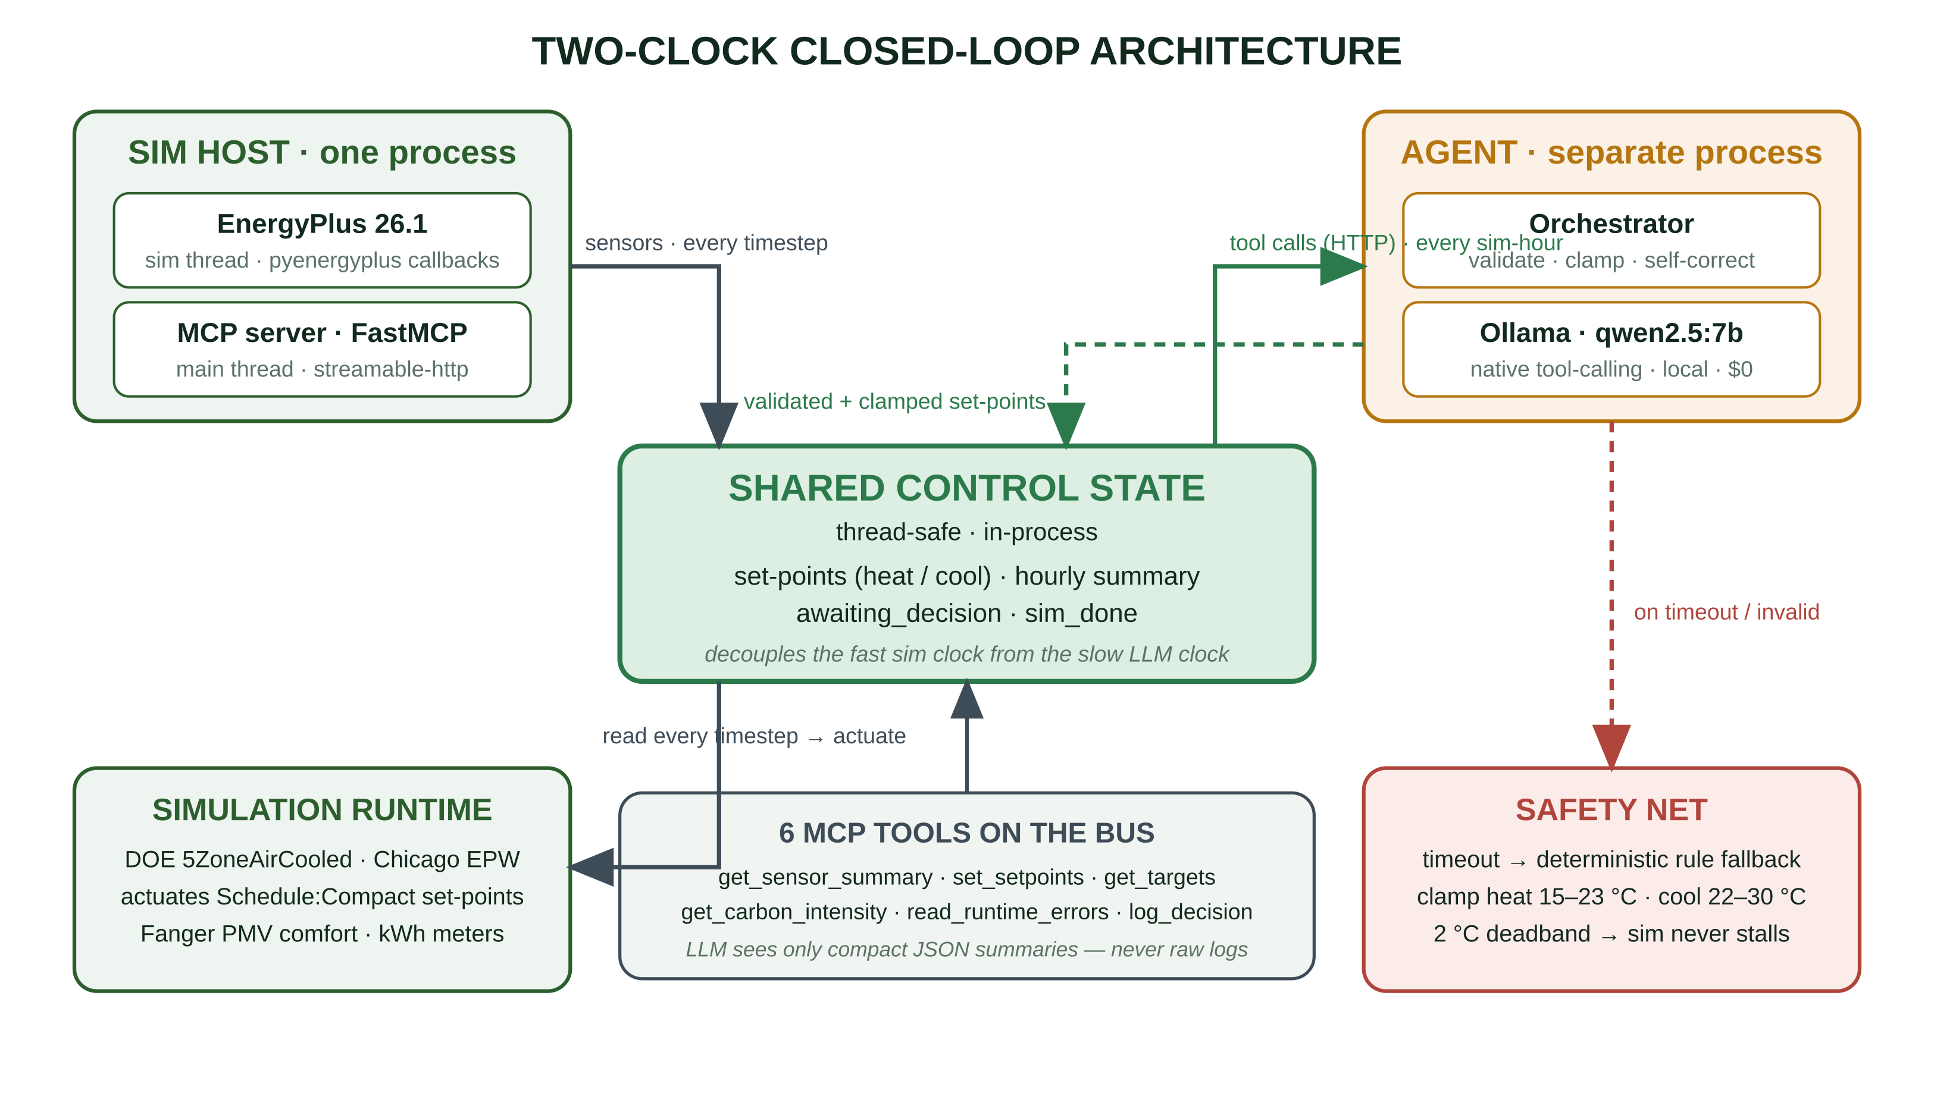
02
Technical Approach
TECHNOLOGY STACK
Simulation
EnergyPlus 26.1 · pyenergyplus API · eppy builds run.idf
Cognition
Ollama — qwen2.5:7b brain, llama3.2:3b fallback
Agent bus
MCP · FastMCP over streamable-http
Comfort
Fanger PMV/PPD (ASHRAE 55)
Dashboard
Streamlit · Plotly · pandas
Ops
Python 3.12 · uv · Docker · GitHub Actions CI · ruff
HOW THE HARD PARTS ARE HANDLED
LLM sees only compact JSON + top-N .err lines — never raw logs
Set-point hold + small local model keeps the loop real-time
Strict contract: must call set_setpoints, temp 0.2, hard bounds
Working prototype — runs today: 164 consecutive hourly LLM decisions actuated into a live 7-day EnergyPlus co-simulation, zero stalls.

Slide 4



03
Feasibility & Viability
$0 cost
100% open-source, offline
Laptop-scale
7B on 16 GB RAM
Engineered
52 tests · CI · ruff-clean
Deterministic
bundled weather + carbon
RISKS → MITIGATION → OBSERVED RESULT
LLM latency stalls the sim
Hourly cadence + hold + timeout → rule fallback
0 stalls / 7-day run
LLM emits invalid set-points
Validate & clamp: heat 15–23°C, cool 22–30°C
Every value bounded
Saves energy by hurting comfort
Hard comfort bounds; PMV penalised
|PMV| 0.45 → 0.26
Unreliable tool-calling
Strict schema + retry, else rule
164 / 164, 0 fallbacks
SCALES TO REAL BUILDINGS — the same six MCP tools map 1:1 onto a live Building Management System. Swap the simulator for real sensor/actuator I/O; the agent logic is unchanged.

Slide 5

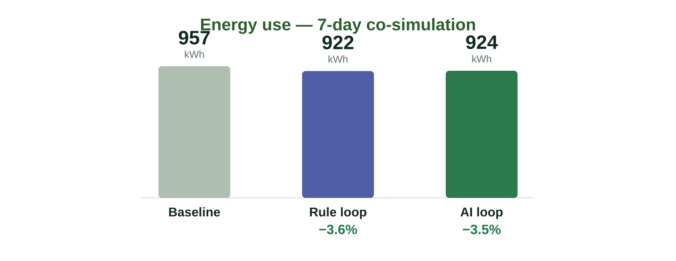
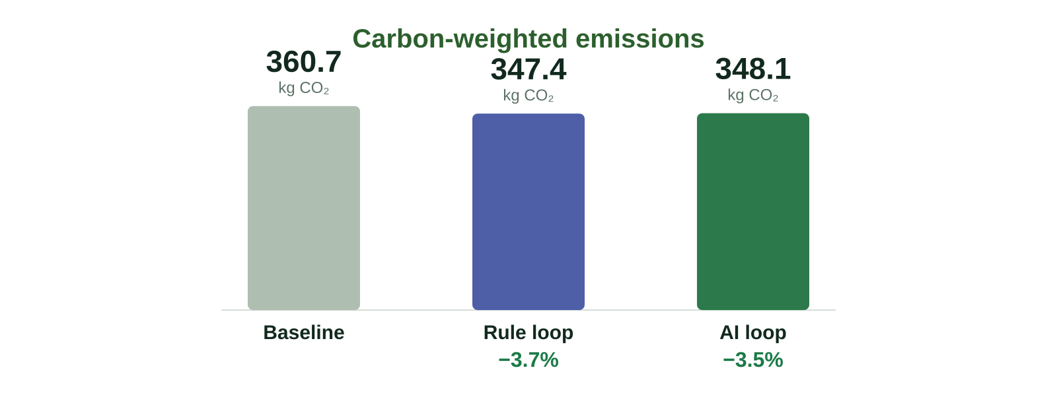
04
Artifacts & Results
MEASURED · 7 JULY DAYS · CHICAGO EPW · IDENTICAL BUILDING
LIVE STREAMLIT DASHBOARD · localhost:8601
Run | Energy | CO₂ (wt.) | vs base
Baseline | 957 kWh | 360.7 kg | —
Rule loop | 922 kWh | 347.4 kg | −3.6%
AI loop | 924 kWh | 348.1 kg | −3.5%
164 / 164 LLM decisions — 0 fallbacks, 0 crashes over the full run.
Clean log: hour_id strictly 4→167, no duplicates.
hour 4–6 night/empty → heat 15.0 cool 30.0 deep setback
hour 7 pre-open → heat 21.1 cool 25.0 pre-condition
hour 8–16 occupied → heat 21.6 cool 25.0 hold band
hour 18+ evening/empty→ heat 15.0 cool 30.0 back to setback
Dashboard also plots zone temperature (comfort band shaded), hourly energy, applied set-points, PMV distribution & the decision log.

Slide 6

05
Research & References
EnergyPlus (NREL / DOE)
whole-building simulation engine — energyplus.net
pyenergyplus runtime API
in-process co-simulation callbacks & actuators
Model Context Protocol
open tool-calling standard — modelcontextprotocol.io
Ollama
local open-source LLM serving — ollama.com
Qwen2.5 / Llama 3.2
open-weight models with native tool-calling
ASHRAE 55 · Fanger PMV/PPD
thermal-comfort model for the comfort bound
DOE 5ZoneAirCooled
reference small-office building (base .idf)
Grid carbon intensity
hourly gCO₂/kWh profile → carbon-aware control
All quantitative claims trace to committed run artifacts — data/*.csv · data/decisions.jsonl · github.com/rag3frost

