Slide 1
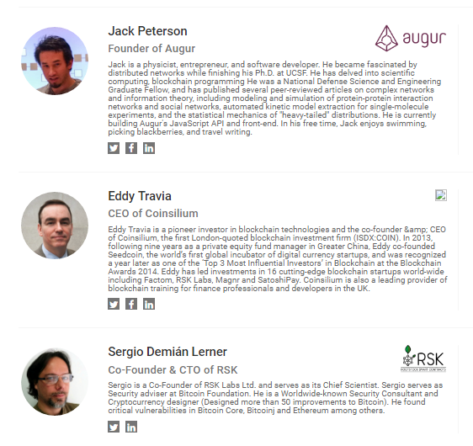
List of ether hackathon judges and their linkedin profiles.
https://www.linkedin.com/in/jack-peterson-420b0258
https://www.linkedin.com/in/startupeddy
https://www.linkedin.com/in/selerner

Slide 2
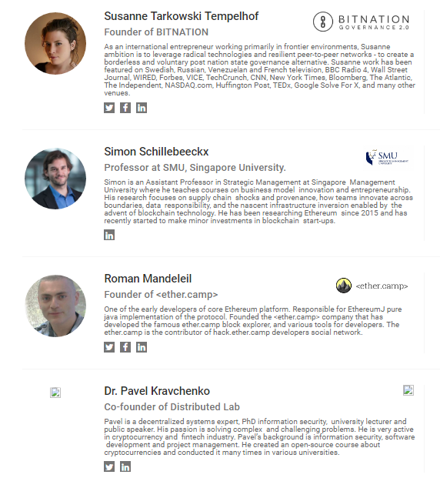
https://www.linkedin.com/in/susannetarkowski
https://www.linkedin.com/in/simonschillebeeckx
https://www.linkedin.com/in/romanmandeleil
https://www.linkedin.com/in/pkravchenko

Slide 3
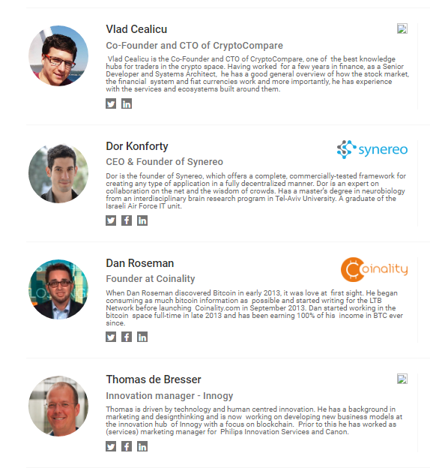
https://www.linkedin.com/in/vcealicu
https://www.linkedin.com/in/dor-konforty-25673512
https://www.linkedin.com/in/danroseman
https://www.linkedin.com/in/thomasdebresser

Slide 4
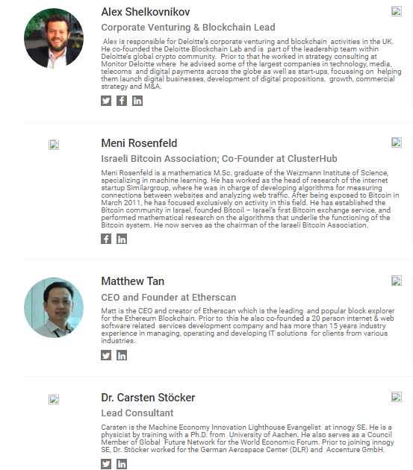
https://www.linkedin.com/in/shelkovnikov
https://www.linkedin.com/in/menir
https://www.linkedin.com/in/matthew-tan-4a3021a7
https://www.linkedin.com/in/carsten-stoecker-1145871

Slide 5
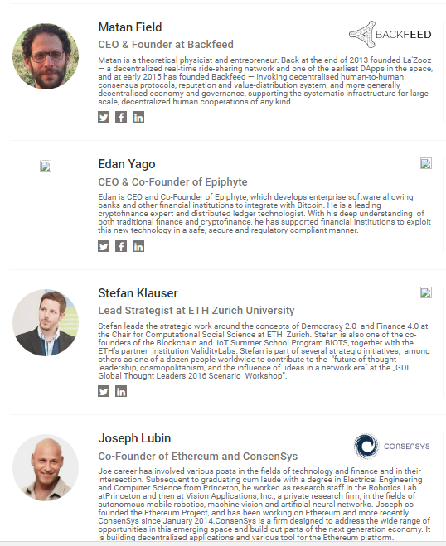
https://www.linkedin.com/in/matan-field-92a2b396
https://www.linkedin.com/in/edanyago
https://www.linkedin.com/in/beinnovative
https://www.linkedin.com/in/joseph-lubin-48406489

Slide 6
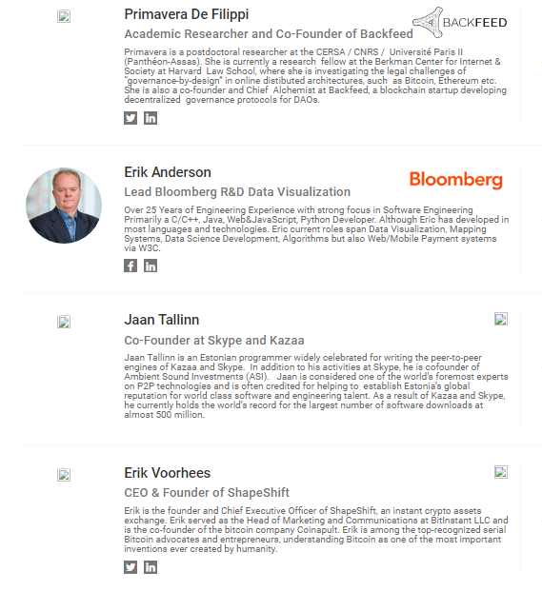
https://www.linkedin.com/in/primavera-de-filippi-07558536
https://www.linkedin.com/in/erikanderson
https://www.linkedin.com/in/erikvoorhees

Slide 7
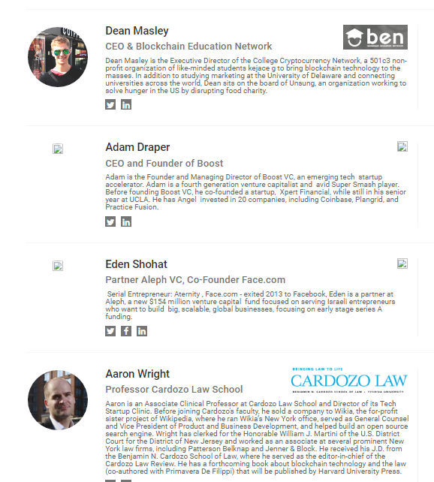
https://www.linkedin.com/in/dmasley
https://www.linkedin.com/in/adraper
https://www.linkedin.com/in/edens
https://www.linkedin.com/in/aaronwright

