Slide 1
AWS

Slide 2
AWS INTRO
https://github.com/ragaPriya224/references/blob/master/bck/cloud/what_is_aws_intro.pdf

Slide 3
Aws Services
AWS Architecture
AWS Compute Services
AWS Storage Services
AWS Database Services
AWS Migration Services
AWS Networking and Content Delivery
AWS Management Tools

Slide 4
AWS EC2 Implementation
AWS Security Data protection
Identity & access management
Network & application protection
Threat detection & continuous monitoring
Compliance & data privacy

Slide 5
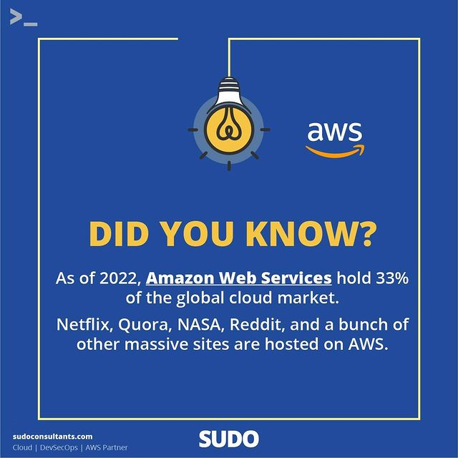

Slide 6


Slide 7
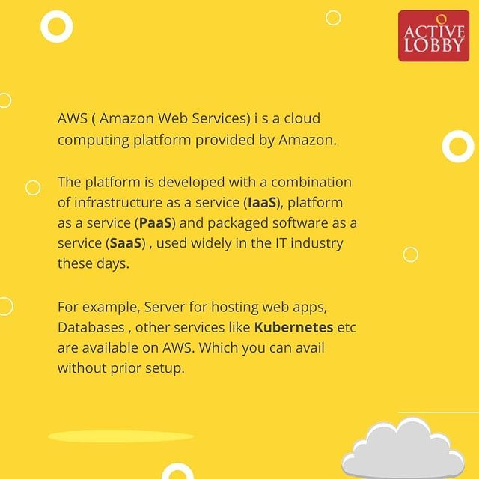

Slide 8
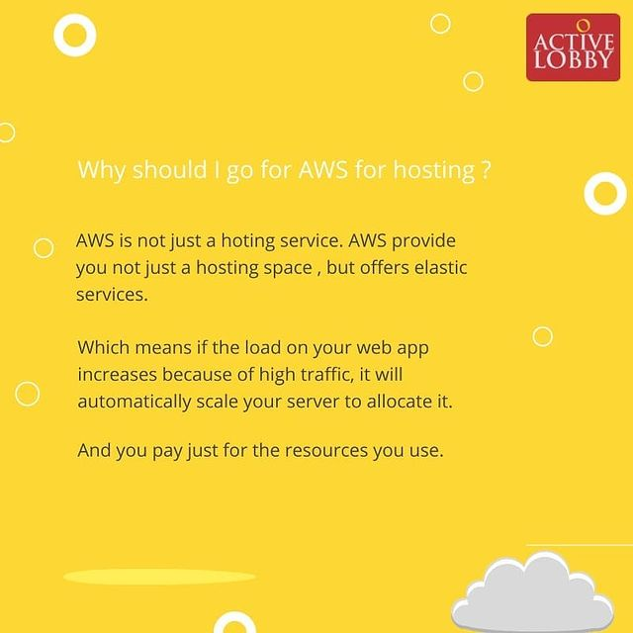

Slide 9
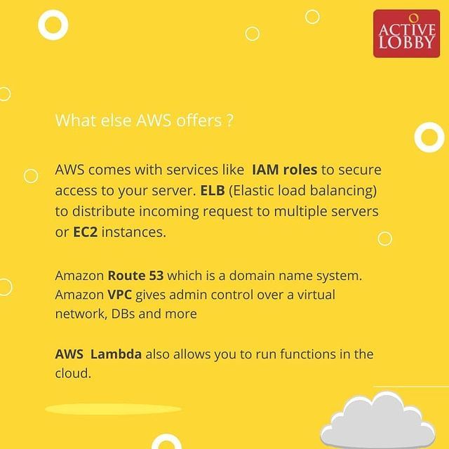

Slide 10


Slide 11
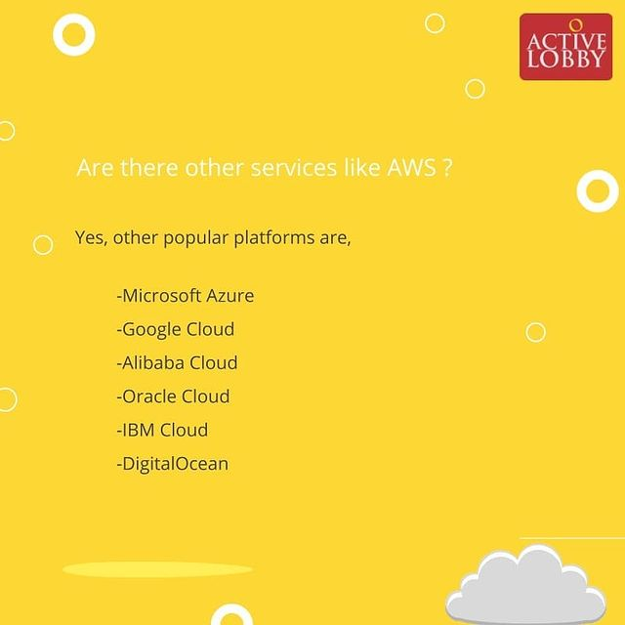

Slide 12


Slide 13


Slide 14
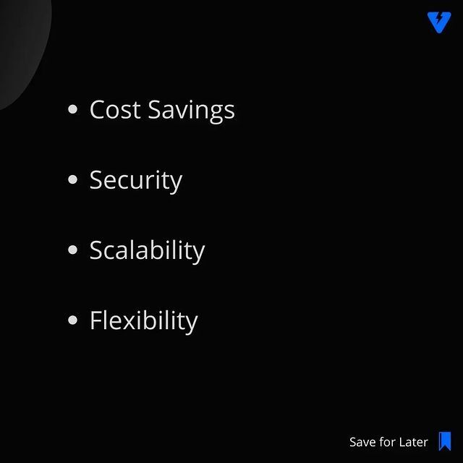

Slide 15
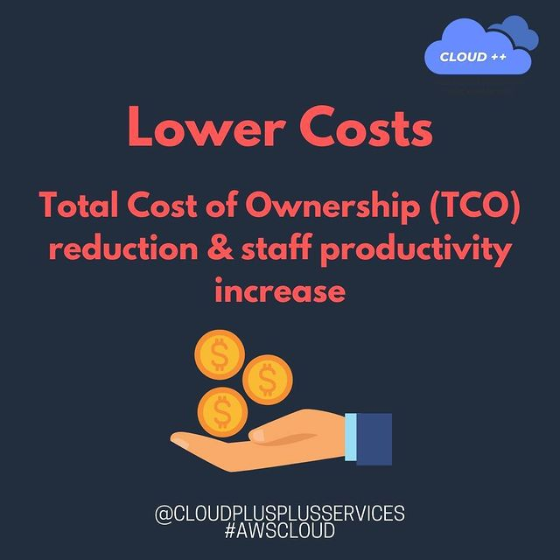

Slide 16
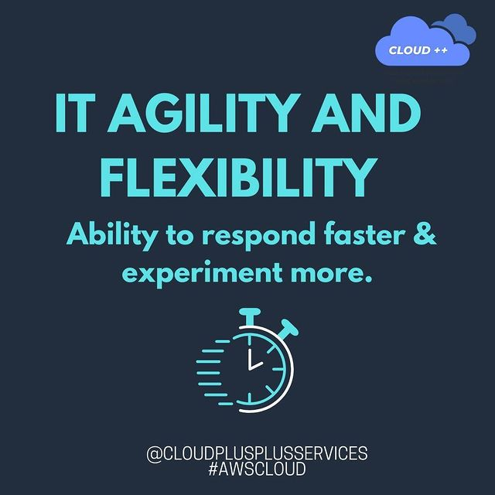

Slide 17


Slide 18


Slide 19
WHAT IS AWS
youtube.com/watch?v=a9__D53WsUs

Slide 20

COMPANIES USING AWS

Slide 21
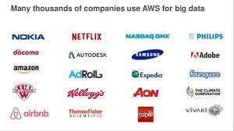
COMPANIES USING AWS

Slide 22
AWS SERVICES
https://github.com/ragaPriya224/references/blob/master/bck/cloud/aws_services.pdf

Slide 23
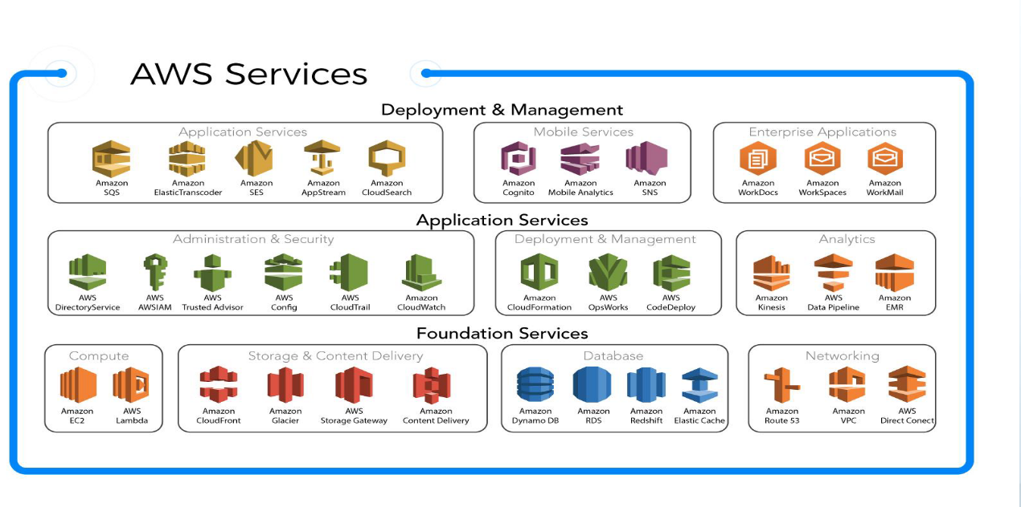

Slide 24
AWS - S3 SIMPLE STORAGE SERVICE

Slide 25
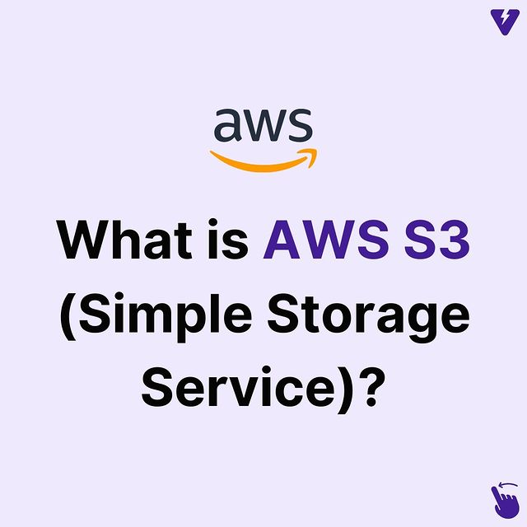

Slide 26
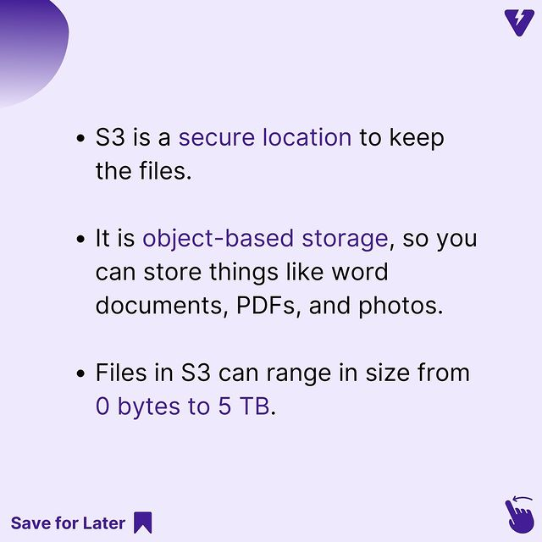

Slide 27
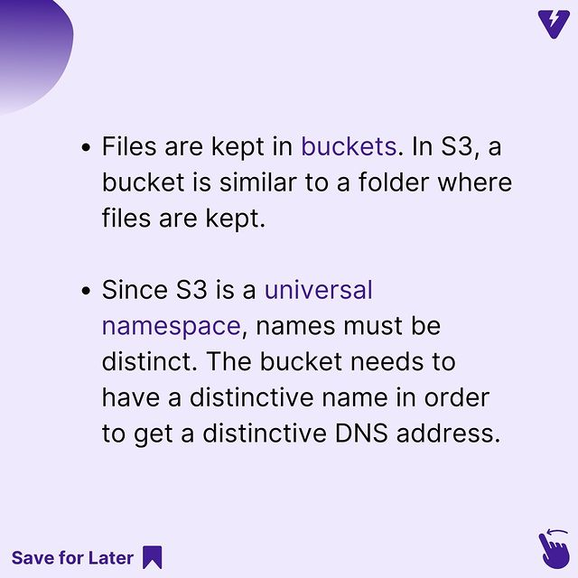

Slide 28
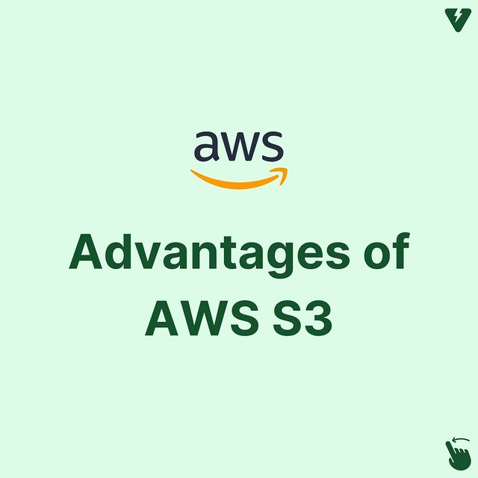

Slide 29
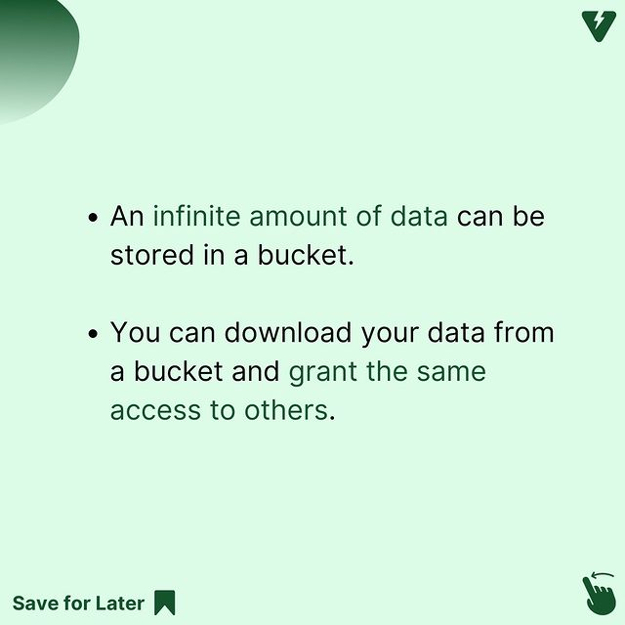

Slide 30
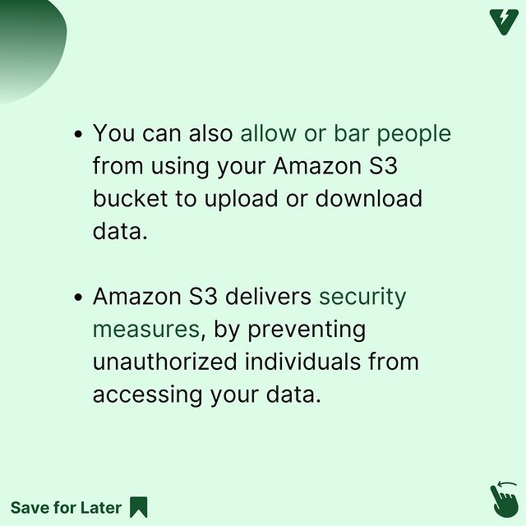

Slide 31
PAY AS YOU GO MODEL

Slide 32
AWS IN 10 MINUTES
https://www.youtube.com/watch?v=r4YIdn2eTm4&t=266s

