Slide 1

REACT

Slide 2
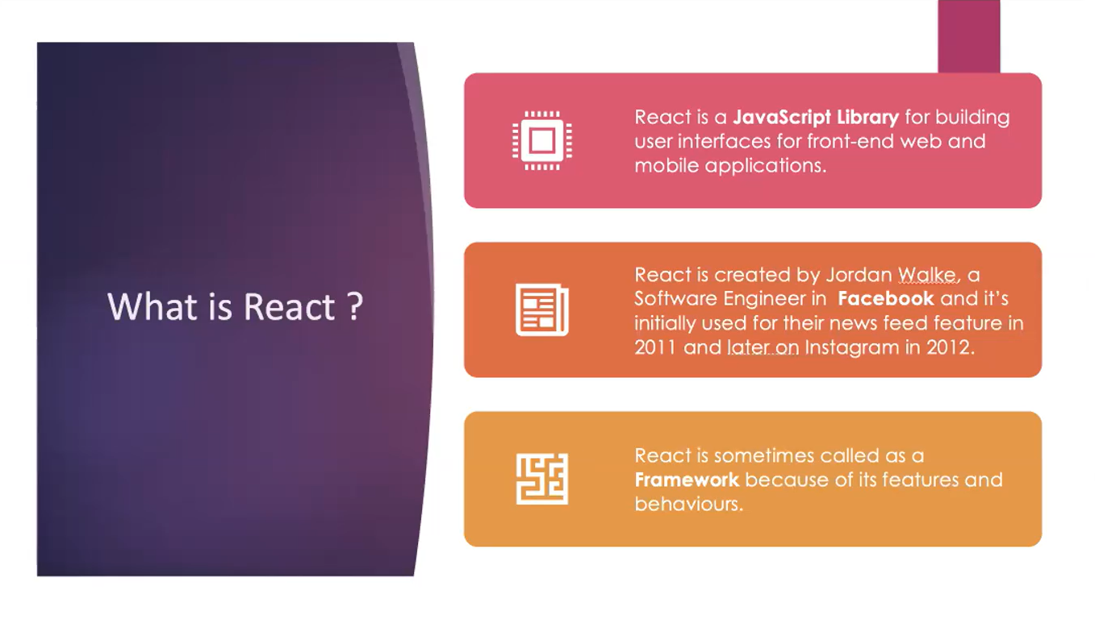

Slide 3

HOW TO CREATE REACT APP?
HOW TO USE COMPONENTS- CLASS COMPONENTS,FUNCTION COMPONENTS
WHAT ARE STATES,PROPS?
STATE?
HOW TO PASS DATA BETWEEN PARENT & CHILD?
HANDLE EVENTS, FORMS?

Slide 4
REQUIREMENTS
NODE JS -INSTALL FROM OFFICIAL WEBSITE. CLICK NEXT->NEXT
https://nodejs.org/en/download/
OPEN TERMINAL node -v
Documentation: https://reactjs.org/

Slide 5
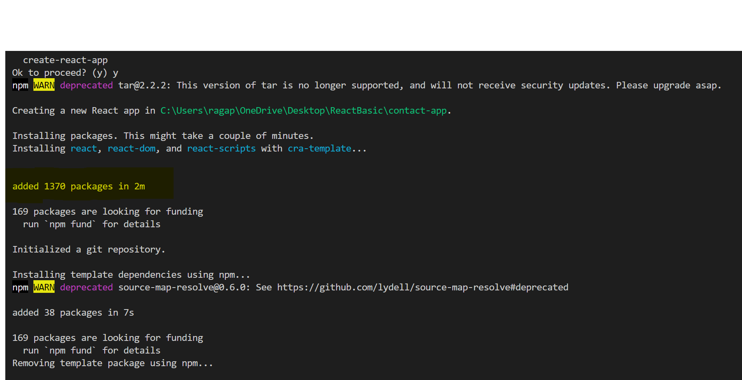
CREATE REACT APP
1.Go to github page of react app
https://github.com/facebook/create-react-app
npx create-react-app my-app
cd my-app
npm start
2. Create react app =>
npx create-react-app contact-app
Lots of dependencies added
Also says, what all commands can be added

Slide 6
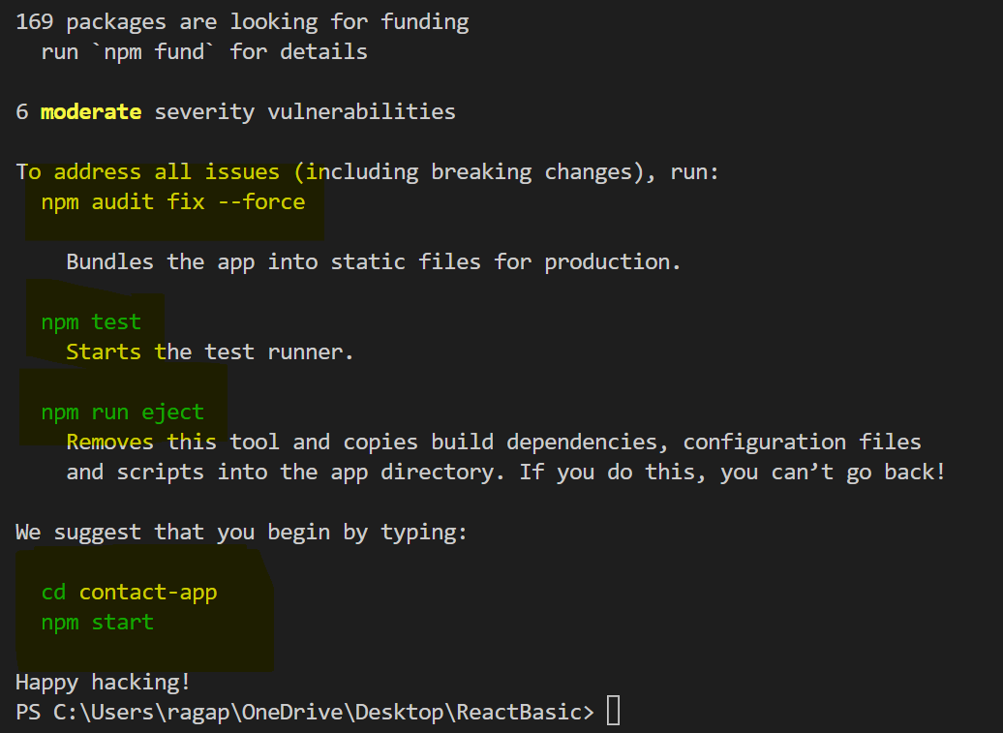
START DEVELOPMENT ENVIRONMENT
Cd .\contact-app\
Npm start => start app

Slide 7
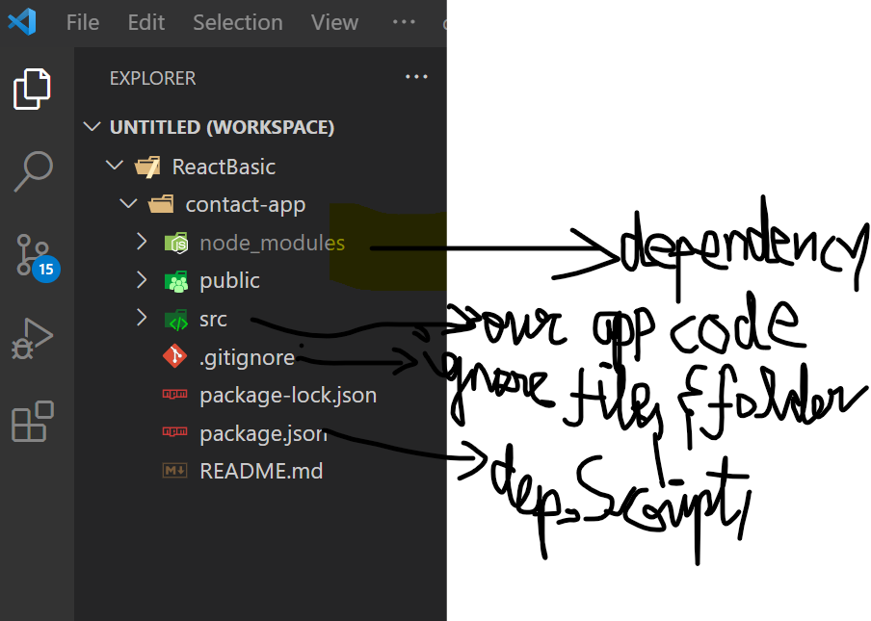
React app folder structure

Slide 8
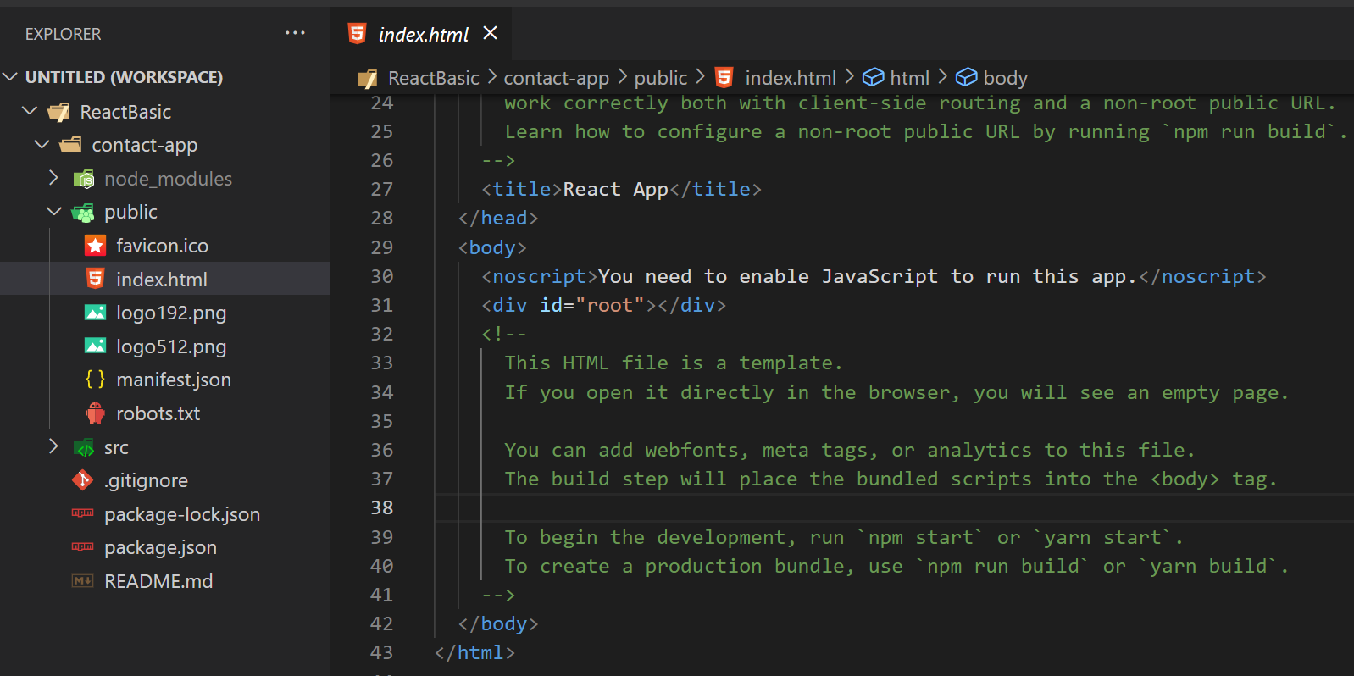

Slide 9
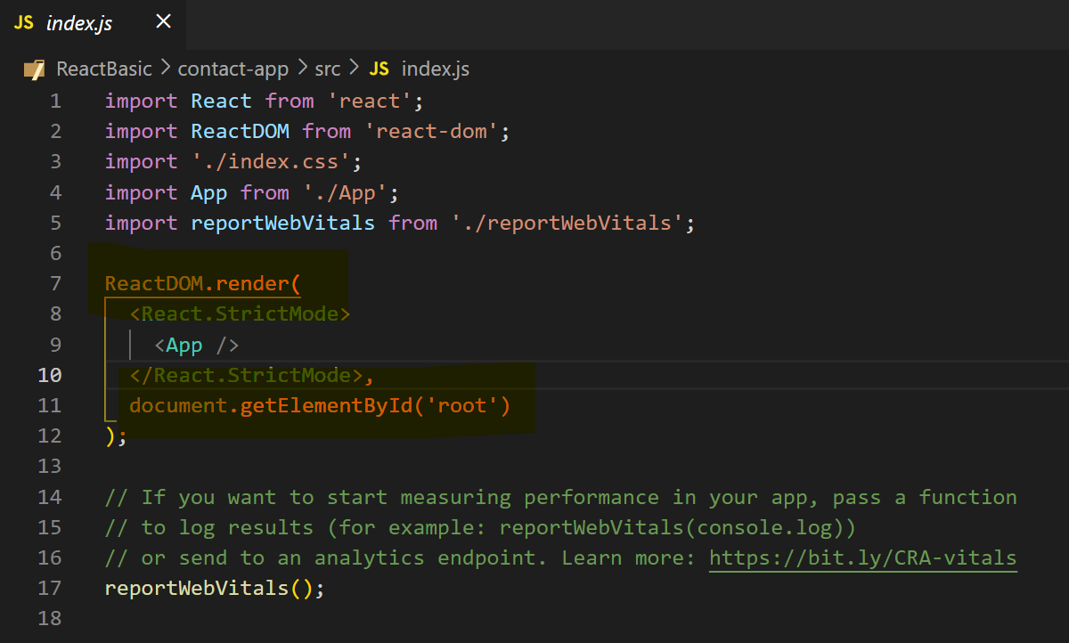
Entry point-> index.js

Slide 10
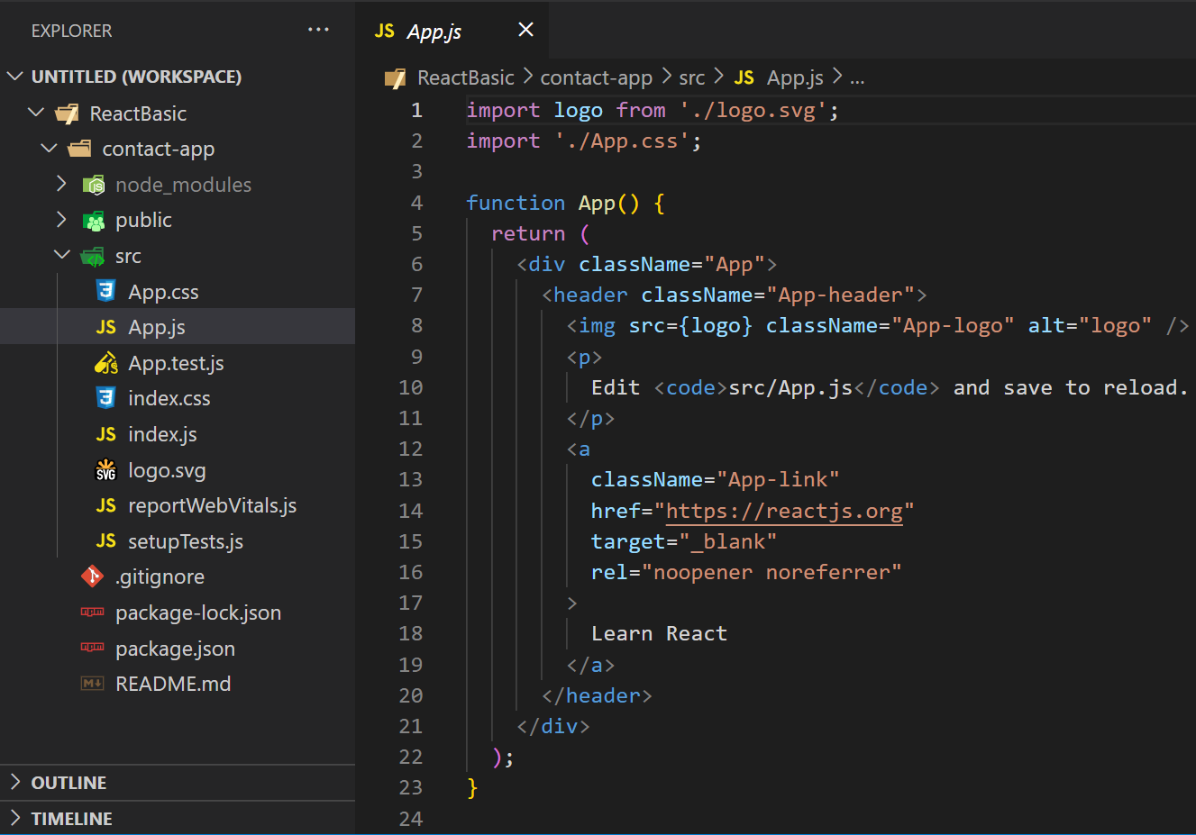
app.js
Default functional component:

Slide 11
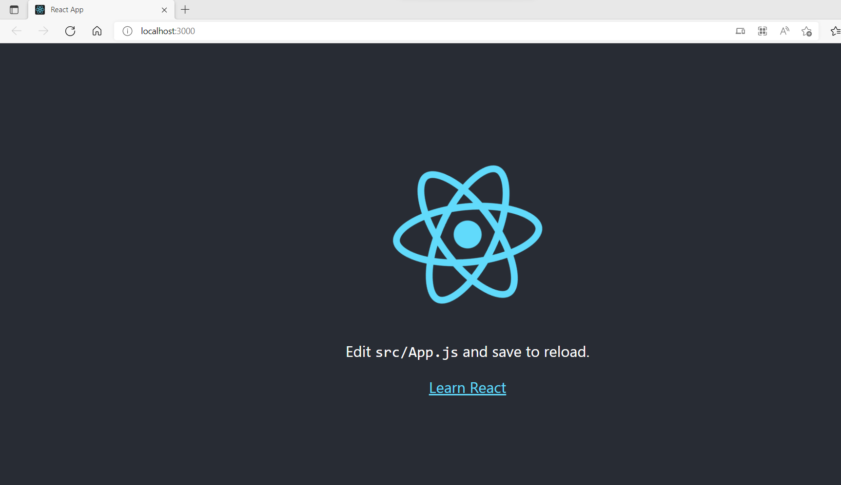
http://localhost:3000/
This is initial app component, which we see on screen

Slide 12
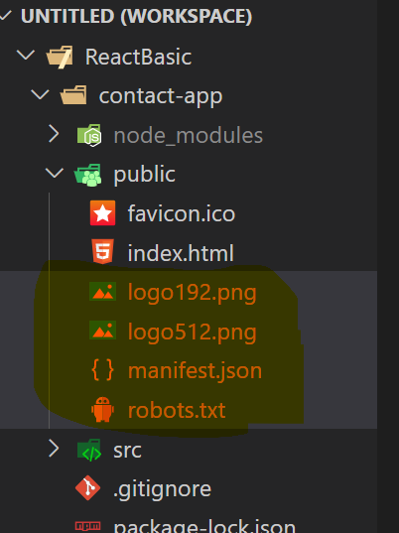
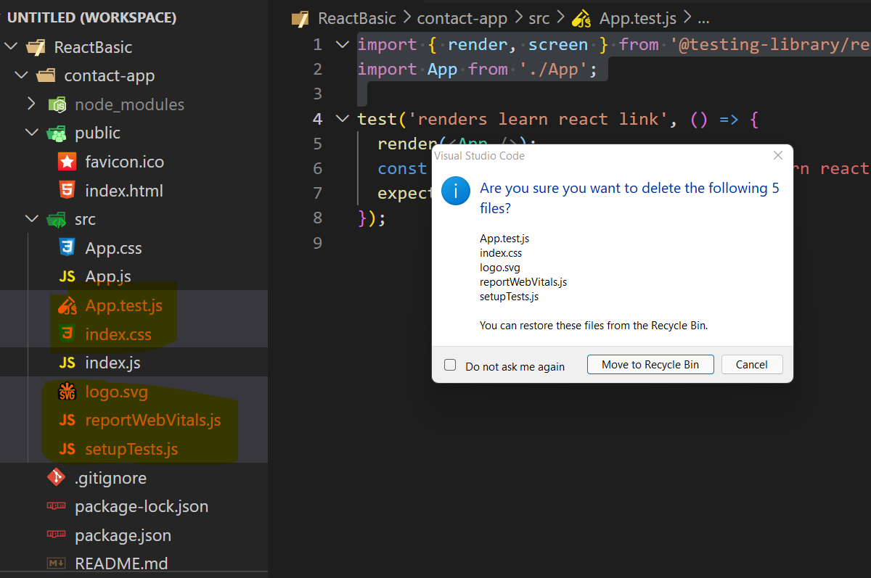
Let’s delete all default stuffs, and build everything from scratch

Slide 13
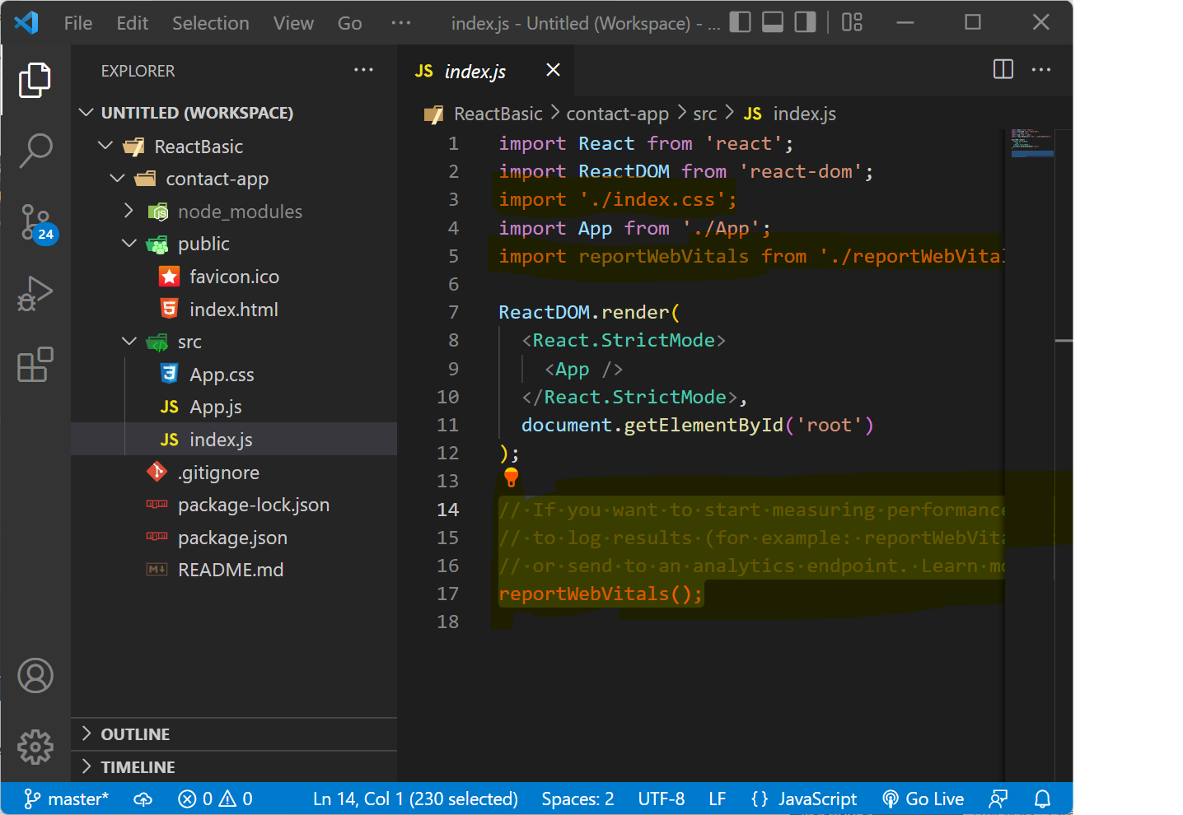
Index.js -> remove some codes

Slide 14
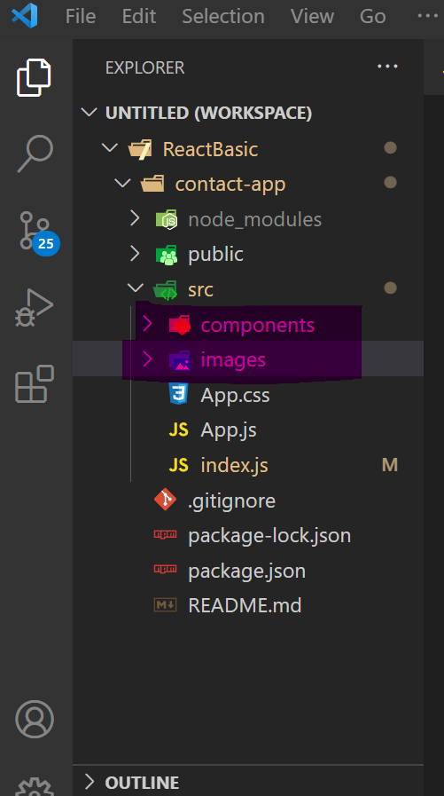
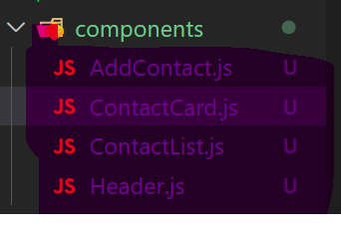
Contact App Folder Structure/ Components
Create 2 new directory’s. Component & images
Add these files in components folder

Slide 15
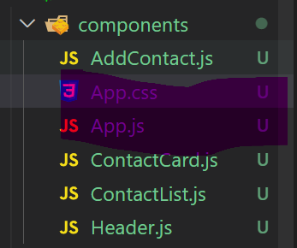
Move app.js,css inside components

Slide 16
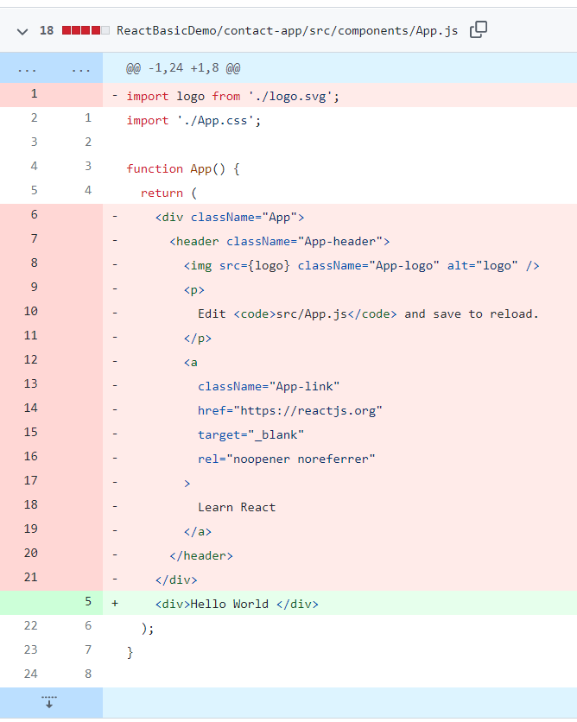
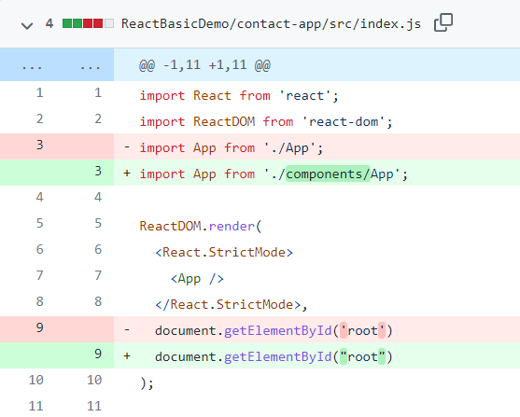
React "Hello World" Components

Slide 17
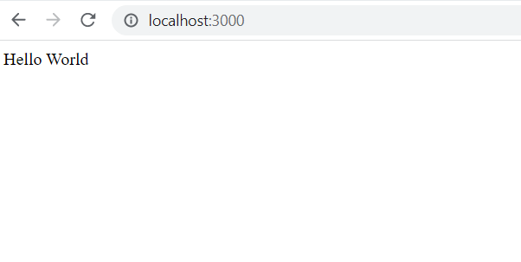
O/P

Slide 18
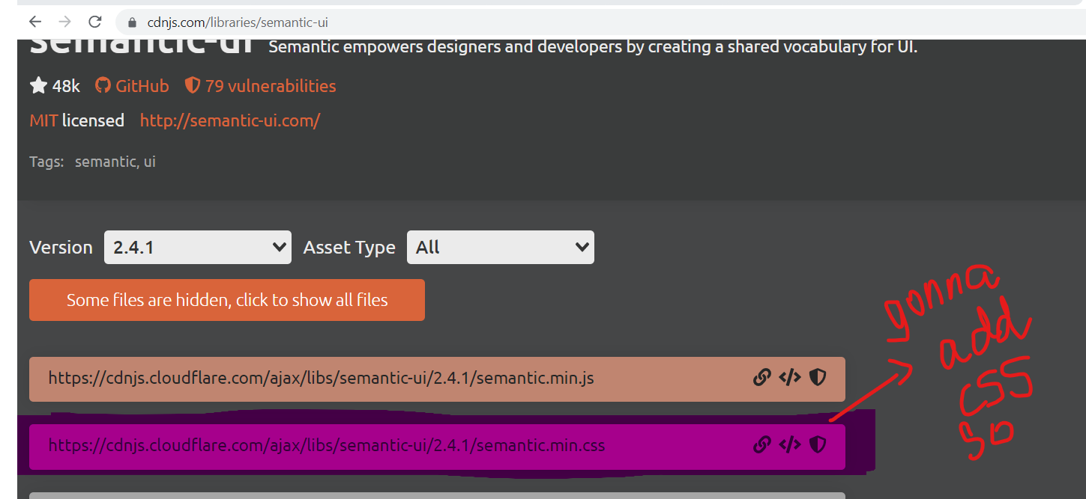
Not gonna concentrate on css, instead using semantic ui library
Semantic ui official website:
https://semantic-ui.com/introduction/getting-started.html https://cdnjs.com/libraries/semantic-ui
Add this in index.html

Slide 19
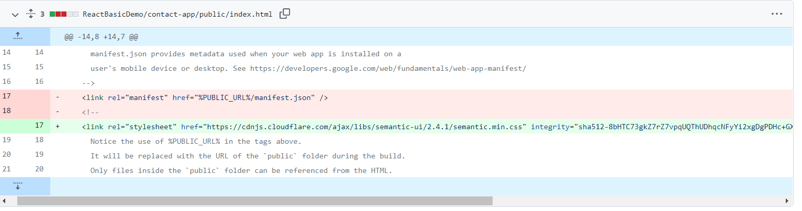
https://github.com/ragaPriya224/B1-IBM/commit/bfef0bc6ef4fcb524c3ec951941f32e74fda4e9c

Slide 20
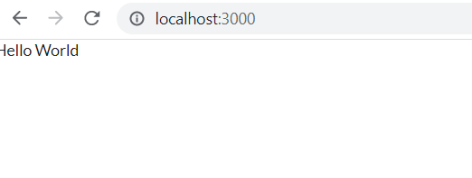
o/p
Change in font family & font size

Slide 21
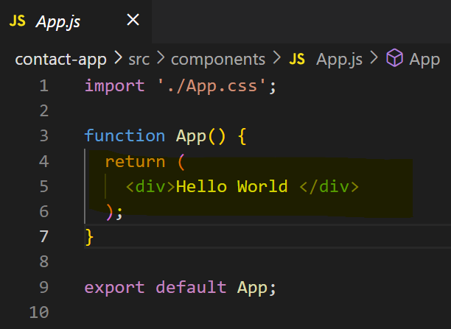
Understand React Components
Component is a piece of reusable code which can be used at any point & it’s an individual piece of code which has it’s own inputs and own outputs and own functionality.
App.js
From app component, we’re returning div of hello world

Slide 22
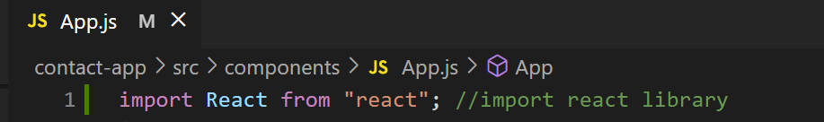
Import react library
This might look like html, but it’s not html. It’s jsx=> combo of js & html. Possible bcoz we using react library

Slide 23
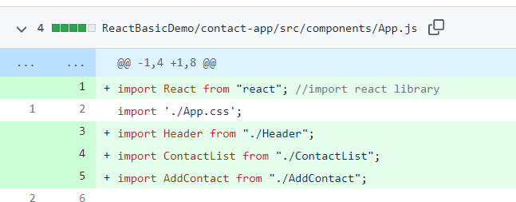
Import our react components in app.js

Slide 24
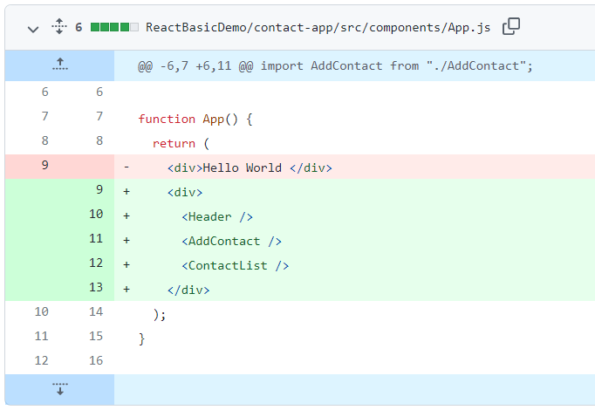
React jsx
U can add header components as custom html element.others too
Noting in screen though !

Slide 25
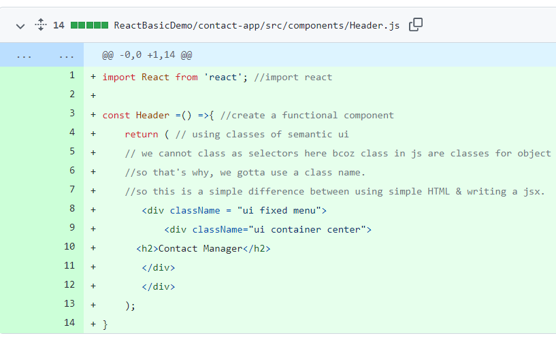
Let’s add code in components(Function Component)
const Header =() =>{ //create a functional component
return ( // using classes of semantic ui
// we cannot class as selectors here bcoz class in js are classes for object oriented programming
//so that's why, we gotta use a class name.
//so this is a simple difference between using simple HTML & writing a jsx.
<div className = "ui fixed menu">
<div className="ui container center">
<h2>Contact Manager</h2>
</div>
</div>
);
}

Slide 26
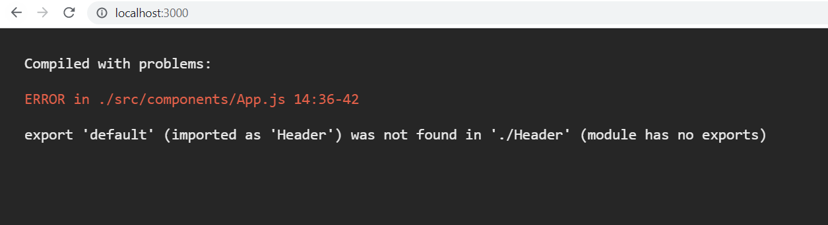
O/P

Slide 27

FIX: in Header.js
export default Header;

Slide 28
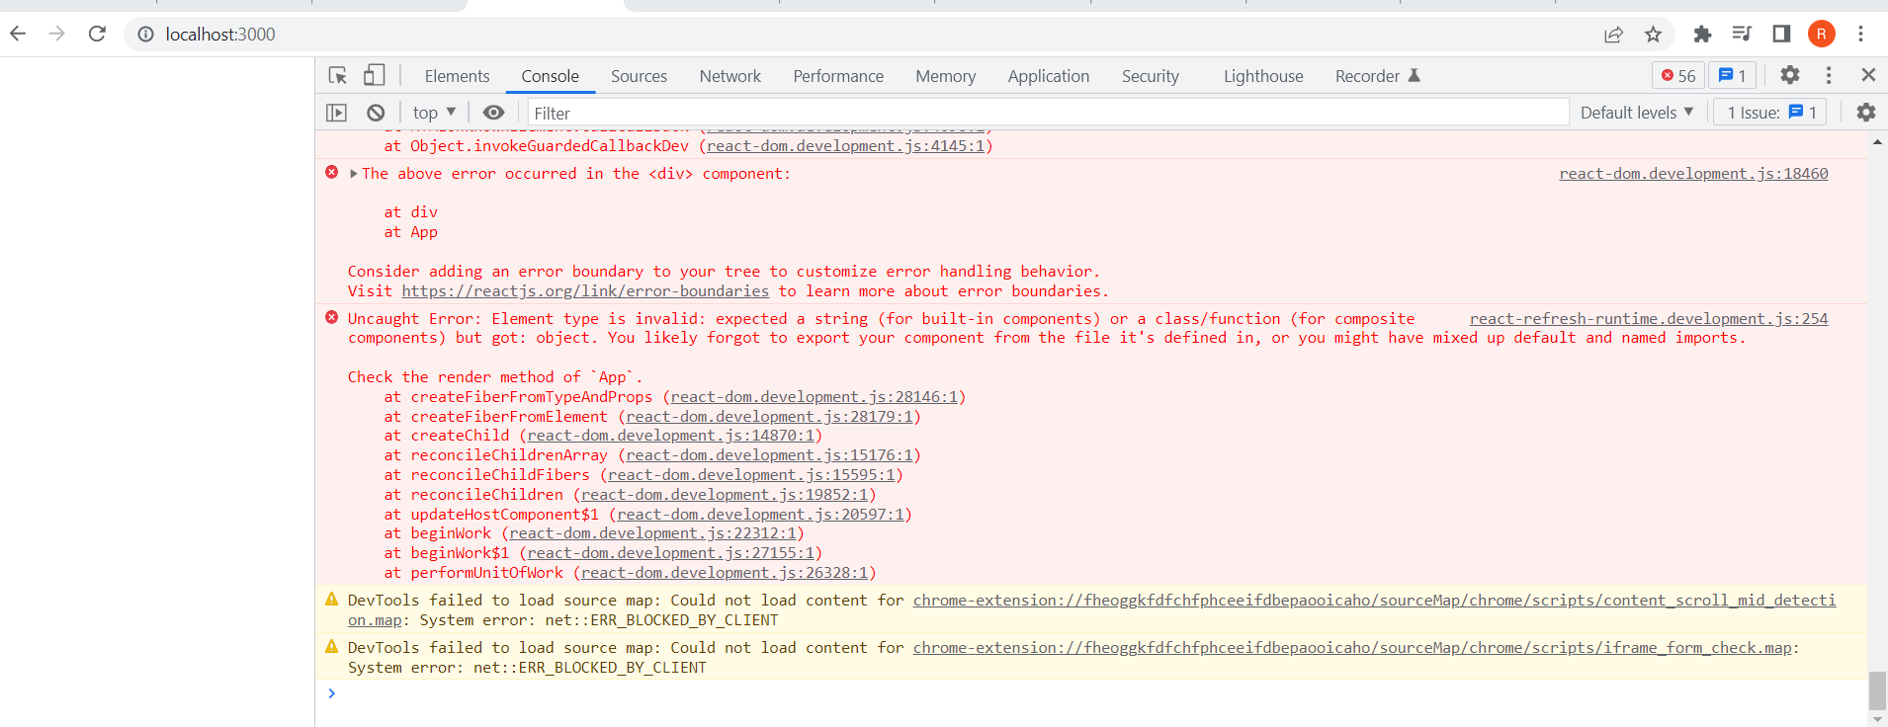
O/P

Slide 29
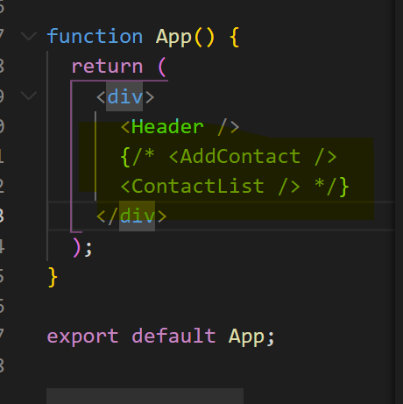
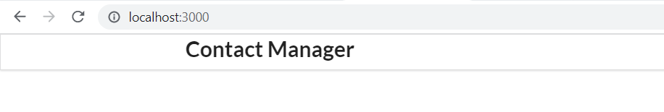
TEMPORARY FIX: COMMENT CONTACTS IN APP.JS
APP.JS
o/p

Slide 30
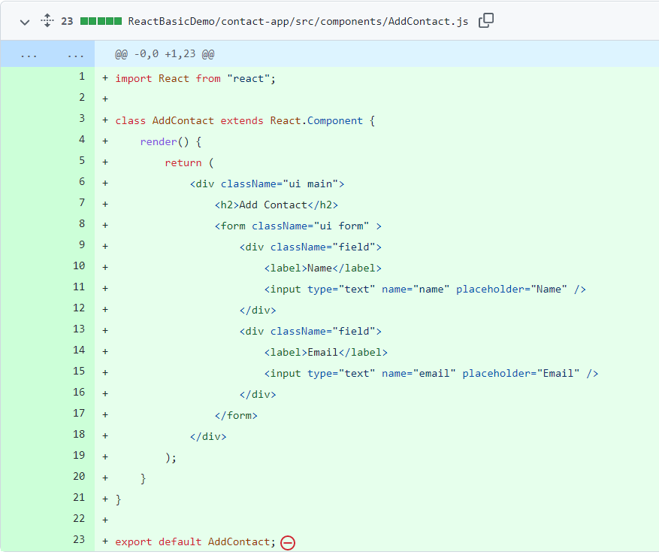
Creating add contact, which contains contact form
import React from "react"; //import
//creating class component
class AddContact extends React.Component {
//cannot simply return, need to use render method
render() {
//create form with name and mail id
return (
<div className="ui main">
<h2>Add Contact</h2>
<form className="ui form" >
<div className="field">
<label>Name</label>
<input type="text" name="name" placeholder="Name" />
</div>
<div className="field">
<label>Email</label>
<input type="text" name="email" placeholder="Email" />
</div>
</form>
</div>
);
}
}
//exporting addcontact
export default AddContact;

Slide 31
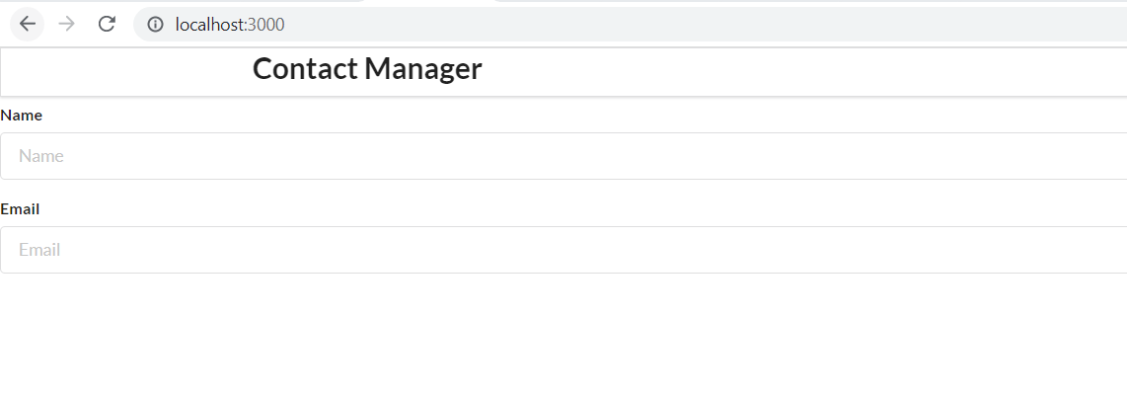
o/p

Slide 32
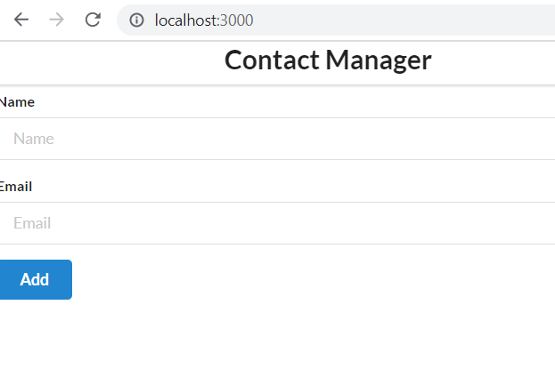
Add a button
<button className="ui button blue">
Add
</button>

Slide 33
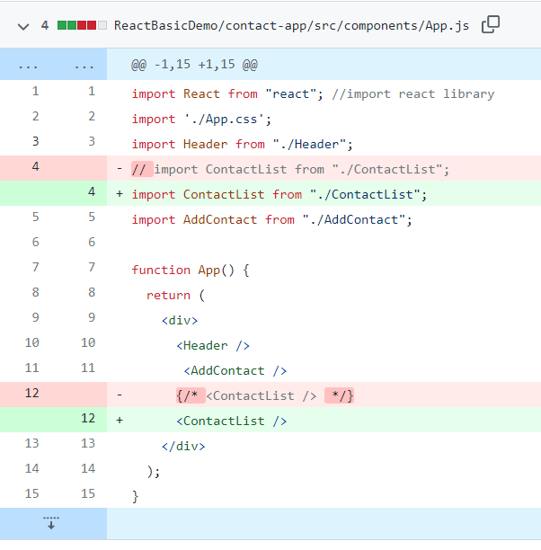
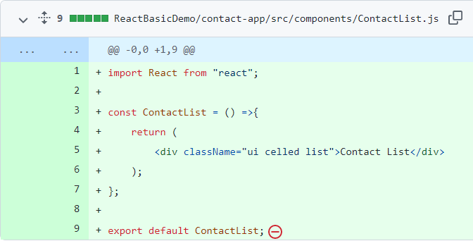
Add code for contactList component.
Creating a functional component

Slide 34
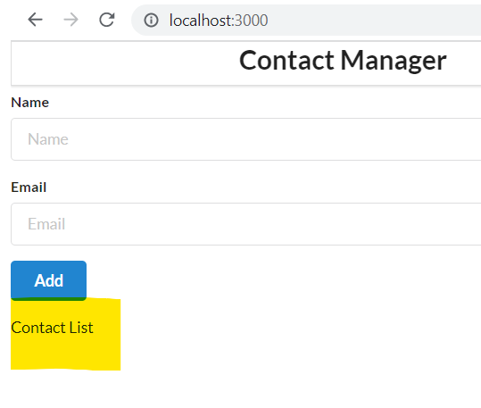
o/p

Slide 35
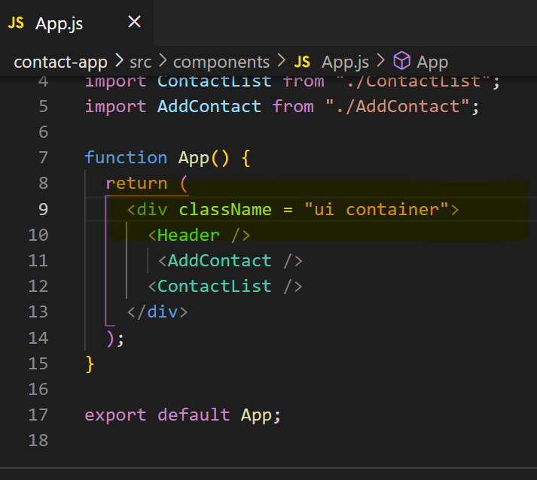
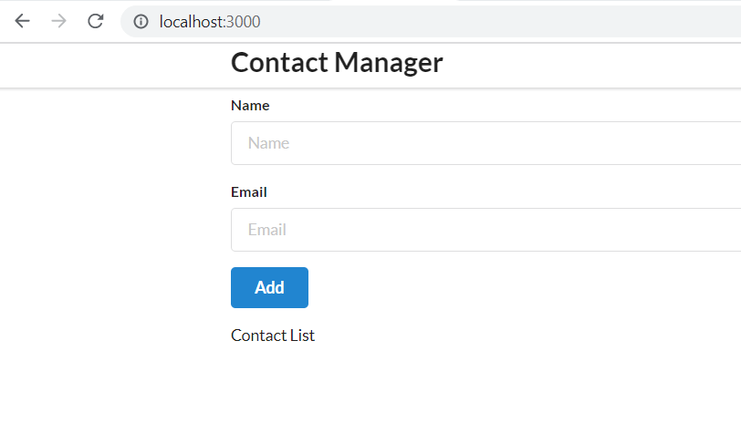
We are done with components, let’s style it a bit

Slide 36
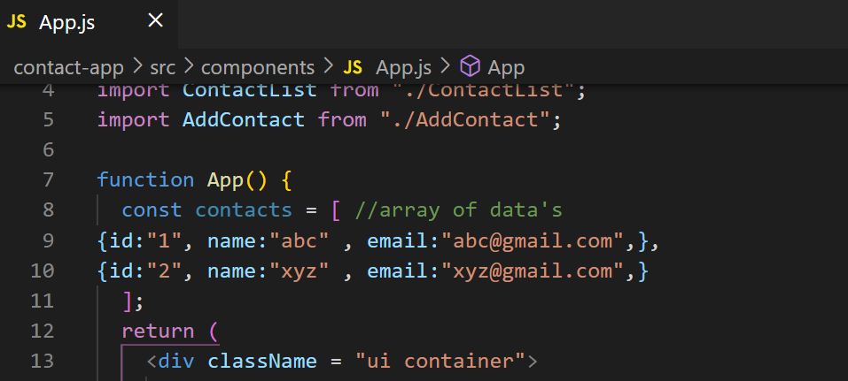
Rendering List in React
const contacts = [ //array of data's
{id:"1", name:"abc" , email:"abc@gmail.com",},
{id:"2", name:"xyz" , email:"xyz@gmail.com",}
];

Slide 37
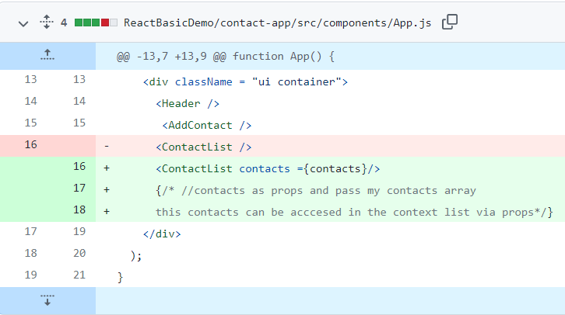
Props - Pass data from parent to child

Slide 38
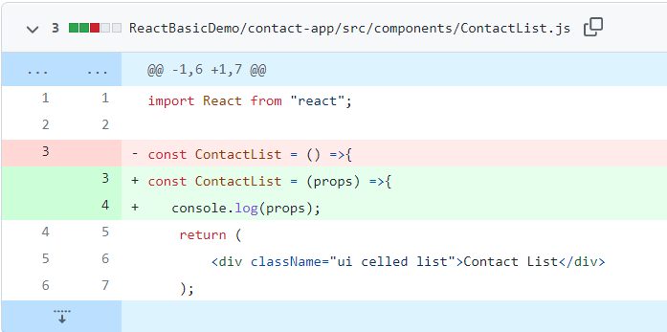
Access props
O/p

Slide 39
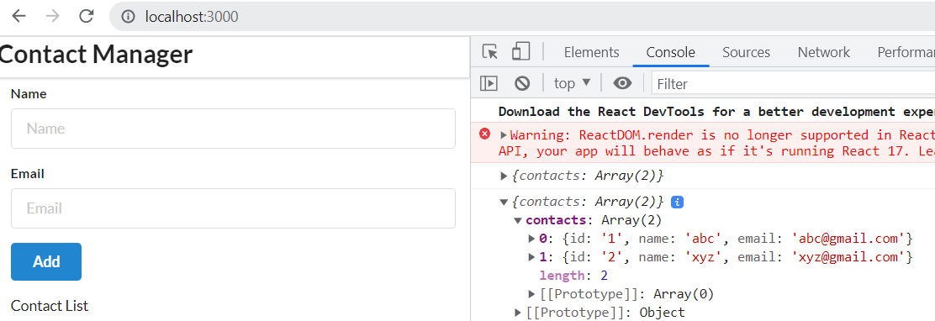
O/p

Slide 40
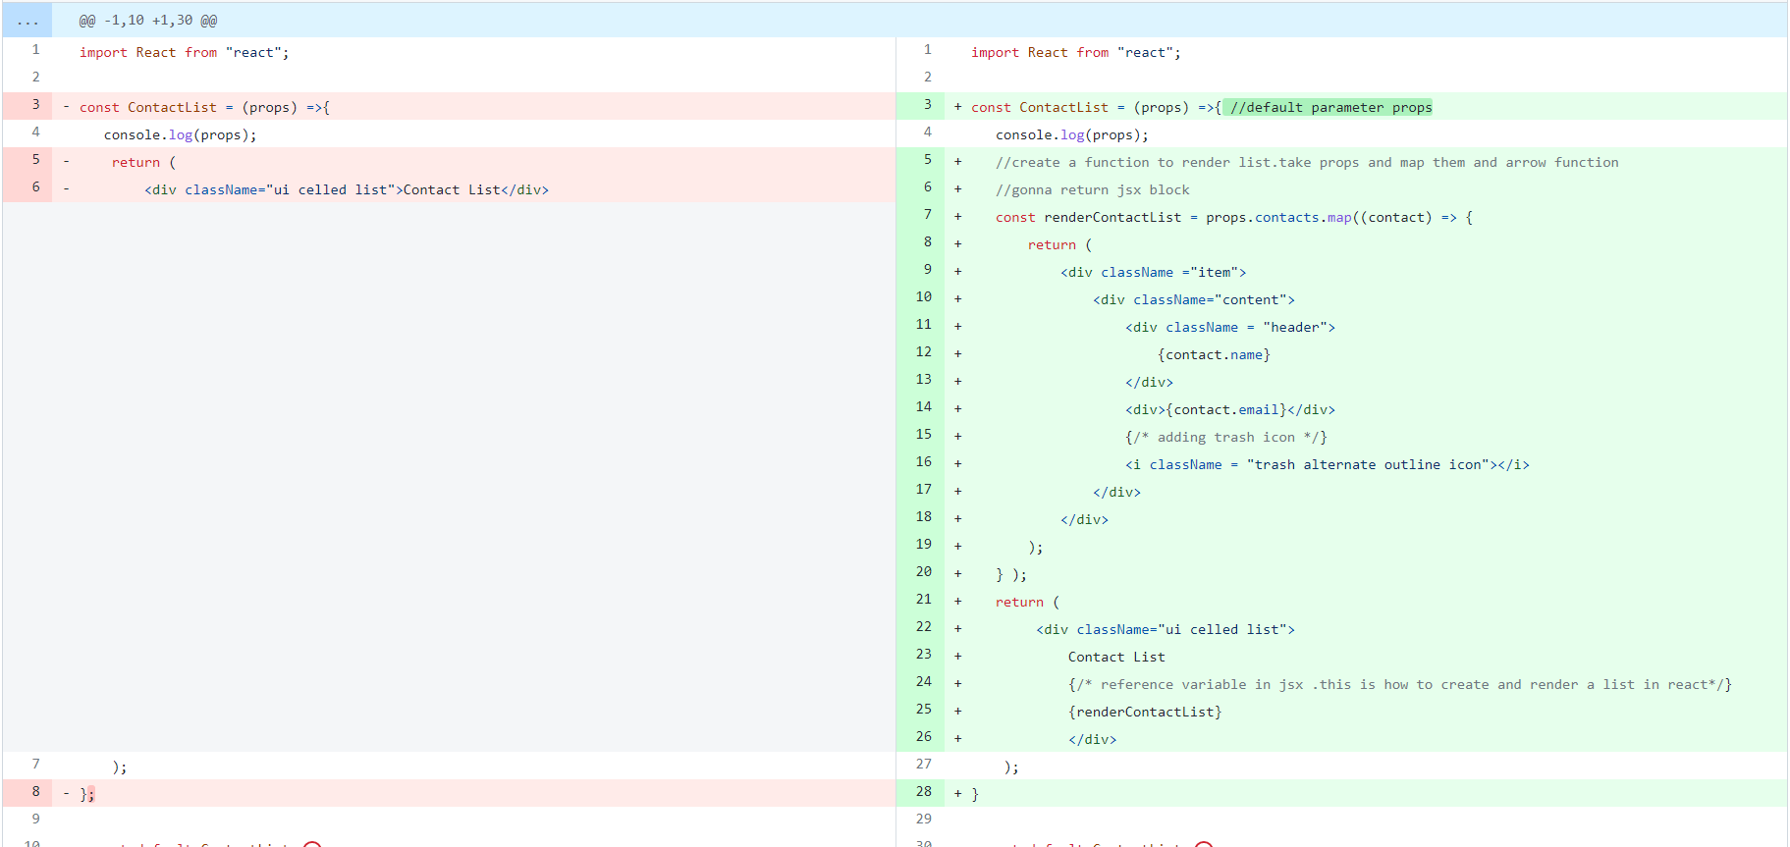
Since, we got contacts object, let’s render list
https://github.com/ragaPriya224/B1-IBM/commit/49226a7974d884593ebe730aaa21b194835a0a49
contactList.js

Slide 41
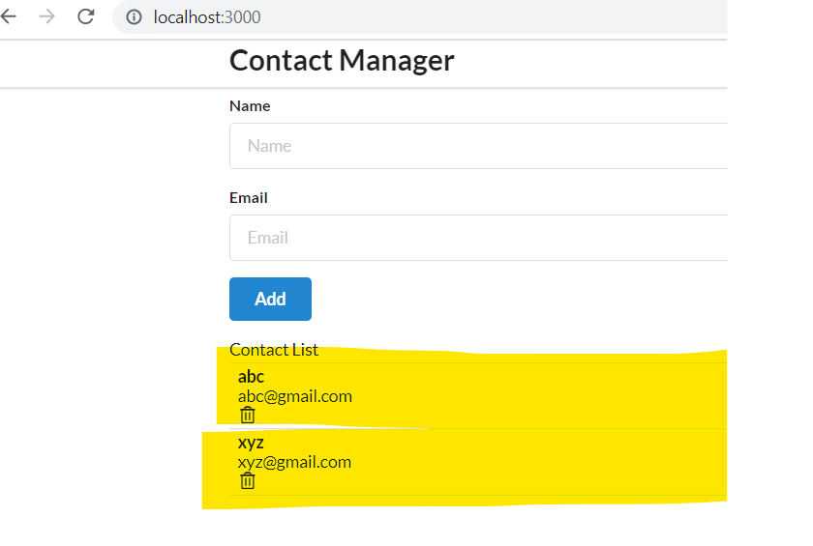
O/P

Slide 42
Some jsx code of contactList to be moved to contact Card

Slide 43
Npm i uuidv4

