Slide 1
DEVOPS

Slide 2
?
DevOps is a set of software development practices that combine software development (Dev) and information technology operations (Ops) to shorten the systems development life cycle while delivering features, fixes, and updates frequently in close alignment with business objectives.

Slide 3
Continuous Collaboration Communication

Slide 4
I Build It I Run It

Slide 5
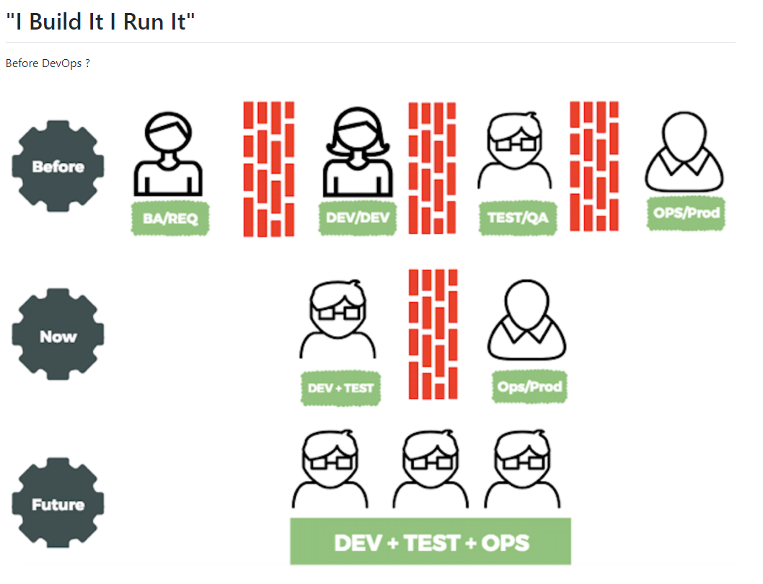

Slide 6
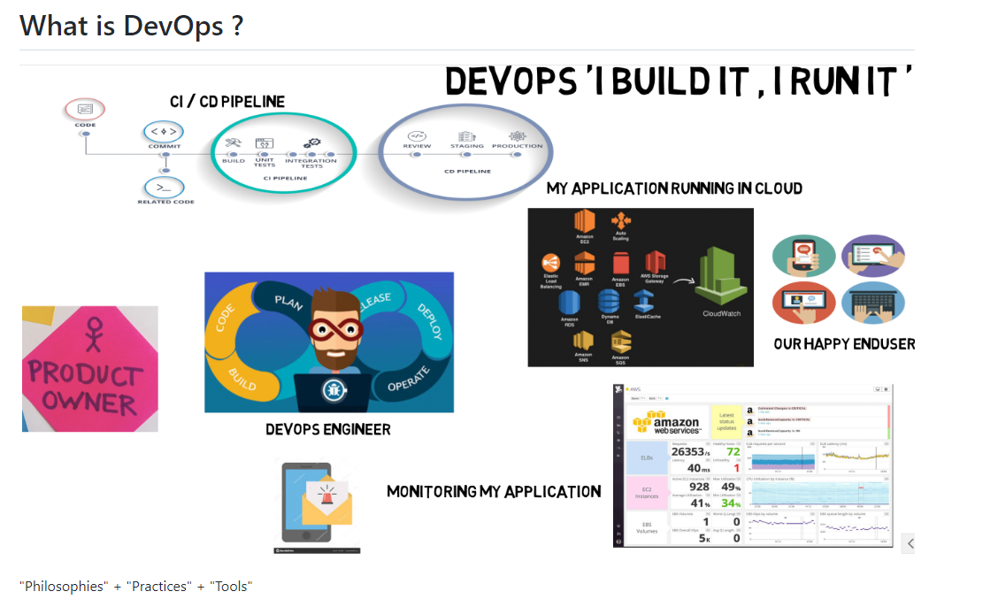
TAKES COMPLETE RESPONSIBILITY

Slide 7
What is DevOps NOT ?
a. It's not a tool.
b. It's not a technology.

Slide 8
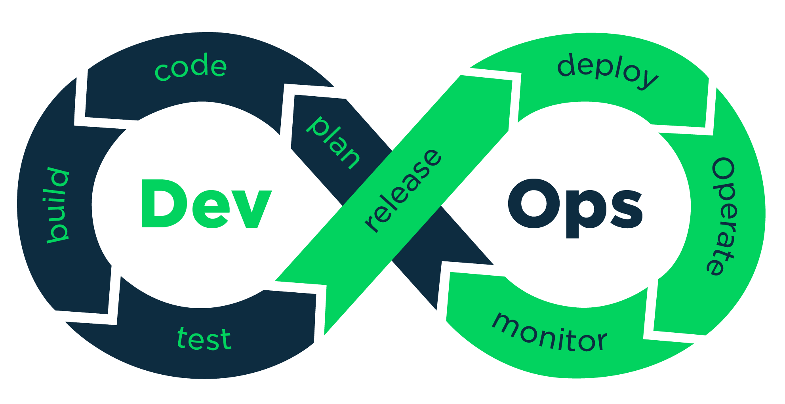
What are the phases of DevOps ?

Slide 9
Benefits of DevOps ?
Continuous software delivery
Less complexity to manage
Happier, more productive teams
Faster delivery of features
Improved communication and collaboration
Early detection and faster correction of defects that helps provide the best services

Slide 10
CHALLENGES
Infrastructure challenges
Overcoming the Dev versus Ops mentality
Too much focus on tools
Right Skillsets
Resistance to change

Slide 11
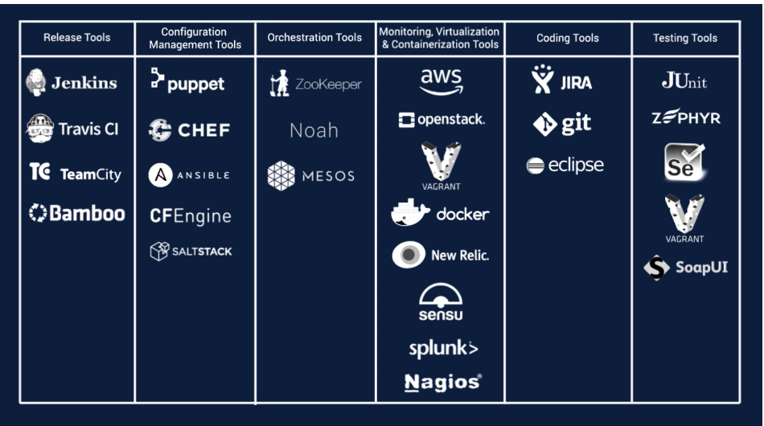

Slide 12
Typical DevOps Skills :
a. Programming Knowledge - Java, Scala, Kotlin, NodeJs, etc.
a. Continuous Integration Tools.
b. Containers Knowledge.
c. SysAdmin.
d. Security & Monitoring.
e. Excellent Communication Skills.
f. Unit & Automation Testing.
Tools : Source Control (like Git, Bitbucket, Svn, VSTS etc) Continuous Integration (like Jenkins, Bamboo, VSTS ) Infrastructure Automation (like Puppet, Chef, Ansible) Deployment Automation & Orchestration (like Jenkins, VSTS, Octopus Deploy) Container Concepts (LXD, Docker) Orchestration (Kubernetes, Mesos, Swarm) Cloud (like AWS, Azure, GoogleCloud, Openstack)

