Slide 1
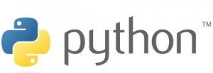

Slide 2
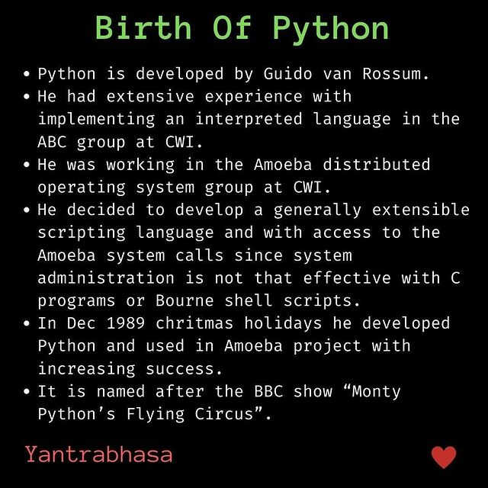

Slide 3
Python was first released in 1991.
It is an interpreted, high-level, general purpose programming language.
It is Object-Oriented.
Designed by Guido van Rossum, Python actually has a design philosophy centered around code readability.
Python is a computer programming language often used to build websites and software, automate tasks, and conduct data analysis.
Python is a general-purpose language, meaning it can be used to create a variety of different programs and isn’t specialized for any specific problems.

Slide 4
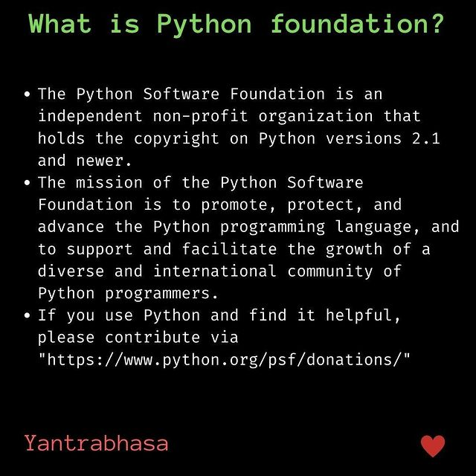

Slide 5
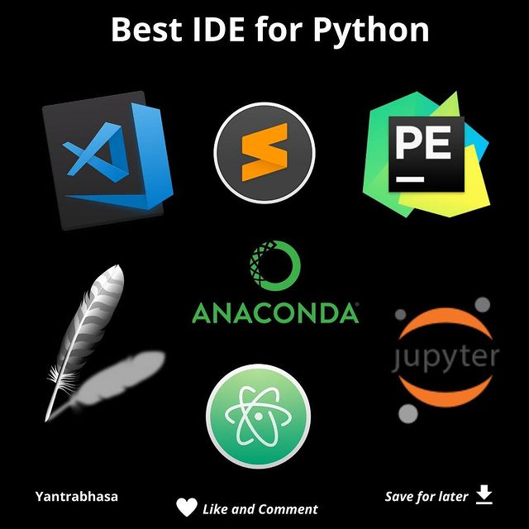

Slide 6
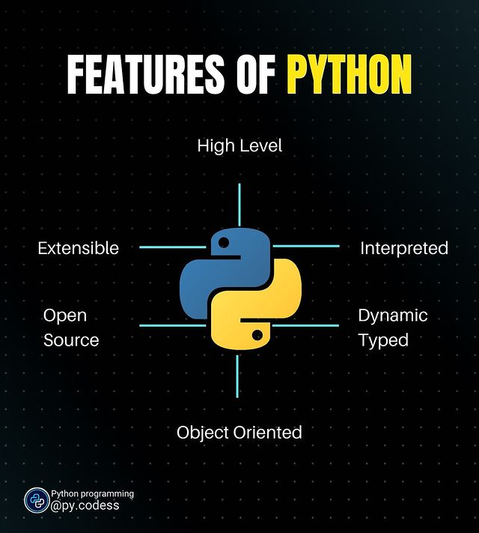

Slide 7
WHEN TO USE PYTHON
Python’s libraries allow a programmer to get started quickly.
Rarely will they need to start from scratch.
If a programmer wishes to jump into machine learning, there’s a library for that.
Generally, Python is the Lego of the programming languages; find a box with instructions on how to use it and get to work. There is little that needs to be started from scratch

Slide 8
Because of its readability, Python is great for:
New programmers
Getting ideas down fast
Sharing code with others

Slide 9
JAVA PYTHON
Java is a statically typed and compiled language,
This single difference makes Java faster at runtime and easier to debug
dynamically typed and interpreted language.
Python is easier to use and easier to read.
people just grasp it easier. With it, the libraries for Python are immense, so a new programmer will not have to start from scratch.

Slide 10
Who uses Python & Java?
Python is often used with new programmers or junior developers entering a data science role.
The big machine learning libraries, TensorFlow and pyTorch, are both written in Python.
Java is used a lot for web development. It is more common among senior-level programmers.

Slide 11
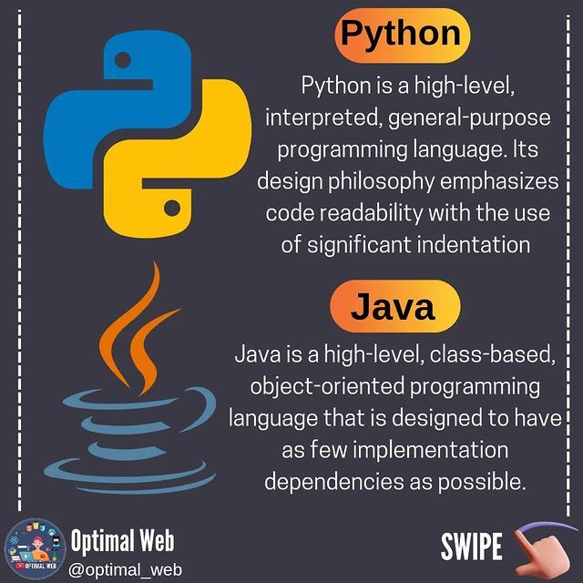

Slide 12
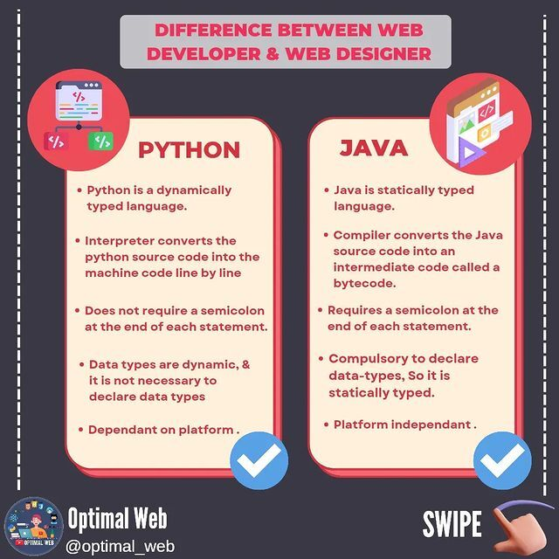

Slide 13
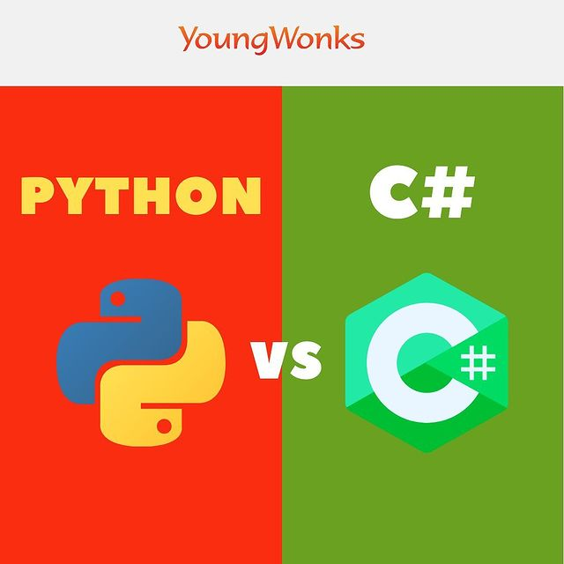

Slide 14
C #
Python
Based on OOP concepts
Statically typed. The compiler will give errors for wrong typecasting
Dependency injection works like a charm.
More organized and consistent syntax and format.
supports multi-paradigm programming (OOP, procedural)
Dynamic type-casting. No need for variable declarations.
No concept of DI as such, however, you can add customized tags to any object at run time
Simple, easy to read and code, doesn’t contain too many symbols or formats.

Slide 15
REAL TIME APPLICATIONS
Data analysis and machine learning
Web development
Automation or scripting
Software testing and prototyping
Everyday tasks

Slide 16
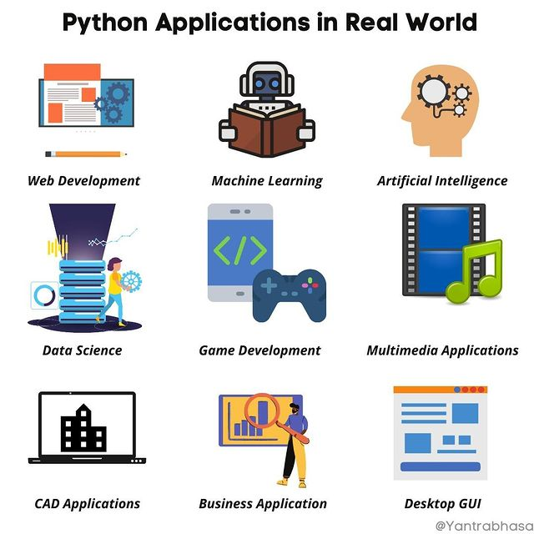

Slide 17
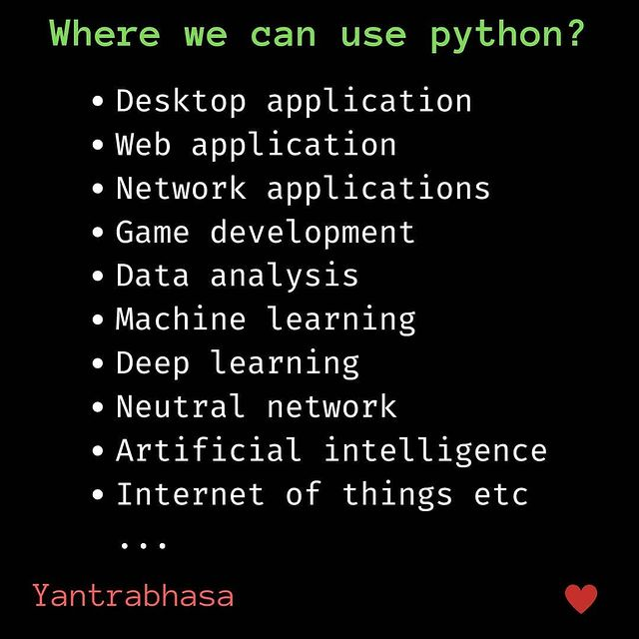

Slide 18
