Slide 1

AZURE

Slide 2
Azure Services
Azure Architecture
Azure Compute Services
Azure Networking Services
Azure Storage Services

Slide 3
What is azure cloud?
Locations

Slide 4
What is Azure cloud?
Microsoft Azure, formerly known as Windows Azure, is Microsoft's public cloud computing platform in February 2010.
It is an open and flexible cloud platform which provides a range of cloud services i.e., helps in development, data storage, compute,analytics, service hosting, networking and service management.
The Azure tool hosts web applications over the internet with the help of Microsoft data centers.

Slide 5
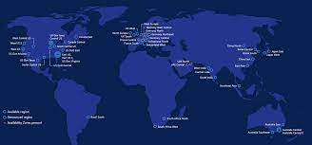
LOCATIONS
Locations are Microsoft ‘ s global locations for Azure
•America, Europe ,Asia Pacific ,Middle East & Africa
•Contains one or more regions
•Meets specific data residency and compliance requirements.

Slide 6
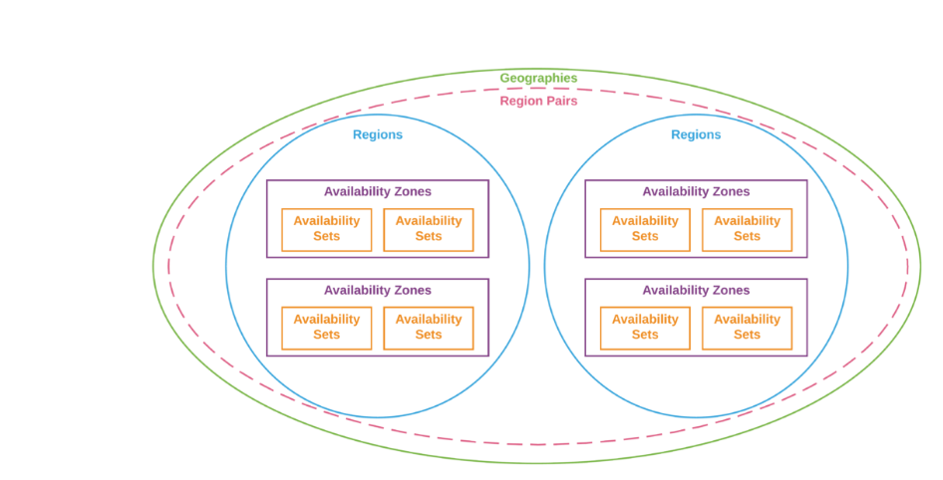
Region
• A region is a set datacenter deployed within a latency defined perimeter and connected through dedicated low latency cable

Slide 7
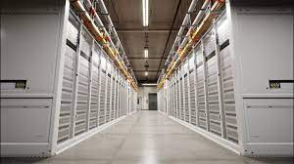
DATA CENTER
A datacenter are centralized locations where computing and networking equipment is concentrated for storing , processing and distributing large volume of data
These data ceneters are located all over the globe.
There are over 160+ Azure datacenters.

Slide 8
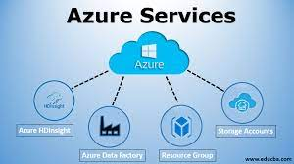
AZURE SERVICES

Slide 9
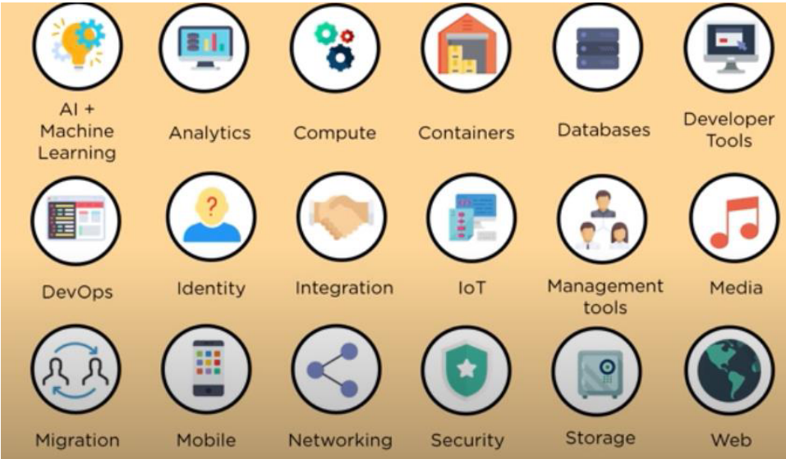
AZURES SERVICES

Slide 10
Azure Compute Services
Compute services provides the building level products, which dictates and determines the execution of an application in Azure platform

Slide 11
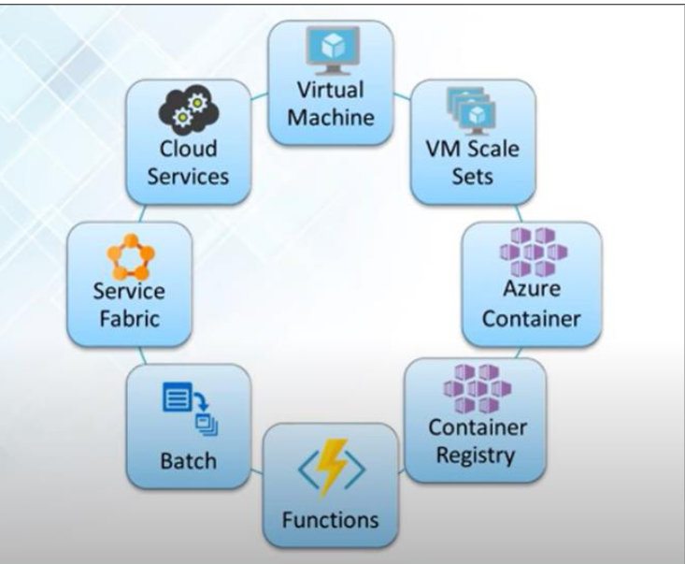
AZURE COMPUTE SERVICES

Slide 12
Virtual Machines
-Allows you to deploy any workload, language any operating system virtually.

Slide 13
Virtual Machine Scale Sets
-Create thousands of virtual machines in minutes
-Rely on integrated load balancing and auto scaling.

Slide 14
Azure Container Services
-Create a container hosting solution optimized for Azure
-Scale and orchestrate applications using DC/OS ,Docker Swarm or Kubernetes

Slide 15
Azure Container Registry
-Store and manage container images across all types of Azure deployments

Slide 16
Functions
-Lets you write code regardless of infrastructure and provisioning of servers, especially when your functions call rate scales upRelyon integrated load balancing and auto scaling.

Slide 17
Batch
-Scale to tens,hundreds or thousands of virtual machines
-Stage data and execute compute pipelines.

Slide 18
Service Fabric
-Simplify microservice based application development lifecycle management
-Deliver low latency performance and efficiency at massive scale.

Slide 19
Cloud Services
-Focus on apps,not hardware
-Support for Java,Node.js,PHP,Python and .NET

Slide 20
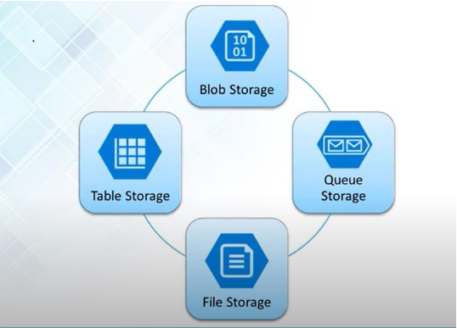
AZURE STORAGE SERVICES

Slide 21
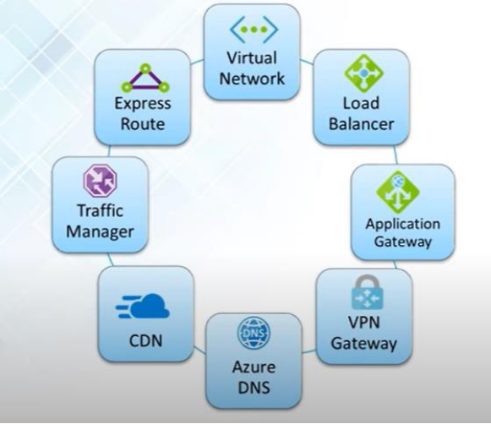
Azure Networking Services

