Slide 1

Basic C Training
Trainer: Priya

Slide 2
PRE - REQUIREMENT?
System
Interest
INTEREST
TIME

Slide 3
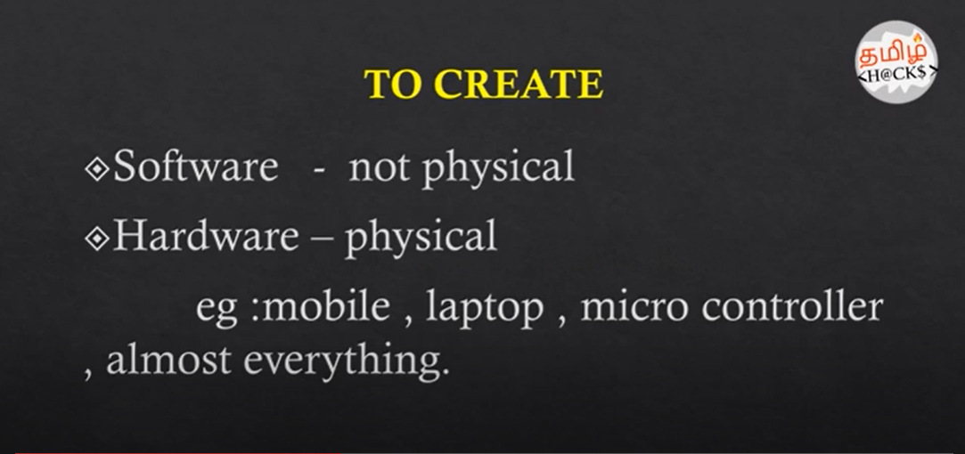
PROGRAMMING ?

Slide 4
Programming Language?
to interact with computer
diff ways
universal
Eg: ATM, bank transaction,electricity, social media,
can safeguard our data
http://helloworldcollection.de/
Analogy-> english

Slide 5
PROGRAMMING ANALOGY
https://github.com/ragaPriya224/references/blob/master/bck/basics/Programming_6YearOld.pdf

Slide 6
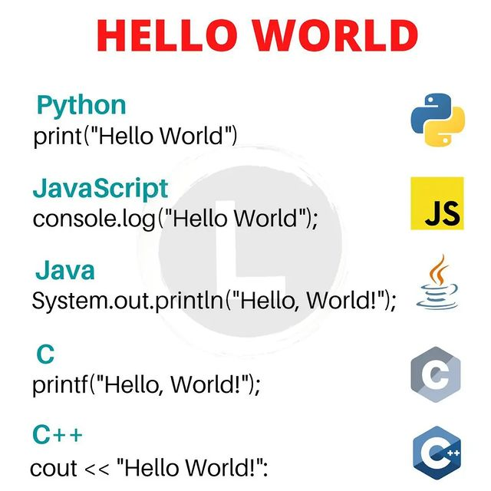

Slide 7
Intro to Software
UI - user Interface Backend Technologies DB - Sql.Nosql
HTML,CSS,JS,TS,Angular
React
Java
.Net
C,C++
Python
Ruby
Scala
R
Mysql,Oracle
Apache Cassandra
Mongo DB
AWS
Docker
Kubernates
IBM WebSphere
Maven
GIT/BitBucket
Jenkins/Puppet
U-deploy
HPE Fortify/BlackDuck

Slide 8
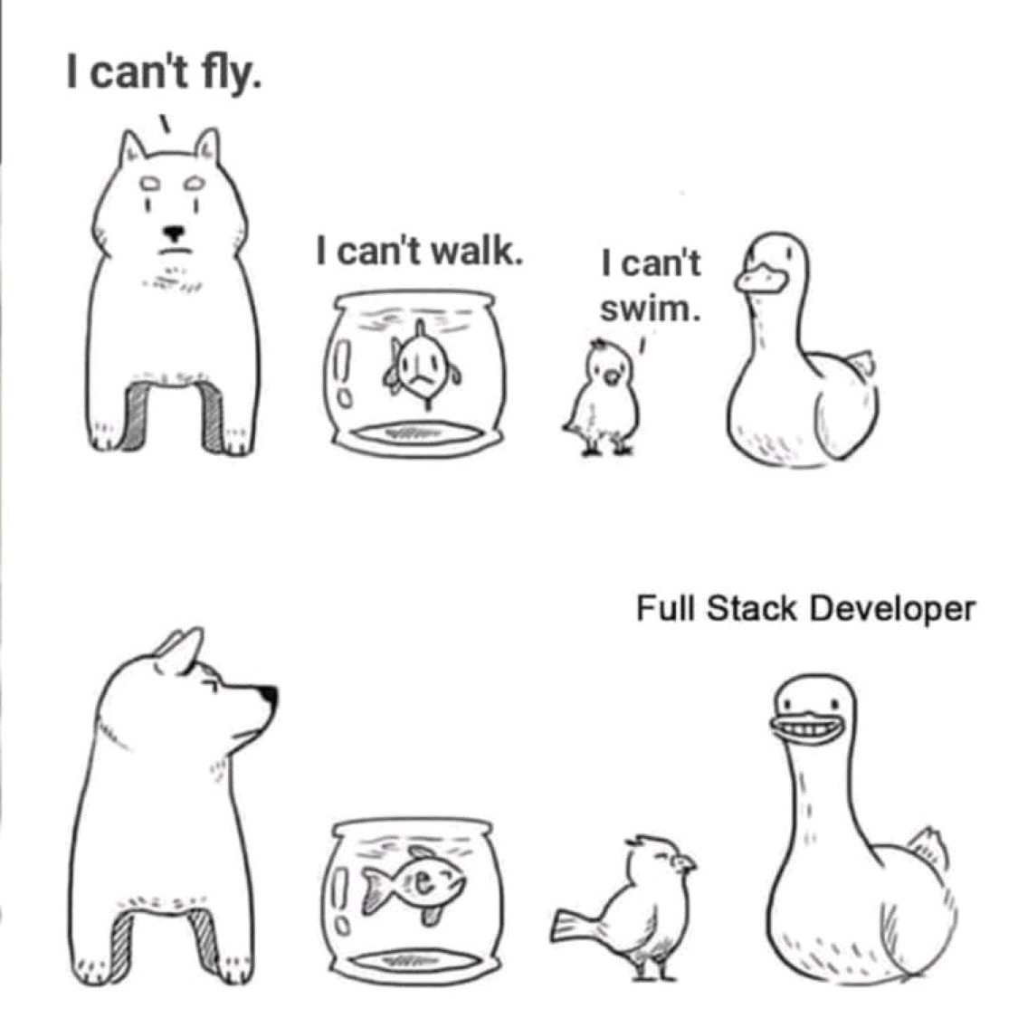

Slide 9
JUST FOR FUN :)
https://github.com/ragaPriya224/references/blob/master/bck/basics/Programmer_dictionary_beginner.pdf

Slide 10
SYMBOLS - USED
https://github.com/ragaPriya224/references/blob/master/bck/basics/symbols_programming.jpg

Slide 11
Basic intro
D:\AHCL\basic-c

Slide 12
High level language?
languages are considered high-level because they are closer to human languages high-level languages are easier to grasp. It allows a programmer to write code more efficiently.

Slide 13
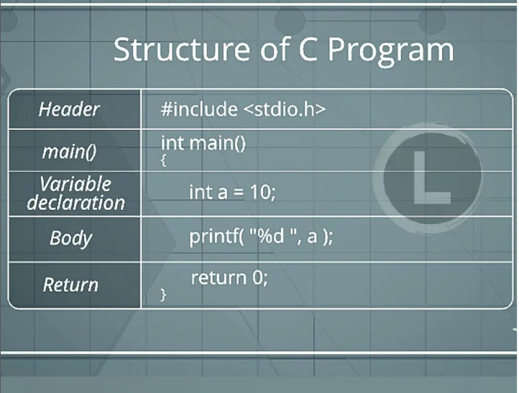
STRUCTURE OF C
Structure of a C program👇
1)Header Files Inclusion,
2)Main Method Declaration,
3)Variable Declaration,
4)Body,
5)Return Statemen.
By structure, it is meant that any program can be written in this structure only. Writing a C program in any other structure will hence lead to compilation error.

Slide 14
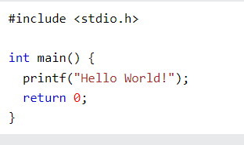
Example explained
Line 1: #include <stdio.h> is a header file library that lets us work with input and output functions, such as printf() (used in line 4). Header files add functionality to C programs.
Don't worry if you don't understand how #include <stdio.h> works. Just think of it as something that (almost) always appears in your program.
Line 2: A blank line. C ignores white space. But we use it to make the code more readable.
Line 3: Another thing that always appear in a C program, is main(). This is called a function. Any code inside its curly brackets {} will be executed.
Line 4: printf() is a function used to output/print text to the screen. In our example it will output "Hello World".
Note that: Every C statement ends with a semicolon ;
#include <stdio.h>
int main() {
printf("Hello World!");
return 0;
}

Slide 15
Line 5: return 0 ends the main() function.
Line 6: Do not forget to add the closing curly bracket } to actually end the main function.

Slide 16
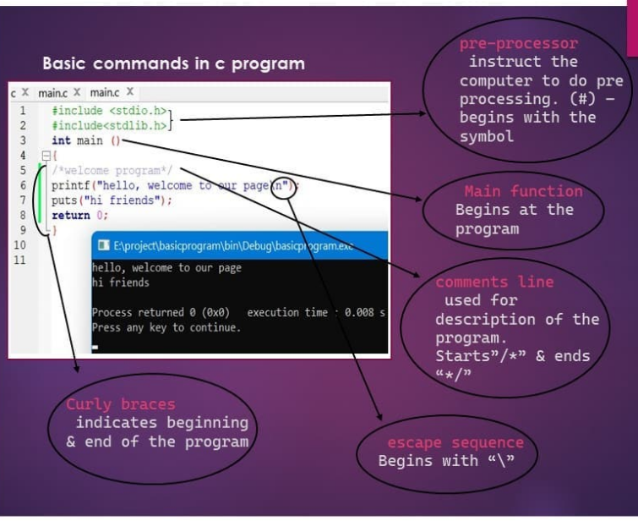

Slide 17
Exercise: -main function
https://www.w3schools.com/c/exercise.php?filename=exercise_syntax1

Slide 18
comments

Slide 19
C Variables
variables are containers for storing data values.
In C, there are different types of variables (defined with different keywords), for example:
int - stores integers (whole numbers), without decimals, such as 123 or -123
float - stores floating point numbers, with decimals, such as 19.99 or -19.99
char - stores single characters, such as 'a' or 'B'. Char values are surrounded by single quotes

Slide 20
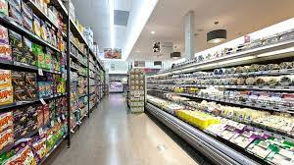

Slide 21
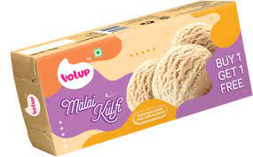
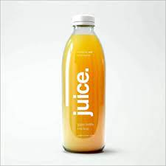
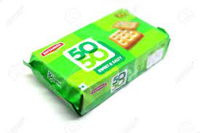
Data Types
Int, float , char, String

Slide 22
int pen = 10;
Syntax: type variableName = value;
Int -> data type
Pen -> variable
= -> assigning
10 ->value
; -> end of statement

Slide 23
Coding standards:
{
Names
int a,b,c

Slide 24
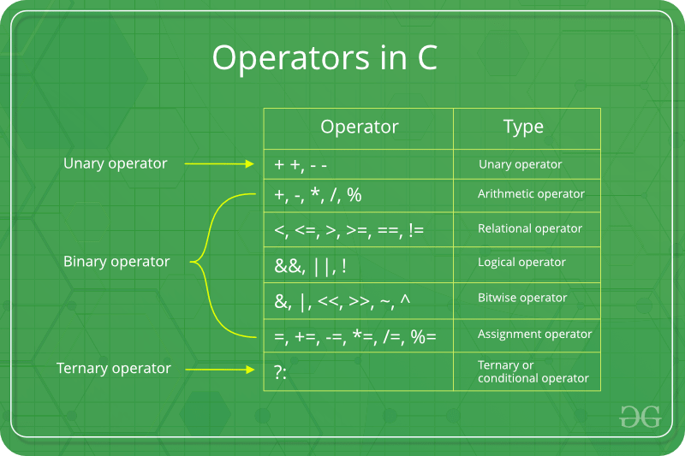

Slide 25
RELATIONAL:
Exercise:
exercise: check according to age, someone is eligble to vote or not

Slide 26
ARITHMETIC OPERATORS

Slide 27
Assignment
// Online C compiler to run C program online
#include <stdio.h>
int main() {
// Write C code here
printf("Hello world");
int a = 10;
//int b = a+5; // 15
//a = a+5; //15
a+=5; //15
return 0;
}

Slide 28
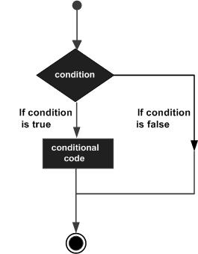
Decision making

Slide 29
FLOW CONTROL

Slide 30

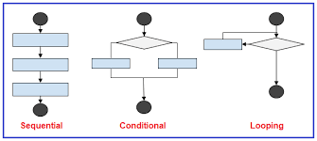
FLOW CONTROL
Selection Iterative Transfer
if else else if while() break
switch() do while() continue
for return

Slide 31
if statement
// if it's saturday or sunday, i have to print it's weekend ;)
// if it's other days, i have to print, it's weekday :(
if (condition) {
// block of code to be executed if the condition is true
}

Slide 32
task
you have 100 rupee, and your favourite icecream is 50 rupee. Write a logic to find whether you’ll be able to buy a icecream or not. If yes, print , “yummy”, if no, print, “let me buy next time”
if it’s sunday, print weekend
if that is not the case, print BORING

Slide 33
nested if problem
Try affording an iphone of 50k.
If not, try afford a redmi of 25k
If not, try buying normal nokia set of 2k
If not, return home

Slide 34
Conditional
if(mark > 50){
printf("pass");
}else{
printf("fail");
}
(mark > 50) ? printf("pass") : printf("fail");
condition ? expression1 : expression2;

Slide 35
switch(expression) {
case x:
// code block
break;
case y:
// code block
break;
default:
// code block
}
int main() {
int mark = 90;
switch(mark) {
case 90:
case 80:
printf("excellent");
break;
case 70:
printf("grade c ");
break;
case 60:
printf("grade d ");
break;
default:
printf("none matched");
}
return 0;
}

Slide 36
task:
Have a variable day of datatype int.
Write a switch case,such that if it’s day 1, then output should be monday, day 2 -> tuesday like that till day 7.. Suppose if you any number other than these, print “give a valid input”

Slide 37
while loop syntax
while (condition) {
// code block to be executed
}
int main() {
int number = 10;
while (number < 5) {
printf("hello buddy");
number++;
}
printf("bye!");
return 0;
}

Slide 38
do while loop syntax
int main() {
int number = 10;
do {
printf("hello aliens");
number++;
}
while (number<5);
return 0;
}
do {
// code block to be executed
}
while (condition);

Slide 39
For loop
for(initialization; condition; increment/decrement){
//statement or code to be executed
}

Slide 40
Continue
int main() {
int num = 1;
while(num < 5){
if(num == 3){
printf("weekend ");
num++;
continue;
}else{
num++;
}
printf("good ");
}
return 0;
}

Slide 41
FUNCTIONS

Slide 42
POINTS TO COVER:
What? 2. Definition, call, declare 3.
Multiple times, diff return types, parameter any…std

Slide 43
SYNTAX
returnType functionName(parameter1, parameter2, parameter3) {
// code to be executed
}
// parameters optional
Meaningful function names to be given

Slide 44
FUNCTIONS
file:///D:/AHCL/FUNCTIONS_c.pdf

Slide 45
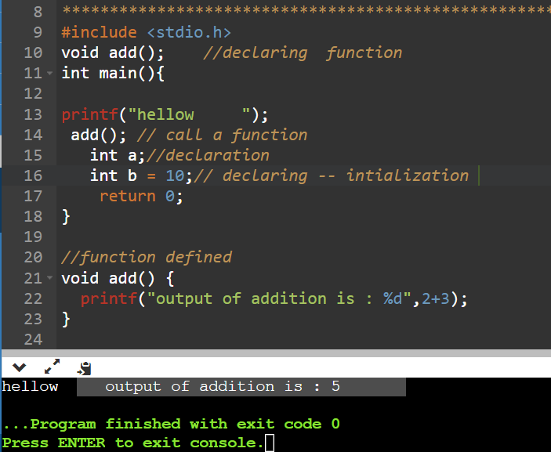
Function - without parameters, void r type
#include <stdio.h>
void add(); //declaring function
int main(){
printf("hellow ");
add(); // call a function
int a;//declaration
int b = 10;// declaring -- intialization
return 0;
}
//function defined
void add() {
printf("output of addition is : %d",2+3);
}

Slide 46
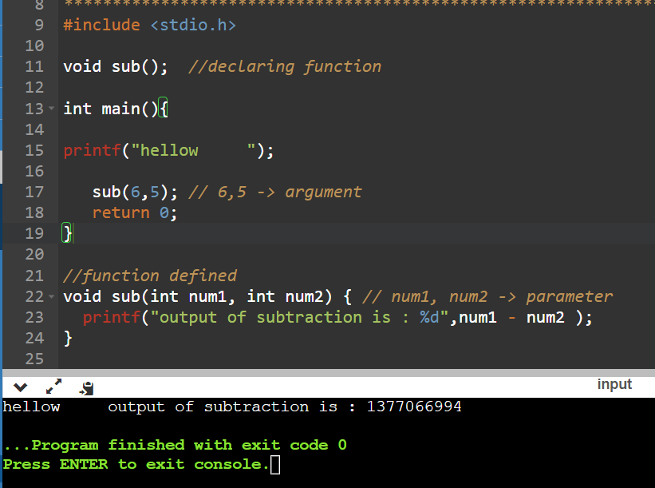
Function -> with parameters, void return type
#include <stdio.h>
void sub(); //declaring function
int main(){
printf("hellow ");
sub(6,5); // 6,5 -> argument
return 0;
}
//function defined
void sub(int num1, int num2) { // num1, num2 -> parameter
printf("output of subtraction is : %d",num1 - num2 );
}

Slide 47
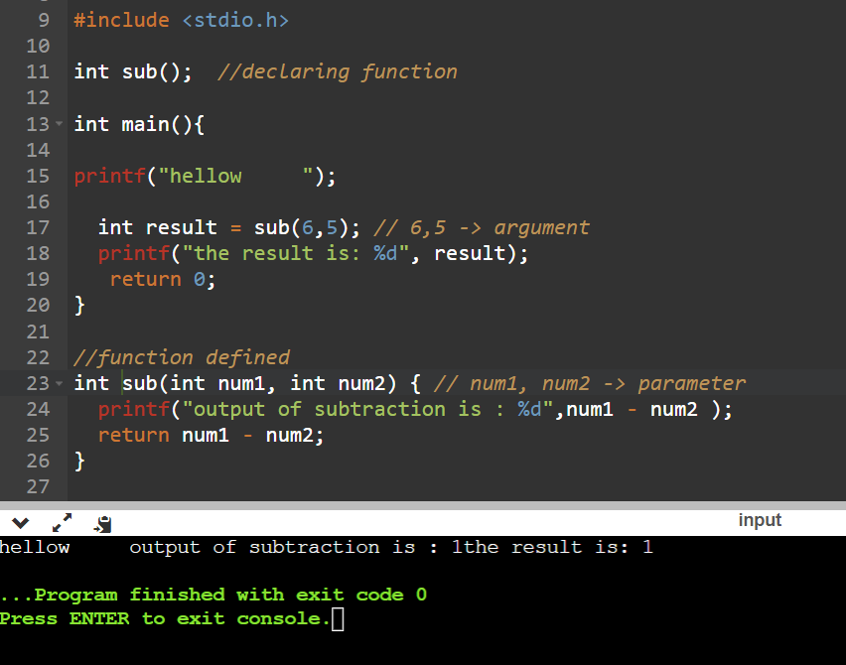
function-> with parameters, with return type
#include <stdio.h>
int sub(); //declaring function
int main(){
printf("hellow ");
int result = sub(6,5); // 6,5 -> argument
printf("the result is: %d", result);
return 0;
}
//function defined
int sub(int num1, int num2) { // num1, num2 -> parameter
printf("output of subtraction is : %d",num1 - num2 );
return num1 - num2;
}

Slide 48
Task:
create a function to multiply two numbers and return it

Slide 49
ARRAYS

Slide 50
ARRAY
int myNumbers[] = {25, 50, 75, 100};
Access the Elements of an Array
Change an Array Element
Loop Through an Array
4.Set Array Size
MISC: CAN’T CHANGE , index

Slide 51
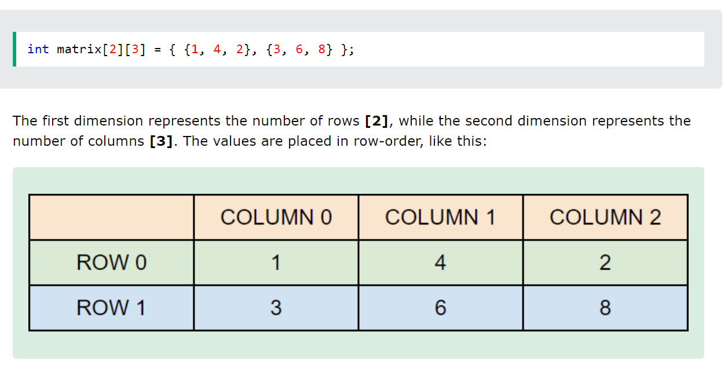
2D

Slide 52
Creation
Access
Change
loop

Slide 53
STRING

Slide 54
STRING?
The string can be defined as the one-dimensional array of characters terminated by a null ('\0'). The character array or the string is used to manipulate text such as word or sentences. Each character in the array occupies one byte of memory, and the last character must always be 0. The termination character ('\0') is important in a string since it is the only way to identify where the string ends. When we define a string as char s[10], the character s[10] is implicitly initialized with the null in the memory.

Slide 55
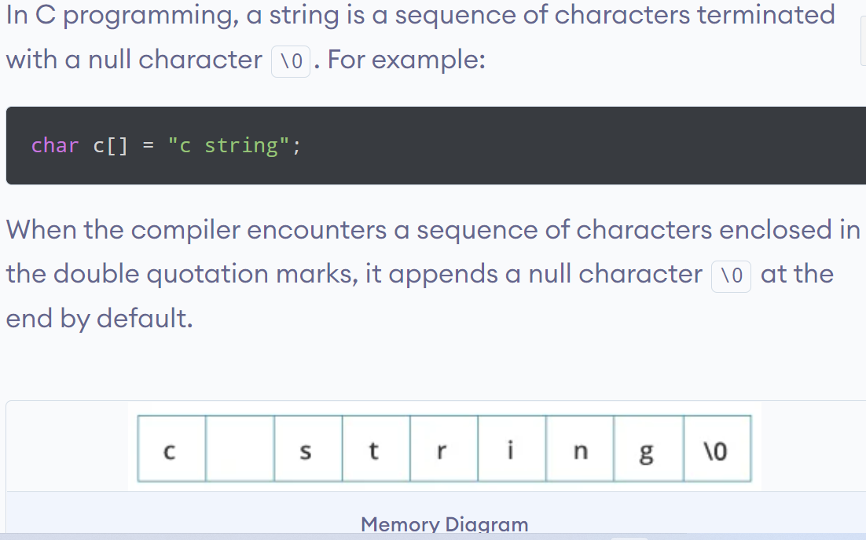

Slide 56
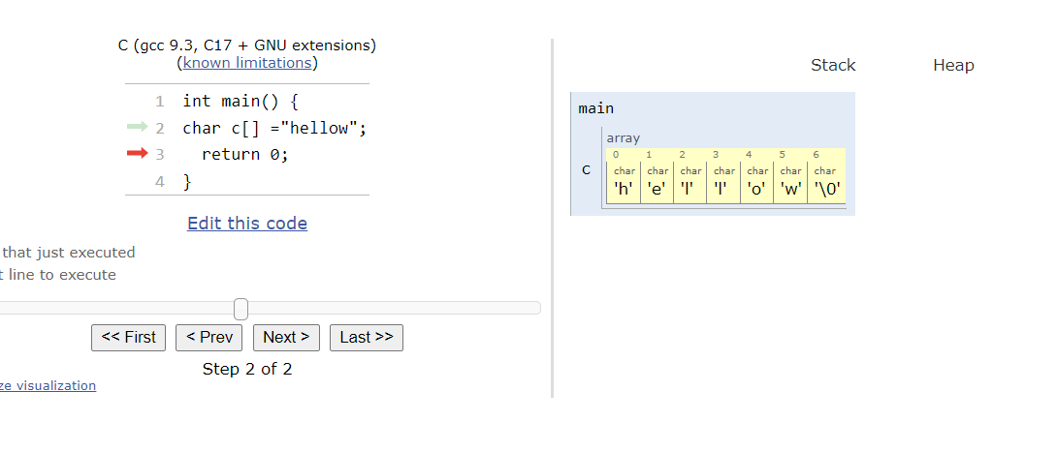

Slide 57
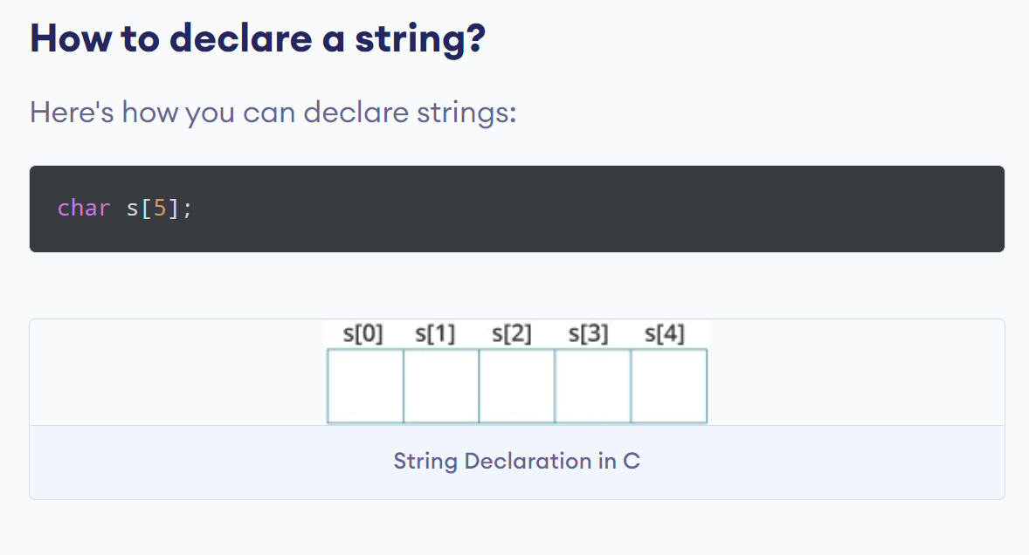
declaration

Slide 58
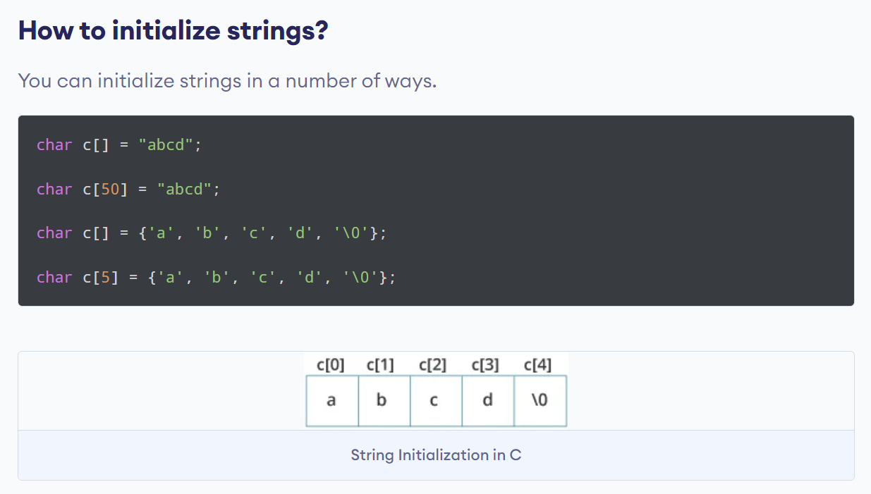
initialize

Slide 59
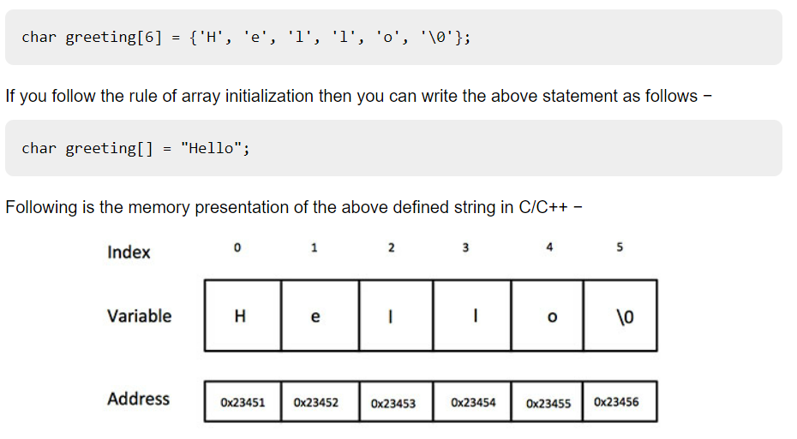

Slide 60
2 ways
By char array
By string literal

Slide 61
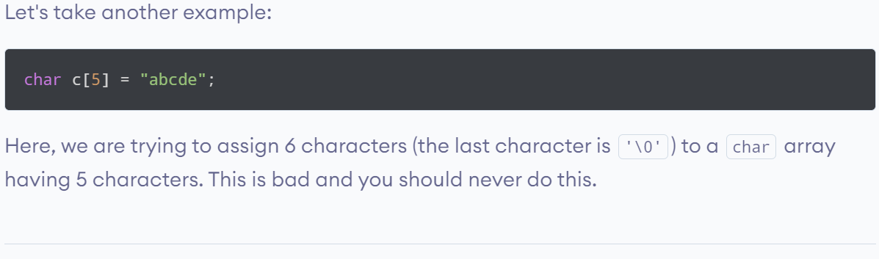
Bad practice

Slide 62
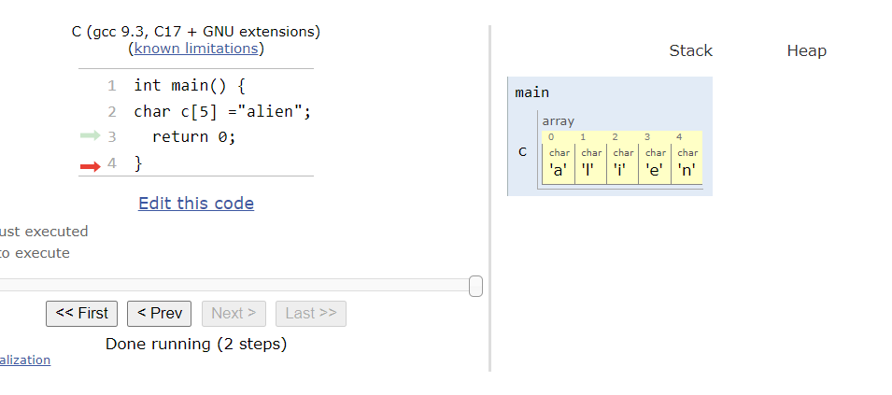

Slide 63
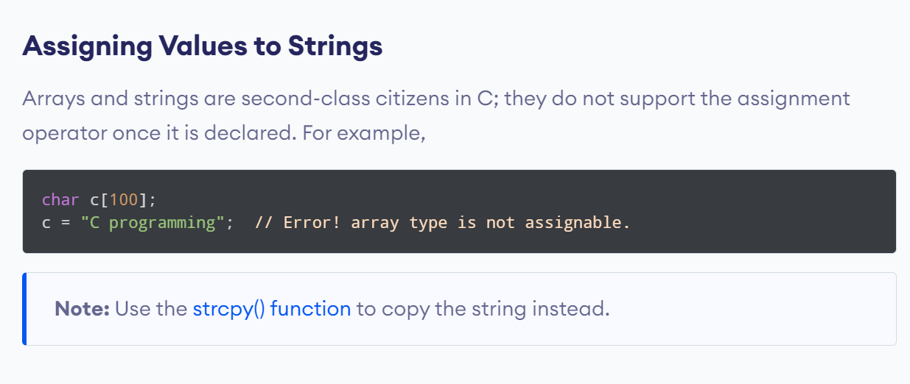
Bad practice

Slide 64
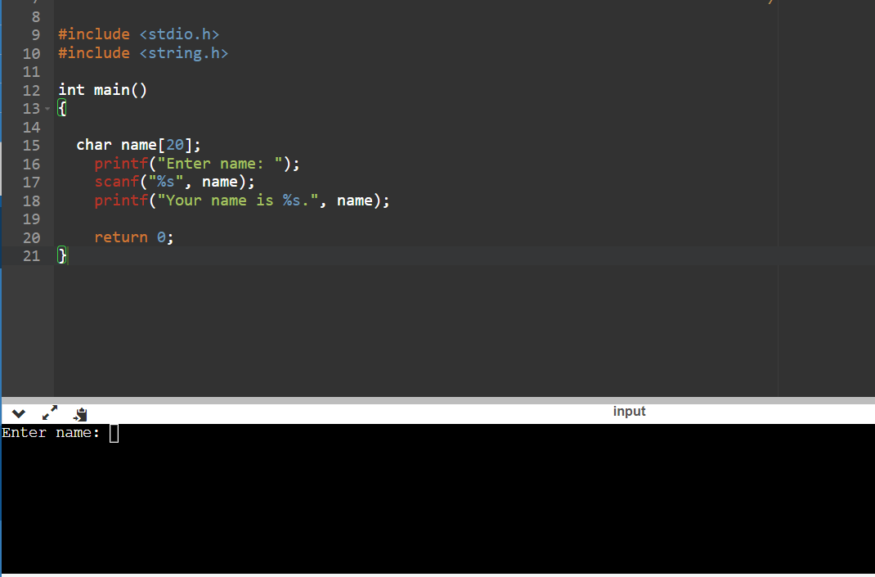
Scanf - intro

Slide 65
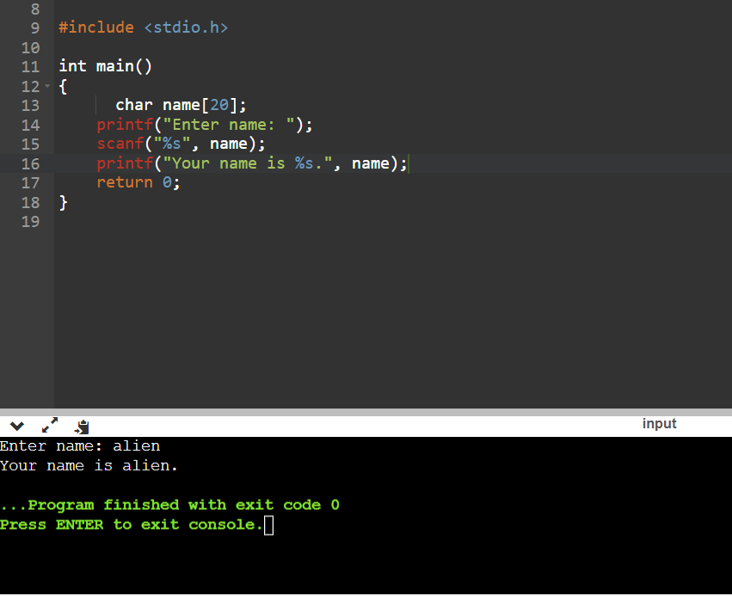
contd…
#include <stdio.h>
int main()
{
char name[20];
printf("Enter name: ");
scanf("%s", name);
printf("Your name is %s.", name);
return 0;
}

Slide 66
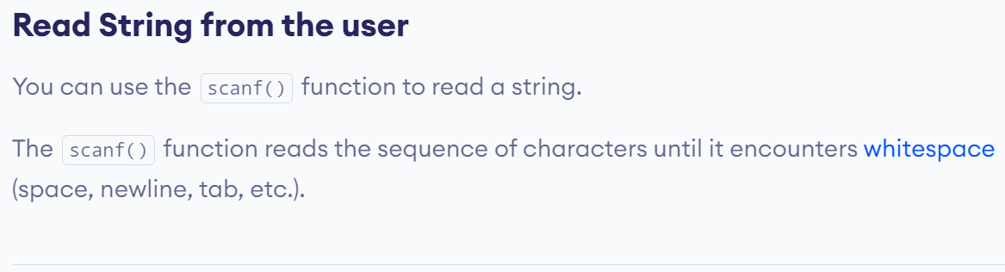

Slide 67
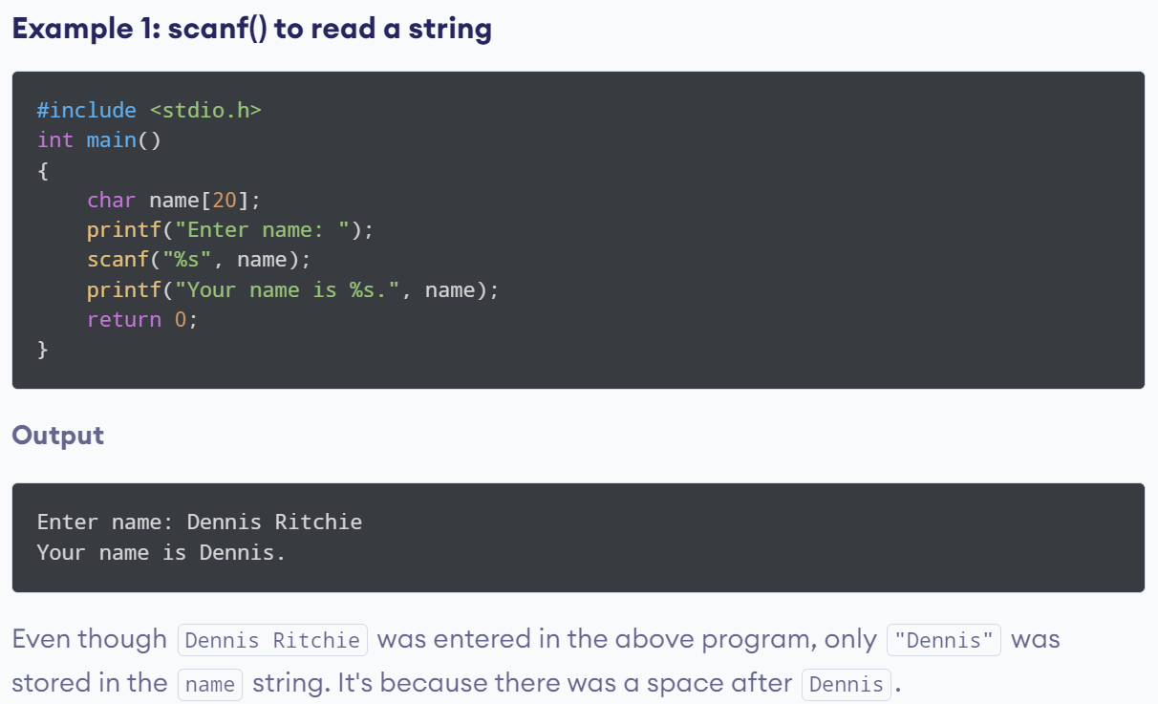
issue
char name[20];
printf("Enter name: ");
scanf("%s", name);
printf("Your name is %s.", name);

Slide 68
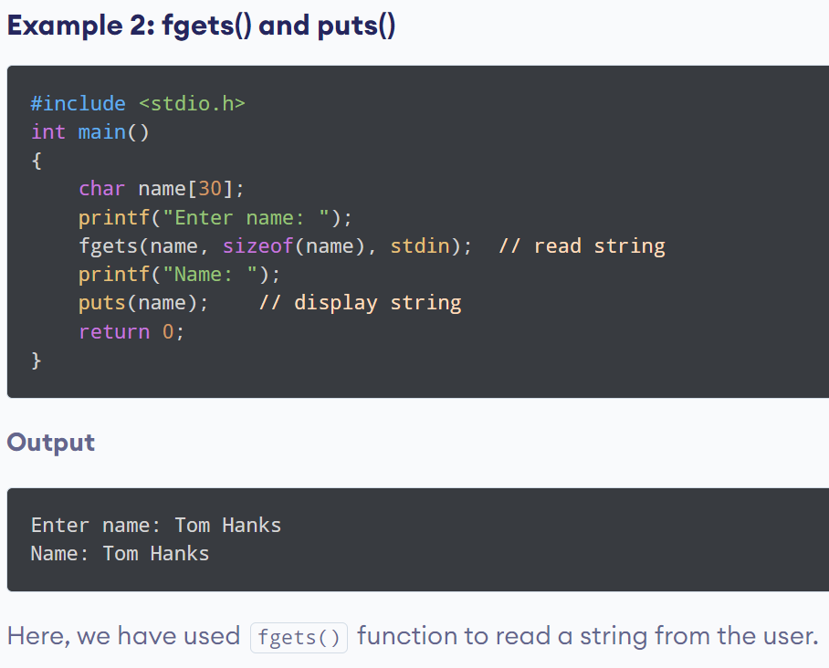
#include <stdio.h>
int main()
{
char name[30];
printf("Enter name: ");
fgets(name, sizeof(name), stdin); // read string
printf("Name: ");
puts(name); // display string
return 0;
}

Slide 69
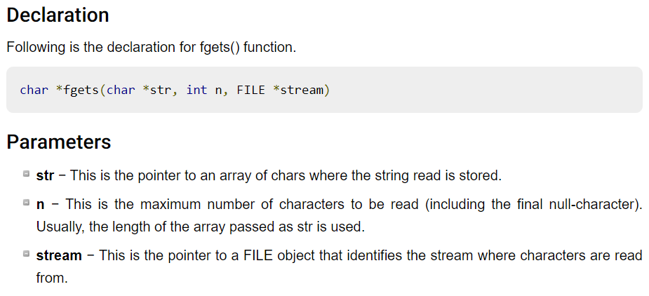

Slide 70
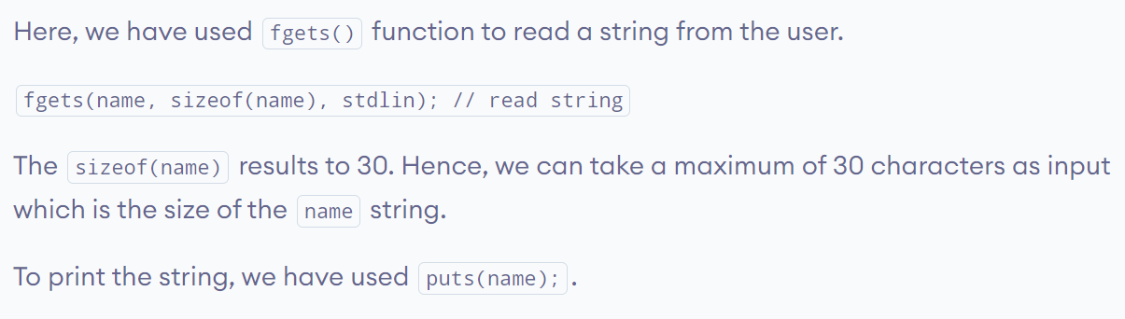
NOTE:
gets() -> not a standard
stdin is an "input stream", which is an abstract term for something that takes input from the user or from a file

Slide 71
sizeof()
code
#include <stdio.h>
int main() {
int a = 16;
printf("Size of variable a : %d",sizeof(a));
printf("Size of int data type : %d",sizeof(int));
printf("Size of char data type : %d",sizeof(char));
printf("Size of float data type : %d",sizeof(float));
printf("Size of double data type : %d",sizeof(double)); printf("Size of a+2 is : %d",sizeof(a+2));
return 0;
}
output
Size of variable a : 4
Size of int data type : 4
Size of char data type : 1
Size of float data type : 4
Size of double data type : 8 Size of a+2 is : 4

Slide 72
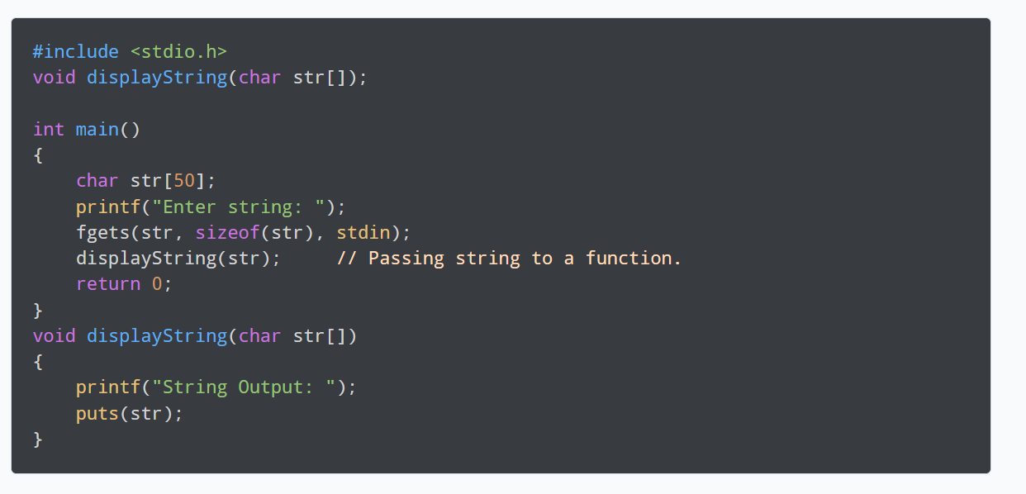
PASS STRING TO FUNCTION

Slide 73
STRING MANIPULATIONS
strlen() - calculates the length of a string
strcpy() - copies a string to another
strcmp() - compares two strings
strcat() - concatenates two strings

Slide 74
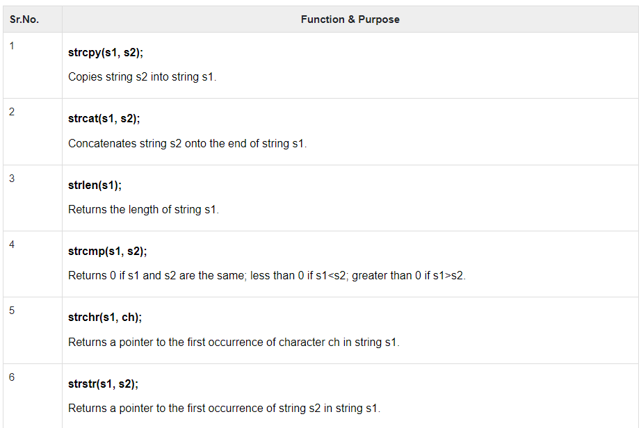

Slide 75
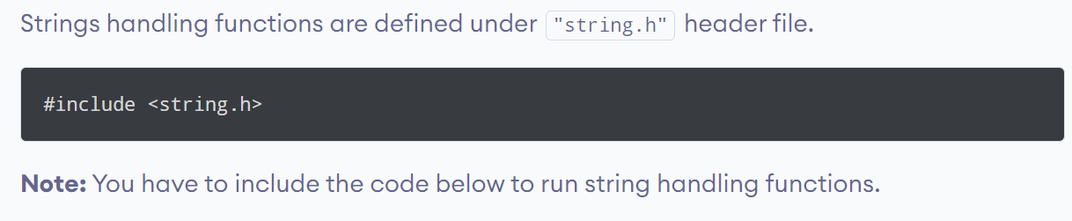

Slide 76
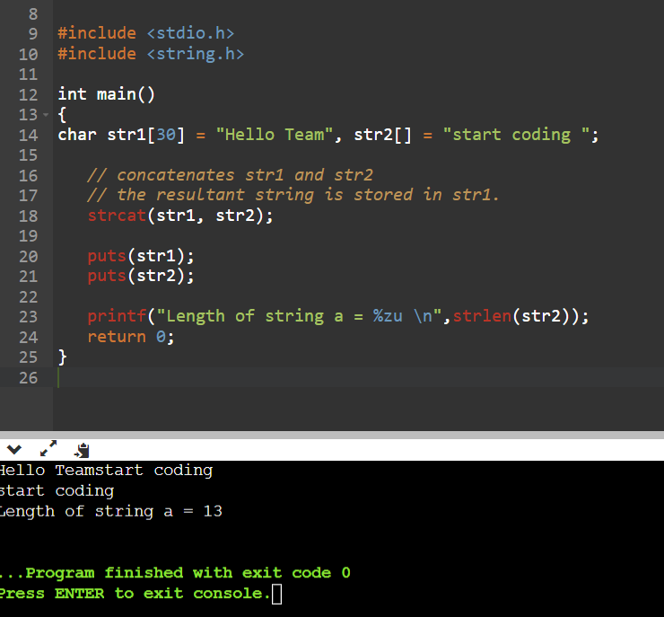
strcat() -> concatenation - joins
#include <stdio.h>
#include <string.h>
int main()
{
char str1[30] = "Hello Team", str2[] = "start coding ";
// concatenates str1 and str2
// the resultant string is stored in str1.
strcat(str1, str2);
puts(str1);
puts(str2);
printf("Length of string a = %zu \n",strlen(str2));
return 0;
}

Slide 77
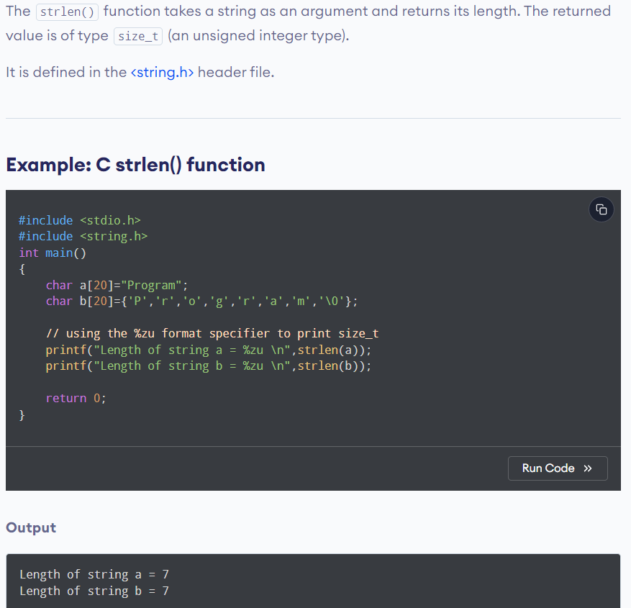
strlen() Note that the strlen() function doesn't count the null character \0 while calculating the length.
#include <stdio.h>
#include <string.h>
int main()
{
char a[20]="Program";
char b[20]={'P','r','o','g','r','a','m','\0'};
// using the %zu format specifier to print size_t
printf("Length of string a = %zu \n",strlen(a));
printf("Length of string b = %zu \n",strlen(b));
return 0;
}

Slide 78
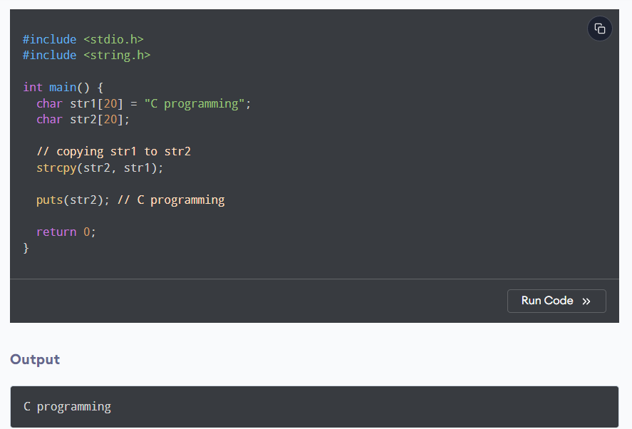
strcpy() ->copy string
strcpy(destination, source);
Note: When you use strcpy(), the size of the destination string should be large enough to store the copied string. Otherwise, it may result in undefined behavior
#include <stdio.h>
#include <string.h>
int main() {
char str1[20] = "C programming";
char str2[20];
// copying str1 to str2
strcpy(str2, str1);
puts(str2); // C programming
return 0;
}

Slide 79
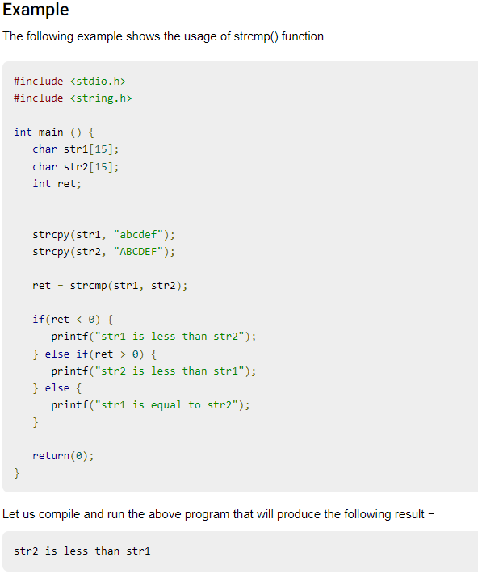
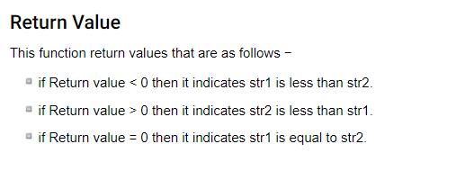
strcmp() -> compare

Slide 80
code
#include <stdio.h>
#include <string.h>
int main () {
char str1[15];
char str2[15];
int ret;
strcpy(str1, "abcdef");
strcpy(str2, "ABCDEF");
ret = strcmp(str1, str2);
if(ret < 0) {
printf("str1 is less than str2");
} else if(ret > 0) {
printf("str2 is less than str1");
} else {
printf("str1 is equal to str2");
}
return(0);
}

