Slide 1

REACT

Slide 2
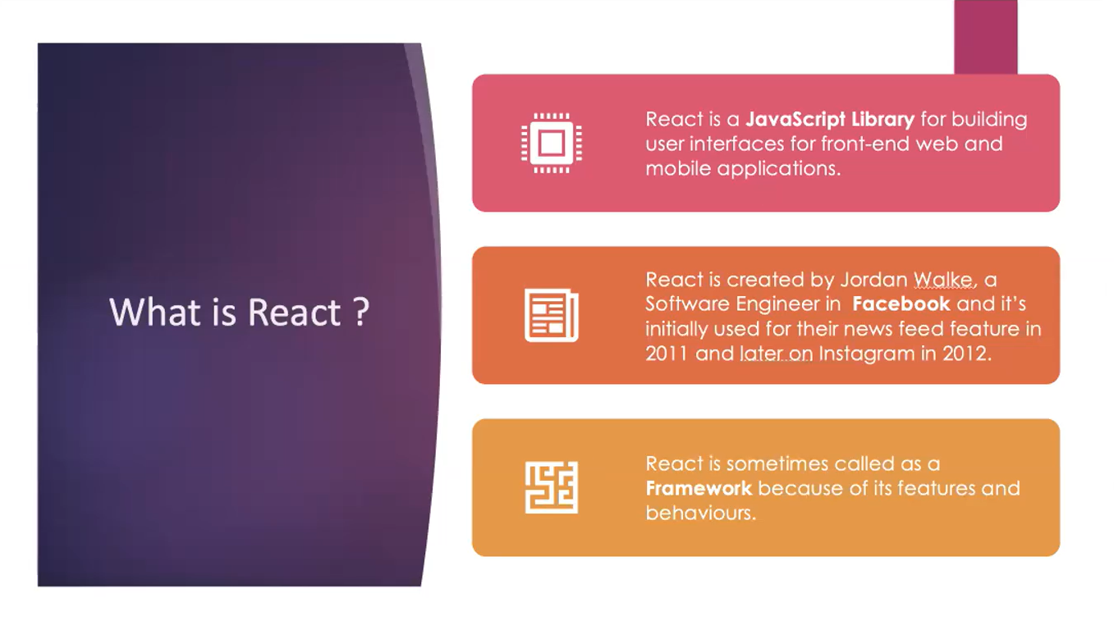

Slide 3

HOW TO CREATE REACT APP?
HOW TO USE COMPONENTS- CLASS COMPONENTS,FUNCTION COMPONENTS
WHAT ARE STATES,PROPS?
STATE?
HOW TO PASS DATA BETWEEN PARENT & CHILD?
HANDLE EVENTS, FORMS?

Slide 4
REQUIREMENTS
NODE JS -INSTALL FROM OFFICIAL WEBSITE. CLICK NEXT->NEXT
https://nodejs.org/en/download/
OPEN TERMINAL node -v
Documentation: https://reactjs.org/

Slide 5
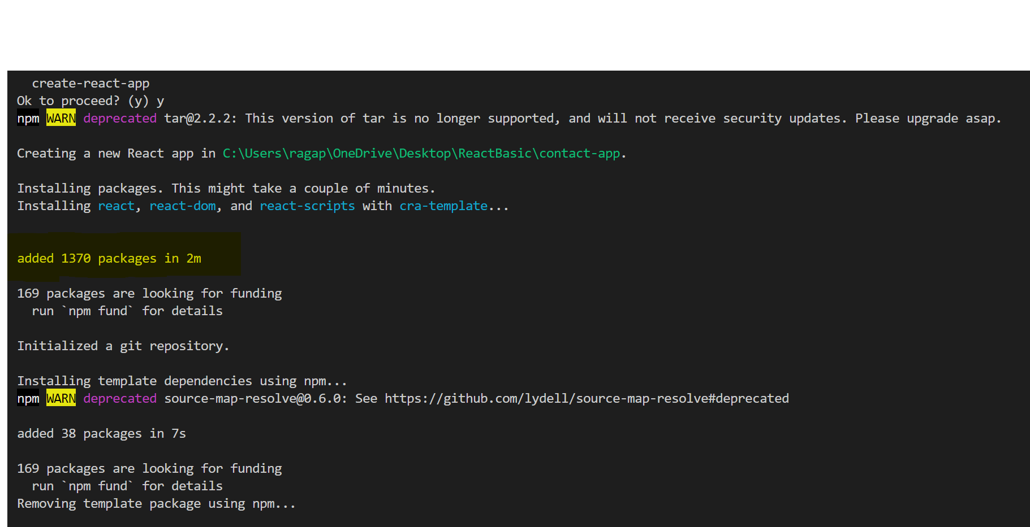
CREATE REACT APP
1.Go to github page of react app
https://github.com/facebook/create-react-app
npx create-react-app my-app
cd my-app
npm start
2. Create react app =>
npx create-react-app contact-app
Lots of dependencies added
Also says, what all commands can be added

Slide 6
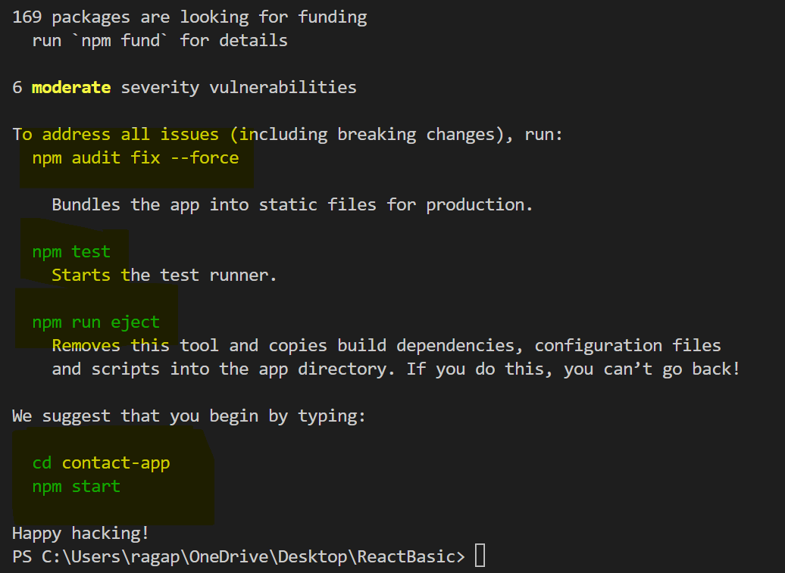
START DEVELOPMENT ENVIRONMENT
Cd .\contact-app\
Npm start => start app

Slide 7
REACT COMMANDS:
1. check node version -> node -v
2.create react app -> npx create-react-app contact-app
3.cd .\contact-app\
4.Npm start => start app

Slide 8
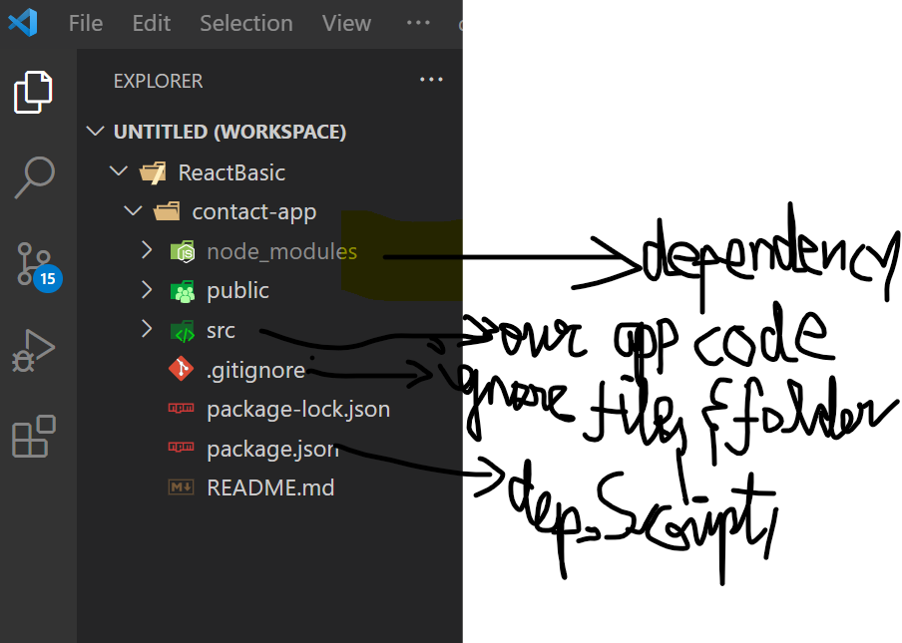
React app folder structure

Slide 9
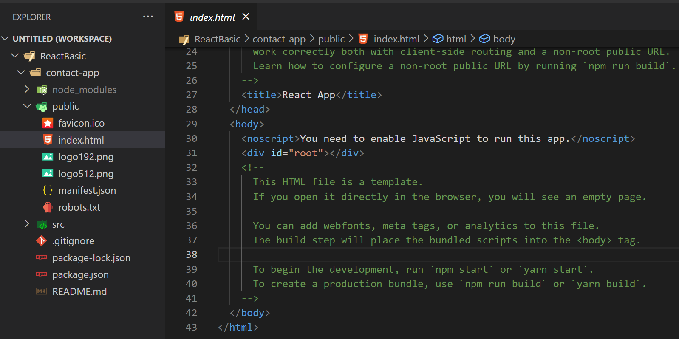

Slide 10
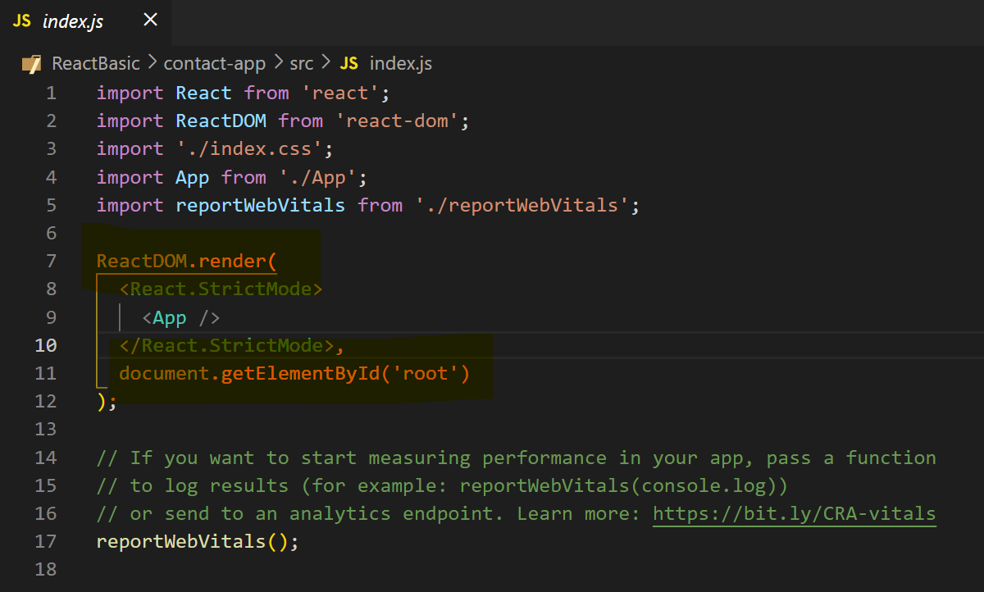
Entry point-> index.js

Slide 11
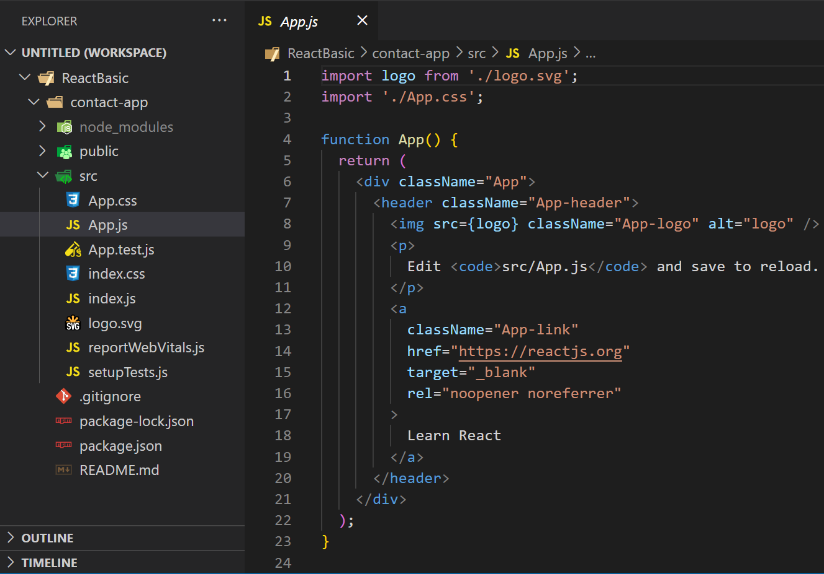
app.js
Default functional component:

Slide 12
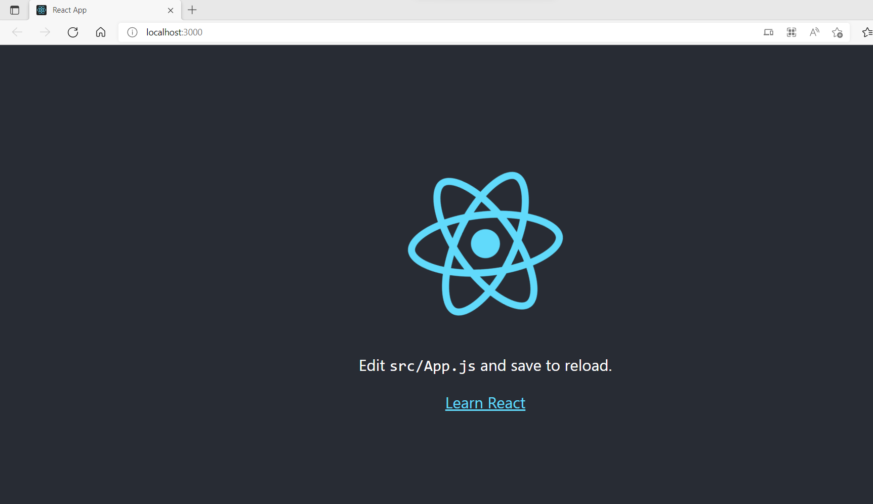
http://localhost:3000/
This is initial app component, which we see on screen

Slide 13
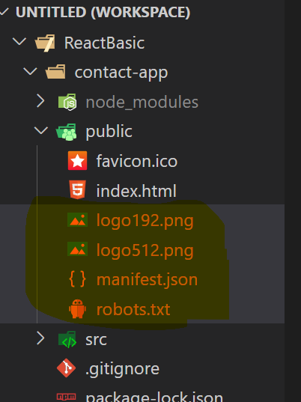
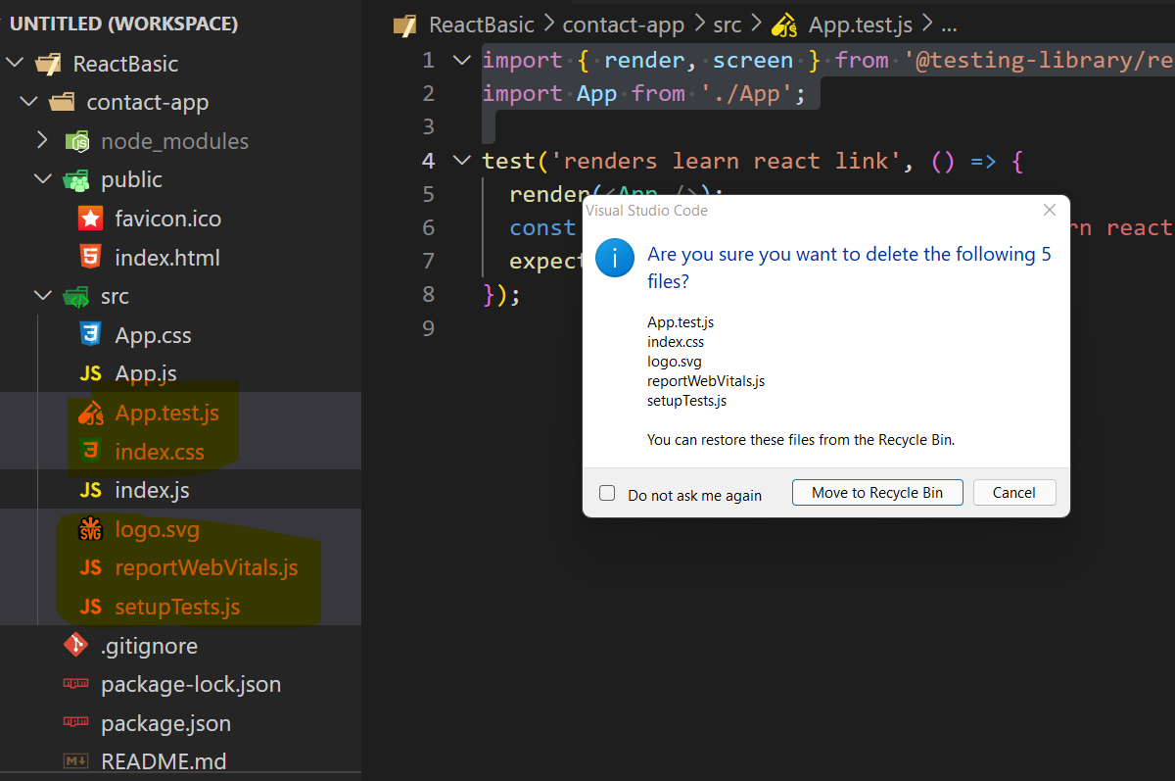
Let’s delete all default stuffs, and build everything from scratch

Slide 14
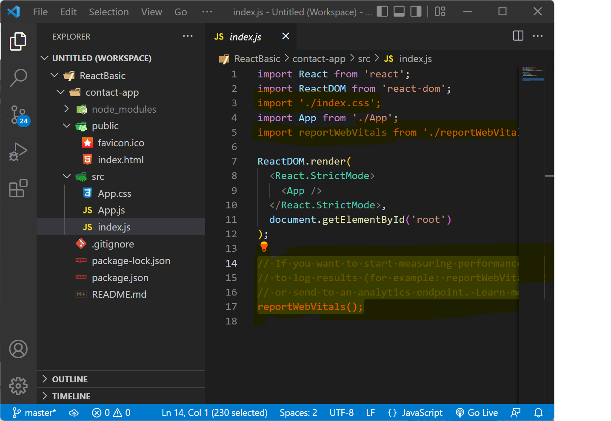
Index.js -> remove some codes

Slide 15
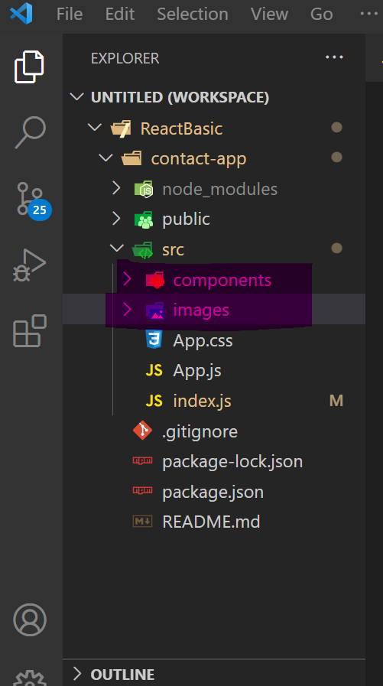
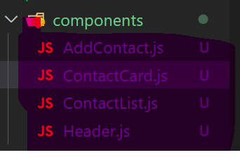
Contact App Folder Structure/ Components
Create 2 new directory’s. Component & images
Add these files in components folder

Slide 16
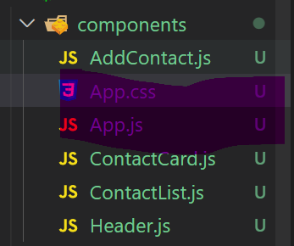
Move app.js,css inside components

Slide 17
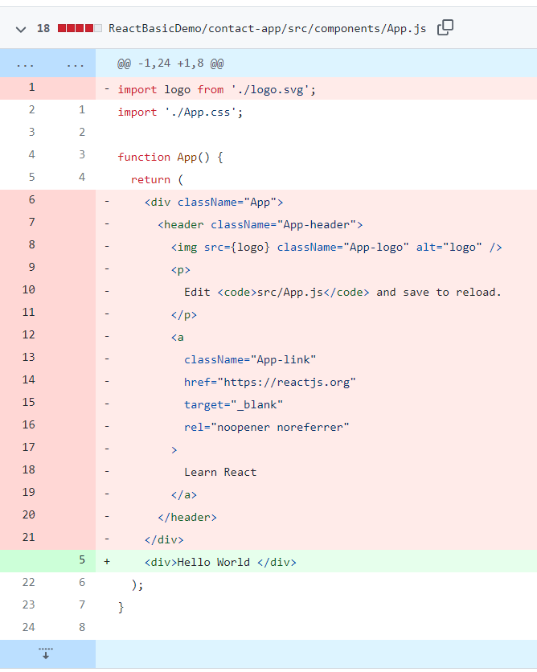
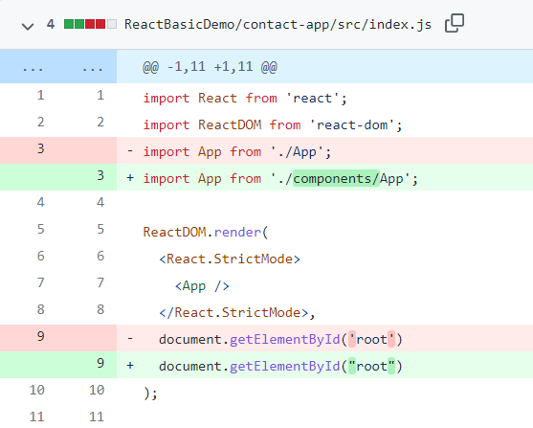
React "Hello World" Components

Slide 18
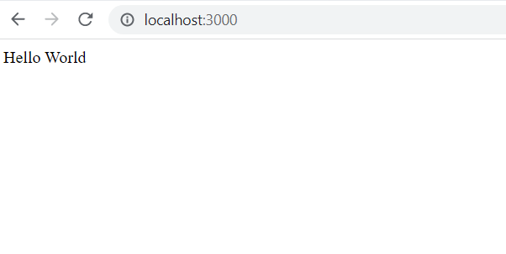
O/P

Slide 19
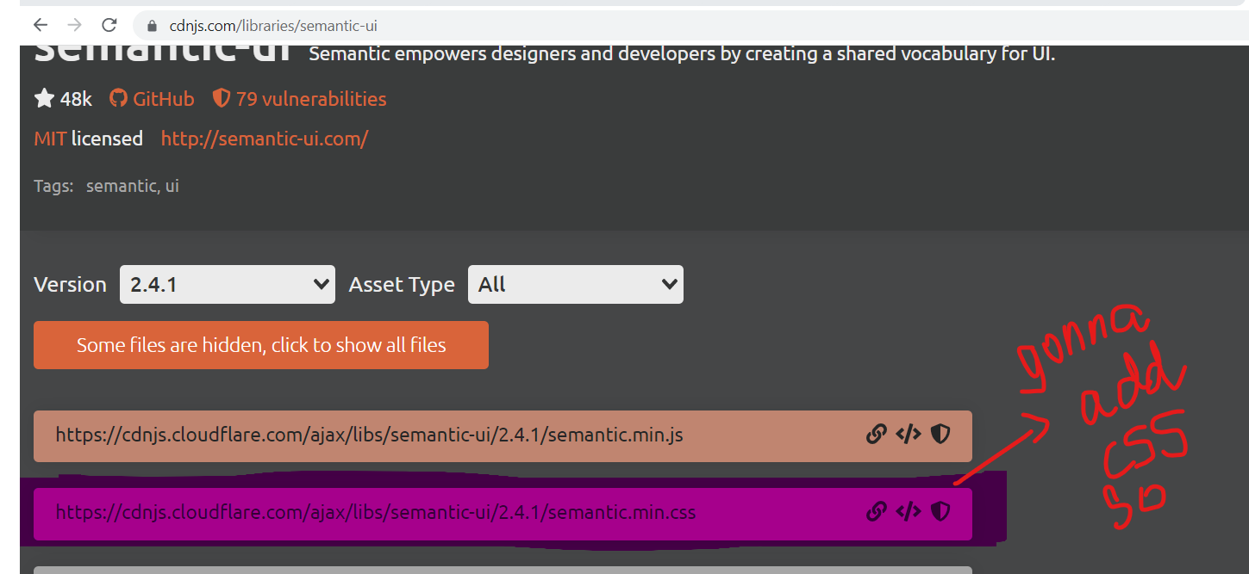
Not gonna concentrate on css, instead using semantic ui library
Semantic ui official website:
https://semantic-ui.com/introduction/getting-started.html https://cdnjs.com/libraries/semantic-ui
Add this in index.html

Slide 20
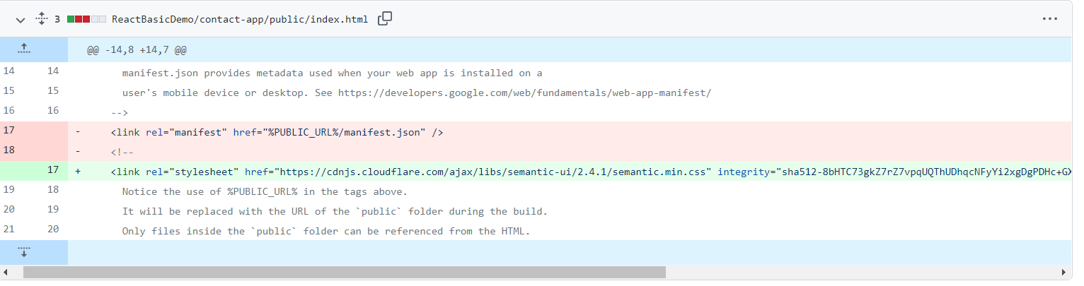
https://github.com/ragaPriya224/B1-IBM/commit/bfef0bc6ef4fcb524c3ec951941f32e74fda4e9c

Slide 21
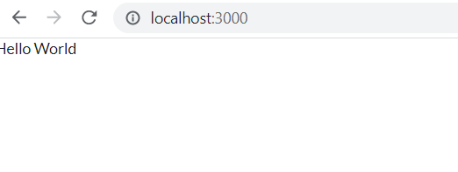
o/p
Change in font family & font size

Slide 22
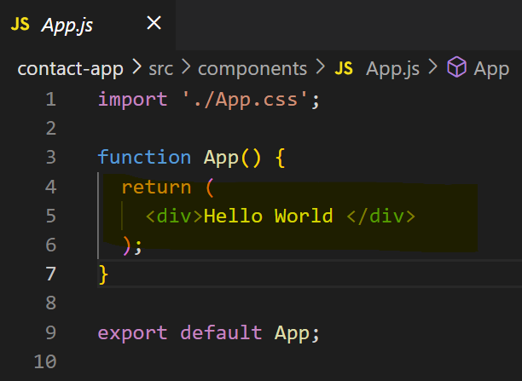
Understand React Components
Component is a piece of reusable code which can be used at any point & it’s an individual piece of code which has it’s own inputs and own outputs and own functionality.
App.js
From app component, we’re returning div of hello world

Slide 23
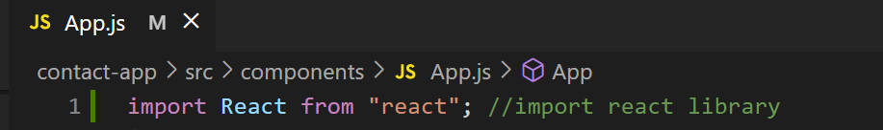
Import react library
This might look like html, but it’s not html. It’s jsx=> combo of js & html. Possible bcoz we using react library

Slide 24
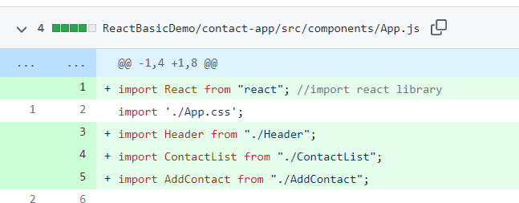
Import our react components in app.js

Slide 25
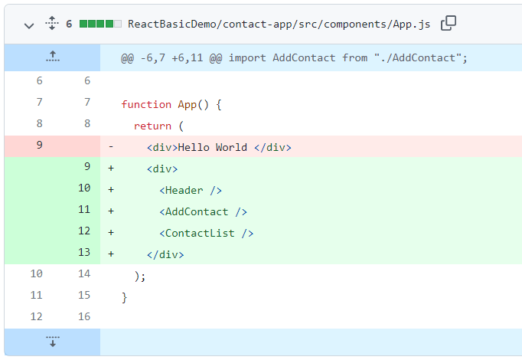
React jsx
U can add header components as custom html element.others too
Noting in screen though !

Slide 26
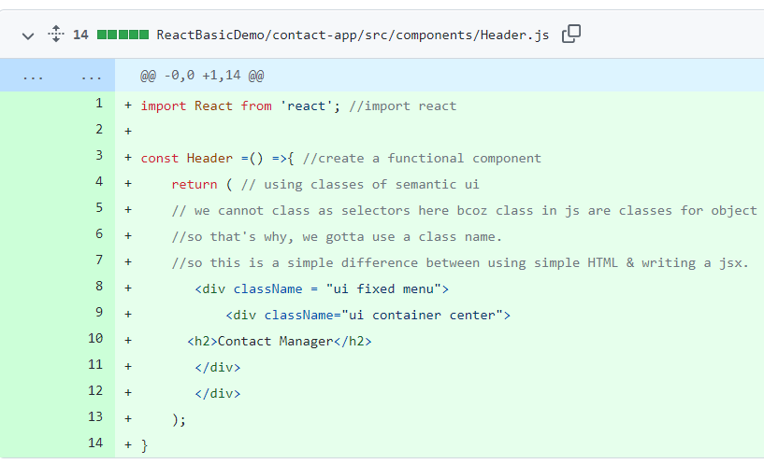
Let’s add code in components(Function Component)
const Header =() =>{ //create a functional component
return ( // using classes of semantic ui
// we cannot class as selectors here bcoz class in js are classes for object oriented programming
//so that's why, we gotta use a class name.
//so this is a simple difference between using simple HTML & writing a jsx.
<div className = "ui fixed menu">
<div className="ui container center">
<h2>Contact Manager</h2>
</div>
</div>
);
}

Slide 27
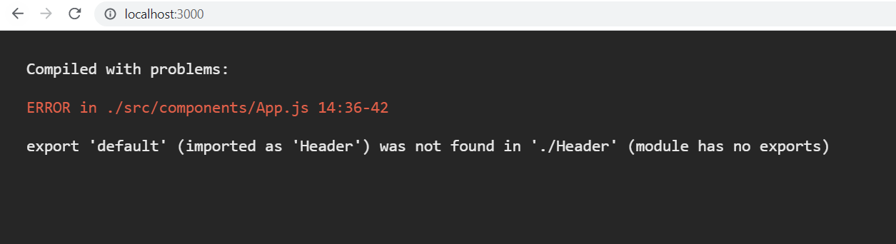
O/P

Slide 28

FIX: in Header.js
export default Header;

Slide 29
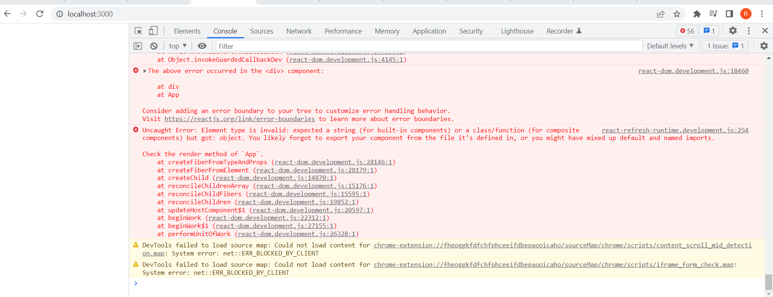
O/P

Slide 30
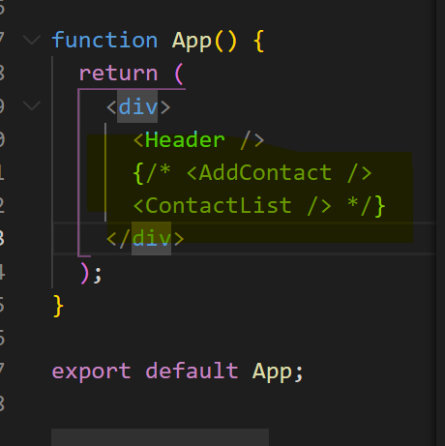
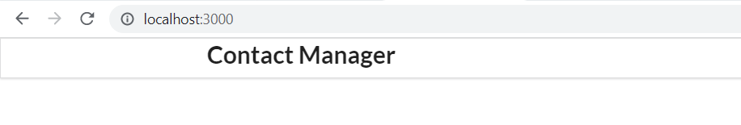
TEMPORARY FIX: COMMENT CONTACTS IN APP.JS
APP.JS
o/p

Slide 31
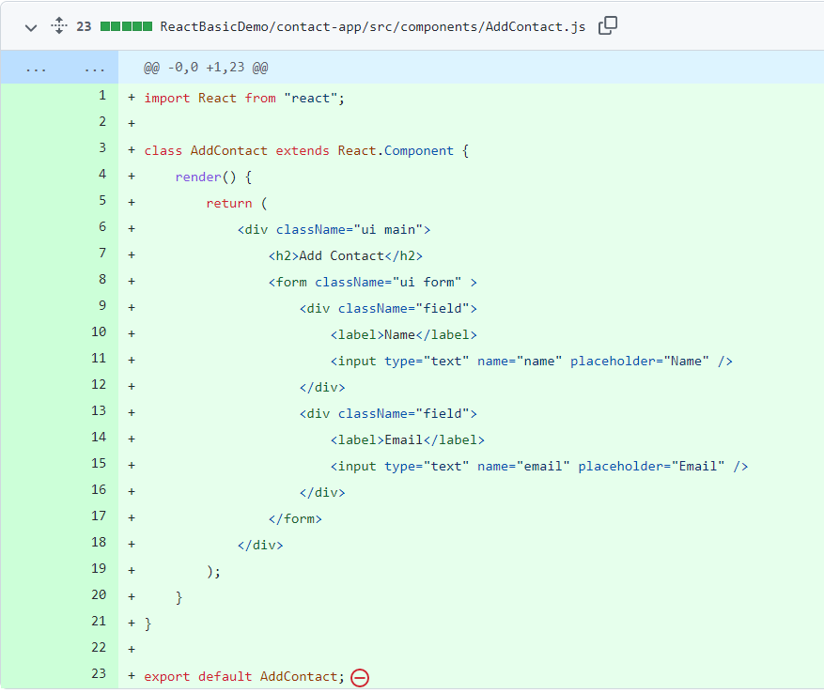
Creating add contact, which contains contact form
import React from "react"; //import
//creating class component
class AddContact extends React.Component {
//cannot simply return, need to use render method
render() {
//create form with name and mail id
return (
<div className="ui main">
<h2>Add Contact</h2>
<form className="ui form" >
<div className="field">
<label>Name</label>
<input type="text" name="name" placeholder="Name" />
</div>
<div className="field">
<label>Email</label>
<input type="text" name="email" placeholder="Email" />
</div>
</form>
</div>
);
}
}
//exporting addcontact
export default AddContact;

Slide 32
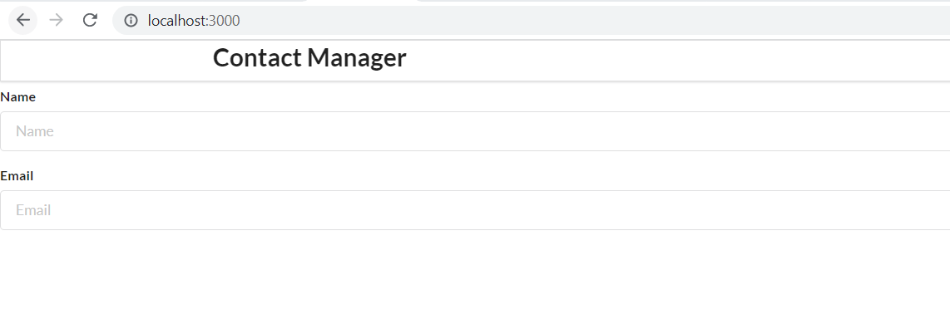
o/p

Slide 33
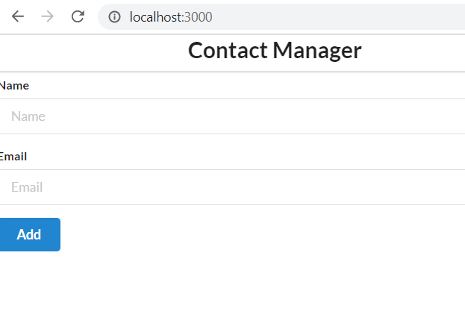
Add a button
<button className="ui button blue">
Add
</button>

Slide 34
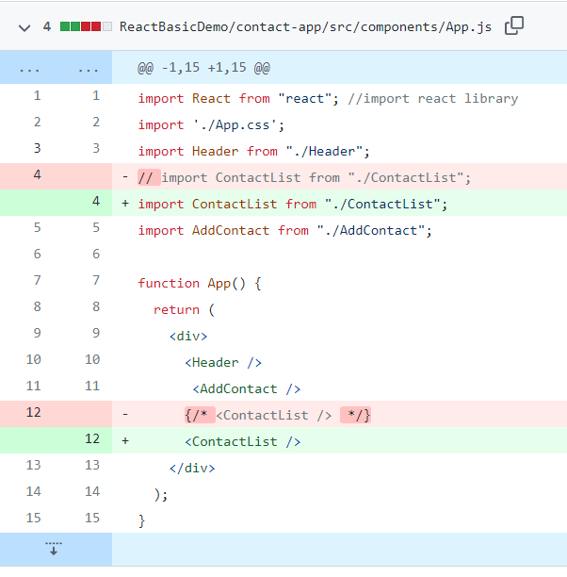
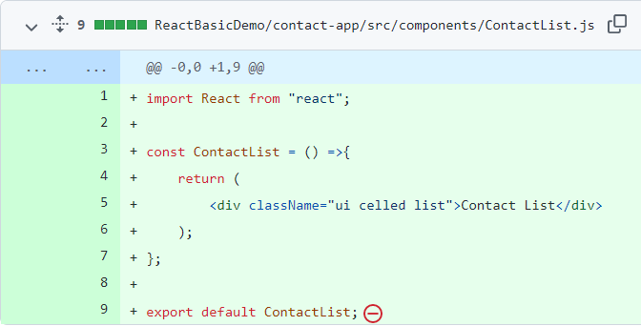
Add code for contactList component.
Creating a functional component

Slide 35
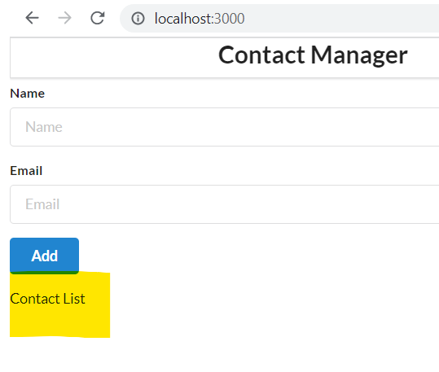
o/p

Slide 36
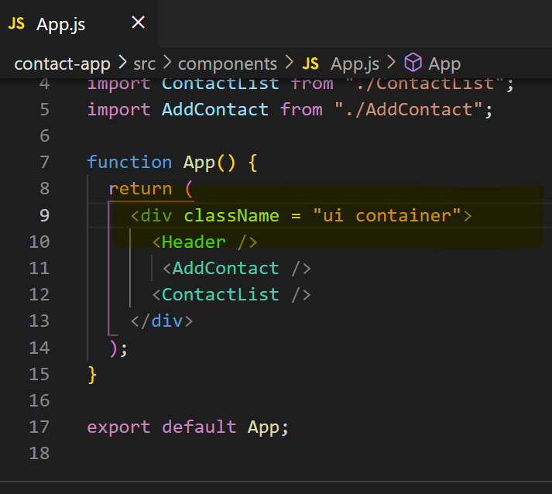
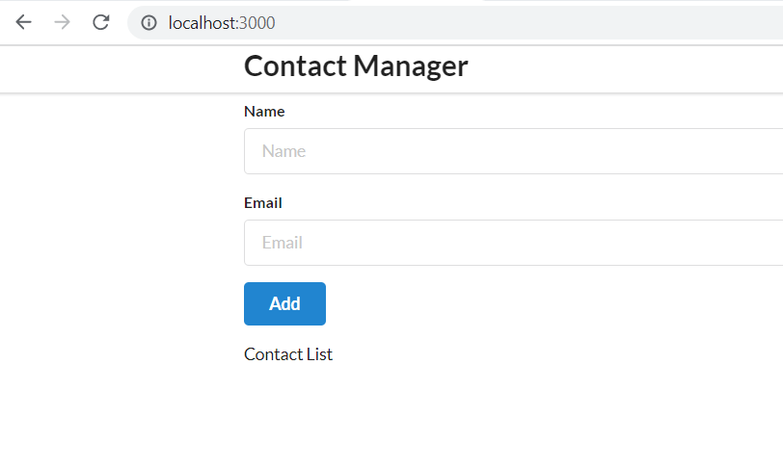
We are done with components, let’s style it a bit

Slide 37
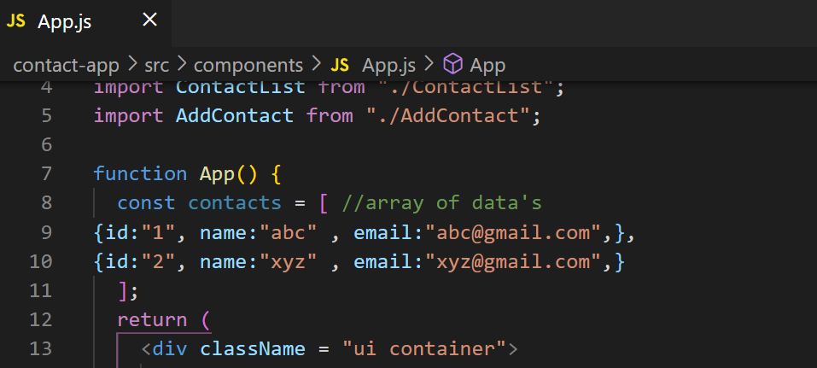
Rendering List in React
const contacts = [ //array of data's
{id:"1", name:"abc" , email:"abc@gmail.com",},
{id:"2", name:"xyz" , email:"xyz@gmail.com",}
];

Slide 38
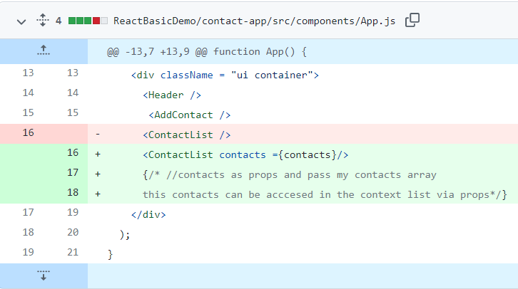
Props - Pass data from parent to child

Slide 39
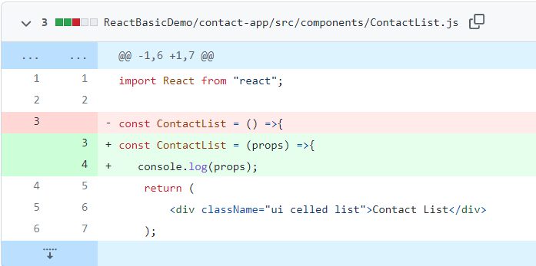
Access props
O/p

Slide 40
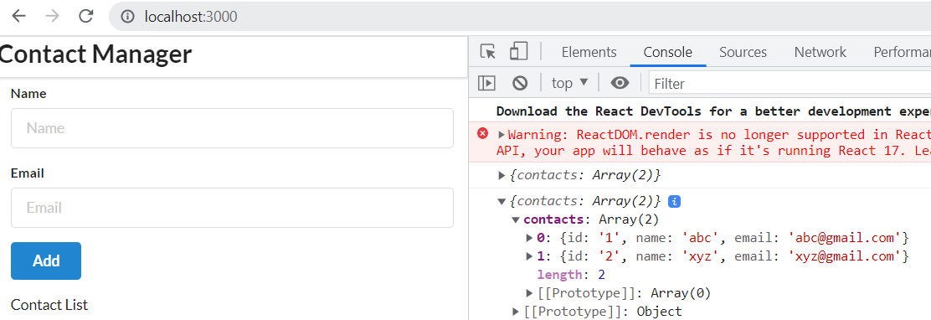
O/p

Slide 41
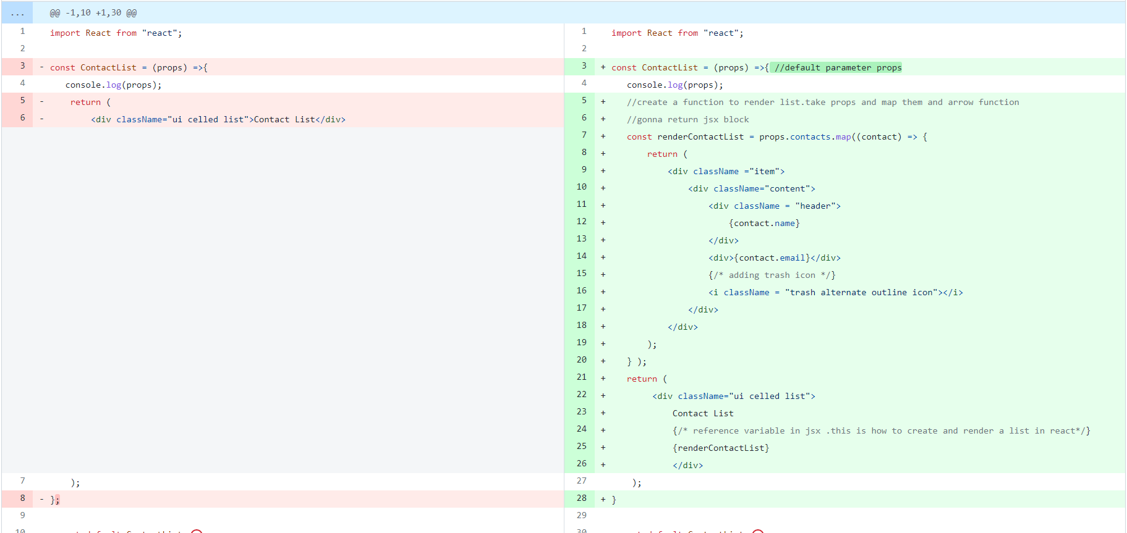
Since, we got contacts object, let’s render list
https://github.com/ragaPriya224/B1-IBM/commit/49226a7974d884593ebe730aaa21b194835a0a49
contactList.js

Slide 42
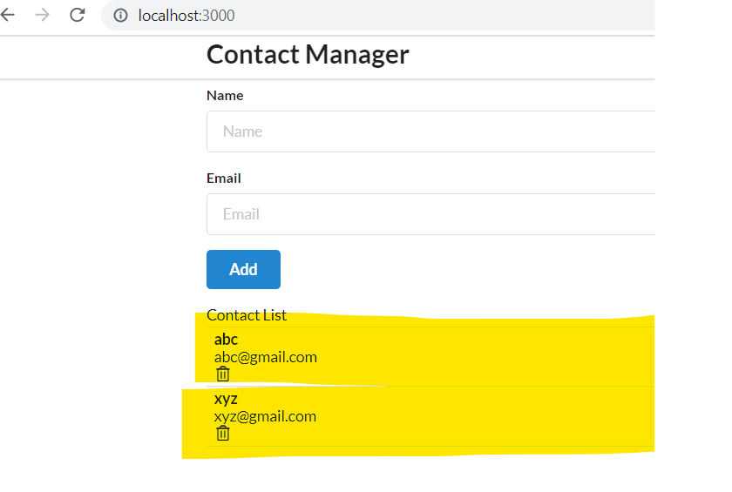
O/P

Slide 43
Some jsx code of contactList to be moved to contact Card

Slide 44
Npm i uuidv4

