Slide 1

genieTEXT: Transit
Canabang Inc.
Demo prepared by Ragaeeb Haq

Slide 2

Overview
Canabang Inc.
Mobile dynamic information
What is genieTEXT: Transit?
Target Audience
History
genieTEXT: Transit - In Action
genieTEXT Micro Edition: Transit
Advantages
Notes:
-Who are we and what do we do?
-Mobile dynamic information: The problem
-What is genieTEXT: Transit?
-Target Audience: Who do we believe will use our product
-History: From its ancestor “BusTimes”
-genieTEXT: Transit - In Action: Several examples of its use
-genieTEXT: Transit Micro Edition: Making the service even easier for users
-Advantages

Slide 3
Canabang Inc.
Home-business providing software development services.
genieTEXT was designed, developed, documented, tested, and maintained by its respective developers.
Notes:
-We are working with other companies on providing SMS-capabilities to book taxis, rental cars, etc.

Slide 4
Mobile Dynamic Information
Users need a way to access dynamic information that may be stored at a source from anywhere.
Current methods available:
Phone-line Operators
World-Wide Web Internet Access
Messaging Requests
Notes:
-Physical copy data are not dynamic
-Phone-line operators costly: staffing costs
-Internet access: user needs access to the Internet from their location
-Phone has access to our service using a protocol readily available in all phones

Slide 5
What is genieTEXT: Transit?
genieTEXT is a suite of services intended to bring dynamic data to mobile phones through SMS.
genieTEXT: Transit helps bring transit service information to a user’s mobile phone through a simple text message.
Notes:
-The user simply sends a request to an address to retrieve some data from a typical database, our service processes the message and sends back a reply with the requested data.
-The data can be static or dynamic.

Slide 6
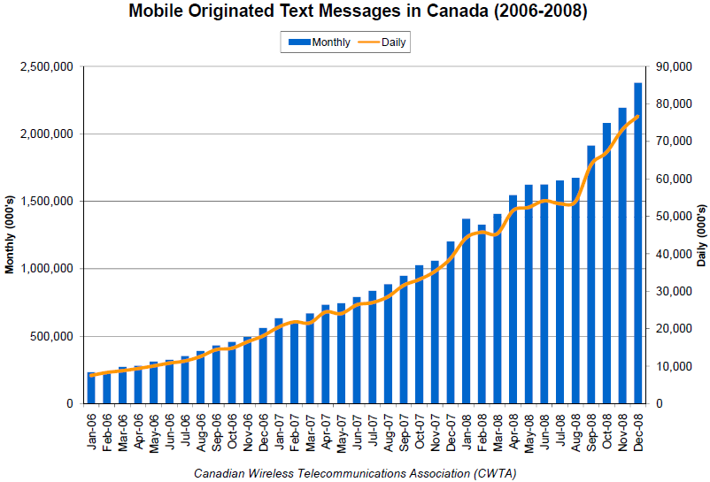
Target Audience
In 2008, over 76 million text messages were sent per day.
Notes:
-Text-messaging in Canada increased from 369 000 per day in 2002 to 3.4 million per day in 2005, to 45.3 million per day in 2007 to over 76 million/day in 2008.^{1, 3, 4}
1: http://www.textmessageblog.mobi/2008/07/11/bell-telus-blasted-for-text-message-fees/
3: http://www.cwta.ca/CWTASite/english/whatsnew_download/mar22_05.html
4: http://www.txt.ca/facts.htm

Slide 7
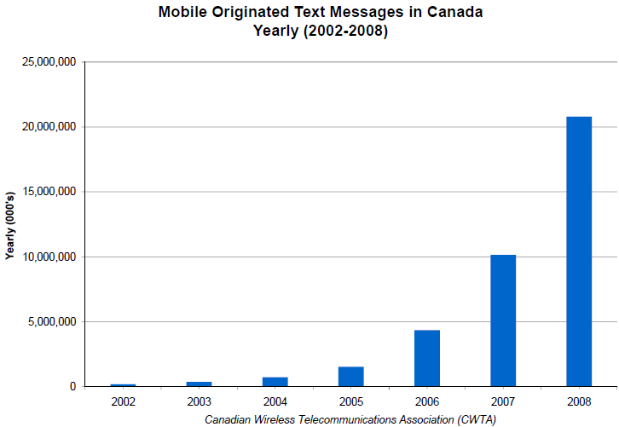
Target Audience
In 2008, over 20.7 billion text messages sent.
Notes:
-In 2005, roughly 1.5 billion text messages were sent, in 2006 that almost tripled to 4.3 billion, in 2007 it jumped to 10.1 billion, and over 20.7 billion in 2008.^{2, 4}
2: http://www.textmessageblog.mobi/2007/04/04/canadas-texting-volume-triples-over-last-year/
4: http://www.txt.ca/facts.htm

Slide 8
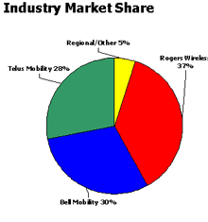
Target Audience
Ottawa’s largest wireless providers were surveyed.
Age group: 15-30 uses more text messaging services than voice communication services.
Older age groups use more voice communication than text messaging.

Slide 9
History
BusTimes v3.01:
MIDlet that stored static transit service information.
Transit service data could not be updated without downloading a new binary package.
Users could not access any information outside what was pre-loaded.
Users had to download transit time schedules manually as well as the binary distribution.
Notes:
-BusTimes v3.01:
-Created as an economically viable method of accessing times for a certain stop for individuals on Pay Per Use plans since calling 613-560-1000 costs minutes.
-Gives instant results (do not have to wait for the computer to speak) for people in a rush.
-Hassle since users have to download new schedules every fall one by one.

Slide 10
History
BusTimes v4.00:
MIDlet that stored static transit service information.
Additional transit schedule data can be stored in external memory card.
Transit service data could now be updated without downloading a new binary package.
Data is still static,
No support for newer transit service technologies (ie: Travel Planner).
Notes:
-BusTimes v4.00:
-Graphics different for every phone model (inconsistency).
-Data is still static (therefore new buses that would be temporarily added would not appear in the search query).
-Disadvantageous because users still needed to download the binary and transit data information.
-Not everyone has a memory card on the phone, therefore this reduces target audience.
-Faster database queries.

Slide 11
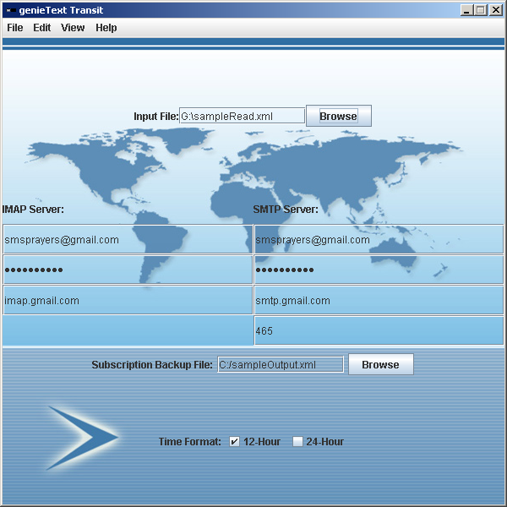
genieTEXT: Transit In Action
Deployment
1) Enter mail server either manually or through an XML file
Notes:
-Text message service (GSM cards process things slower and less concurrently).
-If you don’t want to deploy graphically, it can be done via command line

Slide 12
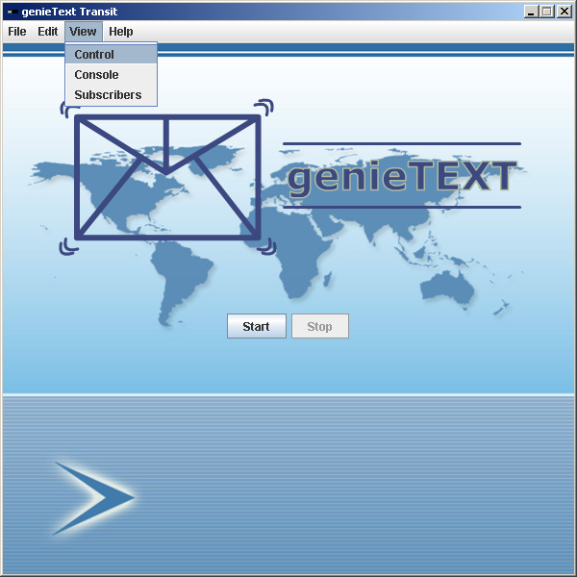
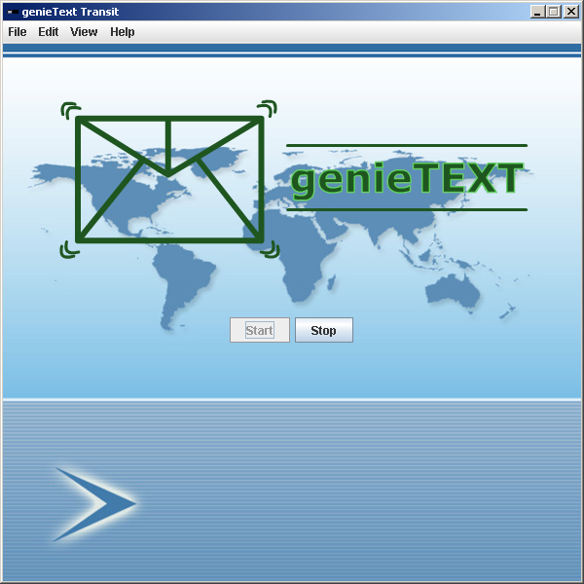
genieTEXT: Transit In Action
Deployment
2) Go to View -> Control, and hit “Start”.
Notes:
-As soon as the service has successfully started, the blue logo will turn into a green one.

Slide 13
genieTEXT: Transit In Action
Example 1: When is the next 121 coming to stop #8894?
Query:
121 8894

Slide 14
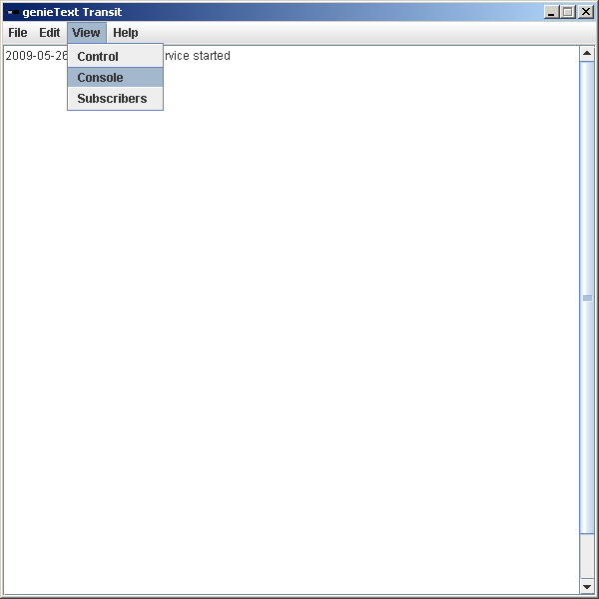
genieTEXT: Transit In Action
Monitoring
To view the log of incoming requests, go to View -> Console.
Notes:
-If an address could not be replied to, they are filtered out (postmaster type)

Slide 15
genieTEXT: Transit In Action
Example 2: When is the next 121 coming to stop #8894 on a Tuesday after 4:15pm?
Query:
121 8894 w 1615
w: Weekday Schedule
s: Saturday Schedule
d: Sunday Schedule
Notes:
-Keycodes are inevitable when it comes to text message requests (they can be replaced by longer codes [ie: full instead of u] but that means the user has to write more.

Slide 16
genieTEXT: Transit In Action
Example 3: Get all the times that the 121 arrives at stop #8894 on Saturdays.
Query:
121 8894 s a
f: First time the bus arrives at station.
l: Last time the bus arrives at station.
a: All times the bus arrives at station (list).
Notes:
-Schedule sheets, if we wanted the route pictures, we can even include that through MMS technology (limitation: phone must be able to handle MMS)

Slide 17
genieTEXT: Transit In Action
Example 4: Reverse stop # lookup.
Query:
8894
Notes:
Conditional

Slide 18
genieTEXT: Transit In Action
Example 5: Station stop # lookup.
Query:
Billings Bridge Stop
Notes:
Conditional

Slide 19
genieTEXT: Transit In Action
Example 6: Transit Planner Lookup.
Query:
Walkley.Jasper to 1010 Merivale Rd.
Notes:
“.” was used because it is the most easily accessible in any keypad instead of the slash. Since younger generation is our target audience, they will be the ones who will know how to locate the dot more.

Slide 20
genieTEXT: Transit In Action
Example 7: Location stop # lookup.
Query:
Walkley.Jasper
Notes:
Conditional

Slide 21
genieTEXT: Transit In Action
Example 8: Subscription service.
Query:
sub
Unsub: Unsubscribe from messaging list.
Notes:
Conditional

Slide 22
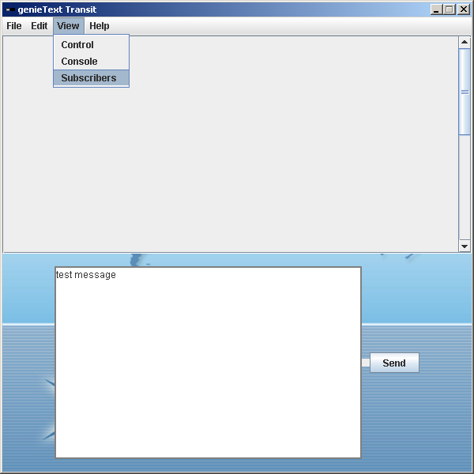
genieTEXT: Transit In Action
Monitoring subscription list
Go to View -> Subscribers
Notes:
Conditional

Slide 23
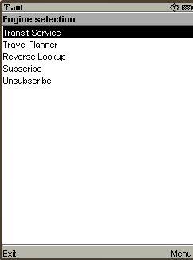
genieTEXT ME: Transit
The Micro Edition of the service goes back to its roots.
Users no longer need to memorize complex syntax to retrieve the information they need.
Notes:
Conditional

Slide 24
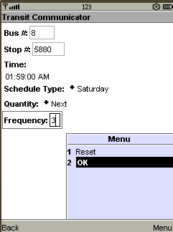
genieTEXT ME: Transit
genieTEXT: Micro Edition converts the parameters into a properly formatted message that is sent to the central service.
The program then waits for a response from the server and displays it to the user.
Notes:
Conditional

Slide 25
genieTEXT: Advantages
Disadvantages of 613-560-1000 service:
Costs minutes for simple information on cellular phones [Rogers charges by the minute].
The average subscriber has limited day-time minutes
Students make up a significant portion of transit service users and with increasing tuition fees, they need to converse their minutes to keep from going over their monthly limit.
Rogers Communications Inc. charges 25 cents/minute per extra minute overused while charging 15 cents per extra text message sent.
Notes:
-According to Rogers, most subscribers have a text messaging plan, and a majority of them have almost unlimited (ie: 2500 for $10).
-Most people try to get the free evenings and weekends plan to conserve their minutes, however students usually attend morning classes (meaning they will use up precious day-time minutes).

Slide 26
genieTEXT: Advantages
Disadvantages of 613-560-1000 service:
Periods of excessive call volumes will delay the amount of time before the computer answers the call.
Processing a text message is done relatively quickly by the system while if someone was to access the phone service, the phone line will be in use until the information is fully conveyed to the caller.
No complex tasks available (travel planner, reverse lookup, etc.), need to talk to an operator which means staffing requirements, thus increasing costs.

Slide 27
genieTEXT: Advantages
Disadvantages of Mobile Travel Planner service:
Internet access is mandatory
Wi-Fi and GSM Internet connection (on non-3G phone models) is much slower than traditional high speed connections.
Mobile browser users sometimes disable cookies and scripts for security purposes which interferes with the Travel Planner.
Internet data access for those who do not have data plans is very costly ($3/extra MB for Rogers).
Internet usage consumes the battery significantly.
Notes:
-According to Rogers, most people don’t have a data plan because most people don’t have phones that handle data (Ie: Blackberry, Iphone)

Slide 28
genieTEXT: Advantages
Service is extremely easy to deploy and maintain.
-Applicable to all mobile phones since they all support SMS technology.
-Gives users a choice (they do not have to stick to the 613-560-1000 number), and giving users choice is always a good thing.
-Reduces network load on 613-560-1000 numbers.
-Reduces need to print physical copies of bus schedules.

Slide 29
genieTEXT: Advantages
No Internet access required on mobile phone. Only reception is needed.
Processing time is completely on server-side, and there is no intense processing on mobile phone which conserves battery.
Versatility
Overall usage duration is much less than mobile travel planner.
Notes:
-If there is no reception, then there is no Internet access anyway and nothing would work.
-Responses and requests can be as complex or as simple as the transit service chooses.
-Mobile travel planner: open browser, access transit service website, input parameters, then receive response, and loading time is applicable for every step.

Slide 30
genieTEXT: Advantages
SMS messages are stored on the phone/SIM card when they arrive. This allows the user to save responses and save costs by avoiding another search query.
Further cuts down costs by having fewer display screens in stations.
-genieTEXT ME: size is small – one time downloading
-Innovative way of OC Transpo to show they are making transit easier for citizens after strike (especially students who were mainly affected)
Notes:
-On the other hand, the 613-560-1000 or the travel planner require you to request the information again if you forget it.

Slide 31
genieTEXT: Summary
genieTEXT: Transit is a service providing users an alternative method of accessing transit information.
The program uses Short Message Service technology to exchange information between the client and server.
Users send queries to an address/number and receive responses.
The system provides subscription handling as well as request monitoring technologies.
genieTEXT: Transit provides all the services that 560-1000 service offers plus more.

