Slide 1
Getting Things Done with Copilot Cowork for HR Tasks
Instructor-led, hands-on workshop · 2 hours 35 minutes · ~25 attendees
©2026 Microsoft Corporation. All rights reserved.
Notes:
WELCOME (0:00-0:05). Introduce yourself and the goal: by the end, every attendee knows when to use Copilot Chat vs. Cowork and has built an executive command center, researched the web, had Cowork navigate websites in its browser, built a custom skill, an onboarding pack, an automation, and a no-code agent, and finished with the Executive Command Center capstone. 2 hours 35 minutes, one 15-minute break after Ex 4. The pace is brisk: play the demo videos instead of waiting on long runs. Tenant note: ATTENDEES use their own work accounts; YOU demo from a SEPARATE tenant, so your screen may differ. Golden rule all day: every Cowork output is a DRAFT; Cowork pauses at checkpoints.

Slide 2
Agenda — 2 hours 35 minutes, hands-on
Framing and a UI tour, then eight scenario-based exercises with one break.
5 min
Welcome & context
What Cowork is, HR value, the approval model
15 min
Break
5 min
Copilot vs. Cowork
The difference and when to use which
10 min
Ex 5 · Onboarding pack
Orientation deck (+ kickoff, announcement)
10 min
Cowork UI walkthrough + setup
New task, My tasks, Automations, Customize
15 min
Ex 6 · Automate & share
Automations + Daily Briefing (+ sharing)
15 min
Ex 1 · Deep Research
Cited briefing + 5 questions; optional /cost
15 min
Ex 7 · Agent Builder
Non-Cowork: build an HR Policy Agent
15 min
Ex 2 · Navigate websites
Cowork drives Edge: dol.gov + lni.wa.gov
15 min
Ex 8 · Executive Command Center
Capstone: HTML dashboard, skill, schedule
15 min
Ex 3 · Build a custom skill
Centerpiece: HR Policy Answer
5 min
Wrap-up
Three tools and next steps
15 min
Ex 4 · Recruiting + reporting
Inclusive job posting + ticket summary
Notes:
AGENDA. Framing (what/why + Copilot vs Cowork), a UI tour + setup, then EIGHT exercises with one 15-minute break after Ex 4. Each exercise opens with a scenario card, then a hands-on slide with steps and a checkpoint. Ex 1 is Deep Research with an optional cost check; Ex 8 is the Executive Command Center; Ex 2 has Cowork drive a browser; Ex 3 (custom skill) is the centerpiece; Ex 7 steps OUTSIDE Cowork into Agent Builder.

Slide 3
Copilot vs. Cowork — what’s the difference?
Start here: the mental model for the whole day.
COPILOT (CHAT) = YOUR AI ASSISTANT
COWORK = YOUR AI COWORKER
You ask, it answers — you drive each step
Best for quick answers, drafting, summarizing, rewriting
Output: a response in the chat
HR example: “Summarize this policy in 3 bullets.”
You describe an outcome — it plans and does the multi-step work
Best for tasks that end in a doc, email, deck, report, or schedule
Output: finished artifacts — and it can run on a schedule
HR example: “Draft welcome emails for all 4 new hires and save them as drafts.”
Rule of thumb: several steps that end in a file, email, schedule, or report → Cowork. A quick answer or rewrite → Copilot Chat. Both are grounded in your work through Work IQ and respect the same permissions. We also use a third tool — Agent Builder — in Exercise 7.
Notes:
COPILOT vs COWORK (0:05-0:10). Copilot (Chat) = assistant: you ask, it answers, you drive. Cowork = coworker: you describe an outcome, it does the multi-step work and returns a deliverable, pausing for approval. Give one HR example of each and land the rule of thumb. Cowork isn't a replacement for Chat — it's the 'do it for me' mode of the same Copilot family. Detail: reference/00-copilot-vs-cowork.md.

Slide 4
What is Copilot Cowork?
You describe the outcome — Cowork plans and delivers, grounded in your work via Work IQ.
1 · PLANS
2 · PICKS
3 · PAUSES
4 · RETURNS
the steps needed to reach your outcome
e.g., gather → draft → schedule
the right skills and apps for each step
e.g., Email, Word, Calendar
for your approval at key checkpoints
e.g., before it sends or deletes
finished artifacts, ready for your review
e.g., a deck, report, or dashboard
Why HR cares — the checkpoint model: nothing irreversible (like sending an email) happens without your approval. Every output is a draft to review, so HR stays accountable. You’ll approve actions one at a time all day.
Notes:
WHAT IS COWORK. Describe the OUTCOME, not the steps. Cowork plans -> picks skills -> pauses for approval -> returns artifacts, grounded via Work IQ (permission-aware). Hammer the checkpoint model; attendees may meet approval dialogs throughout the training, including the Exercise 8 capstone.

Slide 5
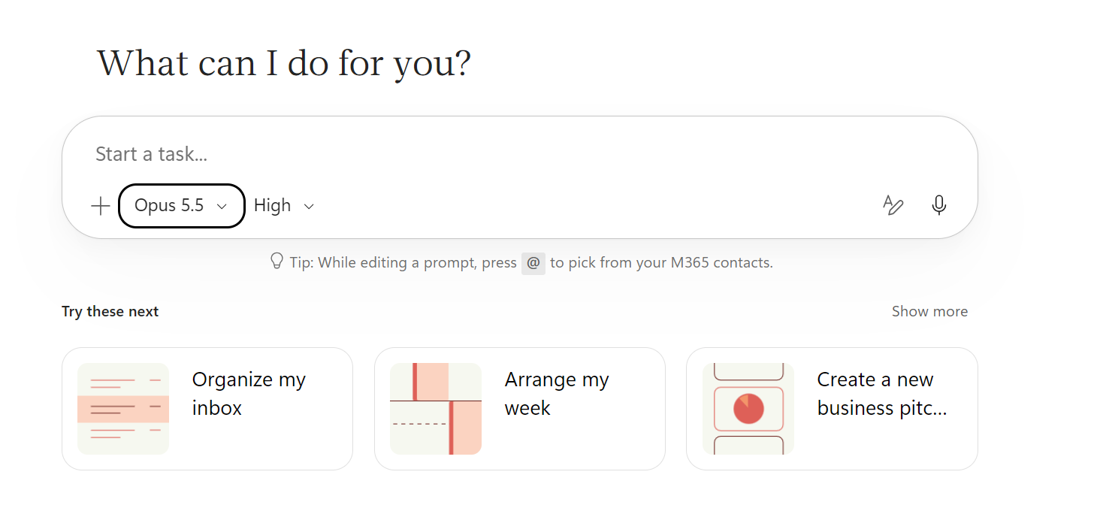
Cowork UI walkthrough
Four places in the left navigation you’ll use all day.
NEW TASK
Start a task, pick a model and reasoning effort, attach files, or try a starter.
MY TASKS
Find and resume previous tasks — past work is always a click away.
AUTOMATIONS
Run tasks on a schedule or on events. Tabs: Runs and Manage schedules.
New task home: Start a task box, model picker (e.g., Opus 5.5), reasoning effort (e.g., High), attach (+), dictate, and “Try these next” starters.
While a task runs, open the side panel: progress, skill chips, the Output folder of files Cowork created, and schedules update in real time.
CUSTOMIZE
Custom instructions, your personal skills, and plugins.
Notes:
COWORK UI WALKTHROUGH (part of 0:10-0:20). The screenshot is the NEW TASK home ('What can I do for you?'): Start a task box, model picker, reasoning effort, attach, dictate, 'Try these next'. Then MY TASKS (resume past work), AUTOMATIONS (Runs / Manage schedules), CUSTOMIZE (instructions, skills, plugins). Point out the session side panel — you'll refer to it all day. Detail: reference/07-cowork-ui-walkthrough.md.

Slide 6



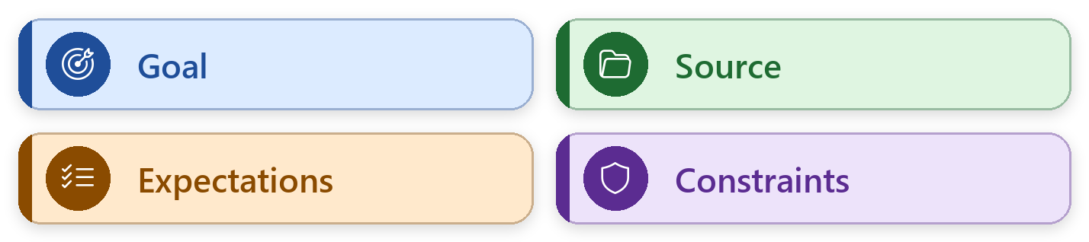
Demo · Copilot and Cowork UI
Format
Video
Demo
Demo video
Watch for in the demo
Copilot Chat → Ask a quick question; get a one-shot answer
Open Cowork → From the Microsoft 365 Copilot app
New task → Start box, model picker, reasoning effort, attach
Left nav → My tasks · Automations · Customize
Side panel → Progress, skill chips, Output folder
Recorded run: the Copilot and Cowork UI walkthrough
Facilitator: insert your recording here (see notes)
Watch, don't click yet. You'll set up your own account in a few minutes.
Next: setup in your own account.
Notes:
DEMO VIDEO — COPILOT AND COWORK UI WALKTHROUGH. Show the difference first: a quick question in Copilot Chat, then the same app's Cowork entry point. Then tour New task, My tasks, Automations, Customize, and the side panel of a running task. Play your pre-recorded demo so the room doesn't wait while the task runs, and narrate the steps on the right as they happen. TO ADD THE VIDEO (once, before the session): select the media icon in the frame (or Insert > Video > This Device) and pick your recording; on Playback set Start: When Clicked On; use Trim Video to cut long waits. Record it from your demo account with the same prompt. NO VIDEO? Run the demo live, then move on.

Slide 7
Setup — sign in and copy the data
Do this before Exercise 1. Proctors: triage sign-in issues now.
1 · SIGN IN
2 · COPY THE DATA
3 · ETIQUETTE
Sign in with your own work account
Open copilot.cloud.microsoft in Microsoft Edge
Select Cowork next to Chat
Smoke test: “Give me a one-sentence hello.”
Edge profile = your work account (for Ex 2)
Download and extract zava-sample-knowledge.zip
In your OneDrive → Documents, use Folder upload to add the ai_hr_cowork_workshop folder
Attach files with + → Attach cloud files, or type /
Your OneDrive, drafts, and skills are your own
Keep custom skills “Only you” or initialed
Ex 8 uses your own data: keep it private
Other exercises: Zava files only
Never send to real people; save drafts
You’re in your own work account, so your screens match each other. The facilitator demos from a separate tenant, so the instructor’s screen may look a little different.
Notes:
SETUP (part of 0:10-0:20). The participant email asks attendees to sign in and upload the files BEFORE the session; here you only confirm it. Anyone who hasn't: sign in + smoke test, then download zava-sample-knowledge.zip, extract it, and use Folder upload to add the ai_hr_cowork_workshop folder (the six Word and Excel files) to Documents in their own OneDrive; no Folder upload option? create the folder and upload the files. Show how to attach a file: + -> Attach cloud files, or type /. EDGE PROFILE CHECK: the browser task in Ex 2 runs in the Edge profile signed in with their work account; anyone in a personal profile adds a work profile now (not InPrivate). Attendees use their OWN work accounts; YOU are on a SEPARATE demo tenant. DATA: Ex 8 reads their own mail and calendar (private: no screen sharing); everything else uses the Zava files. Proctors triage; anyone blocked follows your demo. readiness-checklist.md has the triage.

Slide 8
Settings & models
Shape how Cowork works — you won’t change these every task.
MODEL PICKER
REASONING EFFORT
CUSTOM INSTRUCTIONS
Pick a model or let Cowork decide (default).
Balance quality, speed, and cost per task.
Preferences Cowork applies to every task.
PLUGINS
AUTOMATIONS
IMAGE GENERATION
Extend Cowork from the Microsoft 365 App Store.
Scheduled prompts and event-driven tasks.
Simple visuals for comms and slides.
Tip: for sensitive employee writing, use a higher-capability model and higher reasoning effort. For routine drafts, the defaults are fine. Cowork is usage-billed — match effort to the task.
Notes:
SETTINGS & MODELS. Model picker ('let Cowork decide' is a fine default; Anthropic models may appear as a subprocessor depending on tenant) and reasoning effort (quality vs speed vs cost). Set one custom instruction as a class in Customize. Detail: reference/02-settings-and-models.md.

Slide 9
Skills — how Cowork gets work done
Cowork loads skills automatically and shows them as chips in the side panel.
Word
Excel
PowerPoint
PDF
Email
Scheduling
Calendar
Meetings
Daily Briefing
Enterprise Search
Deep Research
Communications
Adaptive Cards
App (Frontier)
Three kinds of skills: built-in (above) · custom (you build one in Exercise 3) · plugins from the Microsoft 365 App Store. Purple = used hands-on today.
App (Frontier) requires the Frontier program — awareness only in this workshop.
Notes:
SKILLS. You don't invoke skills manually — Cowork activates them and shows chips. Ex 8 gathers mail, calendar, and chats through Work IQ; Ex 1 Deep Research + Word/Excel; Ex 2 is browser use (no skill chip); Ex 4 Word/Excel; Ex 5 PowerPoint, Scheduling, Communications; Ex 6 Daily Briefing. Full list: reference/03-skills-catalog.md.

Slide 10
Prompting best practices
Strong prompts include four elements. No labels needed: just make sure each one is there.
WEAK
“Write an email about open enrollment.”
Cowork has to guess: who it’s for, which dates apply, how long it should be, and whether to send it.
STRONG
GOAL Draft a reminder email to all Zava employees so that anyone who wants to change their benefits does it during November open enrollment. SOURCE Use the Enrollment Windows section of benefits-summary.docx and the Who to Contact section of employee-handbook-excerpt.docx. EXPECTATIONS Keep it under 150 words, with a subject line of eight words or fewer, three short bullets on what to do, and who to contact for help. Use a warm, plain-language tone. CONSTRAINTS Don’t invent dates, deadlines, or plan details that aren’t in the files. Save it as a draft for me to review; don’t send it.
Same topic. Now Cowork knows what to do, where to look, what good looks like, and what not to do.
Notes:
PROMPTING BEST PRACTICES (about 4 min, before the exercises). Read the WEAK prompt aloud and ask the room: what would Cowork have to guess? (Audience, which dates, length, tone, whether to send.) Then walk the STRONG version element by element: GOAL (blue) says what outcome and for whom; SOURCE (green) names the exact files and sections; EXPECTATIONS (orange) describe what good looks like: length, subject line, bullets, tone; CONSTRAINTS (purple) say what not to do. Point out 'don't invent dates': the benefits summary only says November, so a weak prompt invites a made-up deadline. Key message: no labels and no fixed order; just check all four are there. Context about the situation belongs in the Goal. Every exercise prompt, in the workbook and on the exercise cards, uses these same colors, and each card has a Prompt key at the bottom right (setup step D has the legend and this example). When Cowork asks a clarifying question or misses, the missing piece is usually one of the four: add it in a follow-up.

Slide 11
Demo · Prompting best practices
Format
Video
Demo
Demo video
Watch for in the demo
Weak prompt → Cowork guesses, or asks what you meant
Strong prompt → Goal, Source, Expectations, Constraints
Grounding → Dates come from benefits-summary.docx
Compare → Length, subject line, tone, contacts
Constraint held → Saved as a draft, not sent
Recorded run: the weak and strong open-enrollment prompts
Facilitator: insert your recording here (see notes)
Same topic, two prompts. Watch what Cowork does with each, then spot the four elements.
Next: how to read an exercise card; every prompt today uses these colors.
Notes:
DEMO VIDEO — PROMPTING BEST PRACTICES. Run the WEAK prompt from the previous slide, then the STRONG one, in two tasks side by side. Point to each colored element as Cowork uses it, and to the invented-vs-sourced dates. Play your pre-recorded demo so the room doesn't wait while the task runs, and narrate the steps on the right as they happen. TO ADD THE VIDEO (once, before the session): select the media icon in the frame (or Insert > Video > This Device) and pick your recording; on Playback set Start: When Clicked On; use Trim Video to cut long waits. Record it from your demo account with the same prompt. NO VIDEO? Run the demo live, then move on.

Slide 12


How to read an exercise card
Format
Every exercise
Guide
?
Goal: What you’ll accomplish — the business outcome in one sentence.
Output: The finished artifact Cowork hands back: a document, dashboard, email, schedule, or agent.
Why Cowork?: Why this is a Cowork job — the multi-step, cross-app work it orchestrates, and where it pauses for your approval.
Prompt
Workflow
Gather → Cowork pulls context through Work IQ
Analyze → It reasons over what it found
Build → It creates the artifact
Deliver → It pauses for approval, then acts
This panel holds the exact prompt you’ll paste into Cowork.
Before you run it:
Colors mark the Goal, Source, Expectations, and Constraints (see the Prompt key)
Replace any [placeholders], such as [Priority Folder] or [time]
Keep “save as a draft” wording — never send to real people in class
Watch the side panel: skill chips, files, and schedules appear as Cowork works
After it runs:
Review every output as a draft
Approve or decline each checkpoint deliberately
Use the hands-on slide that follows for steps, the checkpoint, and a stretch
Data Sources
M365 Data
Web
OneDrive
Prompt key
Notes:
HOW TO READ A CARD. Every exercise is introduced with the same scenario format. Walk it top-left to bottom-right: Goal, Output, Why Cowork?, Prompt, Workflow, Data sources; the Function tag names the business area. Each card is followed by a hands-on slide with numbered steps, what to watch for, a checkpoint, and a stretch. The Prompt key at the bottom right shows what each prompt color means; the colors are the same on every card and in the workbook.

Slide 13
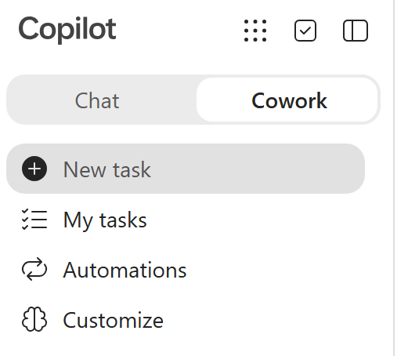
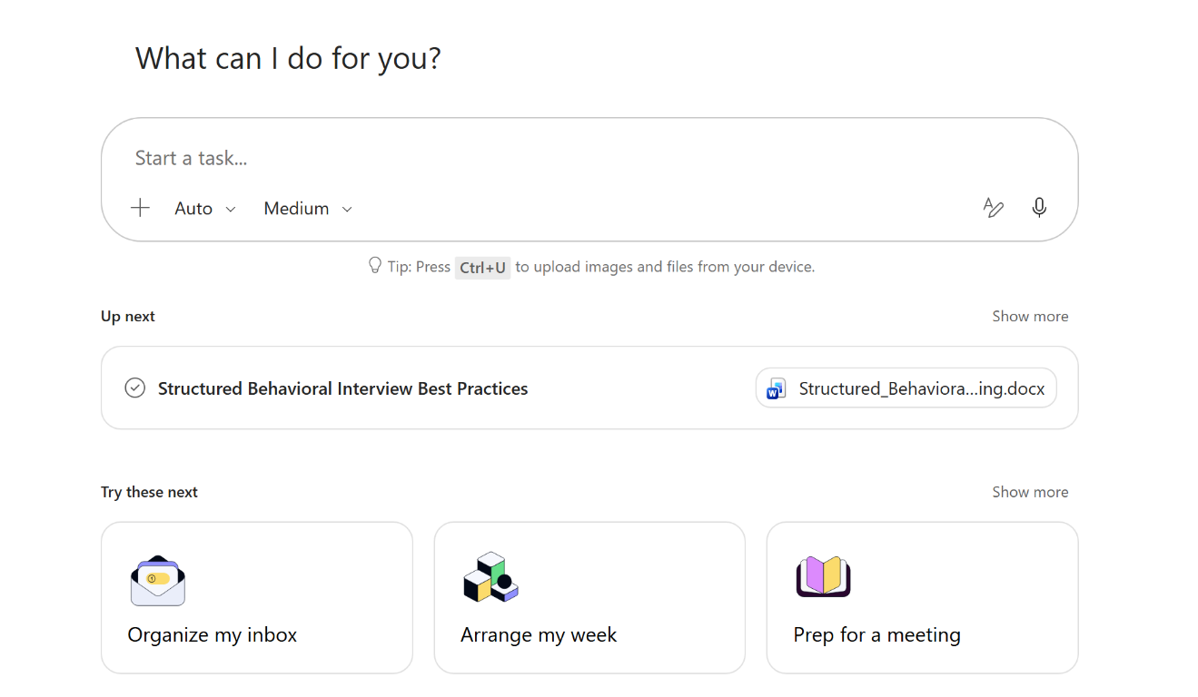
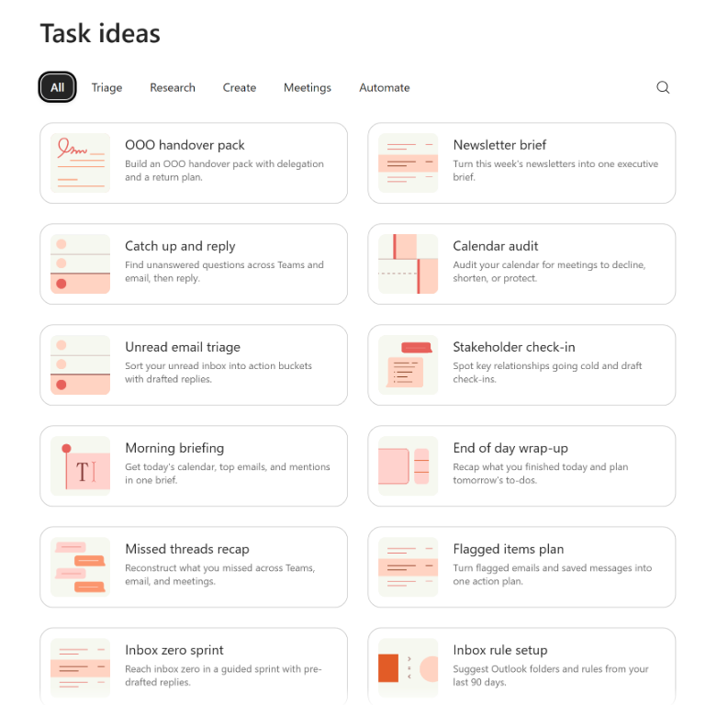
Sample Cowork prompts to get started
Open a new task, pick a suggestion, then tailor the outcome and guardrails.
1 · Cowork → New task
2 · Try these next
3 · Browse Task ideas
Try: "Draft a morning briefing from today's calendar and unread emails; cite sources."
Or: "Review next week's calendar and suggest focus time; do not change any meetings."
Notes:
STARTER PROMPTS (part of setup, before Exercise 1; no extra exercise time). Show the three screenshots from left to right: select Cowork, open New task, then explore Try these next and Task ideas. Suggestions such as Organize my inbox, Arrange my week, and Prep for a meeting are starting points, not fixed instructions. Tailor the goal, sources, output format, and constraints before running. Examples: draft a cited morning briefing; audit next week's calendar and suggest focus time without changing meetings; prepare a meeting brief with an agenda and open questions, without sending messages. Keep this a quick orientation, not another live task. Use the instructor demo account; screenshots are examples and attendee suggestions may differ. Review drafts and approve actions one at a time. Then move straight into Exercise 1.

Slide 14

EXERCISE
Research the Web with Deep Research
01
Get an evidence-based view of structured behavioral interviewing and turn it into questions for a real open role.
15 min · 0:20–0:35
HR · Talent
1
2
3
4
5
6
7
8
Exercise 1 of 8
Notes:
DIVIDER — EXERCISE 1: Research the Web with Deep Research (15 min, 0:20–0:35). Pause here: check the room is ready (anyone still finishing the last exercise?), then introduce the scenario card on the next slide.

Slide 15
Research the Web with Deep Research
Function
HR · Talent
Ex 01
?
Goal: Get an evidence-based view of structured behavioral interviewing and turn it into questions for a real open role.
Output: A cited one-page briefing and five tailored questions for Zava’s HR Coordinator role; if time allows, an interviewer scorecard in Word and Excel with the scoring scales filled in.
Why Cowork?: Good research means reading and citing many sources. Deep Research does that across the web, applies the findings to your job description, and a follow-up turns them into ready-to-use documents.
Prompt
Workflow
Deep Research → Search and read multiple web sources
Synthesize → Key practices with citations
Ground → Compare to job-description-sample.docx
Draft → Briefing + 5 tailored questions
Build → Optional: scorecard in Word + Excel
Use Deep Research to summarize current best practices for structured behavioral interviews from multiple reputable sources. Produce a 1-page briefing with the key practices and cite your sources.
Then:
Now compare these best practices to our HR Coordinator interview needs in job-description-sample.docx, and suggest 5 interview questions.
Optional follow-up (if you have time):
Turn this into an interviewer scorecard in Word AND Excel with the scoring scales filled in.
Data Sources
Web
OneDrive
Prompt key
Notes:
EXERCISE 1 CARD (0:20-0:35, 15 min). SAY: 'Deep Research reads many web sources and cites them, then we make it useful by grounding it in our own job description and turning it into documents.' Point out the three stages on the card: research, ground, and an optional build (Word + Excel). Next exercise shows the OTHER way Cowork uses the web: driving a browser.

Slide 16
Demo · Deep Research
Format
Video
Ex 01
Demo video
Watch for in the demo
Deep Research → Search and read multiple web sources
Synthesize → Key practices with citations
Ground → Compare to job-description-sample.docx
Draft → Briefing + 5 tailored questions
Build → Optional: scorecard in Word + Excel
Recorded run: Exercise 1, Research the Web with Deep Research
Facilitator: insert your recording here (see notes)
Why a recording? Cowork tasks can take several minutes. Watch the run here, then do it yourself.
Next: your turn on the hands-on slide (15 min).
Notes:
DEMO VIDEO — EXERCISE 1: Research the Web with Deep Research. Play your pre-recorded demo so the room doesn't wait while the task runs, and narrate the steps on the right as they happen. TO ADD THE VIDEO (once, before the session): select the media icon in the frame (or Insert > Video > This Device) and pick your recording; on Playback set Start: When Clicked On; use Trim Video to cut long waits. Record it from your demo account with the same prompt. NO VIDEO? Run the demo live, then move on.

Slide 17
Hands-on · Deep Research
Time
15 min
Ex 01
Steps
Watch for
New task → run the Deep Research prompt.
Watch it search and read multiple sources, citing each. Open two citations.
Ground it: attach job-description-sample.docx and compare the findings to it.
Ask for five tailored interview questions.
Optional: scorecard in Word AND Excel, scales filled in; open both from the Output folder.
Optional: type /cost in this task to check approximate credits used (next slide).
The Deep Research skill chip and progress
Citations you can open and check
Optional scorecard: Word + Excel chips
Scales filled in — no “TBD” anchors
✓
Checkpoint: A cited briefing and five interview questions tied to the HR Coordinator role (plus the optional Word + Excel scorecard, every scale filled in).
Discuss
When is web research better than searching your own organization’s content — and when is it riskier?
Stretch: Benchmark PTO / annual-leave norms for mid-size tech firms against the Zava handbook.
Full prompt: participant workbook, Exercise 1
Notes:
EXERCISE 1 HANDS-ON. DO: start Deep Research on your screen first (it takes a few minutes), then the room starts theirs. Use the wait: 'When is web research better than our own content, and when is it riskier?' WATCH FOR: the Deep Research chip; citations that open; Word and Excel chips for the scorecard. IF STUCK: blank scales -> reply 'Fill in the 1, 3, and 5 anchors for every competency.' Only one file -> 'Also create the Excel version.' The scorecard (Task 1c) is OPTIONAL: fast finishers run it. TIME CHECK: at 0:30, demo the scorecard on your screen so everyone sees the Word + Excel output. NEXT: the browser.
PROMPT TO COPY AND PASTE (copy the text under each --- heading; each heading is a separate step):
--- Prompt ---
Use Deep Research to summarize current best practices for structured behavioral interviews from multiple reputable sources. Produce a 1-page briefing with the key practices and cite your sources.
--- Then ---
Now compare these best practices to our HR Coordinator interview needs in job-description-sample.docx, and suggest 5 interview questions.
--- Optional follow-up (if you have time) ---
Turn this into an interviewer scorecard in Word AND Excel with the scoring scales filled in.

Slide 18
Find your outputs · the Output folder
Time
3 min
Ex 01
Show the room
Side panel
Open the side panel — select the side panel toggle at the right of the session.
Input folder = files you attached. Output folder = files Cowork created.
Select Preview on the optional Word or Excel scorecard: it opens in a split view. Try the full-screen toggle and Open in native app.
Download saves one file; Download All saves every output as a zip.
Open OneDrive → Cowork in a new tab: every output is saved there too.
Follow the demo; if you built the optional scorecard, open your own files too.
Progress
Progress bar and step-by-step log
Input folder
Files you attached
Output folder
Download All
interviewer-scorecard.docx
Preview
Download
Skills
Chips for the skills Cowork loaded
Schedule
Scheduled runs (used later in the training)
Every exercise that creates a file ends here. Can’t find it? Side panel toggle → Output folder, or OneDrive → Cowork.
Permissions
“Don’t ask again” approvals — revoke here
Illustration of the side panel’s sections, not a screenshot
Notes:
FIND YOUR OUTPUTS (Ex 1, ~3 min). Take your time here; every later exercise relies on it. On your screen: open the side panel with the side panel toggle; point out Input folder (what you attached) vs Output folder (what Cowork created, each file with Preview and Download); Preview the optional scorecard (split view, full-screen toggle, Open in native app); show Download and Download All (zip); open OneDrive -> Cowork in a new tab to show the same file. Everyone watches the demo; attendees who built the optional scorecard open their own files. The panel on the right is an illustration of the side panel's sections (per Microsoft Learn), not a screenshot.

Slide 19
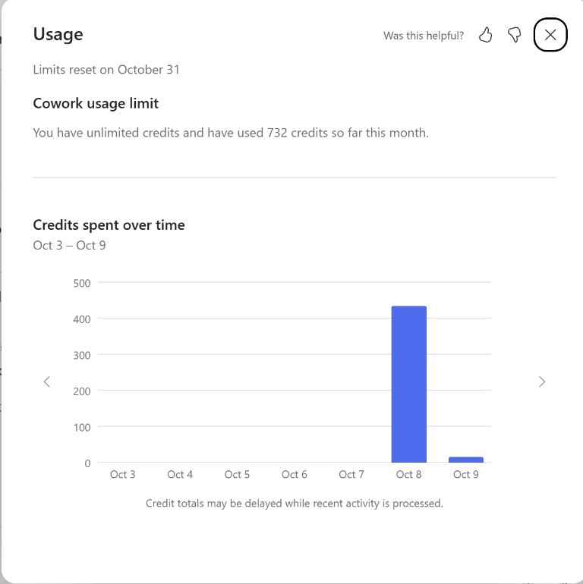
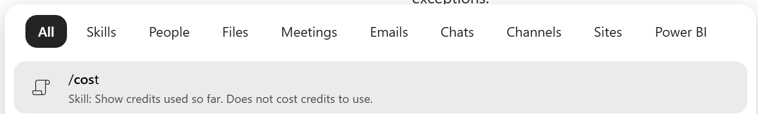
Optional · Check what the task cost
Time
2 min
Ex 01
If time allows
Usage · monthly consumption
Stay in your Deep Research task.
Type /cost, select the skill below, and send it.
Read the approximate credits used by this task so far.
/cost is free; the result is an estimate, not a bill.
Usage totals may be delayed. Reopen any earlier task to check it.
The Usage panel shows monthly consumption, not this task alone.
Scheduled tasks use credits on every run. Pause it after class: Automations → Manage schedules.
Example account; your limits and totals may differ.
Notes:
CHECK THE COST (Ex 1, ~2 min, OPTIONAL: skip it if you are behind and mention /cost at the break). SAY: 'Cowork is usage-billed, so let's see what that research task cost.' DO: in your Ex 1 task type /cost, select the skill shown in the screenshot, and send it; point to the result: credits for this task (all actions in the task, not a line-by-line breakdown), credits used this month, and credits remaining. Then have everyone do it. KEY POINTS: /cost is free; it's an approximation, not a billing record, and can lag a few minutes; you can't check the cost before running a task; you can go back to any earlier task and type /cost; limits are set by the organization, reset at 00:00 UTC on the 1st, and may be a shared group limit. Show the Usage screenshot separately: it is monthly consumption, not the Ex 1 task's cost. The example has 732 credits used this month and an unlimited limit; do not present those as the attendee's balance or a currency amount. Point out the daily chart and delayed-total notice. The weekday schedule uses credits on every run, so pause it after class. Source: Microsoft Learn, 'Credit usage for Microsoft Copilot Cowork tasks'.

Slide 20

EXERCISE
Navigate Websites with Cowork’s Browser
02
Have Cowork drive a real web browser for you — search a site, click through, move to a second site — and bring back a sourced comparison.
15 min · 0:35–0:50
HR · Compliance
1
2
3
4
5
6
7
8
Exercise 2 of 8
Notes:
DIVIDER — EXERCISE 2: Navigate Websites with Cowork’s Browser (15 min, 0:35–0:50). Pause here: check the room is ready (anyone still finishing the last exercise?), then introduce the scenario card on the next slide.

Slide 21
Navigate Websites with Cowork’s Browser
Function
HR · Compliance
Ex 02
?
Goal: Have Cowork drive a real web browser for you — search a site, click through, move to a second site — and bring back a sourced comparison.
Output: An overtime comparison (U.S. DOL vs. Washington L&I vs. Zava handbook) with a link to every page visited; if time allows, a one-page Word brief for payroll about T-2008.
Why Cowork?: Checking policy against official sites means searching, clicking, and copying. Cowork does the clicks in a hidden tab in your own Edge, with your sign-ins and policies, and asks before anything consequential.
Prompt
Workflow
Navigate → dol.gov: site search → Fact Sheet #23
Navigate → lni.wa.gov: menu → overtime page
Ground → Compare with the Zava handbook
Build → Table with links (+ optional brief)
Task 2a — Attach the handbook, then:
Use my browser to do this step by step, and tell me which page you’re on at each step:
1. Go to https://www.dol.gov and use the site’s search box to find the Wage and Hour Division’s overtime pay fact sheet (Fact Sheet #23). Open it and note the overtime rules and when overtime must be paid.
2. Go to https://lni.wa.gov and use the site’s menu or search to find Washington State’s overtime page. Open it and note anything Washington adds to the federal rules.
3. Compare both with the overtime rule in employee-handbook-excerpt.docx. Give me a table with the columns Rule, Federal (DOL), Washington (L&I), and Zava handbook, plus a link to every page you used.
Only read: don’t sign in, and don’t fill in or submit any form except a site search box.
Task 2b — Optional follow-up
Turn this into a one-page Word brief for our payroll team about ticket T-2008: what the rules say, what our handbook says, and the recommended next step. Don’t send it.
Data Sources
Web
OneDrive
Prompt key
Notes:
EXERCISE 2 CARD (0:35-0:50, 15 min). SAY: 'This is Cowork driving a real browser, like a person or a test tool such as Playwright: it types in a site's search box, clicks links and menus, and moves to another site. There's no browser skill to pick and no skill chip; ask for something that needs a website and Cowork opens a hidden tab in your own Edge, with your sign-ins and your company's policies.' Contrast with Deep Research (reads and cites) from Ex 1.

Slide 22
Demo · Browser
Format
Video
Ex 02
Demo video
Watch for in the demo
Navigate → dol.gov: site search → Fact Sheet #23
Navigate → lni.wa.gov: menu → overtime page
Ground → Compare with the Zava handbook
Build → Table with links (+ optional brief)
Recorded run: Exercise 2, Navigate Websites with Cowork’s Browser
Facilitator: insert your recording here (see notes)
Why a recording? Cowork tasks can take several minutes. Watch the run here, then do it yourself.
Next: your turn on the hands-on slide (15 min).
Notes:
DEMO VIDEO — EXERCISE 2: Navigate Websites with Cowork’s Browser. Play your pre-recorded demo so the room doesn't wait while the task runs, and narrate the steps on the right as they happen. TO ADD THE VIDEO (once, before the session): select the media icon in the frame (or Insert > Video > This Device) and pick your recording; on Playback set Start: When Clicked On; use Trim Video to cut long waits. Record it from your demo account with the same prompt. NO VIDEO? Run the demo live, then move on.

Slide 23
Hands-on · Browser
Time
15 min
Ex 02
Steps
Watch for
Check: Cowork open in Edge; Edge profile = your work account; Edge setting Allow Cowork to take actions on.
New task: attach the handbook; paste the two-site prompt.
Consent: select I understand at the browser notice.
Switch to tab to watch it search dol.gov and click through; open two links yourself.
Optional: the Word brief for payroll; open it from the Output folder.
No “browser” skill chip — watch the progress chips
It types in the site search and clicks menus (not guessed URLs)
Sign-in or CAPTCHA? It hands back — don’t enter anything
Nothing submitted beyond a search box
✓
Checkpoint: Two sites navigated by search and menus, and a comparison table linking the DOL fact sheet and the Washington L&I overtime page (plus the optional Word brief about T-2008).
Discuss
When would you use browser use instead of Deep Research? What would you never let it do unwatched?
Stretch: Read only: DOL Fact Sheet #17A and Washington’s exempt salary minimum. Is a salaried HR Coordinator likely exempt?
Full prompt: participant workbook, Exercise 2
Notes:
EXERCISE 2 HANDS-ON. DO: demo first. Show the consent notice (I understand), the progress chips, and Switch to tab so the room sees Edge typing in the DOL search box and clicking through to Fact Sheet #23, then lni.wa.gov. WATCH FOR: a table showing Zava's 1.5x over 40 hours matches federal and Washington rules; DOL adds the regular-payday rule; Washington adds no waiver and no daily overtime; links to both pages. IF STUCK: 'Browser tasks run in Microsoft Edge' -> wrong browser; no browser at all -> Edge profile isn't their work account, InPrivate, the Edge setting is off, or the admin hasn't allowed browser access (reference/10-cowork-browser.md). They follow your demo. 2b is OPTIONAL: fast finishers run it; at 0:45 demo it. STRETCH: Fact Sheet #17A on dol.gov plus Washington's exempt salary minimum on lni.wa.gov, read only. Don't send people to interactive tools such as the DOL eLaws advisors; Cowork declined one in the dry run. NEXT: 'You've used built-in skills and the browser. Now build your own skill.'
PROMPT TO COPY AND PASTE (copy the text under each --- heading; each heading is a separate step):
--- Task 2a — Attach the handbook, then ---
Use my browser to do this step by step, and tell me which page you’re on at each step:
1. Go to https://www.dol.gov and use the site’s search box to find the Wage and Hour Division’s overtime pay fact sheet (Fact Sheet #23). Open it and note the overtime rules and when overtime must be paid.
2. Go to https://lni.wa.gov and use the site’s menu or search to find Washington State’s overtime page. Open it and note anything Washington adds to the federal rules.
3. Compare both with the overtime rule in employee-handbook-excerpt.docx. Give me a table with the columns Rule, Federal (DOL), Washington (L&I), and Zava handbook, plus a link to every page you used.
Only read: don’t sign in, and don’t fill in or submit any form except a site search box.
--- Task 2b — Optional follow-up ---
Turn this into a one-page Word brief for our payroll team about ticket T-2008: what the rules say, what our handbook says, and the recommended next step. Don’t send it.

Slide 24

EXERCISE
Build a Custom Skill: HR Policy Answer
03
Teach Cowork to answer policy and benefits questions the same clear, sourced way — every time.
15 min · 0:50–1:05
HR · Policy
1
2
3
4
5
6
7
8
Exercise 3 of 8
Notes:
DIVIDER — EXERCISE 3: Build a Custom Skill: HR Policy Answer (15 min, 0:50–1:05). Pause here: check the room is ready (anyone still finishing the last exercise?), then introduce the scenario card on the next slide.

Slide 25
Build a Custom Skill: HR Policy Answer
Function
HR · Policy
Ex 03
?
Goal: Teach Cowork to answer policy and benefits questions the same clear, sourced way — every time.
Output: A saved custom skill, “HR Policy Answer,” with a quality score, that triggers on policy questions and answers Answer → Details → Source → “confirm with HR.”
Why Cowork?: Repeating the same instructions in every prompt is error-prone. A custom skill packages tone, format, sources, and guardrails once; Cowork auto-evaluates it (0–100) and applies it when it’s needed.
Prompt
Workflow
Customize → Skills → Add → Create new
Define → Name, description, category, instructions
Evaluate → Auto-score on four dimensions
Test → In-scope triggers; out-of-scope declines
In Customize → Skills → Add → Create new, give Cowork these details:
Name: HR Policy Answer
Category: Human Resources
Description: Answers Zava employee policy and benefits questions in a consistent, sourced format, grounded only in Zava’s handbook and benefits documents.
Instructions:
Use this skill when someone asks about Zava’s HR policy or benefits (PTO, remote/hybrid work, benefits enrollment, overtime, code of conduct, learning budget). Ground answers only in employee-handbook-excerpt.docx and benefits-summary.docx in my OneDrive folder Documents/ai_hr_cowork_workshop. Don’t use web results or any other documents in my Microsoft 365, and if the answer isn’t in these two files, say so instead of guessing. Answer in this format: a direct plain-language answer, then a short Details section, then a Source line naming the document, then the note “Policies can change — please confirm with HR.” Keep a warm, professional tone. Do not handle individual pay, performance, disciplinary, legal, or medical questions — politely redirect those. Produce a draft for HR to review; never send automatically.
Data Sources
OneDrive
Prompt key
Notes:
EXERCISE 3 CARD (0:50-1:05, 15 min) - CENTERPIECE. SAY: 'Build your first custom skill on purpose and let Cowork grade it; the capstone later saves one from a prompt.' Explain why a skill beats re-typing instructions: same format, sources, and guardrails every time. Scoring bands: Excellent 85+, Good 70-84, Needs work 50-69, Poor <50.

Slide 26
Demo · Custom Skill
Format
Video
Ex 03
Demo video
Watch for in the demo
Customize → Skills → Add → Create new
Define → Name, description, category, instructions
Evaluate → Auto-score on four dimensions
Test → In-scope triggers; out-of-scope declines
Recorded run: Exercise 3, Build a Custom Skill: HR Policy Answer
Facilitator: insert your recording here (see notes)
Why a recording? Cowork tasks can take several minutes. Watch the run here, then do it yourself.
Next: your turn on the hands-on slide (15 min).
Notes:
DEMO VIDEO — EXERCISE 3: Build a Custom Skill: HR Policy Answer. Play your pre-recorded demo so the room doesn't wait while the task runs, and narrate the steps on the right as they happen. TO ADD THE VIDEO (once, before the session): select the media icon in the frame (or Insert > Video > This Device) and pick your recording; on Playback set Start: When Clicked On; use Trim Video to cut long waits. Record it from your demo account with the same prompt. NO VIDEO? Run the demo live, then move on.

Slide 27
Hands-on · Custom Skill
Time
15 min
Ex 03
Steps
Watch for
Customize → Skills → Add → Create new.
Name HR Policy Answer, category Human Resources, and paste the instructions.
Confirm — Cowork saves it to your OneDrive skills folder.
Read the score (aim for Good 70+ or Excellent 85+); tighten trigger or scope if needed.
Test in a new task: “At Zava, when is open enrollment…?” should trigger it; a salary question should be declined.
Scores: trigger clarity, instruction specificity, scope boundaries, robustness
Answer → Details → Source → “confirm with HR”
Name Zava in the test, or it may answer from your own company’s content
Keep the skill “Only you” in the shared tenant
✓
Checkpoint: Your skill scores Good or better, triggers on its own, follows the format, and declines out-of-scope questions.
Discuss
Which recurring HR question would you turn into a skill next, and what must it never answer?
Stretch: Add a rule to link to the HR portal whenever a change requires a form.
Full prompt: participant workbook, Exercise 3
Notes:
EXERCISE 3 HANDS-ON. DO: build it live from Customize -> Skills -> Add -> Create new; paste the instructions; read the evaluation ALOUD and name the four dimensions (trigger clarity, instruction specificity, scope boundaries, robustness). Then test both questions in a NEW task, and start the policy question with 'At Zava': attendees' own tenants hold real benefits content, and in the dry run a generic question pulled that instead. WATCH FOR: the skill triggering WITHOUT being named; Answer -> Details -> Source -> confirm-with-HR; the salary question declined. IF STUCK: 'Needs work' -> tighten trigger wording and the out-of-scope list; wrong facts -> check the two file names in the instructions match their OneDrive; answer quotes their own company's benefits -> the instructions must say ONLY the two Zava files, then retest in a new task. Keep skills 'Only you'. Answer key: facilitator-answer-key.md and skills/hr-policy-answer/SKILL.md. NEXT: 'This skill helps YOU. In Ex 7 we build an agent that helps OTHERS.'
PROMPT TO COPY AND PASTE (copy the text under each --- heading; each heading is a separate step):
--- Prompt ---
In Customize → Skills → Add → Create new, give Cowork these details:
- Name: HR Policy Answer
- Category: Human Resources
- Description: Answers Zava employee policy and benefits questions in a consistent, sourced format, grounded only in Zava’s handbook and benefits documents.
--- Instructions ---
Use this skill when someone asks about Zava’s HR policy or benefits (PTO, remote/hybrid work, benefits enrollment, overtime, code of conduct, learning budget). Ground answers only in employee-handbook-excerpt.docx and benefits-summary.docx in my OneDrive folder Documents/ai_hr_cowork_workshop. Don’t use web results or any other documents in my Microsoft 365, and if the answer isn’t in these two files, say so instead of guessing. Answer in this format: a direct plain-language answer, then a short Details section, then a Source line naming the document, then the note “Policies can change — please confirm with HR.” Keep a warm, professional tone. Do not handle individual pay, performance, disciplinary, legal, or medical questions — politely redirect those. Produce a draft for HR to review; never send automatically.

Slide 28

EXERCISE
Recruiting + Reporting
04
Attract the right candidates for an open role and get on top of the HR service queue in minutes.
15 min · 1:05–1:20
HR · Talent & Ops
1
2
3
4
5
6
7
8
Exercise 4 of 8
Notes:
DIVIDER — EXERCISE 4: Recruiting + Reporting (15 min, 1:05–1:20). Pause here: check the room is ready (anyone still finishing the last exercise?), then introduce the scenario card on the next slide.

Slide 29
Recruiting + Reporting
Function
HR · Talent & Ops
Ex 04
?
Goal: Attract the right candidates for an open role and get on top of the HR service queue in minutes.
Output: An inclusive HR Coordinator job posting in Word, with off-putting wording flagged, and a ticket summary highlighting today’s high-priority open items.
Why Cowork?: One task reads a job description and writes a structured document; the other analyzes a spreadsheet and reports on it. Cowork picks the right skills (Word, Excel) for each and grounds both in your files.
Prompt
Workflow
Ground → Read the job description and ticket spreadsheet
Draft → Inclusive job posting (Word)
Analyze → Open vs. closed by category & priority
Report → Today’s high-priority follow-ups
Task 4a — Inclusive job posting
Using job-description-sample.docx, write an inclusive, engaging job posting for the HR Coordinator role for our careers page. Keep it under 350 words, with short What you’ll do, What you’ll bring, and What we offer sections, and mention the hybrid schedule. Then add a separate table that flags any wording in the original description that could discourage qualified applicants, with a suggested alternative for each. Save it as a Word doc. Don’t add pay figures, perks, or requirements that aren’t in the description.
Task 4b — Ticket summary
Using hr-tickets-sample.xlsx, summarize open vs. closed tickets by category and priority, and list the high-priority open items I should follow up on today. Put it in a short report.
Data Sources
OneDrive
Prompt key
Notes:
EXERCISE 4 CARD (1:05-1:20, 15 min). SAY: 'Two quick wins. In Ex 1 we prepared to interview for the HR Coordinator role; now we write the posting that attracts the right candidates. Then we get on top of the ticket queue.' Point out that Cowork picks Word for writing and Excel for analysis on its own.

Slide 30
Demo · Recruiting + Reporting
Format
Video
Ex 04
Demo video
Watch for in the demo
Ground → Read the job description and ticket spreadsheet
Draft → Inclusive job posting (Word)
Analyze → Open vs. closed by category & priority
Report → Today’s high-priority follow-ups
Recorded run: Exercise 4, Recruiting + Reporting
Facilitator: insert your recording here (see notes)
Why a recording? Cowork tasks can take several minutes. Watch the run here, then do it yourself.
Next: your turn on the hands-on slide (15 min).
Notes:
DEMO VIDEO — EXERCISE 4: Recruiting + Reporting. Play your pre-recorded demo so the room doesn't wait while the task runs, and narrate the steps on the right as they happen. TO ADD THE VIDEO (once, before the session): select the media icon in the frame (or Insert > Video > This Device) and pick your recording; on Playback set Start: When Clicked On; use Trim Video to cut long waits. Record it from your demo account with the same prompt. NO VIDEO? Run the demo live, then move on.

Slide 31
Hands-on · Recruiting + Reporting
Time
15 min
Ex 04
Steps
Watch for
Task 4a: attach job-description-sample.docx; write the inclusive job posting and save it as Word.
Check the wording-review table: do you agree with every flag?
Task 4b: attach hr-tickets-sample.xlsx; summarize open vs. closed by category and priority.
List today’s high-priority open items to follow up.
Word for the posting; Excel for the analysis
The High/Open overtime ticket (T-2008)
You’ll automate this report in Exercise 6
✓
Checkpoint: A Word job posting with a wording-review table, and a ticket summary: 6 open / 14 closed, with T-2008 as the only high-priority open ticket.
Discuss
Which recruiting or reporting task eats most of your week today?
Stretch: Summarize employee-roster-sample.xlsx: headcount by department, remote vs. on-site, average PTO used.
Full prompt: participant workbook, Exercise 4
Notes:
EXERCISE 4 HANDS-ON. DO: run 4a and 4b back to back; attendees can start 4b while 4a is still working. WATCH FOR: 4a -> a posting under 350 words with the hybrid schedule, plus a wording-review table (e.g., degree requirement, years of experience framed as must-haves); discuss whether every flag is fair. 4b -> 6 open / 14 closed, T-2008 as the ONLY high-priority open ticket. TRAP: T-2003 and T-2013 are High but Closed; listing them means Status was ignored. IF STUCK: wrong counts -> ask Cowork to show the table it counted from. NEXT: break, then they automate this report in Ex 6.
PROMPT TO COPY AND PASTE (copy the text under each --- heading; each heading is a separate step):
--- Task 4a — Inclusive job posting ---
Using job-description-sample.docx, write an inclusive, engaging job posting for the HR Coordinator role for our careers page. Keep it under 350 words, with short What you’ll do, What you’ll bring, and What we offer sections, and mention the hybrid schedule. Then add a separate table that flags any wording in the original description that could discourage qualified applicants, with a suggested alternative for each. Save it as a Word doc. Don’t add pay figures, perks, or requirements that aren’t in the description.
--- Task 4b — Ticket summary ---
Using hr-tickets-sample.xlsx, summarize open vs. closed tickets by category and priority, and list the high-priority open items I should follow up on today. Put it in a short report.

Slide 32
☕ Break · 15 minutes
Stretch, refill, and note one task you'd hand to Cowork tomorrow.
Next up: Ex 5 · Onboarding pack
Notes:
BREAK (15 min, 1:20-1:35). Sweep the room for blockers and check everyone's Exercise 3 skill saved: Exercise 6 shares it.

Slide 33

EXERCISE
Onboarding Orientation Pack
05
Give a new hire a polished first-day experience without assembling it by hand.
10 min · 1:35–1:45
HR · Onboarding
1
2
3
4
5
6
7
8
Exercise 5 of 8
Notes:
DIVIDER — EXERCISE 5: Onboarding Orientation Pack (10 min, 1:35–1:45). Pause here: check the room is ready (anyone still finishing the last exercise?), then introduce the scenario card on the next slide.

Slide 34
Onboarding Orientation Pack
Function
HR · Onboarding
Ex 05
?
Goal: Give a new hire a polished first-day experience without assembling it by hand.
Output: A 6–8 slide orientation deck for Sofia Alvarez, Zava’s new HR Coordinator; if time allows, a scheduled kickoff with a Teams link and a team announcement draft.
Why Cowork?: Onboarding spans documents, calendars, and communications. Cowork chains PowerPoint, Scheduling, and Communications skills in one flow, grounded in your checklist, handbook, and benefits.
Prompt
Workflow
Ground → Checklist, handbook, benefits
Build → Orientation deck (PowerPoint)
Schedule → Optional: kickoff with a Teams link
Communicate → Optional: announcement draft
Task 5a — Orientation deck
Using onboarding-checklist.docx, employee-handbook-excerpt.docx, and benefits-summary.docx, build a short onboarding orientation PowerPoint (6–8 slides) covering first-day logistics, PTO, remote/hybrid work, and benefits basics. Keep it clean and friendly. Use only facts from these files.
Task 5b — Optional: schedule the kickoff
Schedule a 30-minute onboarding kickoff for Sofia Alvarez’s first day, next Monday at 9:30 AM, add a Teams meeting link, and invite only me. Show it to me before you send it.
Task 5c — Optional: team announcement
Draft a warm, inclusive team announcement introducing Sofia Alvarez, our new HR Coordinator starting next Monday, and her first-week plan, using onboarding-checklist.docx. Save it as an Outlook email draft addressed to me; don’t send it.
Data Sources
OneDrive
M365 Data
Prompt key
Notes:
EXERCISE 5 CARD (1:35-1:45, 10 min). SAY: 'Sofia Alvarez accepted the HR Coordinator role and starts next Monday. Let's get her first day ready.' This is the story arc from Ex 1 (interview) and Ex 4 (posting). Several built-in skills chain together: PowerPoint, Scheduling, Communications. Call out each new skill chip.

Slide 35
Demo · Onboarding Pack
Format
Video
Ex 05
Demo video
Watch for in the demo
Ground → Checklist, handbook, benefits
Build → Orientation deck (PowerPoint)
Schedule → Optional: kickoff with a Teams link
Communicate → Optional: announcement draft
Recorded run: Exercise 5, Onboarding Orientation Pack
Facilitator: insert your recording here (see notes)
Why a recording? Cowork tasks can take several minutes. Watch the run here, then do it yourself.
Next: your turn on the hands-on slide (10 min).
Notes:
DEMO VIDEO — EXERCISE 5: Onboarding Orientation Pack. Play your pre-recorded demo so the room doesn't wait while the task runs, and narrate the steps on the right as they happen. TO ADD THE VIDEO (once, before the session): select the media icon in the frame (or Insert > Video > This Device) and pick your recording; on Playback set Start: When Clicked On; use Trim Video to cut long waits. Record it from your demo account with the same prompt. NO VIDEO? Run the demo live, then move on.

Slide 36
Hands-on · Onboarding Pack
Time
10 min
Ex 05
Steps
Watch for
Task 5a: attach the checklist, handbook, and benefits files; build a 6–8 slide orientation deck.
Optional 5b: schedule a 30-minute kickoff with a Teams link — invite only yourself.
Optional 5c: draft a warm team announcement and save it as an Outlook draft to yourself.
Review each artifact at its checkpoint.
PowerPoint, Scheduling/Calendar, and Communications chips
Your real calendar: invite only yourself
5a is the must-do; 5b and 5c are optional
✓
Checkpoint: A 6–8 slide orientation deck for Sofia Alvarez built only from the Zava files (plus the optional kickoff invite and announcement draft).
Discuss
What else belongs in a new-hire pack at your organization — and who should review it?
Stretch: Turn the orientation deck into a one-page PDF handout.
Full prompt: participant workbook, Exercise 5
Notes:
EXERCISE 5 HANDS-ON. DO: 5a is the must-do (the deck takes longest); 5b and 5c are OPTIONAL for fast finishers, or demo them while the deck builds. WATCH FOR: PowerPoint, Scheduling/Calendar, and Communications chips; an approval dialog before the invite is sent; the announcement saved as a draft, not sent. SAFETY: invite yourself only; Sofia is fictional and has no account. IF STUCK: no Teams link -> ask Cowork to add one before approving. TIME CHECK: at 1:45 move on, even if only 5a is done. NEXT: 'Now let's stop re-asking for the same work.'
PROMPT TO COPY AND PASTE (copy the text under each --- heading; each heading is a separate step):
--- Task 5a — Orientation deck ---
Using onboarding-checklist.docx, employee-handbook-excerpt.docx, and benefits-summary.docx, build a short onboarding orientation PowerPoint (6–8 slides) covering first-day logistics, PTO, remote/hybrid work, and benefits basics. Keep it clean and friendly. Use only facts from these files.
--- Task 5b — Optional: schedule the kickoff ---
Schedule a 30-minute onboarding kickoff for Sofia Alvarez’s first day, next Monday at 9:30 AM, add a Teams meeting link, and invite only me. Show it to me before you send it.
--- Task 5c — Optional: team announcement ---
Draft a warm, inclusive team announcement introducing Sofia Alvarez, our new HR Coordinator starting next Monday, and her first-week plan, using onboarding-checklist.docx. Save it as an Outlook email draft addressed to me; don’t send it.

Slide 37

EXERCISE
Automate & Share
06
Stop re-asking for the same work — put it on a schedule and share what you built.
15 min · 1:45–2:00
HR · Operations
1
2
3
4
5
6
7
8
Exercise 6 of 8
Notes:
DIVIDER — EXERCISE 6: Automate & Share (15 min, 1:45–2:00). Pause here: check the room is ready (anyone still finishing the last exercise?), then introduce the scenario card on the next slide.

Slide 38
Automate & Share
Function
HR · Operations
Ex 06
?
Goal: Stop re-asking for the same work — put it on a schedule and share what you built.
Output: An active weekly automation (Monday HR-ticket digest) and a Daily Briefing; if time allows, your custom skill shared (or kept private) and re-shared after an edit.
Why Cowork?: Recurring work belongs on autopilot. Automations run prompts on a schedule or on events, Daily Briefing pulls your day together, and sharing turns a personal skill into a team asset.
Prompt
Workflow
Automations → Create a weekly schedule
Monitor → Runs and Manage schedules
Brief → Daily Briefing for today
Share → Optional: share / re-share your skill
Task 6a — Automations → Create
Every Monday at 8:00 AM, read hr-tickets-sample.xlsx in my OneDrive folder Documents/ai_hr_cowork_workshop, summarize open tickets by category and priority, list high-priority open tickets first, and put it in a short report. Don’t email anyone.
Choose Activate and run now to see the first run in class.
Task 6b — New task
Give me a Daily Briefing focused on my HR tasks and meetings for today. List the most urgent items first.
Task 6c — Optional: share your skill
Open HR Policy Answer on the Customize page → Share. Keep it “Only you” or share to one colleague (add your initials first). Make a small edit, then Re-share.
Data Sources
M365 Data
OneDrive
Prompt key
Notes:
EXERCISE 6 CARD (1:45-2:00, 15 min). SAY: 'You built a skill and a report. Now put recurring work on a schedule and share what you built.' This is their first scheduled workflow; show where schedules live and how to control them.

Slide 39
Demo · Automate & Share
Format
Video
Ex 06
Demo video
Watch for in the demo
Automations → Create a weekly schedule
Monitor → Runs and Manage schedules
Brief → Daily Briefing for today
Share → Optional: share / re-share your skill
Recorded run: Exercise 6, Automate & Share
Facilitator: insert your recording here (see notes)
Why a recording? Cowork tasks can take several minutes. Watch the run here, then do it yourself.
Next: your turn on the hands-on slide (15 min).
Notes:
DEMO VIDEO — EXERCISE 6: Automate & Share. Play your pre-recorded demo so the room doesn't wait while the task runs, and narrate the steps on the right as they happen. TO ADD THE VIDEO (once, before the session): select the media icon in the frame (or Insert > Video > This Device) and pick your recording; on Playback set Start: When Clicked On; use Trim Video to cut long waits. Record it from your demo account with the same prompt. NO VIDEO? Run the demo live, then move on.

Slide 40
Hands-on · Automate & Share
Time
15 min
Ex 06
Steps
Watch for
Automations → Create: paste the digest prompt — it names the exact file and folder.
Choose Activate and run now, then check the Runs tab for today’s run.
New task: ask for a Daily Briefing on your HR tasks and meetings.
Optional: Customize → Skills → HR Policy Answer → Share; make an edit, then Re-share.
Where to pause, edit, or delete a schedule
The Daily Briefing skill chip
Share etiquette: “Only you” or initialed names
✓
Checkpoint: An active weekly schedule with a completed run naming T-2008, and a Daily Briefing (plus the optional share / re-share).
Discuss
Which report do you rebuild every week that should become an automation?
Stretch: Send the Monday digest as an email draft to your manager instead of a report.
Full prompt: participant workbook, Exercise 6
Notes:
EXERCISE 6 HANDS-ON. DO: create the Automation live; choose 'Activate and run now'; show Runs vs Manage schedules (edit, pause, resume, delete). Demo a Daily Briefing, then Share / Re-share on the Ex 3 skill. WATCH FOR: an Active schedule and a completed run naming T-2008. IF STUCK: run can't find the file -> the prompt must name the exact file and folder. Sharing stays inside the attendee tenant: 'Only you' or initialed names. TIME CHECK: 6a is the must-do; 6b is quick; 6c is OPTIONAL, so demo it. NEXT: Agent Builder, the non-Cowork policy-agent exercise.
PROMPT TO COPY AND PASTE (copy the text under each --- heading; each heading is a separate step):
--- Task 6a — Automations → Create ---
Every Monday at 8:00 AM, read hr-tickets-sample.xlsx in my OneDrive folder Documents/ai_hr_cowork_workshop, summarize open tickets by category and priority, list high-priority open tickets first, and put it in a short report. Don’t email anyone.
Choose Activate and run now to see the first run in class.
--- Task 6b — New task ---
Give me a Daily Briefing focused on my HR tasks and meetings for today. List the most urgent items first.
--- Task 6c — Optional: share your skill ---
Open HR Policy Answer on the Customize page → Share. Keep it “Only you” or share to one colleague (add your initials first). Make a small edit, then Re-share.

Slide 41

⚠ Not Cowork · this exercise uses Copilot Agent Builder (Microsoft 365 Copilot → Create agent)
EXERCISE
HR Policy Agent with Agent Builder
07
Stand up a reusable Q&A agent employees can chat with to get sourced policy answers.
15 min · 2:00–2:15
Agent Builder
1
2
3
4
5
6
7
8
Exercise 7 of 8
Notes:
DIVIDER — EXERCISE 7: HR Policy Agent with Agent Builder (15 min, 2:00–2:15). Pause here: check the room is ready (anyone still finishing the last exercise?), then introduce the scenario card on the next slide. SAY: 'This exercise is NOT Cowork. We switch to Copilot Agent Builder: Microsoft 365 Copilot -> Create agent.' Ask everyone to leave their Cowork task.

Slide 42

HR Policy Agent with Agent Builder
Function
Agent Builder
Ex 07
?
Goal: Stand up a reusable Q&A agent employees can chat with to get sourced policy answers.
Output: A working “HR Policy Agent” in Microsoft 365 Copilot, grounded in Zava’s HR documents, that cites sources and declines out-of-scope questions.
Why Agent Builder?: A Cowork skill helps you in your own tasks. An agent is a standalone helper other people use directly in Copilot — built with no code via Describe → Configure → Try it, then shared or published.
Prompt
Workflow
Describe → Define the agent in plain language
Configure → Name, instructions, knowledge, prompts
Try it → Test in-scope and out-of-scope
Share → Share or publish (optional)
Describe tab
Create an HR Policy Agent that answers Zava employees’ questions about Zava’s policies and benefits — PTO, remote/hybrid work, benefits enrollment, overtime, and the code of conduct — using only Zava’s HR documents, in a warm, professional tone. Always cite the source document and remind the reader that HR should confirm. Politely decline questions about individual pay, performance, legal, or medical matters and redirect them to HR.
Configure tab
Name: HR Policy Agent
Knowledge: employee-handbook-excerpt.docx and benefits-summary.docx (upload, or pick from OneDrive)
Only use specified sources: On · Search all websites: Off
Suggested prompts: “How much PTO do I get at Zava?” · “When is Zava’s open enrollment?” · “What are Zava’s anchor office days?”
⚠ Not Cowork · this one is Copilot Agent Builder
Data Sources
SharePoint
Prompt key
Notes:
EXERCISE 7 CARD (2:00-2:15, 15 min) - NON-COWORK EXERCISE. SAY: 'Everything so far helped YOU. Now we build something OTHER people can use: an agent, in Microsoft 365 Copilot's Agent Builder.' Same no-code spirit, different tool: a persistent, shareable agent grounded in the same Zava files.

Slide 43
Demo · HR Policy Agent
Format
Video
Ex 07
Demo video
Watch for in the demo
Describe → Define the agent in plain language
Configure → Name, instructions, knowledge, prompts
Try it → Test in-scope and out-of-scope
Share → Share or publish (optional)
Recorded run: Exercise 7, HR Policy Agent with Agent Builder
Facilitator: insert your recording here (see notes)
Not Cowork. This demo runs in Copilot Agent Builder (Microsoft 365 Copilot → Create agent), not in a Cowork task.
Next: your turn on the hands-on slide (15 min).
Notes:
DEMO VIDEO — EXERCISE 7: HR Policy Agent with Agent Builder. SAY: 'This one is NOT Cowork. We are in Copilot Agent Builder.' Play your pre-recorded demo so the room doesn't wait while the task runs, and narrate the steps on the right as they happen. TO ADD THE VIDEO (once, before the session): select the media icon in the frame (or Insert > Video > This Device) and pick your recording; on Playback set Start: When Clicked On; use Trim Video to cut long waits. Record it from your demo account with the same prompt. NO VIDEO? Run the demo live, then move on.

Slide 44
Hands-on · HR Policy Agent
Time
15 min
Ex 07
Steps
Watch for
Microsoft 365 Copilot → Create agent (desktop or web).
Describe the HR Policy Agent in plain language.
Configure: name, instructions, the Zava Word files; Only use specified sources on, Search all websites off.
Try it: “At Zava, when is open enrollment…?” gets a sourced answer; a salary question is declined.
Share or publish (optional).
This is Agent Builder — not Cowork
Knowledge must be .docx/.pdf/.xlsx — not .md or .csv
Skill (Ex 3) helps you; this agent helps others
New files show “Preparing” for a few minutes
✓
Checkpoint: A working HR Policy Agent that gives grounded, sourced answers and declines out-of-scope questions.
Discuss
Who would use a policy agent in your org, and which questions should it always hand to a human?
Stretch: Add the onboarding checklist as a third knowledge source and a new-hire suggested prompt.
Full prompt: participant workbook, Exercise 7
Notes:
EXERCISE 7 HANDS-ON. DO: build live via Describe -> Configure -> Try it; add the two Zava Word files as KNOWLEDGE; in Knowledge turn ON 'Only use specified sources' and OFF 'Search all websites'; test 'At Zava, when is open enrollment...?' (sourced answer) and the salary question (declines). WATCH FOR: files showing 'Preparing' for a few minutes; .md or .csv files are rejected. IF STUCK: answers ignore the files -> wait, or refresh Knowledge in Configure; answers about the attendee's own company benefits (seen in the dry run) -> check those two settings and the 'At Zava' wording; Agent Builder prioritizes your sources but can't fully block general knowledge (Copilot Studio can); no Create agent -> desktop/web Microsoft 365 Copilot with a license. External ACTIONS need Copilot Studio (out of scope). TIME CHECK: if behind, run it as a demo and have attendees build it after class. Detail: reference/08-agent-builder-policy-agent.md. NEXT: return to Cowork for the Executive Command Center capstone.
PROMPT TO COPY AND PASTE (copy the text under each --- heading; each heading is a separate step):
--- Describe tab ---
Create an HR Policy Agent that answers Zava employees’ questions about Zava’s policies and benefits — PTO, remote/hybrid work, benefits enrollment, overtime, and the code of conduct — using only Zava’s HR documents, in a warm, professional tone. Always cite the source document and remind the reader that HR should confirm. Politely decline questions about individual pay, performance, legal, or medical matters and redirect them to HR.
--- Configure tab ---
- Name: HR Policy Agent
- Knowledge: employee-handbook-excerpt.docx and benefits-summary.docx (upload, or pick from OneDrive)
- Only use specified sources: On · Search all websites: Off
- Suggested prompts: “How much PTO do I get at Zava?” · “When is Zava’s open enrollment?” · “What are Zava’s anchor office days?”

Slide 45

EXERCISE
Executive Command Center
08
Turn your calendar, communications, and priority work into a daily executive view of decisions, risks, and actions requiring attention.
15 min · 2:15–2:30
Executive
1
2
3
4
5
6
7
8
Exercise 8 of 8
Notes:
DIVIDER — EXERCISE 8: Executive Command Center (15 min, 2:15–2:30). Pause here: check the room is ready (anyone still finishing the last exercise?), then introduce the scenario card on the next slide.

Slide 46
Executive Command Center
Function
Executive
Ex 08
?
Goal: Turn your calendar, communications, and priority work into a daily executive view of decisions, risks, and actions requiring attention.
Output: An interactive executive command center covering meetings, priorities, and org pulse, with labeled recommendations and links to supporting context.
Why Cowork?: What needs your attention is scattered across calendar, email, chats, and documents. Cowork combines: calendar and priority documents, emails, chats and transcripts, signal detection across workstreams, and an interactive daily dashboard, into one recurring workflow.
Prompt
Workflow
Work IQ → Gather calendar, emails, chats, documents
Analyze → Surface urgent items, blockers, quiet signals
Build → Interactive HTML command center
Schedule → Daily run every weekday morning
Build an interactive HTML Executive Command Center that shows what requires my attention today and this week.
Use my calendar, recent emails, Teams conversations, meeting transcripts, and priority documents from [Priority Folder]. Focus on decisions, commitments, risks, and workstreams where my involvement could change the outcome.
At the top, show:
One or two urgent items requiring action
Today’s most important meeting or priority
My busiest day this week
Remaining working days this week
Organize the command center into three views:
Meetings: Key meetings, preparation needed, conflicts, and follow-ups
Priorities: Active commitments, approaching deadlines, blockers, and decisions waiting on me
Org pulse: Workstreams receiving significant attention, areas with limited recent activity, and important commitments that may have gone quiet
For each recommended action, label it:
Lean in; OR, Delegate; OR, Re-engage; OR, Protect time
Explain the signal behind the recommendation and give me one clear next action. Keep recommendations focused on workstreams, decisions, and commitments rather than evaluating individual people. Make the dashboard executive-ready and easy to scan, with expandable sections, traffic-light indicators, and links to the supporting emails, meetings, chats, and files. The most important content should answer: What needs my attention, and what should I do differently today?
Save this as a skill named [Executive Command Center] and schedule it to run every weekday at [time], using the latest available context.
Data Sources
M365 Data
Prompt key
Notes:
EXERCISE 8 CARD (2:15-2:30, 15 min). SAY: 'Watch one prompt gather signals, build a dashboard, save itself as a skill, and schedule itself.' APPROVAL REMINDER: review the permissions Cowork asks for (saving the skill, creating the schedule), one at a time, no Approve All. The detailed approvals slide is in the Appendix after this exercise. It combines the skills from Ex 3 and schedules from Ex 6. Read the guardrail in the prompt aloud: workstreams, not people.

Slide 47
Demo · Executive Command Center
Format
Video
Ex 08
Demo video
Watch for in the demo
Work IQ → Gather calendar, emails, chats, documents
Analyze → Surface urgent items, blockers, quiet signals
Build → Interactive HTML command center
Schedule → Daily run every weekday morning
Recorded run: Exercise 8, Executive Command Center
Facilitator: insert your recording here (see notes)
Why a recording? Cowork tasks can take several minutes. Watch the run here, then do it yourself.
Next: your turn on the hands-on slide (15 min).
Notes:
DEMO VIDEO — EXERCISE 8: Executive Command Center. Record this one from your SEEDED demo account (seed-content.md), never from real mail: the Thursday conflict and T-2008 should show. Attendees then run it on their own data, privately. Play your pre-recorded demo so the room doesn't wait while the task runs, and narrate the steps on the right as they happen. TO ADD THE VIDEO (once, before the session): select the media icon in the frame (or Insert > Video > This Device) and pick your recording; on Playback set Start: When Clicked On; use Trim Video to cut long waits. Record it from your demo account with the same prompt. NO VIDEO? Run the demo live, then move on.

Slide 48
Hands-on · Executive Command Center
Time
15 min
Ex 08
Steps
Watch for
Fill [Priority Folder] (a OneDrive folder of your priority documents, or the Zava folder) and [time] (e.g., 8:00 AM).
New task → paste the Executive Command Center prompt.
Side panel → Output folder → Preview the HTML dashboard (use the Output folder workflow from Ex 1).
Check the top summary, the three views, the action labels, and the links.
Answer any questions in chat; approve the skill and schedule cards one at a time; skip suggested follow-ups.
Work IQ gathering calendar, mail, chats, and files
Labels: Lean in · Delegate · Re-engage · Protect time
Focus on workstreams — not on evaluating people
Your own work, not Zava: private to you, no screen sharing
✓
Checkpoint: An HTML command center opened from the Output folder and found in OneDrive → Cowork, a saved skill, and a weekday schedule. Pause it after class.
Discuss
Which recommendations would you trust? What would an HR-leader version track — open reqs, ER cases, policy deadlines?
Stretch: Make an HR Leader variant with a view for open requisitions and HR ticket trends.
Full prompt: participant workbook, Exercise 8
Notes:
EXERCISE 8 HANDS-ON. DO: show how to fill [Priority Folder] (their own priority-documents folder, or Documents/ai_hr_cowork_workshop) and [time] (e.g., 8:00 AM), then start your demo. SET EXPECTATIONS: this is the only exercise on their OWN mail, calendar, and Teams, so the dashboard shows their real work, not Zava (the dry run flagged this). Tell them what Cowork will ask: clarifying questions (answer in chat), two approval cards near the end (save the skill, create the schedule; one at a time), and suggested follow-ups when it finishes (skip for now). WATCH FOR: Work IQ gathering; the HTML file in the Output folder; in YOUR seeded demo, the Thursday conflict and T-2008 (seed-content.md). Attendees run it on their own mail, calendar, and Teams: results vary and stay private, so debrief on the pattern, never ask them to share screens; a quiet week gives a light dashboard. REVISIT step 3: use the Output folder workflow introduced in Ex 1. CLEANUP: skill stays 'Only you'; pause or delete the weekday schedule after class. NEXT: wrap-up and schedule cleanup.
PROMPT TO COPY AND PASTE (copy the text under each --- heading; each heading is a separate step):
--- Prompt ---
Build an interactive HTML Executive Command Center that shows what requires my attention today and this week.
Use my calendar, recent emails, Teams conversations, meeting transcripts, and priority documents from [Priority Folder]. Focus on decisions, commitments, risks, and workstreams where my involvement could change the outcome.
At the top, show:
- One or two urgent items requiring action
- Today’s most important meeting or priority
- My busiest day this week
- Remaining working days this week
Organize the command center into three views:
- Meetings: Key meetings, preparation needed, conflicts, and follow-ups
- Priorities: Active commitments, approaching deadlines, blockers, and decisions waiting on me
- Org pulse: Workstreams receiving significant attention, areas with limited recent activity, and important commitments that may have gone quiet
For each recommended action, label it:
- Lean in; OR, Delegate; OR, Re-engage; OR, Protect time
Explain the signal behind the recommendation and give me one clear next action. Keep recommendations focused on workstreams, decisions, and commitments rather than evaluating individual people. Make the dashboard executive-ready and easy to scan, with expandable sections, traffic-light indicators, and links to the supporting emails, meetings, chats, and files. The most important content should answer: What needs my attention, and what should I do differently today?
Save this as a skill named [Executive Command Center] and schedule it to run every weekday at [time], using the latest available context.

Slide 49
Appendix
Optional recaps, walkthroughs, and workshop resources
©2026 Microsoft Corporation. All rights reserved.
Notes:
APPENDIX DIVIDER (after Exercise 8). The following slides are optional: learning objectives, workshop download links, Cowork settings, approvals, custom instructions, and responsible use. Cover them only if time allows, or share them after the workshop. Preserve wrap-up and schedule cleanup; the required workshop timing is unchanged.

Slide 50
What you’ll be able to do by the end
Six learning objectives — we’ll check them at wrap-up.
1
Choose the right tool
Copilot Chat, Cowork, or Agent Builder — for the task in front of you.
2
Delegate safely
Describe an outcome; approve Cowork’s actions one at a time.
3
Ground in real content
Attach files, research and browse the web with citations, and check the result.
4
Package repeatable work
Build a custom skill; schedule recurring work with Automations.
5
Build a no-code agent
Answers from HR documents; declines what it shouldn’t answer.
6
Apply HR guardrails
Keep real data private, cite and confirm, people decisions stay with people.
Notes:
OPTIONAL LEARNING OBJECTIVES (after Exercise 8, if time allows). Use the six objectives as a recap of what attendees practiced. They mirror the README and workbook. Skip this slide if time is short; preserve wrap-up and schedule cleanup.

Slide 51
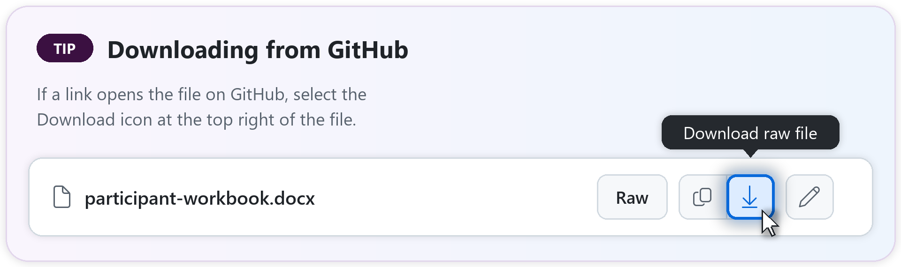
Workshop kit — download links
Everything participants and instructors need. Select a link to download it.
FOR PARTICIPANTS
FOR INSTRUCTORS
Participant workbook · setup + all 8 exercises
Sample data (zip) · the six Zava files
Quick-reference card · one-page handout
Prompt library · copy-paste HR prompts
Responsible use · data-handling rules
After the workshop · 30-day adoption plan
Instructor deck · slides + speaker notes
Facilitator guide · run sheet + triage
Answer key · expected results
Readiness checklist · prep timeline + Plan B
Demo seed content · your Ex 8 demo data + how to load it
Communication kit · overview deck + emails
Everything else: browse the kit on GitHub. Link opens on GitHub? Select the Download icon at the top right of the file. No access? Use the shared Teams/SharePoint folder.
Notes:
WORKSHOP KIT (optional reference, outside the required agenda). Use this for take-away downloads after the exercises or after the workshop. Distribute setup files through the invitation or shared Teams/SharePoint folder before the session. Participants need the workbook and the sample-data zip today; the quick-reference card, prompt library, responsible-use guide, and after-the-workshop pack are take-aways. The right column is for you and the proctors. The links point to the kit's GitHub repo, which is private: before the session, give attendees access or post the files in the shared Teams/SharePoint folder and send that link instead (communication/ has the training overview deck and the invitation emails).

Slide 52
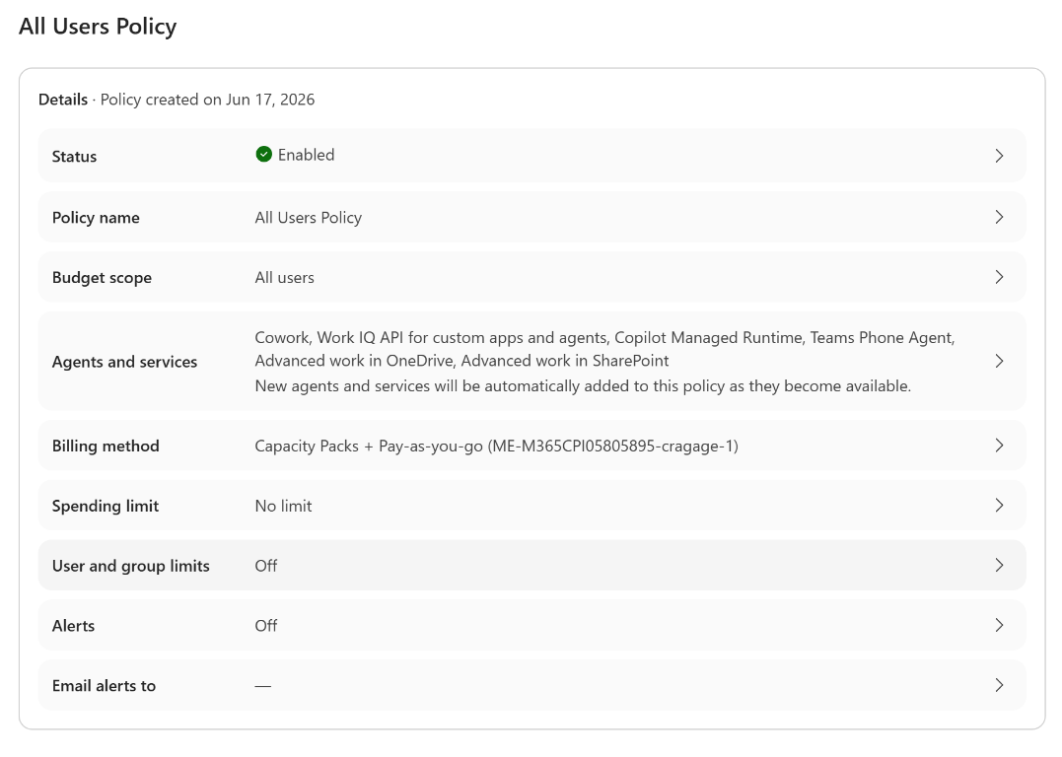
Cowork settings — Edge browsing & Copilot Credits
Complete these prerequisites before training; this Appendix slide is a setup reference.
Example admin spending policy
EDGE BROWSING · ADMIN + USER
Admin: Copilot → Settings → View all → Cowork settings → Allow browser access; include attendees.
User: Edge 152+, work-account profile; no InPrivate or guest window.
In Edge Settings, search Cowork; turn on Allow Cowork to take actions on your behalf.
COPILOT CREDITS · HOST / ADMIN
Enable usage-based billing; include every attendee in an enabled spending policy that selects Cowork.
Confirm enough remaining credits / budget at policy, user, and group levels for all exercises and retries.
Use the estimator and a dry run to set limits with headroom; check /cost during training and pause schedules.
Example only: use workshop-scoped limits and alerts, not unlimited spend.
Notes:
COWORK SETTINGS (Appendix reference). These are mandatory readiness checks, not optional prerequisites. Before class, the host enables usage-based billing and an enabled spending policy selecting Cowork that includes every attendee. Verify remaining policy budget and user/group credit limits have enough headroom for the workshop, retries, and scheduled runs until paused. There is no fixed credit amount guaranteed for every training run: estimate with the Customer Cowork Estimator and test in the attendee tenant. A tiny limit grants access but can interrupt work when exhausted. The screenshot is an example, not a recommendation for All users, No limit, or alerts off. Prefer the workshop group and appropriate limits and alerts. Separately enable Cowork Browsing for attendees in the admin center, and check Edge 152+, the matching work profile, and Allow Cowork to take actions on your behalf. Managed-device policy may require admin help. Run the smoke test and Exercise 2 browser prompt before class. Source: https://learn.microsoft.com/microsoft-365/copilot/cowork/cowork-admin-governance and reference/10-cowork-browser.md; cost planning: instructor/readiness-checklist.md.

Slide 53
How approvals work — one at a time
Optional walkthrough after Exercise 8: sending, posting, deleting, creating meetings.
OPTION
WHAT IT DOES
USE IT TODAY?
Send / Post / Create
Approves this one action
Yes — after reading the preview
Cancel
Skips it; Cowork continues with the rest
Yes — whenever unsure
Show parameters
Shows recipients, targets, and details
Yes — check before approving
Approve All (n)
Approves every pending action at once
No — not today
More options → Always allow
Stops asking for similar actions this session
No — not today
Why: one click on Approve All could bulk-send mail or change many items at once. Clicked one by mistake? Open the side panel’s Permissions section and revoke it.
Notes:
OPTIONAL HOW APPROVALS WORK (after Exercise 8, outside the required agenda). Skip if time is short. Show a real approval dialog and name each option: action button, Cancel, Show parameters, Approve All (n), and More options -> Always allow. Reinforce the exercise reminder: one at a time, no Approve All. Show where to revoke: side panel -> Permissions. Detail: reference/07-cowork-ui-walkthrough.md.

Slide 54
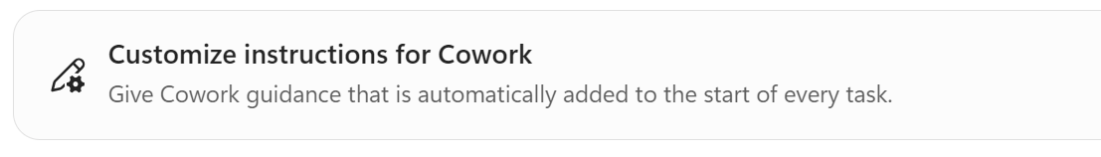
Optional — Customize instructions for Cowork
After Exercise 8, if time allows; otherwise try this after the workshop.
HOW
PASTE THIS (WORKBOOK OPTIONAL SECTIONS)
Customize → Preferences
Select Customize instructions for Cowork
Paste the text, then save
Test it in a new task
I work in HR at Zava. Write in a warm, professional, inclusive tone suitable for employee communications. When you answer a policy or benefits question, cite the source document and add “Policies can change — please confirm with HR.” Save emails and messages as drafts for me to review; during this workshop, never send anything to anyone but me. Unless I ask you to use my mail, calendar, or Teams, use only the Zava sample files in my OneDrive folder Documents/ai_hr_cowork_workshop, and never copy real employee personal data into files or drafts.
Personal to you · type / to reference a file or person · up to ~20 KB, but shorter is better · Role samples: workbook Appendix
Notes:
OPTIONAL CUSTOM INSTRUCTIONS (after Exercise 8, about 1 min; outside the required agenda). Skip this if time is short and point to the workbook's Appendix for later. Show it live: Customize -> Preferences -> 'Customize instructions for Cowork'. Explain: guidance Cowork automatically adds to the START of every new task, so tone, format, and rules don't have to be repeated in each prompt. Attendees who opt in paste the workbook sample, save, then test in a new task: 'Draft a two-sentence reminder to employees that open enrollment is in November.' The reply should use the tone and end with the confirm-with-HR note. Instructions are personal, support rich text and / references, up to about 20 KB; keep them short. Clear or adapt the Zava sample before returning to real work. Role-based samples are in the workbook's Appendix and reference/02-settings-and-models.md. Pick ONE, not stack them.

Slide 55
Responsible use — the golden rules
HR handles sensitive people data. Make these non-negotiable.
1
Every output is a draft
Review before you send, share, or file — especially employee comms.
2
Approve at checkpoints
Cowork pauses before irreversible actions. Read before you confirm.
3
Keep real data private
Ex 8 reads your own mail and calendar: keep results off shared screens. Everything else uses the fictional Zava files.
4
Cite & confirm
For policy answers, name the source and note HR should confirm.
5
Right person, right data
Cowork only reaches content you already have permission to see.
Notes:
OPTIONAL RESPONSIBLE USE (after Exercise 8, outside the required agenda). This detailed recap is optional; the safety rules still apply throughout the exercises. Draft -> review -> approve. Ex 8 runs on their own real data: results stay private, no screen sharing; all other exercises use fictional Zava files; never send to real people (send only to yourself). Cite sources + 'confirm with HR'. Keep recommendations on workstreams, not on evaluating individuals. Detail: reference/06-responsible-use.md.

Slide 56
Facilitation & troubleshooting
For instructors — skip live or use during a break.
KEEP 25 PEOPLE TOGETHER
COMMON BLOCKERS
1 facilitator + 1–2 floaters
Use each hands-on slide’s checkpoint to sync
Seed your demo account 1–2 days ahead (seed-content.md)
Check results with the answer key
Watch the clock: time checks at each break
No Cowork toggle → spare licensed account
Acted without asking → revoke in side panel Permissions
Light dashboard → quiet week; show your demo
No browser task → Edge, signed in with the work account
Agent ignores files → wait for “Preparing”, then refresh
Fallback: anyone blocked follows your demo, using facilitator-answer-key.md. Whole room down? Stop after 10 minutes and switch to Plan B (readiness-checklist.md). Running long? Use the time checks in the facilitator guide.
Notes:
FACILITATION. Biggest risks with ~25 people: pace variance, account readiness, and quiet mailboxes in Ex 8 (your demo account is seeded with seed-content.md, loaded through VS Code + the Work IQ MCP server). Attendees use their own work accounts; you're on a separate tenant. Never ask anyone to share their Ex 8 dashboard. Mirrors facilitator-guide.md, facilitator-answer-key.md, and readiness-checklist.md (timeline, cost planning, Plan B). Time checks: 0:20 Ex 1, 0:50 Ex 3, 1:20 break, 2:00 Ex 7, 2:15 Ex 8; the optional sub-tasks (1c scorecard, 2b brief, 5b + 5c, 6c sharing) are for fast finishers, so demo them rather than wait. If still behind, cut in this order: 6a only, then Ex 7 as a demo. Never cut Ex 3.

Slide 57
Wrap-up & next steps
Three tools, eight exercises, one habit: draft → review → approve.
Three tools
Copilot Chat for quick answers, Cowork to get multi-step work done, Agent Builder for a reusable helper.
What you built
A command center, a cited briefing, a browser task across two sites, a custom skill, an onboarding pack, an automation, and an agent.
Take it with you
The quick-reference card, the prompt library, and the scenario cards in your workbook.
Next week
Pick one task to hand to Cowork. Tomorrow you’ll get a 30-day adoption plan.
Before you leave: clean up the training data with the steps on the last slide. At minimum, delete or pause your Exercise 8 and 6 schedules.
Notes:
WRAP-UP (2:30-2:35). Recap the THREE tools and everything they built. Reinforce the golden rules. Ask each person to name ONE task for next week. Remind them to pause/delete the Ex 8 and Ex 6 schedules, then leave the clean-up slide up while people pack up.

Slide 58
Thank you
Questions? Try the stretch prompts at the end of each exercise in the participant workbook, then explore the kit’s README.
©2026 Microsoft Corporation. All rights reserved.
Notes:
CLOSE. Thank the group and take questions. Point to README.md, the prompt library, and the custom-skill and Agent Builder guides. Then show the clean-up slide.

Slide 59
Clean up the training data
Before you leave (or later today): delete only what you made in the workshop, in this order.
1 STOP AND REVIEW IN COPILOT
2 DELETE THE ZAVA FILES
Automations → Manage schedules: delete or pause the Ex 8 command center and Ex 6 ticket digest
Customize → Skills: delete Executive Command Center and HR Policy Answer unless you’ll use them
Customize → Preferences: if set in the optional section, delete or rewrite the Zava instructions
Copilot → agent … menu: delete HR Policy Agent if you don’t need it (permanent)
OneDrive: delete Documents/ai_hr_cowork_workshop and the Zava files in Cowork
Outlook: delete the Sofia announcement draft and the kickoff meeting (optional Ex 5 tasks)
Laptop: delete the zip, the extracted files, and any Download All zips
Shared laptop: sign out of Microsoft 365
Host, day after: remind attendees about their schedules; remove the workshop group from the Cowork spending policy if attendees shouldn’t keep access. Facilitator: clean up your demo tenant (seed content, demo schedules, skills, and agents).
Notes:
CLEAN UP THE TRAINING DATA (end of session; leave this up while people pack up). Attendees used their own work accounts, so they delete only what they made today and keep anything they want to reuse. Deleting or pausing the Ex 8 and Ex 6 schedules comes first: they're usage-billed. Delete skills from Customize rather than deleting their OneDrive files. The Zava custom instructions apply to every future Cowork task, so they should delete or rewrite them. Deleting the Agent Builder agent is permanent and also removes access for anyone it was shared with. Full steps: the end of participant/participant-workbook.md. Host: also follow the day-after row in instructor/readiness-checklist.md.

