Slide 1


FAKE NEWS DETECTION PROJECT
Submitted by
Raganee Verma

Slide 2
INTRODUCTION
Fake news's simple meaning is to incorporate information that leads people to the wrong path. Nowadays fake news spreading like water and people share this information without verifying it. This is often done to further or impose certain ideas and is often achieved with political agendas.
For media outlets, the ability to attract viewers to their websites is necessary to generate online advertising revenue. So, it is necessary to detect fake news
It is important to identify the fake news from the real true news. The problem has been taken over and resolved with the help of Natural Language Processing tools which help us identify fake or true news based on historical data. The news is now in safe hands

Slide 3
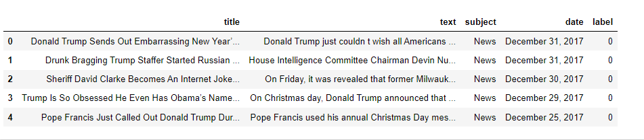
DATA SOURCES AND DESCRIPTION
The data is provided to us from our client database. The sample data is in.csv format
After merging both true and fake dataset the sample data for reference is shown below.
This is our final dataset which contain 44898 rows and 5 columns.
title: It is the title of the news.
text: It contains the full text of the news article.
subject: It represents the subject of the news article.
date: It represents the date of the news article published.
label: It tells whether the news is fake (1) or not fake (0).

Slide 4
Exploratory Data Analysis
First, we check null value by using isnull function and heatmap also but We found that no any missing value are present there.
Then checked datatype of various features & found that all features are object datatype but here date is not object to so we can convert it into datetime.
Checking for unique values in each column and we observed that so many unique values present in title, text, and date column. 8 unique value presents in subject and 2 unique values in our target columns.
Checking distribution of fake and real news and observed that 47% of the news is fake.
We see that both news is equally distributed. dataset is balanced which is good as it will help our model to classify more accurately, so we should expect a good accuracy score and no need to use oversampling or under sampling method.
From count plot of subject, we observed that most of the news are politics background.
Rename title as headline and text as news for better understanding and find the length of string

Slide 5
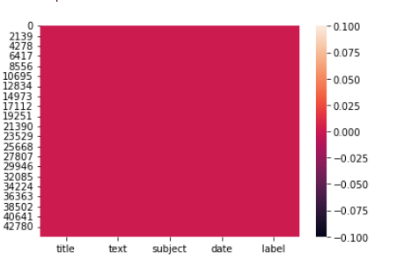
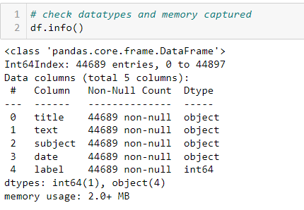
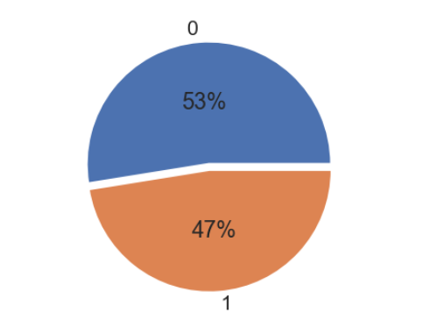
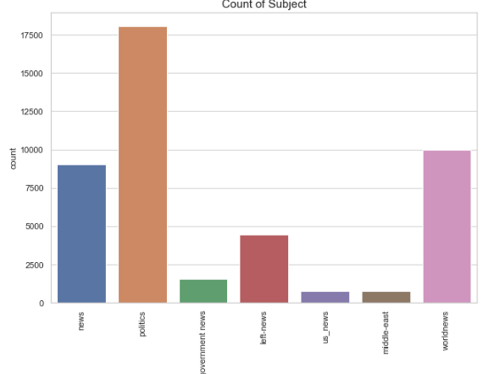
VISUALIZATION OF PREPROCESSING AND DATA ANALYSIS

Slide 6
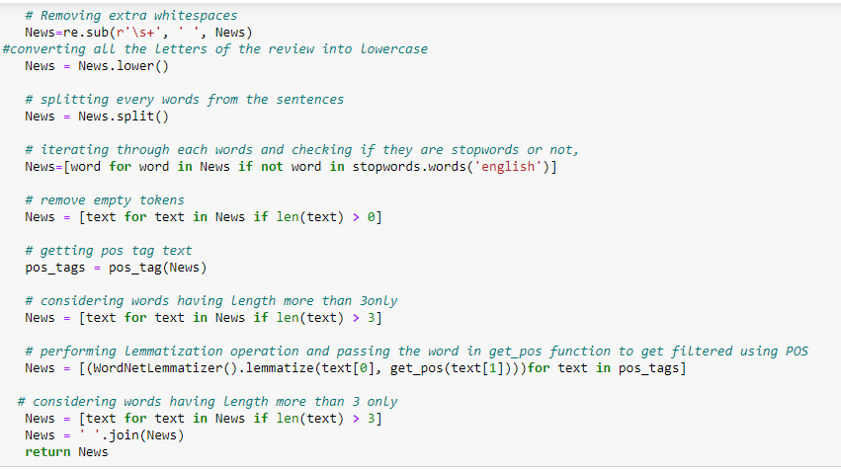
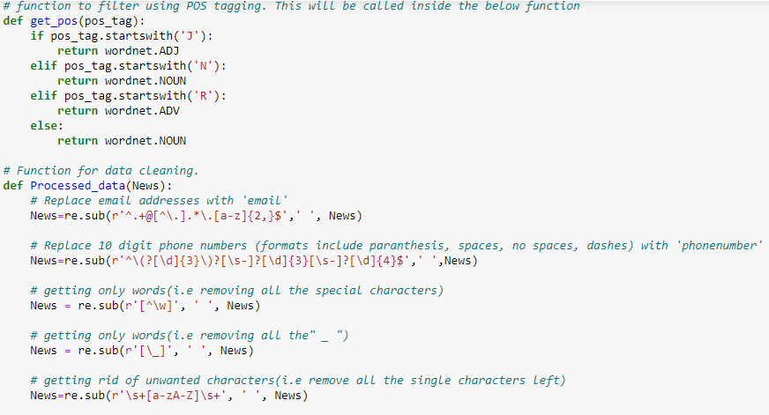
Important cleaning steps are:
Lowering case
Handling of special characters
Removal of stopwords
Handling of hyperlinks
Removing leading and
trailing white space
Replacing URLs with web address
Converted words to most
suitable base form by using
lemmatization

Slide 7
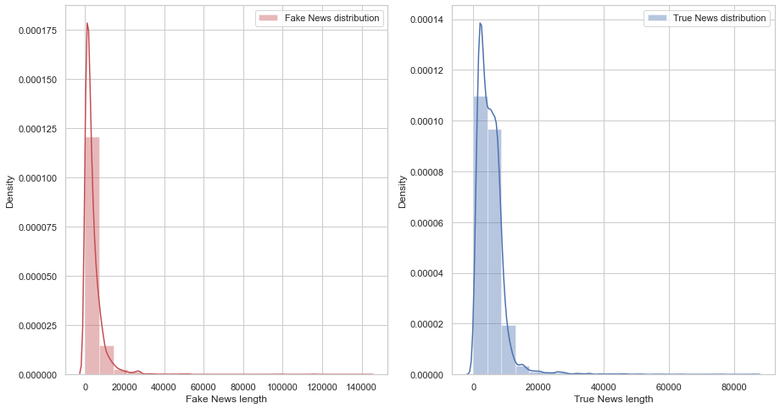
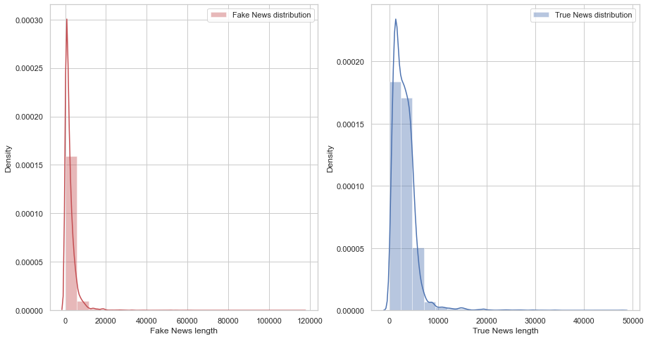
graph to show distribution of word count before cleaning and after cleaning
News Before cleaning
News After cleaning
To get better view of words contained in news. A word dictionary (wordcloud) was made showing the first 200 words highly occurred in fake and real news for both headline and news column.

Slide 8
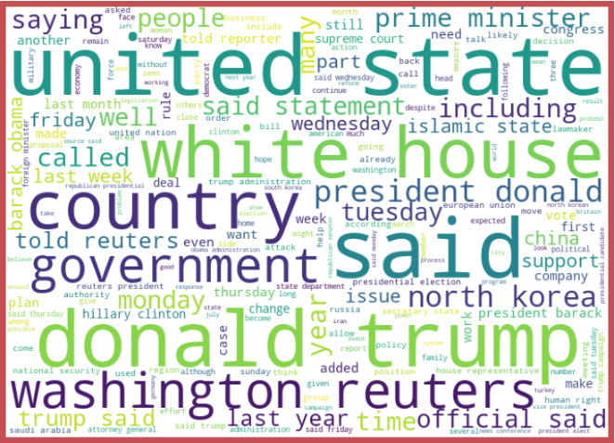
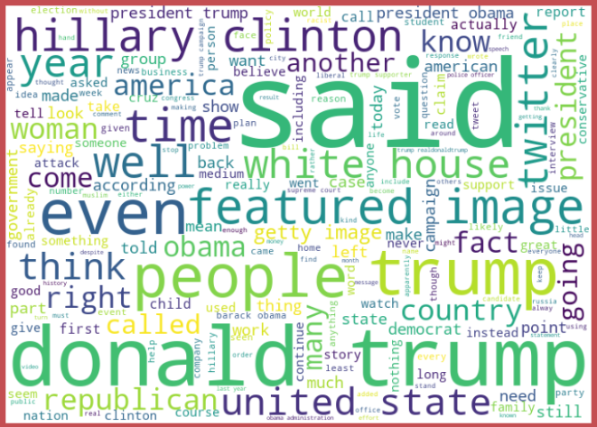
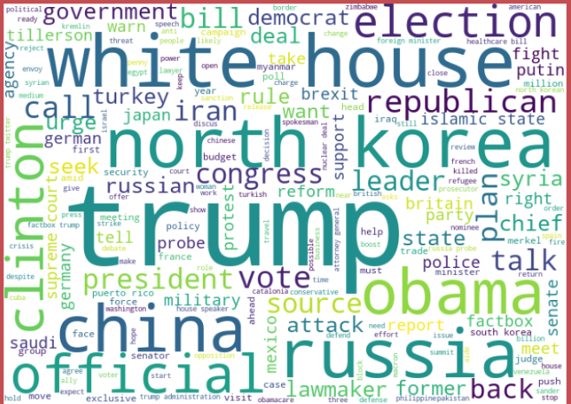
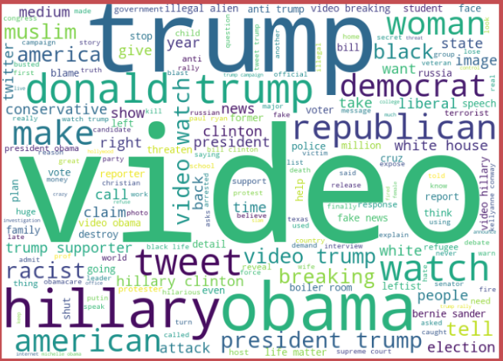
Showing the words highly occurred in fake and real news for both headline and news column

Slide 9
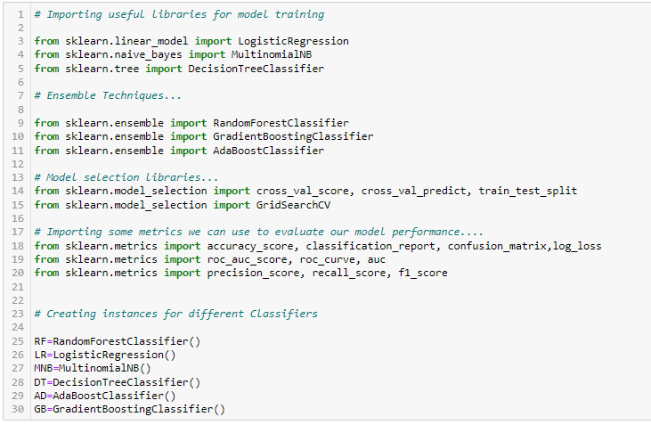
Model Building and Performance
This is a binary classification type problem and below models were used:
LogisticRegression
DecisionTreeClassifier
RandomForestClassifier
AdaBoostClassifier
MultinomialNB
Gradiant booster Classifier

Slide 10
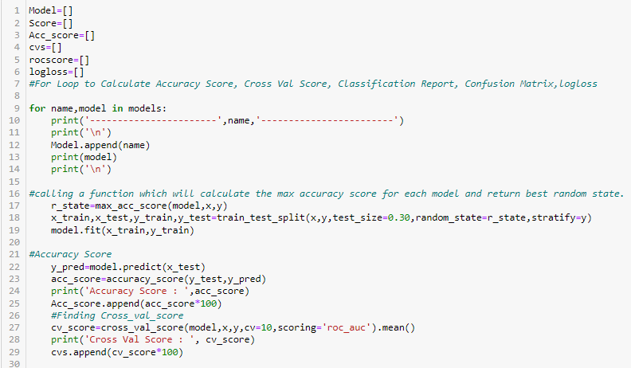
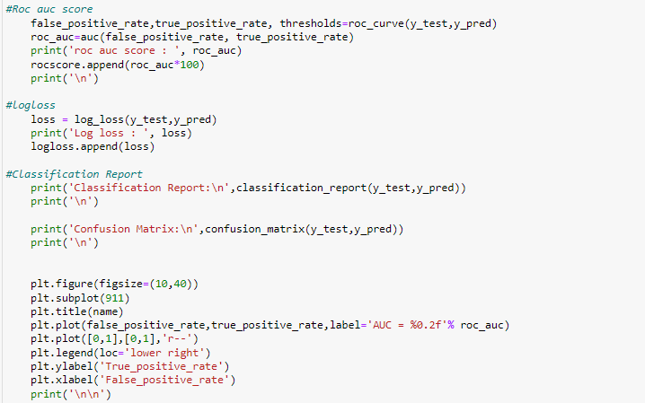
RUN AND EVALUATE SELECTED MODELS

Slide 11
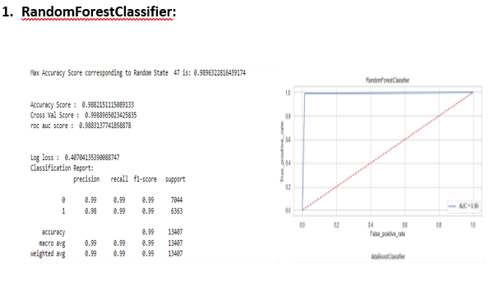
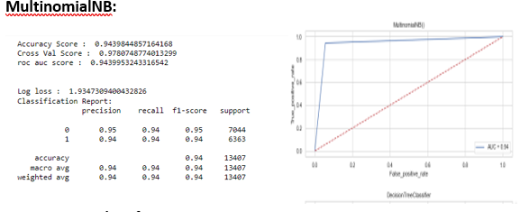

Slide 12
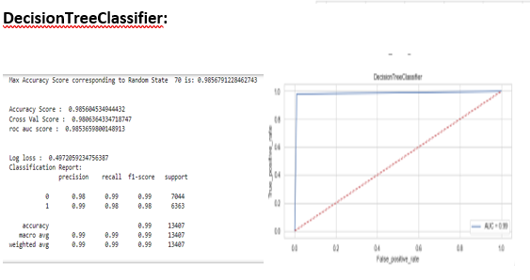
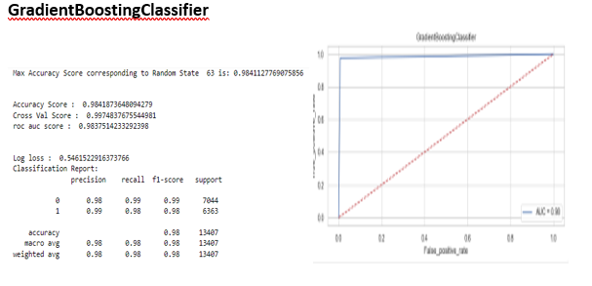

Slide 13
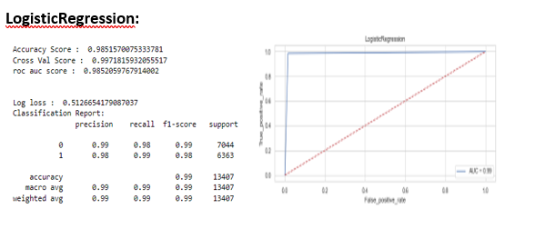
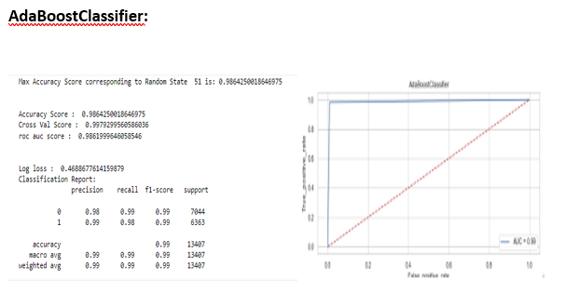

Slide 14
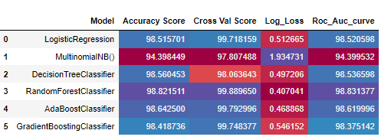
Comparison of all model performance We compare performance of all model and find out the final model according to accuracy score and model performance.

Slide 15
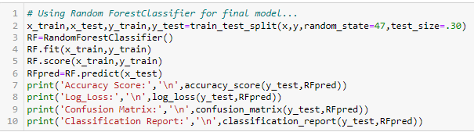
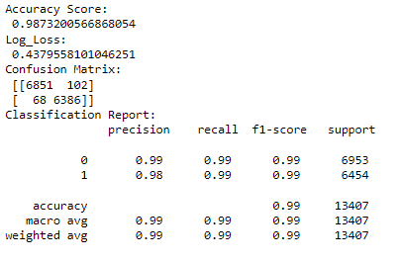
Final model selection We choose the RandomForest Classifier model as the final one, as it gives the highest accuracy score & also log_loss value is minimum which indicates the better prediction

Slide 16
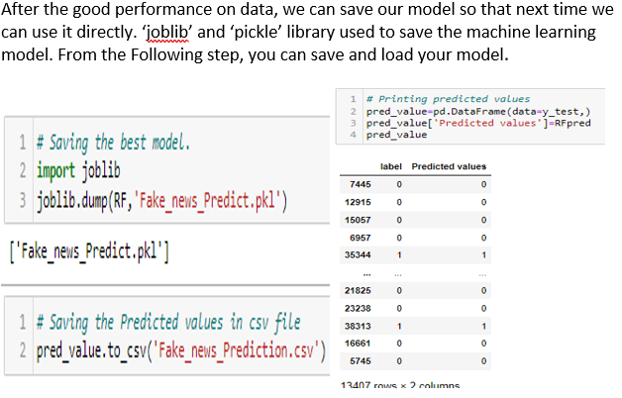
SAVE AND PREDICT FINAL MODEL

Slide 17
CONCLUSION
Machine Learning Algorithms like ,Gradiant Booster,Adaboost and Randomforest Classifier took an enormous amount of time to build the model. Using Hyper-parameter tuning for Randomforest would have resulted in some more accuracy.
The saved model now can help to give an estimate of probability about the type of news being fake or real.
It was overall a nice experience on working on a real time project of NLP domain to see how data science and machine learning is useful in this field.
Today, we learned to detect fake news with Python. We took a Fake and True News dataset, implemented a Text cleaning function, TfidfVectorizer, initialized 6 different model from which Random Forest Classifier is our best model with the accuracy of 98.8%.

