Slide 1
What’s better: Agile Development or Critical Chain Management? Yes!
© 2003 Reginald Braithwaite-Lee
http://www.braithwaite-lee.com

Slide 2
NOTICE
This work is licensed under the Creative Commons Attribution-ShareAlike License. To view a copy of this license, visit http://creativecommons.org/licenses/by-sa/1.0/ or send a letter to Creative Commons, 559 Nathan Abbott Way, Stanford, California 94305, USA.

Slide 3


Slide 4
Global Optimization
does not emerge from
Local Optima

Slide 5
The “Theory of Constraints”
Global optimization does not emerge from local optima
Managing by cost—optimizing local performance—is usually at odds with managing by throughput—exploiting constraints

Slide 6

Though the wind is not made by leaves flapping, as some children guess, the theory is sufficiently profound that it should not be dismissed out of hand. In fact, disassembling erroneous concepts is one of the best ways to find new ideas.
Nicholas Negroponte

Slide 7
Theory of Constraints > Throughput vs. Cost
How does the organization measure creation of business value?
How does the organization measure local performance?
Notes:
Hammond and Bell Labs

Slide 8
Theory of Constraints > Throughput vs. Cost
How does the organization measure creation of business value?
How does the organization measure local performance?
Why aren’t they the same?

Slide 9
Theory of Constraints > Exploiting Constraints
Real systems have one, at most two, constraints
What constrains the throughput of programming projects?
Elevate the Constraint
Non-constrained resources must exceed the capacity of the constraint… and be underutilized!

Slide 10
The critical path determines the time it takes to complete the project: any delay in the critical path is a delay in the project

Slide 11
Critical Chain
The critical path determines the time it takes to complete the project: any delay in the critical path is a delay in the project
Delays accumulate, advances do not
“Padding tasks considered harmful”

Slide 12
Critical Chain > Delays Accumulate, Advances Do Not
Polish and Gold Plating
Sequential Dependencies:
  all delays are passed through
  ‘students’ kill advances
Parallel dependencies:
  delays are passed through
  advances are lost unless all dependencies advance

Slide 13
Critical Chain > Delays Accumulate, Advances Do Not
Next step
One +5
Two +3
Three -8
When will the next task start?

Slide 14
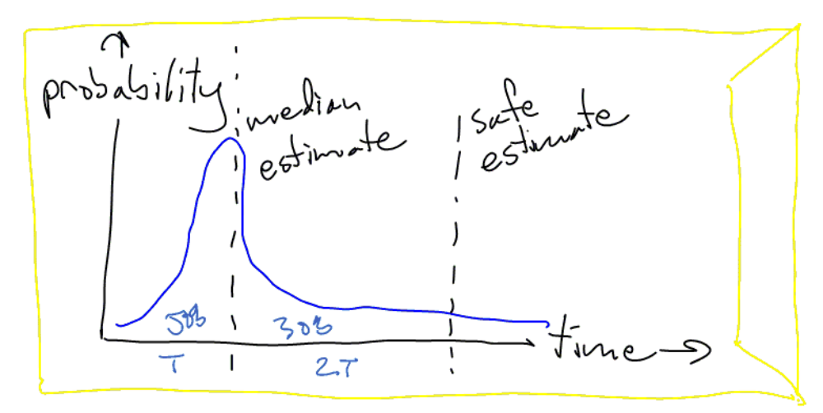
Critical Chain > “Padding Tasks Considered Harmful”

Slide 15
Is there is 200 to 300 percent padding on every task, why is software always late?

Slide 16
Critical Chain Management
Estimate to the median of every task
Place padding where it can protect the critical path
Buffer remaining is the measure of throughput

Slide 17
When a thought is too weak to be expressed simply, simply drop it
Marquis de Vauvenargues

Slide 18
Critical Chain Management
 | Median | Pad | Sched.
Google XP | 2 | 4 | 6
Read “The Goal” | 5 | 3 | 14
Make Slides | 3 | 6 | 23
Review and Fix Up | 2 | 2 | 27

Slide 19
Critical Chain Management
 | Median | Pad | Sched.
Google XP | 2 | 4 | 2
Read “The Goal” | 5 | 3 | 7
Make Slides | 3 | 6 | 10
Review and Fix Up | 2 | 2 | 12
Buffer | 15 |  | 27

Slide 20
Critical Chain Management
The primary constraint is the critical path
Our operational reality is that delays accumulate and advances are lost
We elevate the constraint, moving task padding into the buffer
…and other stuff: read the book!

Slide 21


Slide 22
The entire Eclipse Group, especially its managers, seemed to be operating on instinct. Only the simplest visible arrangements existed among them. They kept no charts and graphs or organizational tables that meant anything. But those webs of voluntary, mutual responsibility, the product of many signings-up, held them together...
Tracy Kidder, "The Soul of a New Machine"

Slide 23
Agile Development
Value Orientation
Planning Game
Small Iterations

Slide 24
Notre Dame was trailing Michigan State and coach Lou Holtz radioed to assistant coach Dave Roberts that he needed a pass the Irish could complete. On the next play QB Ron Powlus tossed a pick and, sure enough, Roberts heard his headphones click. He prepared to have his ear chewed off like a Little Leaguer. "Uh, Dave," said Holtz, "I'm sorry ... let me be a little more clear. We need a pass we can complete TO OUR TEAM!"

Slide 25
Agile Development > Value Orientation
Throughput Orientation
Metrics for business value and local performance are the same!

Slide 26
Agile Development > Planning Game
Steering is more important than Planning
  What constraint does this imply?
  What is the value of a plan?
Implies Continuous Process, not One Time Project
Just In Time Design
  Does Intellectual Property behave like Inventory?

Slide 27
Agile Development > Small Iterations
Parallel Development
  Are advances lost?
  Does it matter?
Visible Progress
  How does this affect padding?

Slide 28
From what I've seen, languages either become popular because they have a big sponsor (Cobol, PL/1, Ada, Java) or by word of mouth among programmers ambitious enough to try a new language (Lisp, C, Smalltalk, Perl, Python). You may notice another difference between the two lists...
Paul Graham

Slide 30
What’s better: Agile Development or Critical Chain Management?
Value Orientation
Planning Game
Small Iterations
Estimate to the median of every task
Place padding where it can protect the critical path
Buffer remaining is the measure of throughput

Slide 31
There's nothing more deadly to your career than having a reputation of being so concerned with process that you don't accomplish anything.
Joel Spolsky

Slide 32
Thank you!

