Slide 1

Scrum: One Person’s Perspective
© 2004 Reginald Braithwaite-Lee
www.braithwaite-lee.com

Slide 2
Why Am I Here Today?
To help you decide whether to investigate Scrum for a current or near-term project.

Slide 3
Things I Won’t be Trying to Accomplish
Prove that Scrum works
Prove that heavy, up-front design and waterfall project management don’t work
Persuade you to abandon practices that are working for you
Teach you to how to use Scrum
Keep you awake (unless you snore)

Slide 4
There's nothing more deadly to your career than having a reputation of being so concerned with process that you don't accomplish anything.
Joel Spolsky

Slide 5
Who is Reg?
Programming since 1975, professionally since 1986, managing since 1994
Development manager, JProbe Suite of J2EE performance and reliability tools
Have delivered software projects on time and under budget for almost ten years

Slide 6
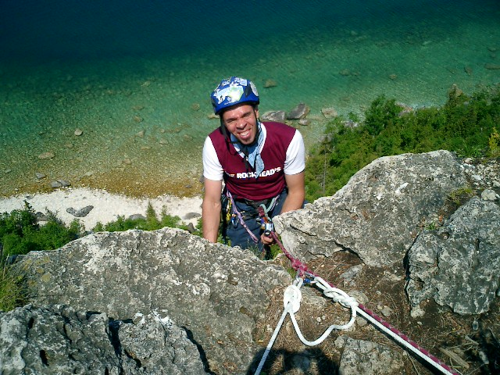
Reg and Scrum
Recent Certified Scrum Master
Has used many of Scrum’s elements
Has not used Scrum on a project

Slide 7
Scrum
An Empirical Methodology for Maximizing ROI of Software Development Projects

Slide 8
Scrum is a Disciplined Management Methodology
Wrapper for existing engineering practices
Maximizes ROI, but doesn’t change I
PMI can wrap Scrum
Scrum works with XP and any other engineering practice you care to entertain
Yes, Scrum works with RUP!!!
Notes:
The second point is not obvious if you weren’t at the presentation.
The complete thought is that while it maximizes your return on investment in software development, it doesn't actually change your investment. In other words, it can't help you if your goal is to hire unskilled programmers and hope that a few so-called "architects" plus a methodology will somehow constrain your team into delivering something.
Scrum maximizes the value from your investment, but it's still important to invest.

Slide 9
I love hearing things like “you can’t have the benefits of capitalism without the drawbacks.” Meaning, most often, “I can’t have the benefits of capitalism without you having the drawbacks.”—Adam Lang

Slide 10
Scrum is Defined
There is a simple, Boolean test for whether a project is practicing Scrum
Scrum has specific roles
Scrum has specific practices
Scrum has specific artefacts
Everything else is not part of Scrum

Slide 11
Scrum has a mindset
Scrum is commitment-oriented: You’ll be introduced to chickens later.
Scrum is results-oriented: projects produce increments of a shippable product, activities are time boxed, and ceremony is discouraged.
Scrum is disciplined. There are practices you must follow on a specified time table.

Slide 12
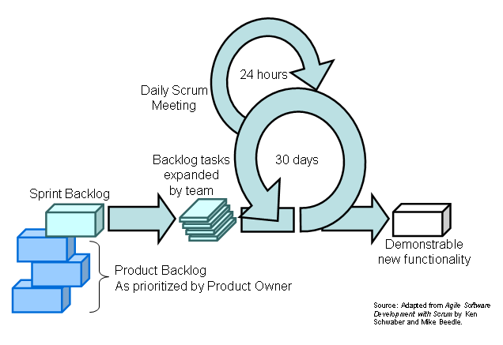
Scrum:

Slide 13
Scrum’s Roles
The Product Owner
The Scrum Master
The Team
Everyone else is not part of Scrum

Slide 14
Scrum’s Practices
The Sprint Planning Meeting
The Sprint
The Sprint Review Meeting
The Sprint Retrospective
The Daily Scrum
All other practices are not part of Scrum

Slide 15
Scrum’s Artefacts
The Product Backlog
The Sprint Backlog
The Sprint Burndown Chart
The Product Increment
Everything else is not part of Scrum

Slide 16
Scrum is…
A management methodology
A discipline
A mindset
A way to obtain measurable ROI
Visible

Slide 17
A Closer Look at Scrum

Slide 18
It’s all about Pigs and Chickens
A joke about opening a diner
The definition of a Pig is “someone who makes a personal commitment to the success of the project”
One perspective is that Scrum is all about getting rid of the Chickens!

Slide 19
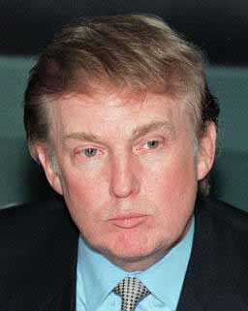
“You’re Fired!”
A really simple metric:
If you can be fired for allowing the project to fail, you are a pig.
If you keep your job even if the project fails, you are a chicken.

Slide 20
Why all the fuss about Pigs and Chickens?
The discussion of Pigs vs. Chickens scales to all aspects of software development projects. Aspects of the projects that are most directly related to the success of the project must be allowed to flourish without interference by practices, rituals, and obstructions that are orthogonal to or inimical to project success.

Slide 21
Scrum’s Roles
The Product Owner
  Owns definition of success
  Manages ROI through prioritization and release plans
The Scrum Master
  Owns the process
  Teaches the Product Owner and the Team
The Team
  Owns the production and engineering process

Slide 22
In computing, turning the obvious into the useful is a living definition of the word “frustration”.
Alan Perlis

Slide 23
“The Product Owner’s focus is ROI. The Product Owner directs the project, Sprint by Sprint, to provide the greatest ROI and value to the organization.”

Slide 24
“The Scrum Master is responsible for the success of the project, and he or she helps increase the probability of success by helping the Product Owner select the most valuable product backlog and by helping the Team turn that backlog into functionality.”

Slide 25
“The Team is responsible for managing itself and has the full authority to do anything to meet the Sprint goal within the guidelines, standards, and conventions of the organization and of Scrum.”
Notes:
This does not exclude the possibility of having team leads, QA leads, development managers, architects,&tc.

Slide 26
Scrum’s Practices
The Sprint Planning Meeting
The Sprint
The Sprint Review Meeting
The Sprint Retrospective
The Daily Scrum
Everything else is not part of Scrum

Slide 27
When a thought is too weak to be expressed simply, simply drop it
Marquis de Vauvenargues

Slide 28
The Sprint Planning Meeting
Product Owner describes highest priority features to the Team.
Team decides what the can commit to delivering in the Sprint.
Notes:
Nobody else can offer unsolicited advice: everyone else

Slide 29
Segment One: Four Hours
The Product Owner selects the ideal backlog for the coming Sprint and communicates its meaning and importance to the team.
Chickens may be invited to provide clarification, but they are immediately dismissed.
Team may ask questions.

Slide 30
Segment Two: Four Hours
The Team decides how much it can commit to delivering in the coming Sprint.
The Product Owner answers questions but does not direct the team’s choices. No chickens allowed.
The outcome is the Sprint Backlog.
Notes:
The consequence of the time box is that there will be inaccuracy.

Slide 31
“The Team decides how to turn the selected requirements into an increment of potentially shippable product functionality. The Team devises its own tasks and figures out who will do them.”

Slide 32
The Sprint
Strictly time boxed to 30 consecutive calendar days: it’s more important to fall short than to slip the date
Activities are visible through the Sprint Backlog and Sprint Burndown Charts
The Product Owner refrains from tinkering with priorities
Within the sprint, there are many possible engineering practices!

Slide 33
If a listener nods his head when you’re explaining your program, wake him up.
Alan Perlis

Slide 34
The Sprint Review Meeting
Time boxed to one hour of prep and four hours of meeting.
Team demonstrates product increment to product owner’s satisfaction.
Informality is encouraged. PowerPoint is discouraged.
Chickens are welcome. Comments from chickens are discouraged.

Slide 35
The Sprint Retrospective
Time boxed to three hours.
Team, Scrum Master, and (optionally) Product Owner review the last Sprint
What went well?
What can be improved?
Actionable items are presented to the Product Owner for prioritization as non-functional requirements.

Slide 36
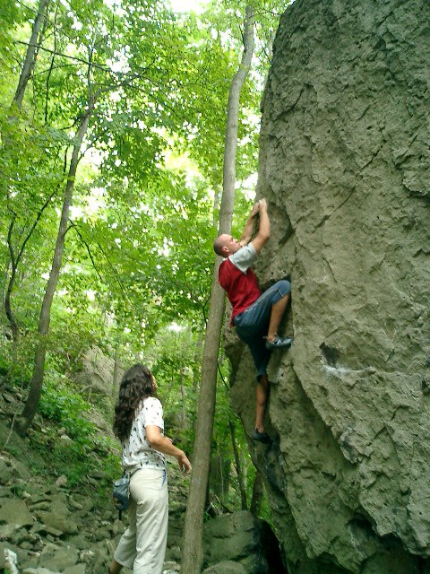
Very Small Exposure Requires Very Little Ceremony

Slide 37
The Daily Scrum
Time boxed to fifteen minutes!
The Team and the Scrum Master only.
What have you accomplished since yesterday?
Are your Sprint Backlog estimates accurate?
What are you working on today?
Is there anything blocking you?

Slide 38
Scrum’s Artefacts
The Product Backlog
The Sprint Backlog
The Sprint Burndown Chart
The Product Increment
Everything else is not part of Scrum

Slide 39
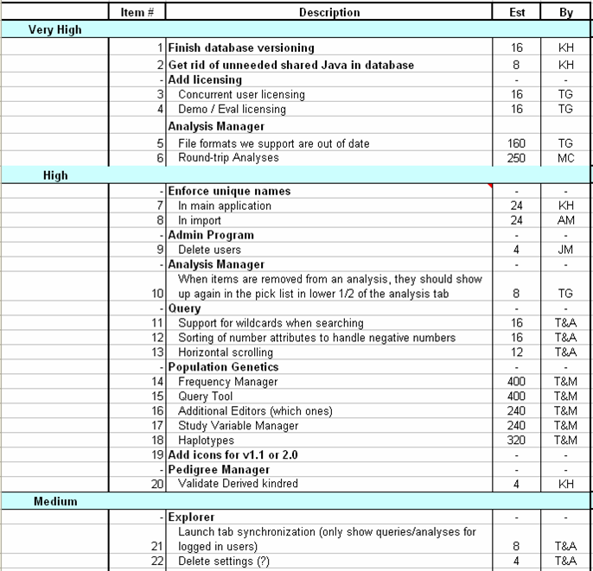
The Product Backlog

Slide 40
The Product Backlog
Prioritized by organizational value
Must be no coarser than a Sprint in size.
How do non-functional requirements work?
How do engineering ‘investments’ work?
Scrum doesn’t provide any magic estimation bullet.
Notes:
Some non-functional requirements belong inside a sprint.

Slide 41
Good Requirements
(see http://www.pragmaticmarketing.com/)
Necessary
Concise (minimal, understandable).
Implementation free.
Attainable (achievable or feasible).
Complete (standalone).
Consistent.
Unambiguous.
Verifiable.
[i] “Characteristics of Good Requirements” by Pradip Kar and Michelle Bailey, given at the 6th INCOSE Symposium. Available at http://www.complianceautomation.com

Slide 42
Good Requirements
(see http://www.pragmaticmarketing.com/)
Necessary. The stated requirement is an essential capability, physical characteristic, or quality factor of the product or process. If it is removed or deleted, a deficiency will exist, which cannot be fulfilled by other capabilities of the product or process.
Concise (minimal, understandable). The requirement statement includes only one requirement stating what must be done and only what must be done, stated simply and clearly. It is easy to read and understand.

Slide 43
Good Requirements
(see http://www.pragmaticmarketing.com/)
Implementation free. The requirement states what is required, not how the requirement should be met. A requirement statement should not reflect a design or implementation nor should it describe an operation. However, the treatment of interface requirements is generally an exception.
Attainable (achievable or feasible). The stated requirement can be achieved by one or more developed system concepts at a definable cost. This implies that at least a high level conceptual design has been completed and cost tradeoff studies have been conducted.

Slide 44
Good Requirements
(see http://www.pragmaticmarketing.com/)
Complete (standalone). The stated requirement is complete and does not need further amplification. The stated requirement will provide sufficient capability.
Consistent. The stated requirement does not contradict other requirements. It is not a duplicate of another requirement. The same term is used for the same item in all requirements.

Slide 45
Good Requirements
(see http://www.pragmaticmarketing.com/)
Unambiguous. Each requirement must have one and only one interpretation. Language used in the statement must not leave a doubt in the reader's mind as to the intended descriptive or numeric value.
Verifiable. The stated requirement is not vague or general but is quantified in a manner that can be verified through inspection, analysis, demonstration or test.

Slide 46
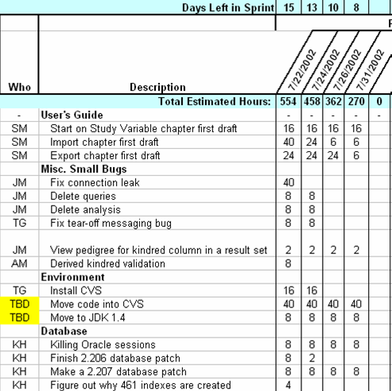
The Sprint Backlog

Slide 47
The Sprint Backlog
Selected by team at outset of Sprint
Changes during Sprint as information is discovered
Okay to use other engineering practices (stories, micro-iterations), but progress must be reported in the backlog
Time estimates must be updated daily

Slide 48
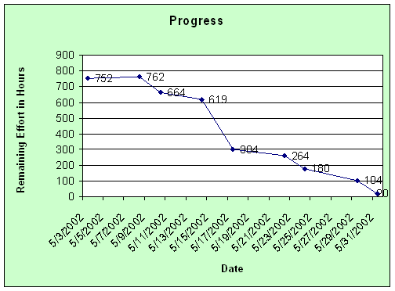
The Sprint Burndown Chart

Slide 49
The Product Increment
Delivers measurable value
“Potentially Shippable”: the process can be halted after every Sprint and there will be some value, some ROI
Must be a product, no matter how incomplete
Notes:
Talk about training, QA

Slide 50
Scrum in Practice
“In theory, there’s no difference between theory and practice. In practice, there is.” —John MacMillan

Slide 51
Documentation is like term insurance: It satisfies because almost no one who subscribes to it depends on its benefits.
Alan Perlis

Slide 52
How does Scrum handle…
Engineering Documentation?
Coding and Design Standards?
Non-functional Requirements?
Sales Engineering?

Slide 53
Shared Resources
Where does the “QA Team” fit?
Where does the “Chief Architect” fit?
Where does the “Oracle Guru” fit?
Where does the “PMO” fit?

Slide 54
What happens when…
There’s a SNAFU within a Sprint?
The team decides it needs more than 30 days to get anything meaningful done?
The team finds itself working on ‘minor requests’
The product owner is too busy to participate?

Slide 55
Around computers it is difficult to find the correct unit of time to measure progress. Some cathedrals took a century to complete. Can you imagine the grandeur and scope of a program that would take as long?
Alan Perlis

Slide 56
Why are sprints 30 days long?
Increments that are too large are inefficient: need artefacts, too much planning
Increments that are too small are inefficient: hard to deliver increments of value
People are lunatics

Slide 57
How Big is a Team?
Typically 5-10 people
Mike Cohn has led teams of 100+
Ken Schwaber has led teams of 600+
Obviously, very large teams are a very special case
“Scrum of Scrums” technique

Slide 58
Pointing Out The Obvious
Why Empirical Methodologies Work for Software Development

Slide 59
“The world is divided into two kinds of people: those who bifurcate and those who don’t.
”

Slide 60
“We use defined processes whenever possible because with them we can crank up unattended production to such a quantity that the output can be priced as a commodity. However, if the commodity is of such unacceptable quality to be unusable, the rework is too great to make the price acceptable, or the cost of unacceptably low yields is too high, we have to turn to and accept the higher costs of empirical process control.”
Ken Schwaber, “Agile Project Management with Scrum”

Slide 61
If there is 200 to 300 percent padding on every task estimate, why is software always late?

Slide 62
Defined Process Control
Every task must be completely and unambiguously understood
Inputs are completely and unambiguously defined
When given a well-defined set of inputs, the same outputs are generated every time.
Notes:
At the presentation, someone asked why I said Scrum was “defined” on one slide, yet talked about it being “an “empirical process” in this section of the presentation. The truth is, I hadn’t noticed the unfortunate ambiguity.
I gave the matter some thought, and here’s how I resolve the ambiguity: there are specific, defined roles, practices, and artifacts in Scrum. That sounds like “defined process control,” and it is. But what’s defined is the management process, not the engineering process. So in fact, every management task is completely and unambiguously understood. The inputs for every management meeting, consisting of Scrum’s artefacts, are also completely and unambiguously understood. And given a well-defined set of inputs, the same outputs are generated every time, so much so that Scrum confidently time boxes the important meetings.
However, the engineering process inside Scrum is an empirical process. And Scrum wraps the engineering process in a way that supports the empirical process. So my opinion is that there is a defined process wrapping an empirical process, and that Scrum works so well be cause it defines the things we can define and does not try to define the things we can’t.
Compare this to how project management is usually done (what actually happens, not what people think happens). People’s management is ad hoc and empirical, with change requests and fire fighting happening whenever and however. So the management is certainly not a defined process. But everyone insists the engineering is a defined process, and run the project as if we know exactly what will be done by when, with no allowance for risk or deviation.

Slide 63
“The best strategic plan is useless if it cannot be executed tactically.
”
Field-Marshall Erwin Rommel
quoted in “Bottom-Up Marketing”

Slide 64
Empirical Process Control
Visibility: those aspects of the process that affect the outcome must be visible to those controlling the process.
Inspection: those aspects of the process that affect the outcome must be inspected frequently enough that unacceptable variances in the process can be detected.
Adaptation: If the inspector determines from the inspection that one or more aspects of the process are outside acceptable limits and that the resulting product will be unacceptable, the inspector must adjust the process or the material being processed.
Notes:
Visibility: and they must be true
Inspection: the inspector must possess the skills to assess what he or she is seeing

Slide 65
Visibility
What is the actual (not ideal) relationship between these aspects and the outcome?
Design Artefacts
Spike Solutions
Test Frameworks
Automated Tests
Design patterns and coding standards
Product Increments

Slide 66
Inspection
What is the actual (not ideal) relationship between these aspects and the outcome?
  Design Artefacts
  Spike Solutions
  Test Frameworks
  Automated Tests
  Design patterns and coding standards
  Product Increments
How do you inspect these aspects?

Slide 67
Adaptation
Adjust the process or the material being processed
Making decisions based on information that was not known at the outset of the project
Refusing to decide is a decision: the team accepts accountability for averting disaster by managing priorities

Slide 68
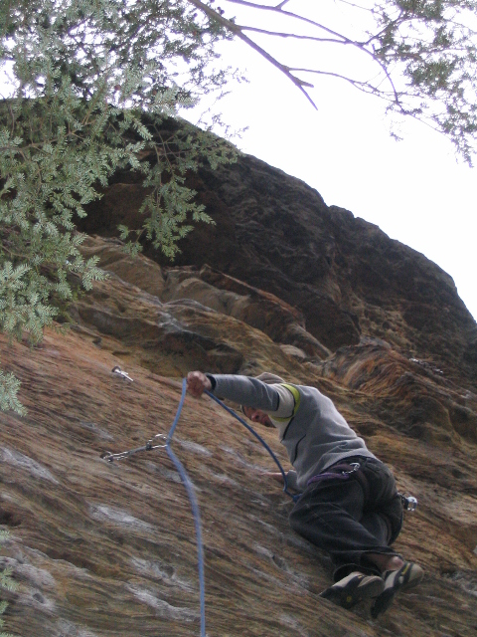
It’s okay to expose yourself to a small amount of risk, but limit the size of the potential fall.

Slide 69
“How to Fail with the RUP”
Craig Larman, Chief Scientist, Valtech USA
Philippe Kruchten, Rational Fellow, Rational Software Canada
Kurt Bittner, General Manager, Process and Project Management Business Unit, Rational Software
http://tinyurl.com/2tvmu

Slide 70
Seven Steps to Failure
Superimpose “Waterfall” Thinking
Apply the RUP as a Heavy, Predictive Process
Avoid Object Technology Skills
Undervalue Adaptive Iterative Development
Avoid Mentors Who Understand Iterative Development
Adopt the RUP in a Big Bang
Take Advice from Misinformed Sources

Slide 71
Scrum, Reloaded
Notes:
At this point in the presentation, I was definitely recapping. I presumed the audience had never heard of Scrum and thought they had better things to do than research it in advance of my presentation. Also, when first presenting some of the material, the audience would need time to digest the ideas in order to ask good questions. A recap provides a good opportunity for people to say "okay, I have a question.“
The title is a reference to the second Matrix movie. If you care, I think it was awful.

Slide 72
The entire Eclipse Group, especially its managers, seemed to be operating on instinct. Only the simplest visible arrangements existed among them. They kept no charts and graphs or organizational tables that meant anything. But those webs of voluntary, mutual responsibility, the product of many signings-up, held them together...
Tracy Kidder, "The Soul of a New Machine"

Slide 73
Scrum is Defined
There is a simple, Boolean test for whether a project is practicing Scrum
Scrum has specific roles
Scrum has specific practices
Scrum has specific artefacts

Slide 74
Scrum:

Slide 75
Scrum’s Roles
The Product Owner
The Scrum Master
The Team

Slide 76
Scrum’s Practices
The Sprint Planning Meeting
The Sprint
The Sprint Review Meeting
The Sprint Retrospective
The Daily Scrum

Slide 77
Scrum’s Artefacts
The Product Backlog
The Sprint Backlog
The Sprint Burndown Chart
The Product Increment

Slide 78
When to use Scrum
Is your next project
“Scrum-Worthy?”

Slide 79
Some reasons to avoid Scrum
Your current software development produces acceptable results
You are a ‘chicken’
You are a pig, but you work in a ‘chicken coop’
Your project cannot be decomposed into good, increment-able requirements (“big ball of mud”)

Slide 80
More reasons to run from Scrum
Your engineering practices embrace heavy, up-front design, the construction of baroque frameworks, and throw-it-over-the-wall attitudes towards QA.
Nobody can agree on ‘done-ness’
Your management practices embrace ‘do it now and forget what I told you to do yesterday’.

Slide 81
Yet another slide of reasons to flee from Scrum as you would flee fleas
Your company prides itself on being ‘flexible’ and ‘adaptive’: these are code words for lack of discipline.
The software really doesn’t matter: development isn’t a core competency and that’s okay because the software isn’t mission critical.

Slide 82
Anybody still here?
Reasons to consider Scrum
This slide left intentionally blank.
Based on what you have seen and heard today, what sorts of organizations would benefit from trying Scrum?

Slide 83
I hope you never fear those mountains in the distance
Never settle for the path of least resistance
Living might mean taking chances, but they're worth taking
Loving might be a mistake but it's worth making
Don't let some hell bent heart leave you bitter
When you come close to selling out, reconsider
Give the heavens above more than just a passing glance
And when you get the choice to sit it out or dance
I hope you dance
Lee Ann Womack, Tia Sillers and Mark D Sanders

Slide 84
Da-waa-ee; Aalghïstapcham; Ispasiba; Ar kun; /Aise; Shukria; Mehrbani; Tazim; Haika; Chavucha; Ni waro; Kazaare; Webare; Mwebare; Yebare; Otyo; Osyo; Ntôndili kwami; Merci mingi; Ndondele; Ntandele; Wuanka; Nkimandi; Manbote; Ni wega; Thengiu; Niwega muno; Wafwa ko; Wabeeja; Murakoze; Aahóow; Kongoi; Rakhmat; Chong rakhmat; Ko rabwa; Murakoze; Tua santa; Asante; Aksante; Ahsante; Asanteni; Asante sana; Shukrani; Nashukuru; Melesí; Há'neng cen; Tâ; Alí:la mó; Shukria; Maigo; Maiteka; Atto; Attö; Dhanyawaada; Dev borem korum; Komapsumnida; Kamsahamnida; Komawoyo; Kulo; Kulo maluhlap; Kulo na maluhlap; Baasee'; Anaa basee; Tenki ya; Tenkey; Dot nuet; Keyi tapon; Shukur; Sipas; Sipas dikim; Murromboo; Gilakas'la; Ah gilakas'la; Nda pandula; Mèsi; Mèsi plen; Mèsi anpil; Granmèsi; Od dju; Jule; De gra; Dilan; Develpai; Gracias; Munchas gracias; Ah bo; Ah bo u ja; Aw bon uija; Da ja; Òboi jâ; Pilamaya ye; Pilamaya yelo; Pilamaya aloh; Khawp jai; Khawp jai lai lai; Gratia; Gratias; Gratias tibi ago; Gratiam habeo; Paldies; Liels paldies; Wanìshi; Trok chi; Melesí; Matóndo; Natondi yo; Gratzia; Mouchou gratzia; Xual mu wa; Dut zoil; Atkel bboxmu; Ahku bumu; Achiu; Dekoju; Labai achiu; Dekui; Labai dekoju; Nuoširdziai dekoju ; Tienu; Tenu; Sia; Dank; Danke; Ek dank auk schoin; Sind auk viellmaols bedankt; Moducué; Webale; Webale nyo; No$un looviq; Hy'shqe siam; Kusakililaku; Webale; Webale; Erokamano; Ck'wálidxw; Helí'dubshewx; Gunasakulila; Merci; Aske; Ashi; Ashi oleng; Ashi naling; Eso; Blagodaram; Asantte; Kooshukhuru; Marahaba; Misaotra; Misaotra tompoko; Misaotra indrindra; Terima kasih; Terima kasih banyak-banyak; Nandi; Valarey nanhi; Nanni; Sabkaa; Ni ke; Grazzi; Grazzi hafna; Chjóonte; Chjoonta; Chjónta tey; Chjónta che; Sanco; Mossi; Baniha; Xie xie; Toa chie; Abaraka; I ning bara; Gura mie ayd; Gura mie eu; Gura mie mooar ayd; Mauruuru; Tika hoki; Ka pai; Meitaki; Meitaki ma'ata; Krasia may; Chaltu; Chaltu may; Traeltu; Manumeimi; Abhari ahi; Dhanyawaadh; Dhanyawaatha; Tau; Koutai; Kommol; Koko; Pöjö; Natejchiri; Nkhi k'a ninashitechino; Baiika; Bisse; Baika; Eswau; Laengz zingh; Laengz zingh meih; Laengz zingh camv; Tö' dun; Welálin; Weláliek; Akpe; Akpe ka ka; Tarimo kasih; Tingki; Tengkiju; Kúta'ùná; Kúta'ùrí; Kúta'ù shãàrí nuùro; Niku tab'i; Ta xa'u zin; Cutahvixieensa; Cacutahvixensa; Tyáhvi nyóò; Nihedebil; Wneeweh; Oneowe; Multumesc; Tang kun; Merçì; Bayarlalaa; Gyalailaa; Tand ikh bayarlalaa; Saikhan zochluullaa; Ta ikh tus bolloo; Wenatase; Barka; Mpuusda barka; Barka wusgo; B'o'tic; Syukprya; Mersi; Tanikiu; Mèu mèu; Kewa; Mvto; Henka; Ka; Akvsv'mkv; Tlazohcamati; Icnelia; Tlazohcamati huel miac; Tlazohcamatzin; Tlazocama; Tlazocamatl; Tlazocamati; Nictlazohcamati; Pinamaya; Aio; Kongoi; Kaigai; Asai; Gràzzie; Tobotonoque; Ttaubotneanauayean; Kuttabotomish; Tsuba kor; Ahéhee'; Jjef bei seiq; Ngeyabonga; Ngiyabonga; Ngiyathokaza; Ngeyabonga kakulu; Ngiyabonga kakulu; Siyabonga; Siyabonga kakulu; Gaantangi fi ye; Gaantangi; A bigi ba; Nyarya bada; Dhanyabaad; Su-bhaay; Qe'ci'yew'yew'; Xoasi; Nägê; Dé kãã; Ná goodoota-ngaa naa ci; Zikomo; Sauha gölö; Söwö gölö ; Thank yu; Well done; Fakaaue; Ha ia; Fakaaue lahi mahaki; Takk; Tusen takk; Takk; Ebóto; Ewata; Lim limt; Danna waat; Ulfaad'd'a; Waaqni sii haa kennu; Maharaba; Galatoomii; Galatomaa; Fayyaa ta'aa; Fayyaa ta'i; We'-a-hnon; Thla-ho; Arfö; Buznyg; Losaka; Hihuri; Namasmasuk; Kibeiné; 'Ara'ya:ikm; 'Ara'yai:km; 'Ara'ye:km; Malimali; Masalu; Sulang; Msuulaang; Ke kmal mesaul; Tingkih; Danki; Tashakkur; Sta na shukria
Notes:
Thank you!

