Slide 1

Working with Development
When should we build products in-house?

Slide 2
Who is Reg Braithwaite-Lee?
Currently Director of Engineering with Opalis Software
Opalis Robot CAPs, JProbe Suite, JProbe Threadalyzer, Aware, Firestorm, nCrypt
More than M$20 in revenues and more than M$50 in value generated

Slide 3

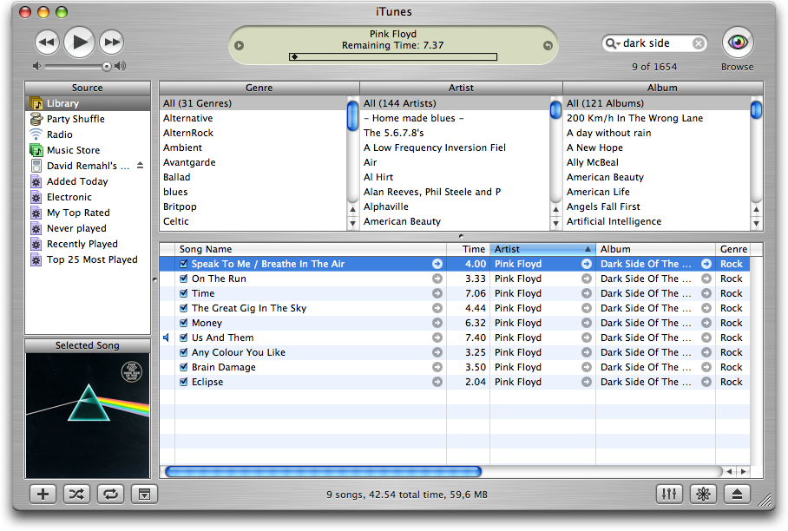

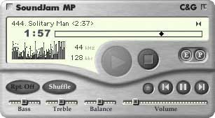
A story involving building and buying
Notes:
Apple bought Soundjam from Casady and Greene, and then proceeded to renovate the interface to bring it into harmony with Apple’s strategy. Then, Apple added the iTunes store and iPod support to create the world’s most successful personal music player.

Slide 4
The questions to ask before we build in- house
Is it theoretically right to build in-house?
Will we succeed in practice if we build in-house?

Slide 5
In theory, theory is the same as practice.
In practice, it isn’t.
—John MacMillan
Notes:
Theoretical concerns are all about linear drivers
Practical concerns are all about

Slide 6
Is it theoretically right to build in-house?
Preconditions for success

Slide 7
Build when the product is core and strategic
(“Core and strategic” does not mean “necessary but not sufficient”)
Ownership and exclusivity
Construction generates knowledge
Not a simple ROI calculation
  Intellectual property?
  Thought leadership?
Notes:
You aren’t paying your supplier to learn how to compete with you.
Construction generates product management and development knowledge.
Strategic products generate more than a simple ROI: increased success with the project has a non-linear contribution to the company’s success.

Slide 8
Do not build if the value of success is bounded
Successful product development is difficult and rare.
If you will only succeed a few times, why waste success on a so-so product or feature?
MP3 playback is of bounded value. iTunes+iPod is not.
Notes:
This is the corollary to “core and strategic”

Slide 9
Do not build if you need to control expertise
The act of construction develops expertise in the product
You may be training your competition

Slide 10
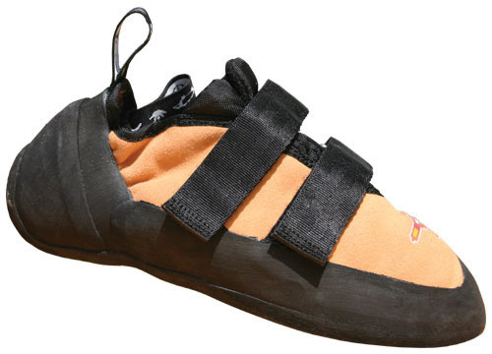
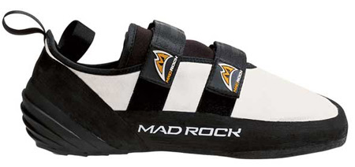
A story about climbing shoes
The Five Ten Anasazi Velcro
The Madrock Mugen
Notes:
Madrock is a new company that competes directly with Five-Ten, an established company. Madrock’s owner used to manufacture shoes for Five-Ten. By strange coincidence, several of Madrock’s shoes look exactly like Five-Ten’s shoes.

Slide 11
Build when there is high design uncertainty
Need iterative development to resolve uncertainty and manage risk
Need partnership with development to solve product design problems
Never mind “cheaper, faster”: uncertain projects can’t be done at arms length
Notes:
Yes, high design uncertainty means it’s a high risk project. See constraints later.
Just because they can’t be done at arms length doesn’t mean they can be done in-house._x0010_

Slide 12
Do not build if a PMP can manage the project
If the uncertainty is low, it shouldn’t be done in-house
Never mind “more expensive, slower:” if it can be done at arms length, do it at arms length

Slide 13
“Offense wins games, but defense wins championships”
Notes:
Avoid these anti-patterns

Slide 14
Will we succeed in practice if we build in-house?
Constraints on success
Notes:
When we say something shouldn’t be done in-house, we don’t guarantee you’ll succeed doing it at arms length

Slide 15
You will fail if you lack construction competence
New product management competence is a rare talent
New product engineering competence is a rare talent
You need both or you will certainly fail
Notes:
Cultural competence at the management and engineering level

Slide 16

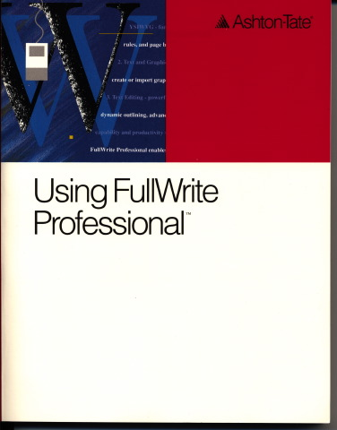
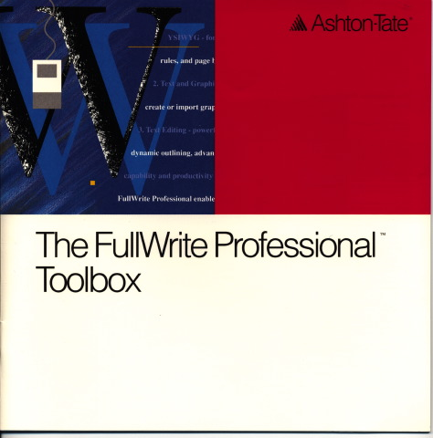
Construction Incompetence
“FullWrite and FullImpact followed earlier patterns and were released filled with bugs, running slow on common hardware, as well as being over two years late.”

Slide 17
Incompetence in the Orchard
In 1994, Apple’s new Copland OS project is ambitious: PowerPC native, runs the bloated System 7, multi-tasks, and will run in 4MB
At the 1995 WWDC Apple’s CEO responds to criticisms and promises to add multi-threading to the kernel, a huge redesign
Previews are incredibly unstable
Apple hires a new manager, Ellen Hancock. After just a few months she decides Copland will never ship
In 1996 Copland is officially cancelled

Slide 18
You will fail if your culture is not supportive
Management must have confidence in the people and the project
The team must have confidence in themselves

Slide 19
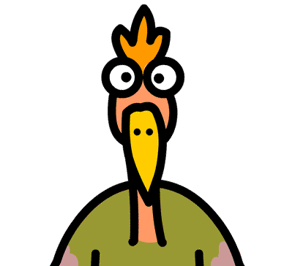

A story about opening a diner

Slide 20
Cultural Turf Wars
In 1988 Apple divides its next generation development into the “Blue” group and the “Pink” group
The “Blue Meanies” are working on a near-term OS, Pink is “far out”
Squabbling and competition for resources breaks out
The Blue Meanies steal as many Pink ideas as they can
In 1991 The Blue Meanies deliver System Seven
Pink has to be spun out into Taligent

Slide 21
You will fail if you cannot resist distraction
Long construction cycles are usually sabotaged by the tyranny of the urgent
Do your engineers have to support existing products?

Slide 22
A story about Office Space
Peter is Innertrode’s Security expert
Peter handled most of the work when Innertrode delivered an OEM product to Dudley Lock
Now Innertrode is developing a new consumer security product, and Peter is on the critical path
What happens to the new product when Dudley Lock needs support and upgrades?
Is the VP going to ask Peter to “Go ahead and come in on Saturday?”

Slide 23
You will fail if you cannot afford the distraction
Most companies can only do one strategic thing, regardless of their size
Regardless of rhetoric, and plans, what will happen if something more strategic is in trouble?
Notes:
Notice how most portfolio companies grow by acquisition? It’s easier to buy than to build.
“One strategic thing” doesn’t have to be another product, it might be sales or marketing!

Slide 24
A story about the Expertise Explorer
The Expertise Explorer head, Andreea, is a brilliant AI researcher
Expertise Explorer never seems to ship and its plans are obsolete before they emerge from the printer
The Product Manager, Geeov, is frustrated
Could the fact that AI has nothing to do with Innertrode’s main business be the culprit?

Slide 25
A story about a pyramid
Innertrode’s CEO declares that the company must “move up the pyramid” and create products that sell to the “C-Level”
A new group is launched to create the star products of the future. Politics break out as everyone scrambles to get into the group
What happens to projects building products selling to the base of the pyramid?

Slide 26
Closing Arguments For and Against
You must be certain beyond a reasonable doubt before
building in-house

Slide 27
We need reasons to build in-house
Core and strategic product
Design Uncertainty

Slide 28
And we need to avoid failure
Lack of construction competence
Unsupportive culture
Cannot afford distraction
Cannot resist distraction

Slide 29

Thanks!
Gale Geddes
Mark Farmer
Paul O’Hagan
Mike Robinson
Alies Maybee
Thanh Nguyen

