Slide 1

Sprocket Central Pty Ltd
Data analytics approach
Junior Consultant - Raga

Slide 2
Agenda
Introduction
Data Exploration
Model Development
Interpretation

Slide 3

Introduction
Customer Analysis Factors
Wealth Segments
Bike Purchases in last 3 years
Age Distribution
Gender segments
Job Industry and Categories
Transactions per Product Line
Transactions per Product Size

Slide 4

Data Exploration
Steps Taken
Detecting / Treating missing values and outliers – Approx 2000 blank records deleted, “Default” column with gibberish values deleted
Uniqueness of Data Records – Treated Approx 500 records
Appropriate Data type basing on metadata – Converted Data type for property_value and product_first_sold_date
Accurate and Consistent Values – Sorted DoB and Edited Spelling for Gender column

Slide 5
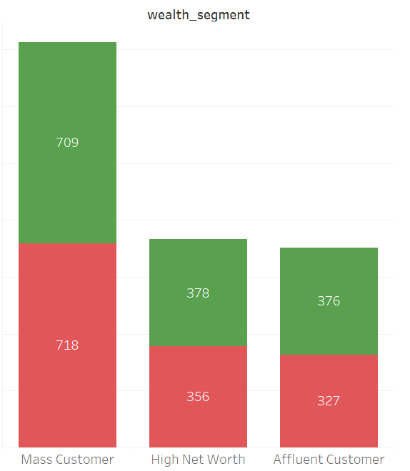
Model Development
Customers who own cars by
Wealth segment
There are 3 wealth segments – Mass, High Net Worth, Affluent
There are more customers from “Mass“ wealth segment
Lesser customers from “Mass” segment have cars
More customers from “High Net Worth” and “affluent” segments have cars

Slide 6
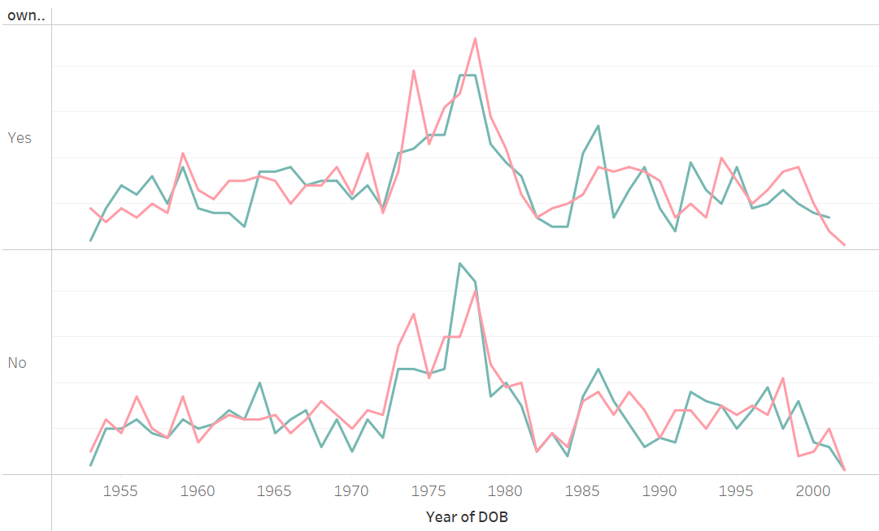
Model Development
Gender of Customers who own Cars - Over the Years 1953-2002
More customers own cars
More female customers own cars
In 1987, Females had maximum cars
Number of cars owned reduced over the years after mid 1970s

Slide 7
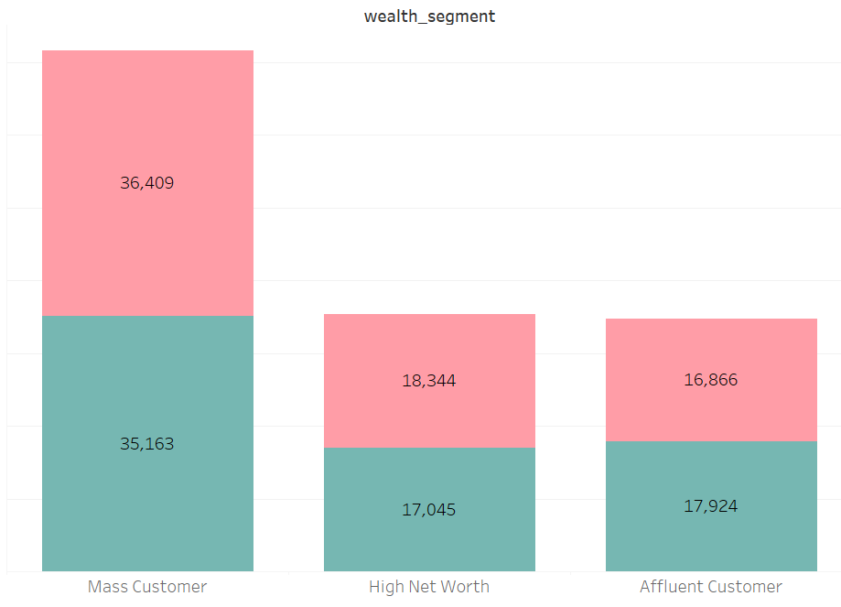
Model Development
Bike purchases in last 3 years
by Gender per Wealth segment
Overall, female customers have made more bike purchases.
“Mass Customers” wealth segment purchased maximum bikes.

Slide 8
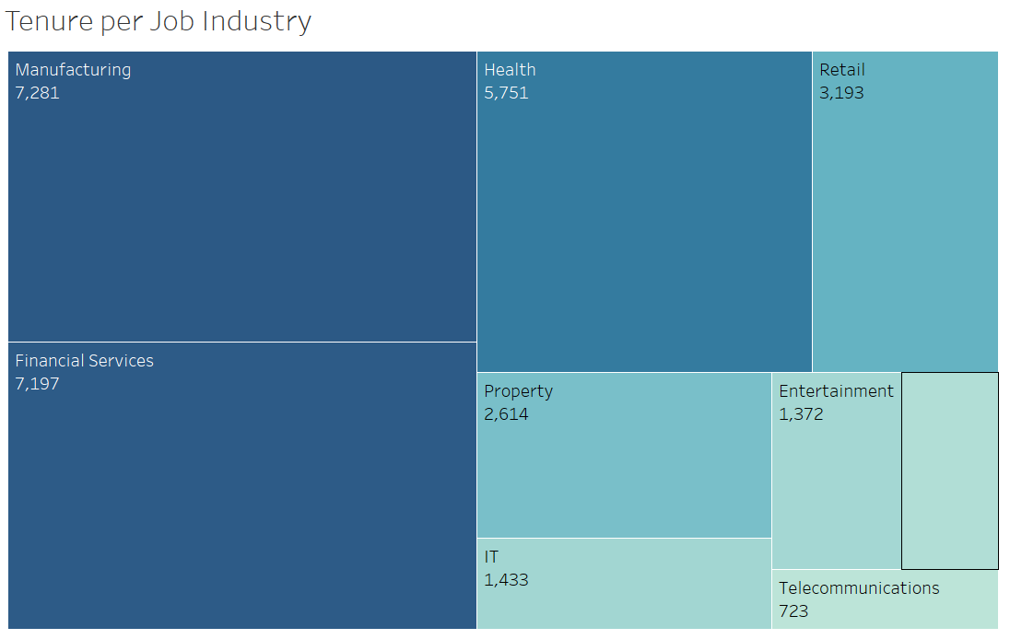
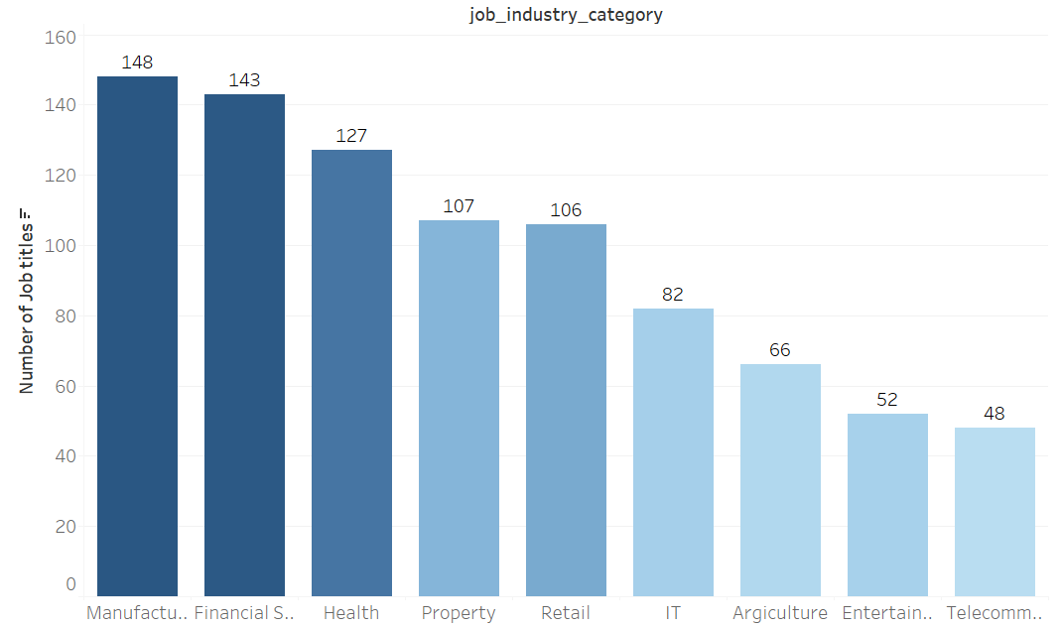
Model Development
Tenure per Job Industry and
Number of job titles per industry
Manufacturing Industry has maximum tenure and the greatest number of job titles
Telecommunication industry has least tenure and least number of job titles
Tenure and number of job titles per industry seems to be directly proportional

Slide 9
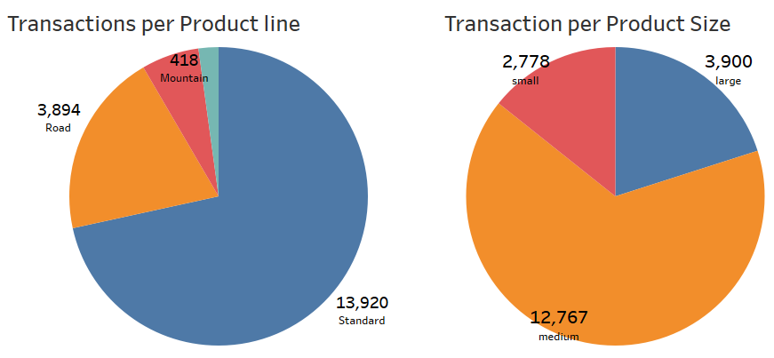
Model Development
Transactions Details for Product Sizes and Product Line
Standard Product Line has greatest Transactions
Mountain Product line has least transactions.
Medium Product Size has maximum transactions with small and large sizes being fairly competitive.
Marketing to improve sales on other product lines and sizes can be done
Continue to attract customers who buy standard line products and medium size products.

Slide 10
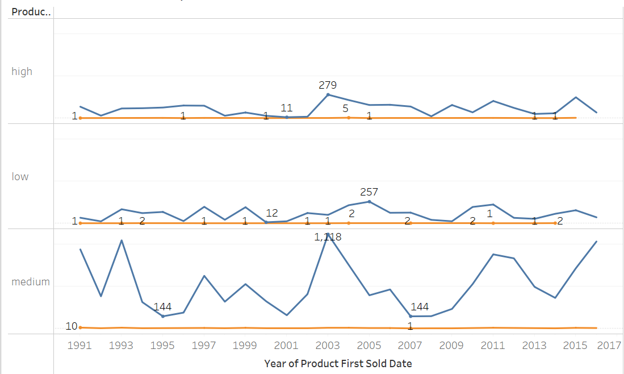
Model Development
Transactions Order status by Product class over the Years
Blue line is approved
Orange line is not approved
Medium products are sold the most
The frequency of unapproved products is very less to that is good.

Slide 11
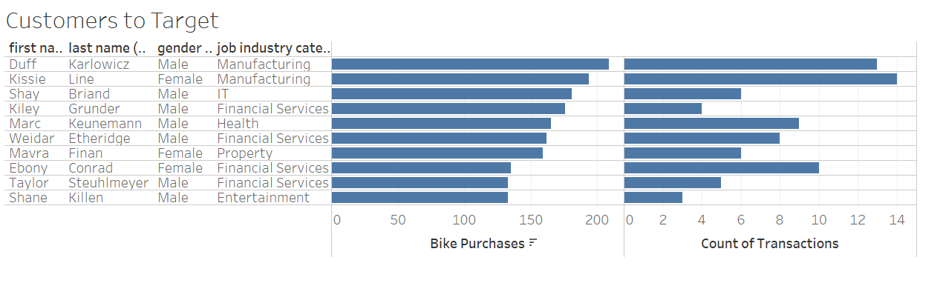
Interpretation
Top 10 Customers to Target
First name, Last name, Gender and Job industry category of Top 10 customers who made most bike purchases can be targeted to drive more value to the organization. The number of transactions performed too gives important insights about their purchasing capability.

Slide 12
Thank You

