Slide 1
Assignment-1 Discussion (skip gram, animal-bird clustering)
Sejal Upadhye, 213050017
Vedant Singh, 213050038
Sagar Poudel, 213051001
4th February 2021

Slide 2
Problem Statement
Create a cluster of “animal words”: cow, dog, bullock, cat … (10 words)
Create a cluster of “bird words”: cuckoo, parrot, crow, sparrow,… (10 words)
Run a concordancer for obtaining the neighboring words of these words
Train a skip-gram model with these words.
Collect the word representations.
Ensure that “animal” words are close to other “animal” words and so are “bird” words; Inter-cluster distance should be large compared to intra-cluster distance; use cosine similarity and other cluster-quality measures.

Slide 3
Dataset Discussion
Gutenberg corpus
Part of NLTK corpus files
25000 eBooks
Brown
500 sources of news, editorials, reviews, etc
1M+ words

Slide 4
Details of Input words
Animal words
dog, cat, mouse, cow, buffalo, tiger, lion, deer, goat, monkey
Bird words
pigeon, crow, sparrow, owl, goose, duck, eagle, vulture, chicken, dove

Slide 5
Details of context words
Size of context window
2 words to the left, 2 words to the right
Removed stop words
Give a SAMPLE of context words for a SAMPLE of Animal words
Dog : spoilt, impudent, sport, strength, fellow, time
Buffalo : handle, machine, fly, landscape, robe
Give a SAMPLE of context words for a SAMPLE of Bird words
Crow : mary, face, neighbourhood, rapid, foot
Eagle : abomination, kind, eat, swan, pelican

Slide 6
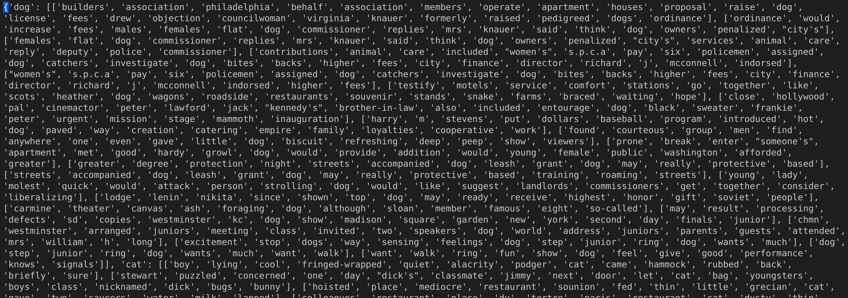
Vocabulary
Give the complete list of your vocabulary (separate list)
Min 2883 words, max 5863
Sample of the vocabulary, Each array in value of a dictionary represents the sentences
Unique words are taken as input vocabulary

Slide 7
Skip Gram implementation

Slide 8
Details on the Skip Gram N/W
#Input neurons (equal to vocab)
2883 to 5863, Best: 5863
#Hidden neurons (design decision)
1 to 64, Best: 16
#Output neurons
#compartments (equal to context words) = 4
Each compartment of has #neurons=vocab

Slide 9
Training details (hyper-parameters)
How many epochs?
600 to 2000
What is the learning rate?
0.01
Convergence criterion (at what error level do you stop)
If score doesn't improve beyond 0.001 over 5 epochs

Slide 10
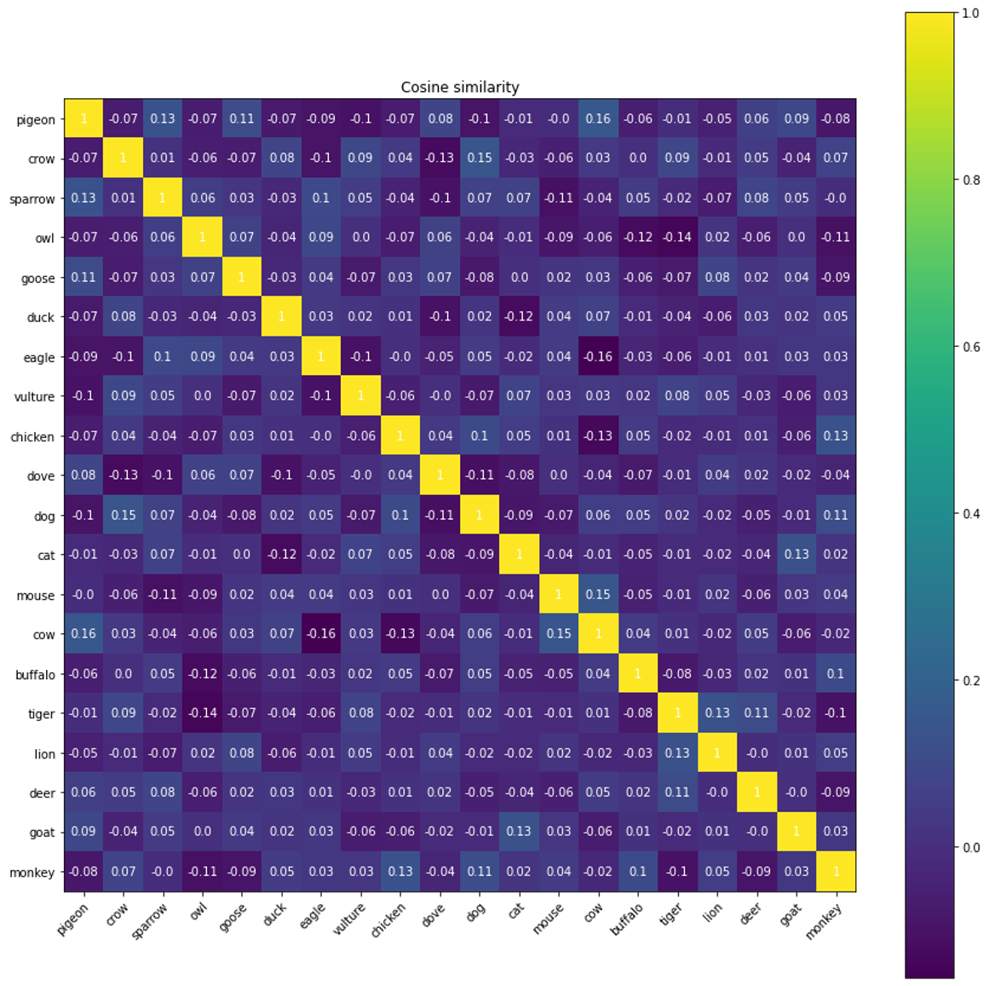
PoC (proof of concept)
Animal+Bird vs Animal+Bird words cosine similarity
Max : 0.16 (cow-pigeon)
Min : -0.16 (cow-eagle)

Slide 11
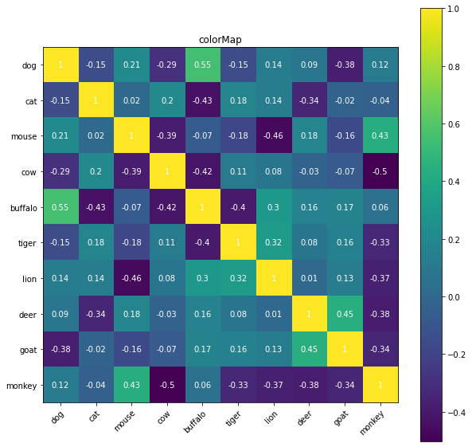
PoC (proof of concept)
Animal vs Animal words cosine similarity
Dog - Buffalo: 0.53
Cow – Monkey: -0.48

Slide 12
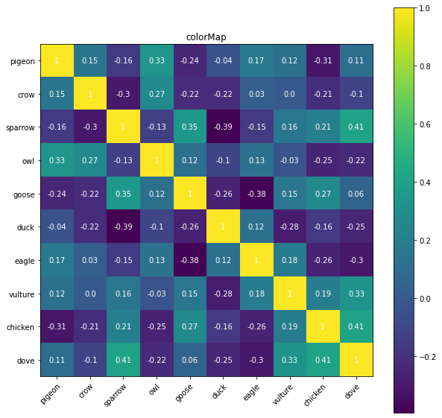
PoC (proof of concept)
Bird vs Bird words cosine similarity
Sparrow-Dove : 0.41
Duck-Sparrow -0.39

Slide 13
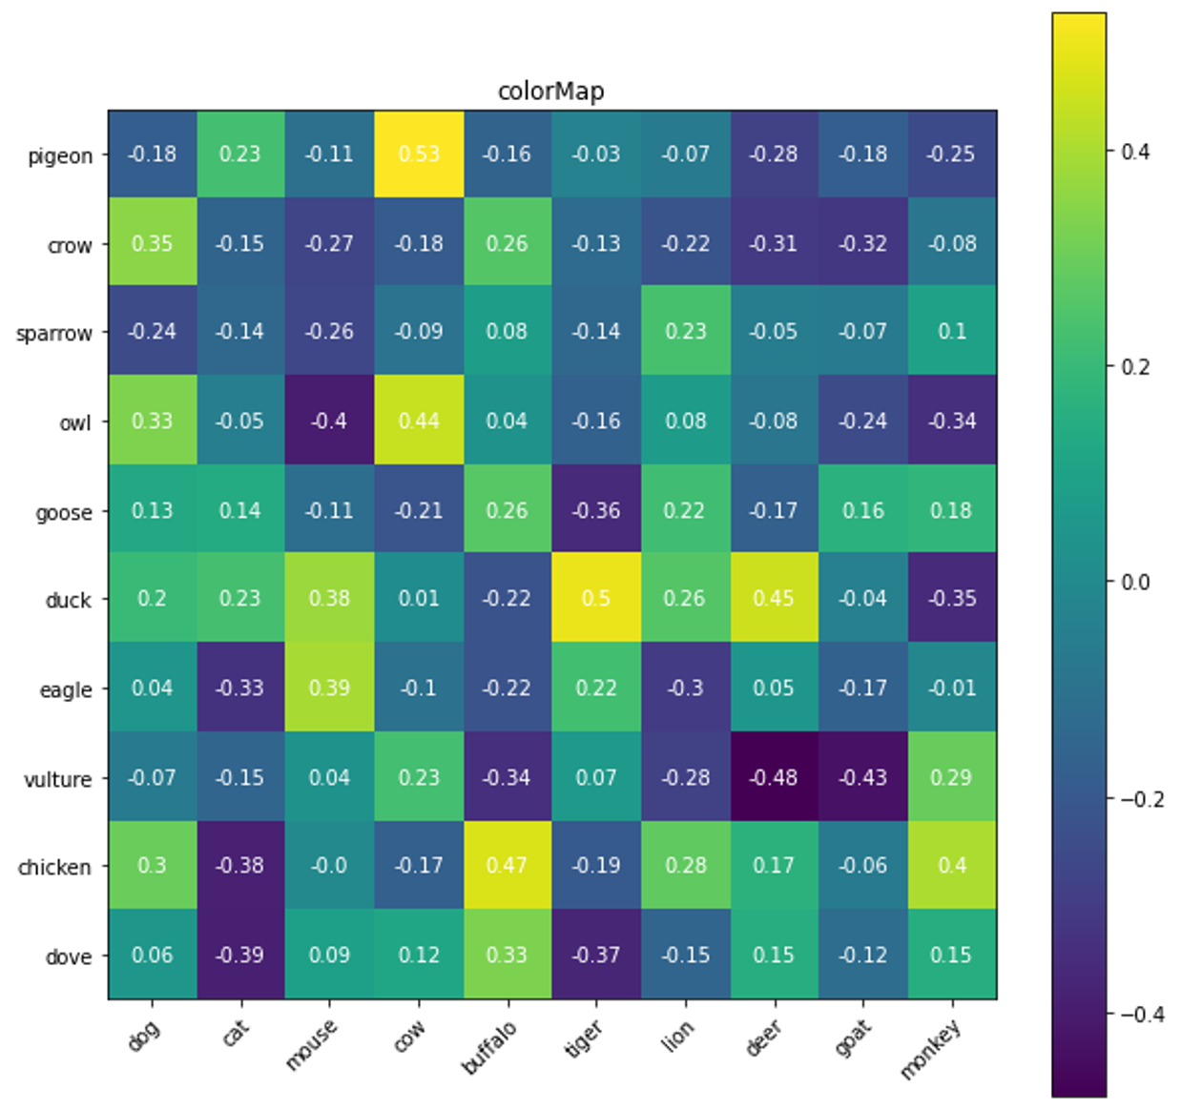
PoC (proof of concept)
Animal vs Bird words cosine similarity
Cow - Pigeon: 0.53
Vulture – Deer: -0.48

Slide 14
Various performance parameters (basic + advance)
Vocab Size | Embedding size | Loss | Jaccard score | Silhouette score | DB score
4301 | 16 | 1.477 | 0.538 | 0.0826 | 2.517
4301 | 32 | 2.692 | 0.533 | 0.055 | 2.744
2883 | 16 | 0.962 | 0.285 | 0.101 | 2.309
5086 | 16 | 1.256 | 0.501 | 0.098 | 2.382

