Slide 1
Kubernetes ConfigMaps & Secrets

Slide 2
ConfigMaps

Slide 3
ConfigMaps
ConfigMaps allow you to decouple configuration artifacts from image content to keep containerized applications portable
ConfigMaps are designed to more conveniently support working with strings that do not contain sensitive information used by containerized applications.
They can be used to store individual properties in form of key-value pairs.
However, the values can also be entire config files or JSON blobs to store more information.

Slide 4
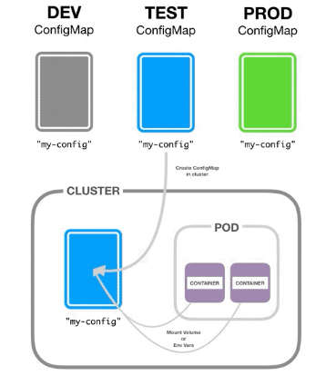
ConfigMaps Cont..
The configuration data can then be used as:
for a container
Config files in a voluEnvironment variables
Command-line arguments me
Good use cases for ConfigMaps are:
for example
storing config files for tools like redis or prometheus
This way we can change the configuration of these without having to rebuild the container

Slide 5
Demo: ConfigMaps

Slide 6
Secrets

Slide 7
Secrets
Secrets can (and should) be used for storing small amounts (less than 1MB each) of sensitive information like passwords, keys, tokens, etc.
Using secrets is quite straightforward. You reference them in a pod and can then use them either as files from volumes or as environment variables in your pod.
Keep in mind that each container in your pod that needs to access the secret needs to request it explicitly. There’s no implicit sharing of secrets inside the pod.
There’s also a special type of secret called imagePullSecrets. Using these you can pass a Docker (or other) container image registry login to the Kubelet, so it can pull a private image for your pod.

Slide 8
Secrets Cont…
When updating secrets that are used by already running pods you need to be careful, as running pods won’t automatically pull the updated secret. You need to explicitly update your pods (for example using the rolling update functionality of deployments explained in the second blog post in this series).
Further keep in mind that you create a secret in a specific namespace and only pods in the same namespace can access the secret.
Secrets are kept in a tmpfs and only on nodes that run pods that use those secrets. The tmpfs keeps secrets from coming to rest on the node. However, they are transmitted to and from the API server in plain text, thus, be sure to have SSL/TLS protected connections between user and API server, but also between API server and Kubelets (Giant Swarm clusters do come with both enabled by default).

Slide 9
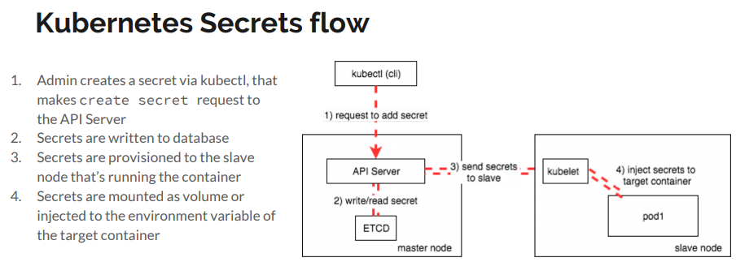

Slide 10
Demo: Secrets

Slide 11
Towards more portable containers
Once, you’re using Secrets and ConfigMaps, it’s easy to differentiate between environments like dev, test, and prod. You can just use different secrets and configs to configure your containers for the respective environment.
These two concepts also make your containers more versatile in that they keep out some of the specifics and let different users deploy them in different ways. Thus, you can foster better re-use between teams or even outside of your organization.
Secrets (and in some use cases also ConfigMaps) are especially helpful when sharing with other teams and organizations or even more when sharing publicly. You can freely share your images (and manifests), maybe even keep them in a public repository, without having to worry about any company-specific or sensitive data being published.

