Slide 1
Kubernetes Networking

Slide 2
Kubernetes Networking Model
Kubernetes Networking has one important fundamental design philosophy: Every Pod has a unique IP. And the Pod IP is shared by all the containers in the Pod, and it’s routable from all the other Pods
Ever notice some “pause” containers running on your Kubernetes nodes? They are called “sandbox containers”, whose only job is to reserve and hold a network namespace (netns) which is shared by all the containers in a pod.
This way, a pod IP doesn’t change even if a container dies and a new one in created in it’s place.
A huge benefit of this IP-per-pod model is there are no IP or port collisions with the underlying host. And we don’t have to worry about what port the applications use.
With this in place, the only requirement Kubernetes has is that these Pod IPs are routable/accessible from all the other pods, regardless of what node they’re on.

Slide 3
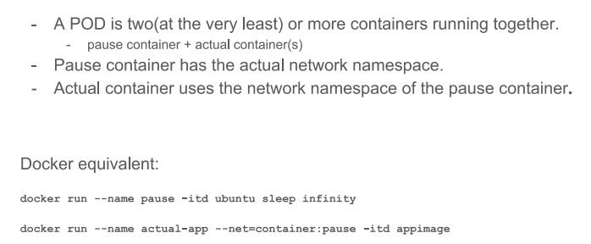
What is Pod – in terms of Networking

Slide 4
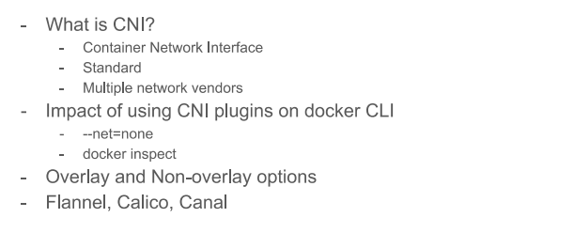
Network Plugins

Slide 5
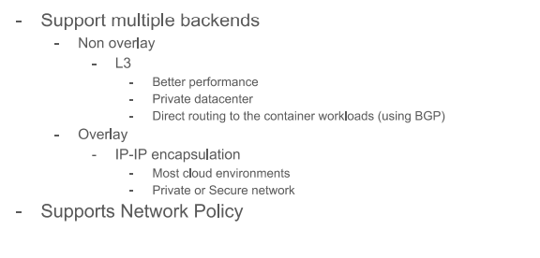
Calico

Slide 6
Calico Cont..
Calico is highly scalable: With its Layer 3 approach to virtual networking and Internet-style architecture, Calico is far more scalable than current overlay solutions and Connect apps with a high performance service mesh built on an Internet-scale routed network fabric.
Calico is secure: It Secure the cluster and meet compliance requirements with network and application policies.
Calico is simple: Eliminate complexity and leverage proven technologies for resilience and easy troubleshooting with a simplified networking model
Calico can talk to existing switches and routers in the network because it’s based on IP and communicates using the same type of IP packets.
Calico is the most trusted networking solution for mission-critical cloudnative applications.

Slide 7
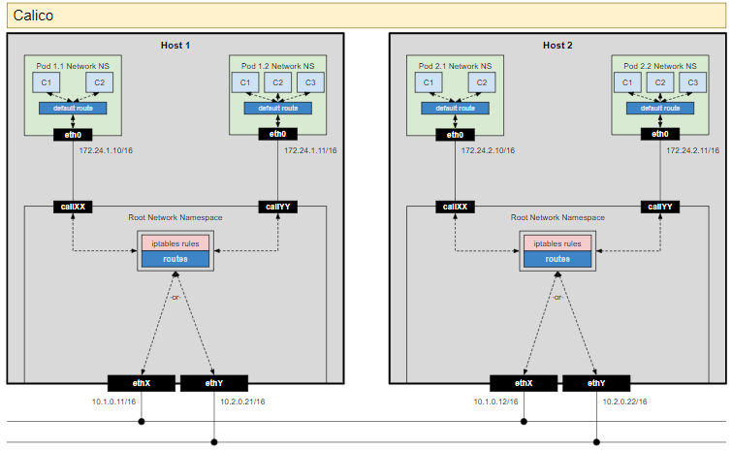
Calico Architecture

Slide 8
Overlay Networks
Overlay networks are not required by default.
however, they help in specific situations. Like when we don’t have enough IP space, or network can’t handle the extra routes. Or maybe when we want some extra management features the overlays provide.
One commonly seen case is when there’s a limit of how many routes the cloud provider route tables can handle. For example, AWS route tables support up to 50 routes without impacting network performance.
So if we have more than 50 Kubernetes nodes, AWS route table won’t be enough. In such cases, using an overlay network helps.
It is essentially encapsulating a packet-in-packet which traverses the native network across nodes. You may not want to use an overlay network since it may cause some latency and complexity overhead due to encapsulation-decapsulation of all the packets.

Slide 9
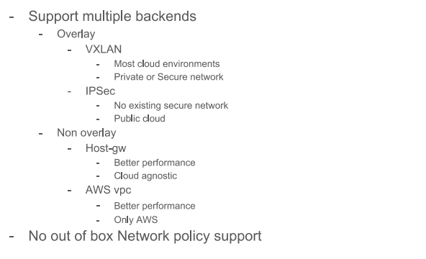
Flannel

Slide 10
Flannel Overlay Network Flow

Slide 11
Flannel Overlay Network Flow Cont..
Here we see that it’s the same setup as before, but with a new virtual ethernet device called flannel0 added to root netns. It’s an implementation of Virtual Extensible LAN (VXLAN), but to linux, its just another network interface.
The flow for a packet going from pod1 to pod4 (on a different node) is something like this:
The packet leaves pod1’s netns at eth0 and enters the root netns at vethxxx.
It’s passed on to cbr0, which makes the ARP request to find the destination.
3a. Since nobody on this node has the IP address for pod4, bridge sends it to flannel0 because the node’s route table is configured with flannel0 as the target for the pod network range .
3b. As the flanneld daemon talks to the Kubernetes apiserver or the underlying etcd, it knows about all the pod IPs, and what nodes they’re on. So flannel creates the mappings (in userspace) for pods IPs to node IPs.
flannel0 takes this packet and wraps it in a UDP packet with extra headers changing the source and destinations IPs to the respective nodes, and sends it to a special vxlan port (generally 8472). Even though the mapping is in userspace, the actual encapsulation and data flow happens in kernel space. So it happens pretty fast.
3c. The encapsulated packet is sent out via eth0 since it is involved in routing the node traffic.

Slide 12
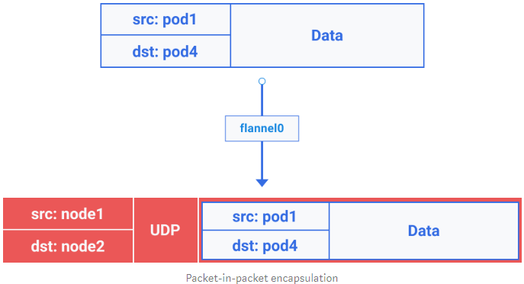
Flannel Overlay Network Flow Cont..

Slide 13
Flannel Overlay Network Flow Cont..
4. The packet leaves the node with node IPs as source and destination.
5. The cloud provider route table already knows how to route traffic between nodes, so it send the packet to destination node2.
6a. The packet arrives at eth0 of node2. Due to the port being special vxlan port, kernel sends the packet to flannel0.
6b. flannel0 de-capsulates and emits it back in the root network namespace.
6c. Since IP forwarding is enabled, kernel forwards it to cbr0 as per the route tables.
7. The bridge takes the packet, makes an ARP request and finds out that the IP belongs to vethyyy.
8. The packet crosses the pipe-pair and reaches pod4

Slide 14
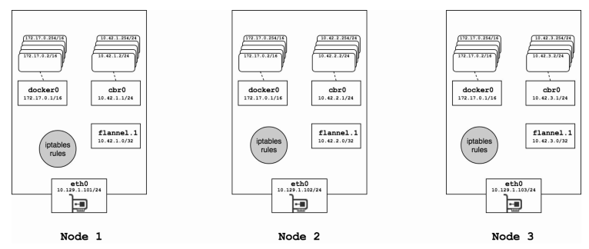
Flannel Architecture – VXLAN

Slide 15
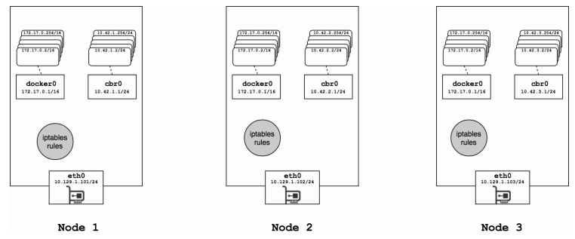
Flannel Architecture – Host Gateway

Slide 16
Single Pod Networking
Cont1
Cont2
Pause
eth0
Pod
vethxx
cni0
eth0
Kube-node

Slide 17
How Pods Communicate in single Node ?
On every Kubernetes node, which is a linux machine in this case, there’s a root network namespace (root as in base, not the superuser) — root netns.
The main network interface eth0 is in this root netns.
Similarly, each pod has its own netns, with a virtual Ethernet pair connecting it to the root netns. This is basically a pipe-pair with one end in root netns, and other in the pod netns.
We name the pod-end eth0, so the pod doesn’t know about the underlying host and thinks that it has its own root network setup. The other end is named something like vethxxx.
This is done for all the pods on the node. For these pods to talk to each other, a linux ethernet bridge cbr0 is used. Docker uses a similar bridge named docker0.

Slide 18
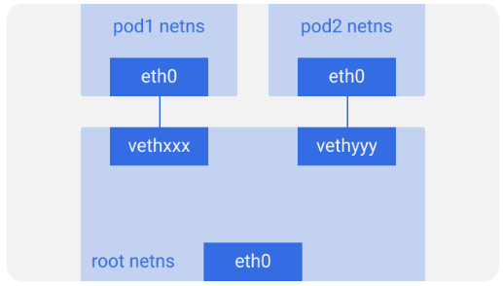
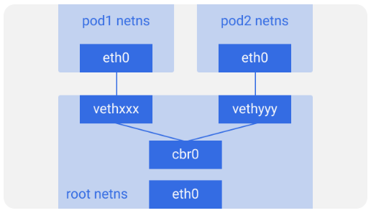
How Pods Communicate in single Node ? Cont..

Slide 19
How Pods Communicate in single Node ? Cont..
Assume a packet is going from pod1 to pod2.
It leaves pod1’s netns at eth0 and enters the root netns at vethxxx.
It’s passed on to cbr0, which discovers the destination using an ARP request, saying “who has this IP?”
vethyyy says it has that IP, so the bridge knows where to forward the packet.
The packet reaches vethyyy, crosses the pipe-pair and reaches pod2’s netns.

Slide 20
How Pods in Different Nodes communicate ?
pods should be reachable across nodes as well.
Kubernetes doesn’t care how it’s done. We can use L2 (ARP across nodes), L3 (IP routing across nodes — like the cloud provider route tables), overlay networks, or even carrier pigeons.
It doesn’t matter as long as the traffic can reach the desired pod on another node. Every node is assigned a unique CIDR block (a range of IP addresses) for pod IPs, so each pod has a unique IP that doesn’t conflict with pods on another node.
In most of the cases, especially in cloud environments, the cloud provider route tables make sure the packets reach the correct destination.
The same thing could be accomplished by setting up correct routes on every node. There are a bunch of other network plugins that do their own thing.

Slide 21
How Pods in Different Nodes communicate ? Cont..

Slide 22
How Pods in Different Nodes communicate ? Cont..
Assume a packet is going from pod1 to pod4 (on a different node)
It leaves pod1’s netns at eth0 and enters the root netns at vethxxx.
It’s passed on to cbr0, which makes the ARP request to find the destination.
It comes out of cbr0 to the main network interface eth0 since nobody on this node has the IP address for pod4.
It leaves the machine node1 onto the wire with src=pod1 and dst=pod4.
The route table has routes setup for each of the node CIDR blocks, and it routes the packet to the node whose CIDR block contains the pod4 IP.
So the packet arrives at node2 at the main network interface eth0. Now even though pod4 isn’t the IP of eth0, the packet is still forwarded to cbr0 since the nodes are configured with IP forwarding enabled.
The node’s routing table is looked up for any routes matching the pod4 IP. It finds cbr0 as the destination for this node’s CIDR block.
The bridge takes the packet, makes an ARP request and finds out that the IP belongs to vethyyy.
The packet crosses the pipe-pair and reaches pod4

Slide 23
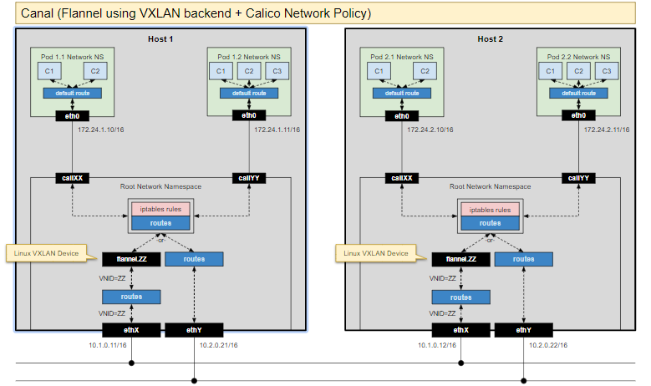
Canal (Flannel + Network Policy)

Slide 24
Network Policy ?
Network policies are sets of conditions, constraints, and settings that allow you to designate who is authorized to connect to the network and the circumstances under which they can or cannot connect.
A network security policy is a formal document that outlines the principles, procedures and guidelines to enforce, manage, monitor and maintain security on a computer network. It is designed to ensure that the computer network is protected from any act or process that can breach its security

