Slide 1
What is Pod ?
A Pod is the basic execution unit of a Kubernetes application, the smallest and simplest unit in the Kubernetes object model that you create or deploy.
A Pod represents processes running on your Cluster.
A Pod encapsulates.
an application’s container (or, in some cases, multiple containers),
storage resources,
a unique network IP,
options that govern how the container(s) should run.
A Pod represents a unit of deployment: a single instance of an application in Kubernetes, which might consist of either a single container or a small number of containers that are tightly coupled and that share resources.
The shared context of a Pod is a set of Linux namespaces, cgroups, and potentially other facets of isolation

Slide 2
Types of Pods we See !!
Single Container Pods
Multi Container Pods
Init Container Pods
Static Pods

Slide 3
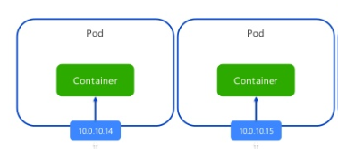
Single container Pods
The “one-container-per-Pod” model is the most common Kubernetes use case
We can think of a Pod as a wrapper around a single container, and Kubernetes manages the Pods rather than the containers directly
NODE

Slide 4
DEMO: Single Container Pods

Slide 5
Multi Container Pods
usually containers that need to work together.
A Pod might encapsulate an application composed of multiple co-located containers that are tightly coupled and need to share resources.
Note that grouping multiple co-located and co-managed containers in a single Pod is a relatively advanced use case. You should use this pattern only in specific instances in which your containers are tightly coupled
example, you might have a container that acts as a web server for files in a shared volume, and a separate “sidecar” container that updates those files from a remote source.
Containers within a Pod share an IP address and port space, and can find each other via localhost

Slide 6
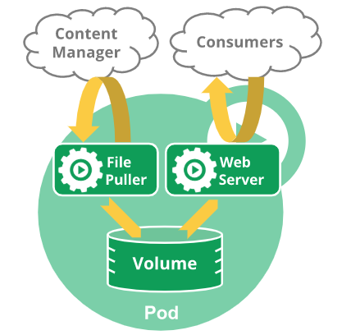
Multi Container Pods

Slide 7
DEMO: Multi Container Pods

Slide 8
Init Container Pods
A Pod can have multiple containers running apps within it, but it can also have one or more init containers, which are run before the app containers are started.
Init containers are exactly like regular containers, except:
Init containers always run to completion.
Each init container must complete successfully before the next one starts.
If a Pod’s init container fails, Kubernetes repeatedly restarts the Pod until the init container succeeds.
However, if the Pod has a restartPolicy of Never, Kubernetes does not restart the Pod.
To specify an init container for a Pod, add the initContainers field into the Pod specification,

Slide 9
Use Cases: Init Container Pods
Wait for a Service to be up & running, like database server
Wait for some time before starting the app container with a command like sleep
Clone a Git repository into a Volume
Place values into a configuration file and run a template tool to dynamically generate a configuration file for the main app container. For example, place the POD_IP value in a configuration and generate the main app configuration file using Jinja
Register the Pod with a remote server.

Slide 10
DEMO: Init Container Pods

Slide 11
Static Pods
Static Pods are managed directly by the kubelet daemon on a specific node, without the API server observing them.
Unlike Pods that are managed by the control plane (for example, a Deployment); instead, the kubelet watches each static Pod (and restarts it if it crashes).
Static Pods are always bound to one Kubelet on a specific node.
The kubelet automatically tries to create a mirror Pod on the Kubernetes API server for each static Pod. This means that the Pods running on a node are visible on the API server, but cannot be controlled from there.

Slide 12
Static Pods Cont…
When the kubelet starts, it automatically starts all defined static Pods. As you have defined a static Pod manifest path in kubelet Confi.
Labels from the static Pod are propagated into the mirror Pod. You can use those labels as normal via selectors, etc.
deleting the static Pod using kubectl will recreate the pod automatically by kubelet process again.

Slide 13
DEMO: Static Pods

Slide 14
The Pause Container
The 'pause' container is a container which holds the network namespace for the pod.
Kubernetes creates pause containers to acquire the respective pod’s IP address and set up the network namespace for all other containers that join that pod
If the pause container is dead, Kubernetes consider the pod died and kill it and reschedule a new one.
If you docker stop the pause container, you would find that the Pod would have a new internal IP without any change in Restart count of the Pod.
if you docker stop the container of the Pod, you would find the Pod status as Completed and then if you would docker start the same, you would find Pod in Running again with Restart count of the Pod incremented by 1 with no change in IP

Slide 15
DEMO: Pause Container

Slide 16
Why single container per Pod ?
In Kubernetes each Pod is meant to run a single instance of a given application.
If we want to scale your application horizontally (e.g., run multiple instances), we should use multiple Pods, one for each instance.
Creating multiple pods for single application referred to as replication. Replicated Pods are usually created and managed as a group by an abstraction called a Controller.
If we run multiple unrelated processes in a single container/pod:
Your responsibility to keep all those processes running, manage their logs, and so on.
we have to include a mechanism for automatically restarting processes if they crash.
All those processes would log to the same standard output, so you’d have a hard time figuring out what process logged what.
Kubernetes can not scale containers can scale only pods

Slide 17
Life time of Pods
Pods aren’t intended to be treated as durable entities.
They won’t survive scheduling failures, node failures, or other evictions, such as due to lack of resources, or in the case of node maintenance.
We rarely create individual Pods directly in Kubernetes, even singleton Pods. This is because Pods are designed as relatively ephemeral, disposable entities.
We should almost always use controllers even for singletons. Such as Jobs OR ReplicationController, ReplicaSet, Deployment OR Daemon Sets
All three types of controllers contain a Pod Template. It is recommended to create the appropriate controller and let it create Pods, rather than directly create Pods yourself. That is because Pods alone are not resilient to machine failures, but controllers are.
Controllers provide self-healing with a cluster scope, as well as replication and rollout management. Controllers like StatefulSet can also provide support to state full Pods

Slide 18
Pods & Controllers
A Controller can create and manage multiple Pods for you, handling replication and rollout and providing self-healing capabilities at cluster scope.
For example, if a Node fails, the Controller might automatically replace the Pod by scheduling an identical replacement on a different Node.
Some examples of Controllers that contain one or more pods include:
Jobs
Deployment / replication controller / replica set
StatefulSet
DaemonSet
etc…
In general, Controllers use a Pod Template that you provide to create the Pods for which it is responsible.

Slide 19
Shared resources in pod for containers
Networking: Each Pod is assigned a unique IP address. Every container in a Pod shares the network namespace, including the IP address and network ports. Containers inside a Pod can communicate with one another using localhost. When containers in a Pod communicate with entities outside the Pod, they must coordinate how they use the shared network resources (such as ports).
Storage: A Pod can specify a set of shared storage Volumes. All containers in the Pod can access the shared volumes, allowing those containers to share data. Volumes also allow persistent data in a Pod to survive in case one of the containers within needs to be restarted. See Volumes for more information on how Kubernetes implements shared storage in a Pod

Slide 20
Pod Template
Pod templates are pod specifications which are included in other objects, such as Replication Controllers, Jobs, and DaemonSets
Controllers use Pod Templates to make actual pods
Example:
apiVersion: v1
kind: Pod
metadata:
name: myapp-pod
labels:
app: myapp
spec:
containers:
- name: myapp-container
image: alpine
command: ['sh', '-c', 'echo hi there!! && sleep 3600']

