Slide 1
FINAL YEAR ENGINEERING PROJECT REVIEW
AI Assistant for Material
Integrity Assessment
Defect Detection · Root Cause Analysis · Failure Prediction · Engineering Recommendations
PROJECT
Mechanics of Materials Project
TEAM MEMBERS
Ragashri, Anjana, Sreya
DEPARTMENT
Department of Mechanical Engineering — EV Specialization
INSTITUTION & YEAR
VIT Chennai · 2025-29

Slide 2
02
PROBLEM STATEMENT
Why weld integrity needs more than visual inspection
Weld integrity directly affects the structural reliability and safety of a component.
Weld defects — cracks, undercut, lack of fusion — can reduce load-carrying performance.
Conventional inspection can be time-consuming and depends heavily on inspector experience.
Detecting a defect is only one part of the problem.
Engineers also need to understand possible causes and the appropriate next action — not just a defect label.
Welding
Possible
Defect
Inspection
Engineering
Decision
The engineering gap
A defect label alone does not tell an engineer why it occurred or what to do next. Bridging detection with engineering interpretation is the core problem this project addresses.
AI ASSISTANT FOR MATERIAL INTEGRITY ASSESSMENT
2

Slide 3
03
MOTIVATION & EXISTING GAP
From manual interpretation to assisted engineering decisions
CONVENTIONAL WORKFLOW
Weld
Manual
Inspection
Defect
Identification
Engineer
Interpretation
PROPOSED WORKFLOW
Weld
AI
Vision
Defect
Detection
Confidence
Engineering
Interpretation
Recommen-
dation
Verification
This project is intended as engineering decision support — it does not replace engineering judgment, certified inspection, or NDT verification.
AI ASSISTANT FOR MATERIAL INTEGRITY ASSESSMENT
3

Slide 4
04
PROJECT OBJECTIVES
What the system is designed to achieve
1
2
3
Detect visible weld defects using computer vision.
Localize defects using bounding boxes.
Provide AI confidence for each detection.
4
5
6
Connect defect detection with engineering knowledge.
Provide possible root-cause factors and recommendations.
Develop a future process-parameter prediction module.
AI ASSISTANT FOR MATERIAL INTEGRITY ASSESSMENT
4

Slide 5
05
PROPOSED SYSTEM ARCHITECTURE
End-to-end data flow across both operating modes
USER
WEB DASHBOARD → CHOOSE MODE
POST-WELD INSPECTION
PRE / IN-PROCESS PREDICTION
Upload Weld Image
Welding Process Parameters
YOLO Vision Model
ML Prediction Model
Defect + Bounding Box + Confidence
Defect / Risk Prediction
Engineering Knowledge Layer
Engineering Recommendation
Severity + Causes + Recommendations
VERIFICATION / MANUAL INSPECTION / NDT
AI ASSISTANT FOR MATERIAL INTEGRITY ASSESSMENT
5

Slide 6
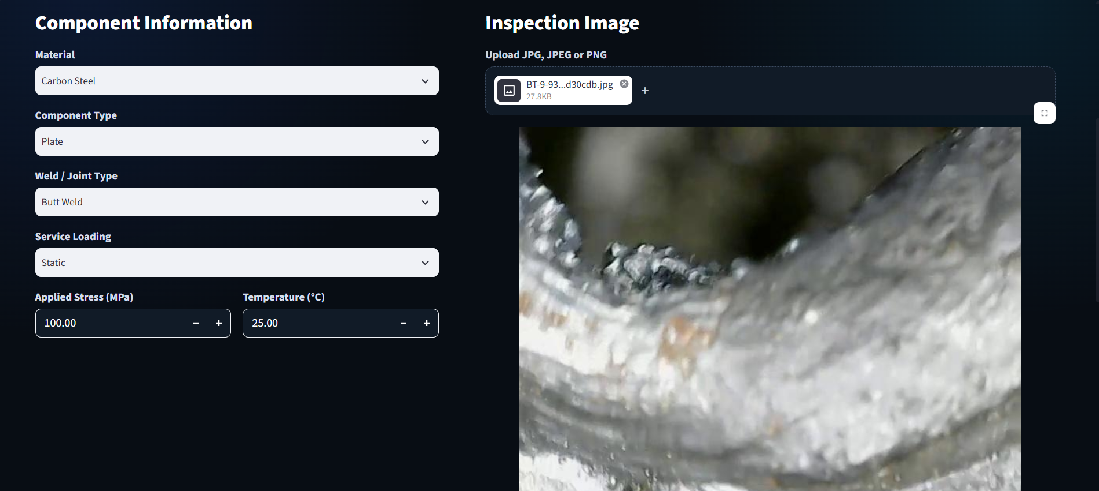
06
POST-WELD AI INSPECTION
Current implementation — image-based defect detection
PROCESSING WORKFLOW
CURRENT DEFECT CLASSES (7)
Upload Image
BT
Burn Through
CN
Contamination
Preprocessing
LOF
Lack of Fusion
NW
Normal Weld
YOLO Inference
SR
Spatter
SC
Surface Crack
Defect Detection
UC
Undercut
Confidence Filtering
[ Dashboard Screenshot Placeholder ]
Post-weld inspection result view
Result Visualization
Engineering Interpretation
AI ASSISTANT FOR MATERIAL INTEGRITY ASSESSMENT
6

Slide 7
07
DATASET & MODEL DEVELOPMENT
Building the weld-defect detection pipeline
Weld image dataset covering 7 defect classes.
Approximately 7,165 images used for detection.
Bounding-box annotations for object detection.
YOLO-based object detection architecture.
Dataset split into training, validation and test sets.
Dataset quality was also evaluated during development.
Dataset split
Images
Train
~5,000
Validation
1,435
Test
715
Classes
7
Object detection approach
YOLO was chosen for its ability to jointly localize and classify defects in a single forward pass, enabling near real-time inference suited to a web-based inspection dashboard.
AI ASSISTANT FOR MATERIAL INTEGRITY ASSESSMENT
7

Slide 8
08
DATA QUALITY & MODEL IMPROVEMENT
Identifying and addressing annotation inconsistencies
Original dataset
BOUNDING-BOX ANNOTATION REVIEW
BEFORE
AFTER
Annotation analysis
Extremely wide,
thin box — inconsistent
with crack geometry
Flagged annotation
removed from the
clean training copy
Potentially suspicious Surface Crack annotations identified
307 removed from a clean training copy
Why this matters
Original dataset preserved
Inconsistent annotations can mislead a detection model during training. The original dataset was preserved unchanged, and a separate clean copy — with potentially inconsistent Surface Crack annotations removed — is currently being used for retraining. Final retraining accuracy is not yet available, as training is still in progress.
Retraining in progress (clean copy)
AI ASSISTANT FOR MATERIAL INTEGRITY ASSESSMENT
8

Slide 9
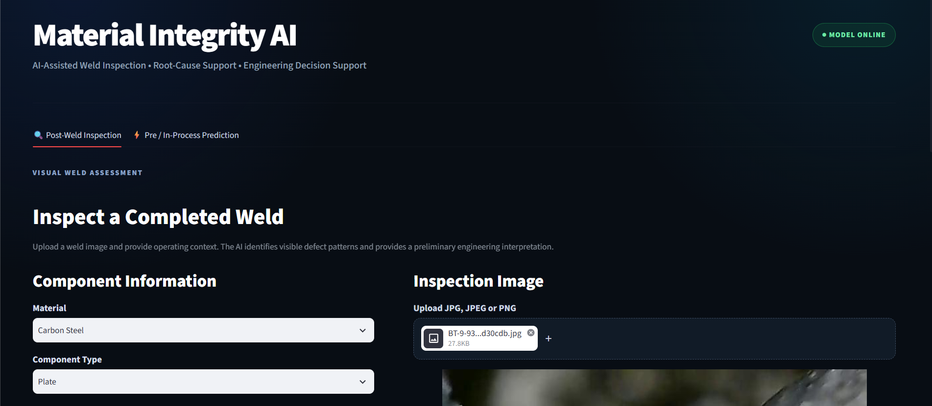
09
WEBSITE / DASHBOARD
Proposed engineering inspection interface
INTERFACE SECTIONS
Image upload
Detection result
[ Dashboard Screenshot Placeholder ]
AI confidence
Full-page view of the web-based inspection dashboard
Defect location
Engineering interpretation
Possible root causes
Recommendations
Verification requirement
AI ASSISTANT FOR MATERIAL INTEGRITY ASSESSMENT
9

Slide 10
10
ENGINEERING INTERPRETATION
Converting a raw AI detection into engineering guidance
AI OUTPUT
“Undercut detected — confidence XX%”
ENGINEERING INTERPRETATION — POSSIBLE CONTRIBUTING FACTORS
Excessive current
High travel speed
Improper electrode / torch angle
Welding technique
RECOMMENDATION
Inspect defect dimensions and verify against the applicable welding acceptance criteria.
IF UNCERTAIN → MANUAL INSPECTION / NDT
AI detection ≠ final engineering certification.
AI ASSISTANT FOR MATERIAL INTEGRITY ASSESSMENT
10

Slide 11
11
FUTURE WORK — PRE-WELD / IN-PROCESS PREDICTION
PLANNED / FUTURE WORK
Planned second module of the system
WELDING PROCESS PARAMETERS (INPUTS)
Current
Voltage
Travel Speed
MACHINE LEARNING MODEL
Welding Process
Wire Feed Speed
Torch / Electrode Angle
Material
Plate Thickness
Joint Type
POSSIBLE OUTPUTS
Defect likelihood
Weld-quality risk
Distortion-related risk
Parameter recommendations
This module is planned future work. It is not yet fully trained or integrated into the current system.
AI ASSISTANT FOR MATERIAL INTEGRITY ASSESSMENT
11

Slide 12
CONCLUSION & FUTURE SCOPE
Computer
Vision
+
Machine
Learning
+
Engineering
Knowledge
+
Interactive
Web Interface
FUTURE SCOPE
Current status
Improve YOLO performance with cleaned and expanded datasets
Add more weld-image datasets
Train the process-parameter prediction model
Add geometry / severity analysis
Add NDT data integration
Add failure-risk prediction
Connect future hardware / camera systems
Deploy the platform online
Streamlit-based web dashboard developed
YOLO-based weld defect detection pipeline implemented
Dataset annotation quality reviewed; retraining on a cleaned copy in progress
Pre-weld / in-process prediction module planned as future work
From Defect Detection to Engineering Decision Support
Thank You

