Slide 1
Brain Tumor Prediction using ANN
A presentation by
Ragava Krishnan & Sadiq Peer Mohamed

Slide 2


Agenda
Abstract
Objectives
Existing System
Proposed System
System Architecture
Modules Used
Output

Slide 3
Abstract
Early detection of brain tumors is crucial for proper treatment and improved patients care. This research introduces a methodology employing artificial neural networks (ANN) to predict the presence of brain tumors based on doctor reports.
Doctor reports serves as the dataset, from which relevant features like radius mean, symmetry mean, concavity, fractal dimensions are extracted as inputs for the ANN model.
The model utilizes sigmoid function to predict the tumor, and 250 neurons are used in each layer. This approach offers support for early detection and decision-making, there by enhancing patient care.

Slide 4
Objectives
Early Detection of Brain Tumors: Implement a methodology that aids in the early detection of brain tumors to improve treatment outcomes.
Utilization of Artificial Neural Networks (ANN): Develop and train an ANN model to predict the presence of brain tumors based on features extracted from doctors' reports.
Support for Medical Professionals: Assists healthcare professionals in making quicker and more accurate diagnoses.

Slide 5
Existing System
Traditional Diagnostic Methods:
Medical Imaging: Predominantly relies on MRI, CT scans, and expert interpretation.
Limitations: Time-consuming, requires skilled radiologists, potential for delays in diagnosis.
Expert Dependency: Heavily relies on expert radiologists for accurate interpretation.

Slide 6
Proposed System
Enhance brain tumor prediction accuracy using Artificial Neural Networks (ANN) with features extracted from doctors' reports.
Extract relevant features from doctors' reports.
Train the ANN on labeled data to identify patterns indicating tumor presence.
Predict tumor likelihood based on input features.

Slide 7
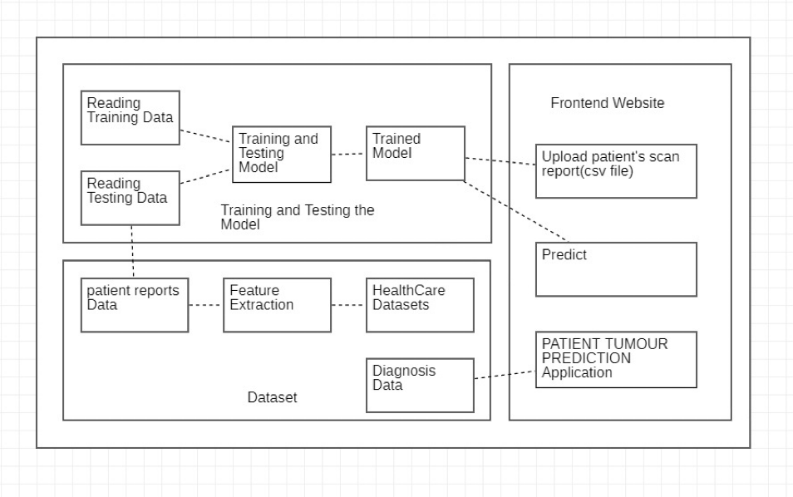
System Architecture

Slide 8
Modules Used
Flask: It's utilized to create a web application that allows users to input their information (such as patient name, age) and upload a CSV file containing test data. Flask handles the routing and interaction between the user's browser and the server.
Pandas: Since the project involves handling tabular data, Pandas is used to read the CSV file uploaded by the user. It allows for efficient manipulation and preprocessing of the data before feeding it into the machine learning model.
NumPy: In the project, NumPy may be used alongside Pandas for tasks like data preprocessing, converting data into arrays suitable for model training.
TensorFlow: As the core machine learning library in the project, TensorFlow is crucial for building, training, and deploying the neural network model used for cancer diagnosis. I

Slide 9
OUTPUT

Slide 10
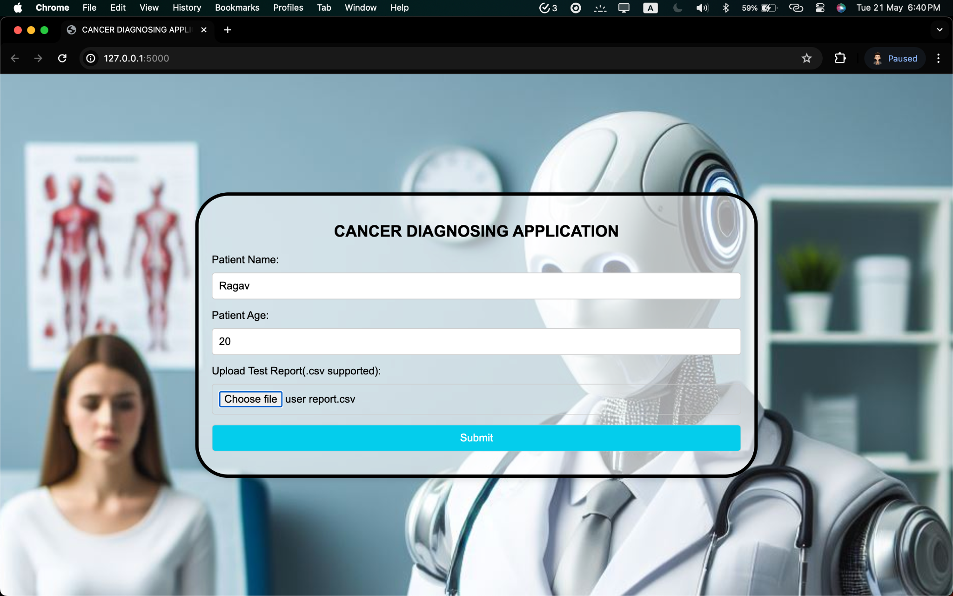

Slide 11
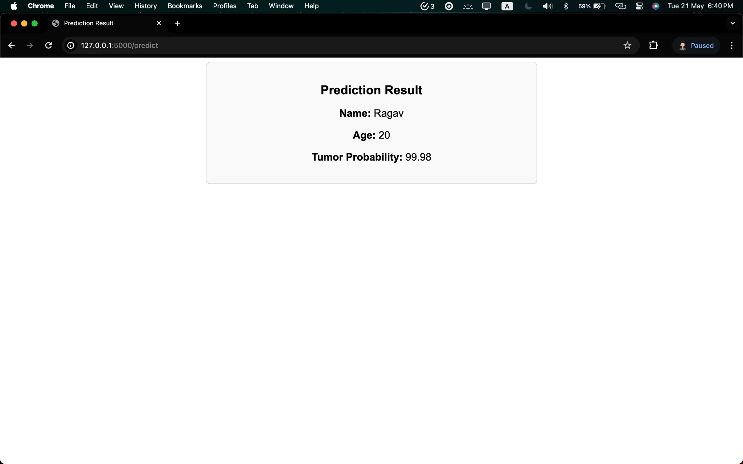

Slide 12
THANK YOU FOR YOUR TIME

