Slide 1
IoT BASED SMART FARMING
RAGAVA KRISHNAN N S - 210701201 | SADIQ PEER MOHAMED K - 210701522

Slide 2
INTRODUCTION AND PURPOSE OF THE PROJECT
The IoT smart farming project aims to improve farming by using technology to monitor conditions like temperature, humidity, and soil moisture.
It automatically adjusts watering based on real-time data. Sensors and cloud connectivity help optimize water use and crop management, making farming more efficient and productive.
Farmers can check and control their fields remotely using a web app, ensuring better crop growth and sustainability.
This project helps make farming more efficient and resilient compared to traditional methods.

Slide 3
COMPONENTS USED
Soil moisture sensor
ESP8266 Microcontroller (NodeMCU)
Relay Module
Water Pump
9V Battery
Temperature & Humidity Sensor (DHT11)

Slide 4
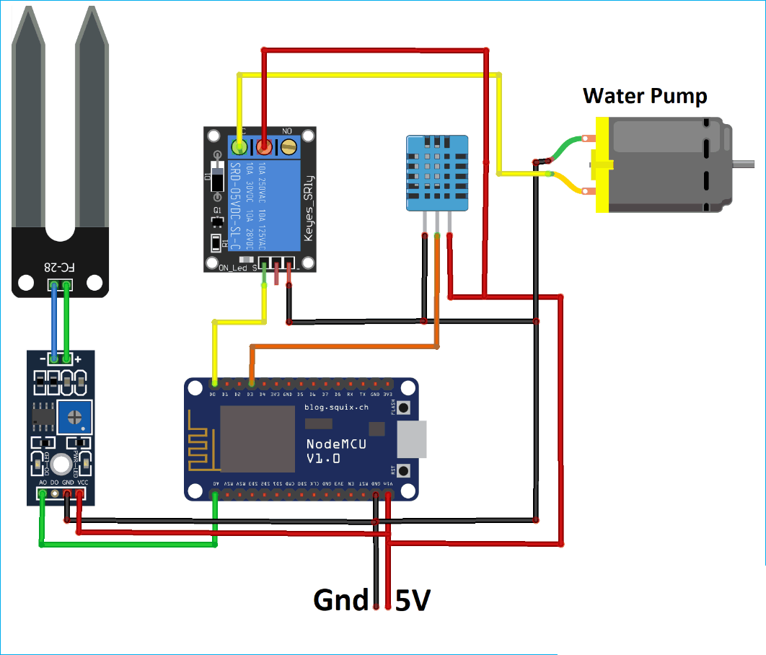
CIRCUIT DIAGRAM

Slide 5
RESULTS
Precision Irrigation: IoT sensors measure soil moisture levels in real-time, ensuring that water is applied only when and where it is needed. This reduces water waste and optimizes water usage.
Automated Scheduling: Smart irrigation systems automatically adjust watering schedules based on soil moisture data, weather forecasts, and plant needs, leading to more efficient water use.
Optimal Soil Moisture Levels: Maintaining ideal soil moisture conditions promotes healthier plant growth and higher yields. Consistent moisture levels prevent over- or under-watering, both of which can negatively impact crop health.
Stress Reduction: Proper irrigation reduces plant stress, enhancing growth and increasing resistance to diseases and pests.
Reduced Water Bills: Efficient water use leads to lower water consumption.

Slide 6
CONCLUSION AND FUTURE SCOPE
In conclusion, the implementation of an IoT smart farming system that monitors temperature and humidity and automates irrigation, along with a web app for real-time monitoring, significantly enhances the efficiency and productivity of modern agriculture by optimizing resource management and increasing yields.
The ability to remotely monitor and adjust irrigation settings allows farmers to make informed decisions, despite challenges like cost and maintenance.
Looking ahead, integrating machine learning algorithms can further improve irrigation and crop yield efficiency.

Slide 7
THANK YOU FOR THE TIME

