Slide 1
Shopping Site for Disabled people
Team Members
Ragava Krishnan N S(210701207)
Sai Prasad R (210701220)
Ramanujan N R (210701206)
Ramkeerthan M A(210701207)

Slide 2
ABSTRACT
This idea introduces a groundbreaking shopping platform designed specifically for individuals with disabilities, harnessing the power of eye blink interactions for intuitive control. Traditional online shopping interfaces often present accessibility challenges for people with disabilities, particularly those with motor impairments. Our solution integrates cutting-edge eye-tracking technology and machine learning algorithms to interpret users' eye blinks as commands, facilitating seamless navigation and interaction with the platform. Key features include customizable settings, voice-assisted navigation, and adherence to accessibility standards. User feedback will inform iterative improvements to enhance efficiency and user satisfaction. This platform aims to revolutionize the online shopping experience, promoting independence and inclusivity for diverse user groups.

Slide 3
Objectives and Users
Allow users to add items to their cart with the help of their blink
Allow users to access the search bar
Allow users to proceed to payment gateway
Allow users to customize the speed of the progress bar, blinking and also the eye they want to use
Also add an additional voice based navigation system
Can be used by physically disabled who cannot move any
part of their body other than blink their eyes

Slide 4
Existing System
There isn't an existing commercial system specifically designed for online shopping utilizing eye blink interactions for individuals with disabilities. However, there are existing technologies and systems in the field of assistive technology and eye-tracking interfaces that could potentially be adapted or integrated into such a system.

Slide 5
Proposed System
The proposed system aims to create an inclusive and accessible online shopping platform specifically tailored for individuals with disabilities, leveraging eye blink interactions for intuitive control. It features a
User-friendly interface with customizable settings
Integration of eye-tracking technology for precise input
Browsable product catalogs
Shopping cart management, seamless checkout process
Accessibility features including voice-assisted navigation
Compatibility with assistive technologies.
Usability testing and feedback gathering are integral for refining the system to ensure a seamless and empowering online shopping experience for users with disabilities.

Slide 6
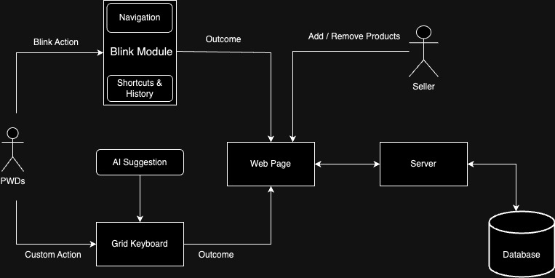
System Architecture
Communication:
Browser request webpage
Server with DB returns pages
Pages contain
Web Pages
Blink Module Scripts
Navigation Bar
Shortcuts and Navigation History manager
Grid KeyBoard with AI assistance
Blink Module and Grid Keyboard gives actions and inputs to webpages

Slide 7
MODULES OF THIS APPLICATION
WEB STACK MODULE
This module contains the usual web modules required for a webpage like
Server Scripting Language
Frontend(HTML,CSS,JS)
DATABASE(MYSQL)
BLINK MODULE
This module is the focus of this project.
It contains the following sub-modules
EYE-DETECTION MODULE
This module is responsible for detection of eye and blink
NAVIGATION MODULE
This module is responsible for mapping navigation and blink
KEYBOARD MODULE
This module is responsible for getting Input from user with smart suggestion

Slide 8
ABSTRACTION
The blink module will be independent of the type of application
Custom anchors will be used in html code while designing the webpage to identify the highlight able items.
These anchors must be positioned by the developers of the website.
This module can be installed in any website regardless of its functionality

Slide 9
Navigation bar (5 sections)
The Navigation Bar is the core of the system. It contains an infinitely progress bar that allows us to choose actions.
The available actions are
In: used to go inside the highlighted area
Back: used to go back to prev highlighted area
Next: select the sibling element of the highlighted element
Prev: select the prev element of the highlighted element
Rest: allow the user to blink without any consequences

Slide 10
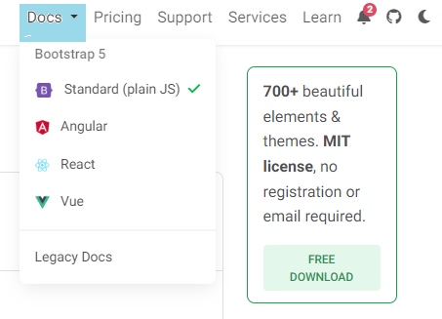
Hover Effect
Hover effect will be applied to the currently highlighted element.
Menu Like DropDown that activate on Hover can also be asscessed.

Slide 11
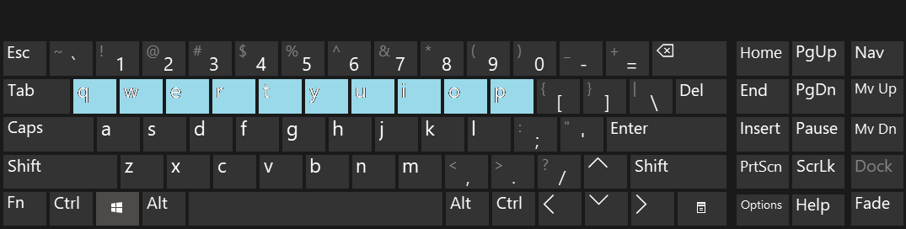
Keyboard accessibility
Keyboard will be split into group which are also divided into sub groups with a nested structure.
These group will be highlighted over a loop which allow the user to select the group then the subgroup and so on.
At last the intended key can be selected if there are no subgroups.

Slide 12
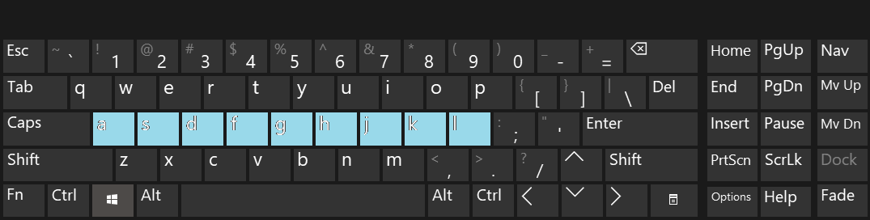
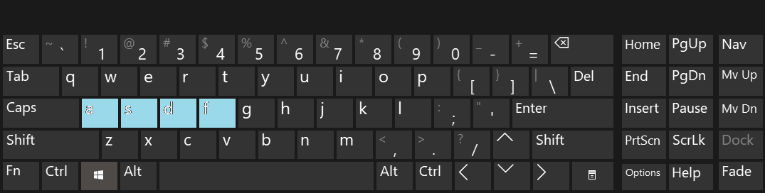
Keyboard accessibility

Slide 13
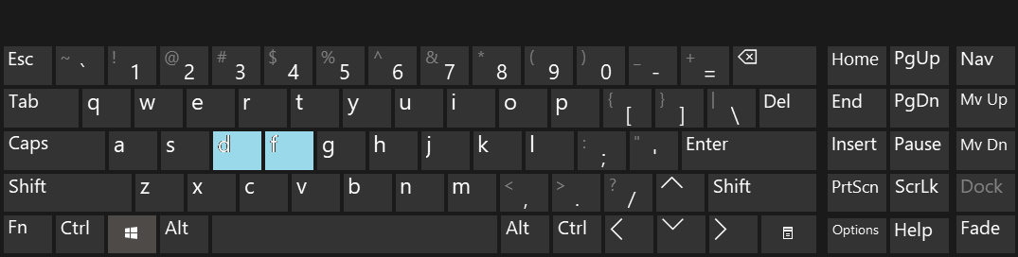
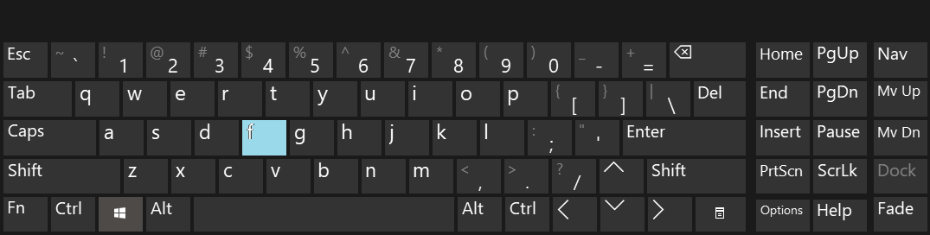
Keyboard accessibility

Slide 14
LONG PRESS MODULE
This module allows the user to open shortcuts based on the amount of time the eye is closed
Navigation history bar can be opened by closing the eye for about 1-2 seconds. This bar allow user to directly jump between previously visited pages and anchor tags. We can choose the page while when the required anchor is highlighted similar to the keyboard module.
Settings bar can be opened by closing the eye for about 2-3 seconds. Configurations like speed and size of the navigation bar, navigation bar resets, speed of switching between the options for navigation history bar and keyboard etc

Slide 15
INITIALIZATION and TUTORIAL
User will be given tutorials
Periodic requests for adjustment of speed will be given as the user familiarise with the software

Slide 16
Thank You

