Slide 1




NEXT GEN EMPLOYABILITY PROGRAM
Creating a future-ready workforce
Team Members
College Name
Student Name : Sivakaviyaragavan R
Student ID : au951221104052
JP College Of Engineering

Slide 2

CAPSTONE PROJECT SHOWCASE
Project Title
Voting Web Application using Django Framework
Abstract | Problem Statement | Project Overview | Proposed Solution | Technology Used | Modelling & Results | Conclusion

Slide 3
Abstract
This project aims to develop a robust web-based voting application using Django framework, catering to diverse organizational and community needs. The application will facilitate efficient and transparent voting processes, incorporating features such as user authentication, poll creation, real-time updates, and reporting functionalities. Through meticulous design and implementation, the platform strives to enhance user engagement, maintain data integrity, and ensure scalability. Challenges such as security risks and technical complexity will be addressed to deliver a reliable and user-friendly voting solution. Overall, this project represents a significant advancement in modernizing and democratizing the voting experience.
Source :

Slide 4
Problem Statement
The challenge at hand is to create a robust web-based voting application utilizing the Django framework, tailored to meet the diverse needs of organizations, institutions, or communities seeking efficient and transparent voting processes. The objective is to address issues such as security vulnerabilities, technical complexity, and user adoption barriers while delivering a user-friendly platform that ensures data integrity and scalability. By overcoming these challenges, the goal is to provide a reliable and accessible solution that enhances democratic engagement and fosters trust in the voting process.
Source :

Slide 5
Project Overview
This project entails the development of a comprehensive web-based voting application using the Django framework, catering to the requirements of various organizations, institutions, or communities. The application will facilitate efficient and transparent voting processes by incorporating features such as user authentication, poll creation, real-time updates, and reporting functionalities. Challenges such as security risks and technical complexity will be addressed to ensure data integrity, scalability, and user satisfaction. The project aims to deliver a reliable, user-friendly, and accessible voting platform that enhances democratic engagement and fosters trust in the voting process.
Source :

Slide 6
Proposed Solution
.
The proposed solution involves the creation of a robust web-based voting application using the Django framework. This application will offer a comprehensive set of features including user authentication, poll management, real-time updates, and reporting capabilities. By leveraging Django's powerful tools and adhering to best practices in security and scalability, the solution aims to provide an efficient, transparent, and user-friendly voting platform. Through careful design and implementation, the solution will address challenges such as security risks, technical complexity, and user adoption barriers, ultimately delivering a reliable and accessible voting solution for organizations, institutions, and communities.
Source :

Slide 7
Advantages
Efficiency: Utilizing the Django framework streamlines development, ensuring efficient creation of a scalable voting application.
Security: Leveraging Django's built-in security features ensures robust protection of user data, safeguarding against unauthorized access or tampering.
Scalability: The application's architecture allows for seamless scalability, accommodating growth in user base and voting demands without sacrificing performance.
User Experience: With an intuitive design, the application offers a seamless user experience, encouraging higher participation rates and building trust in the voting process.
Source :

Slide 8
Disadvantages
Potential Security Risks : Despite implementing security measures, there's always a risk of vulnerabilities that could compromise user data or the integrity of the voting process.
Technical Complexity : Developing and maintaining a comprehensive voting application may require significant technical expertise and resources, posing challenges for smaller organizations or teams.
User Adoption Barriers : Users unfamiliar with online voting platforms may face a learning curve, potentially leading to resistance or lower participation rates.
Dependence on Internet Connectivity : Reliance on internet access for voting could exclude individuals or communities with limited or unreliable connectivity.
Source :

Slide 9



Technology Used
Frontend
Backend
Source :

Slide 10
Modelling & Results
Algorithmic Implementation: Developing efficient algorithms for real-time updates, notifications, and result calculations optimizes the application's performance and responsiveness, enhancing the user experience.
Testing and Validation: Conducting rigorous testing and validation procedures ensures the reliability, functionality, and security of the voting application, mitigating risks associated with potential errors or vulnerabilities.
Performance Monitoring: Continuously monitoring the application's performance metrics allows for the identification of performance bottlenecks and the implementation of optimization strategies to maintain optimal performance under varying loads.
Outcome Analysis: Analyzing voting data and results enables administrators to derive meaningful insights, track voting trends, and make informed decisions, contributing to the improvement and refinement of the voting process over time.
Source :

Slide 11
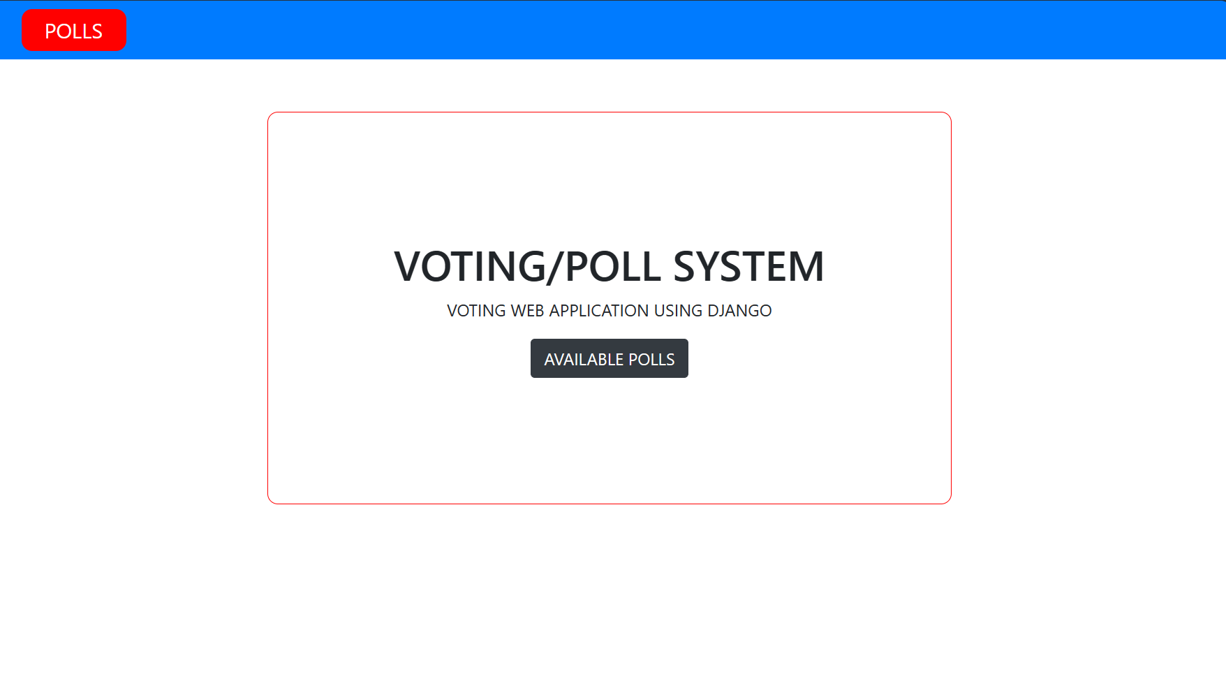
Homepage

Slide 12
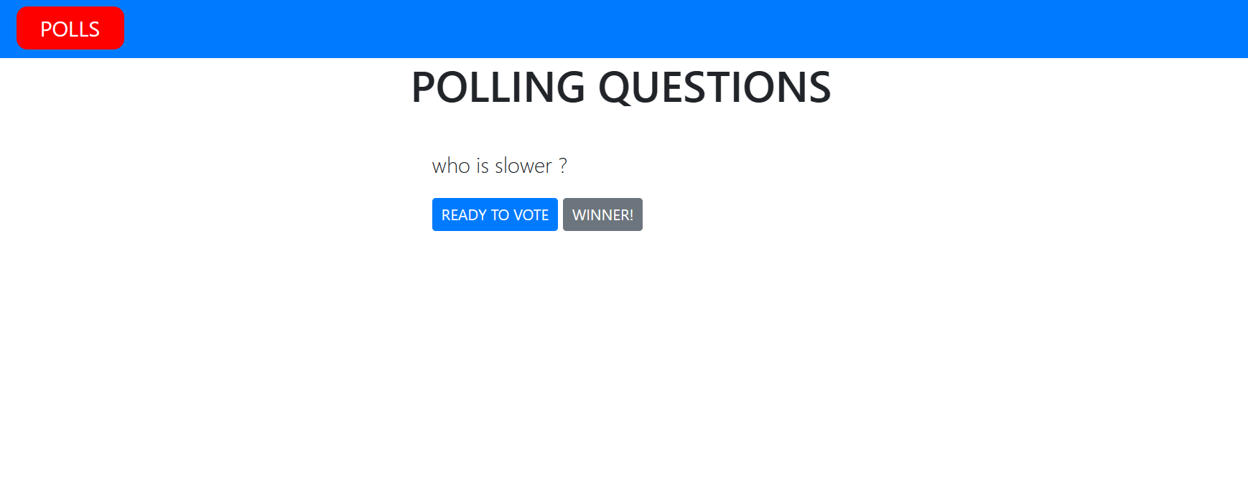
Polls Page

Slide 13
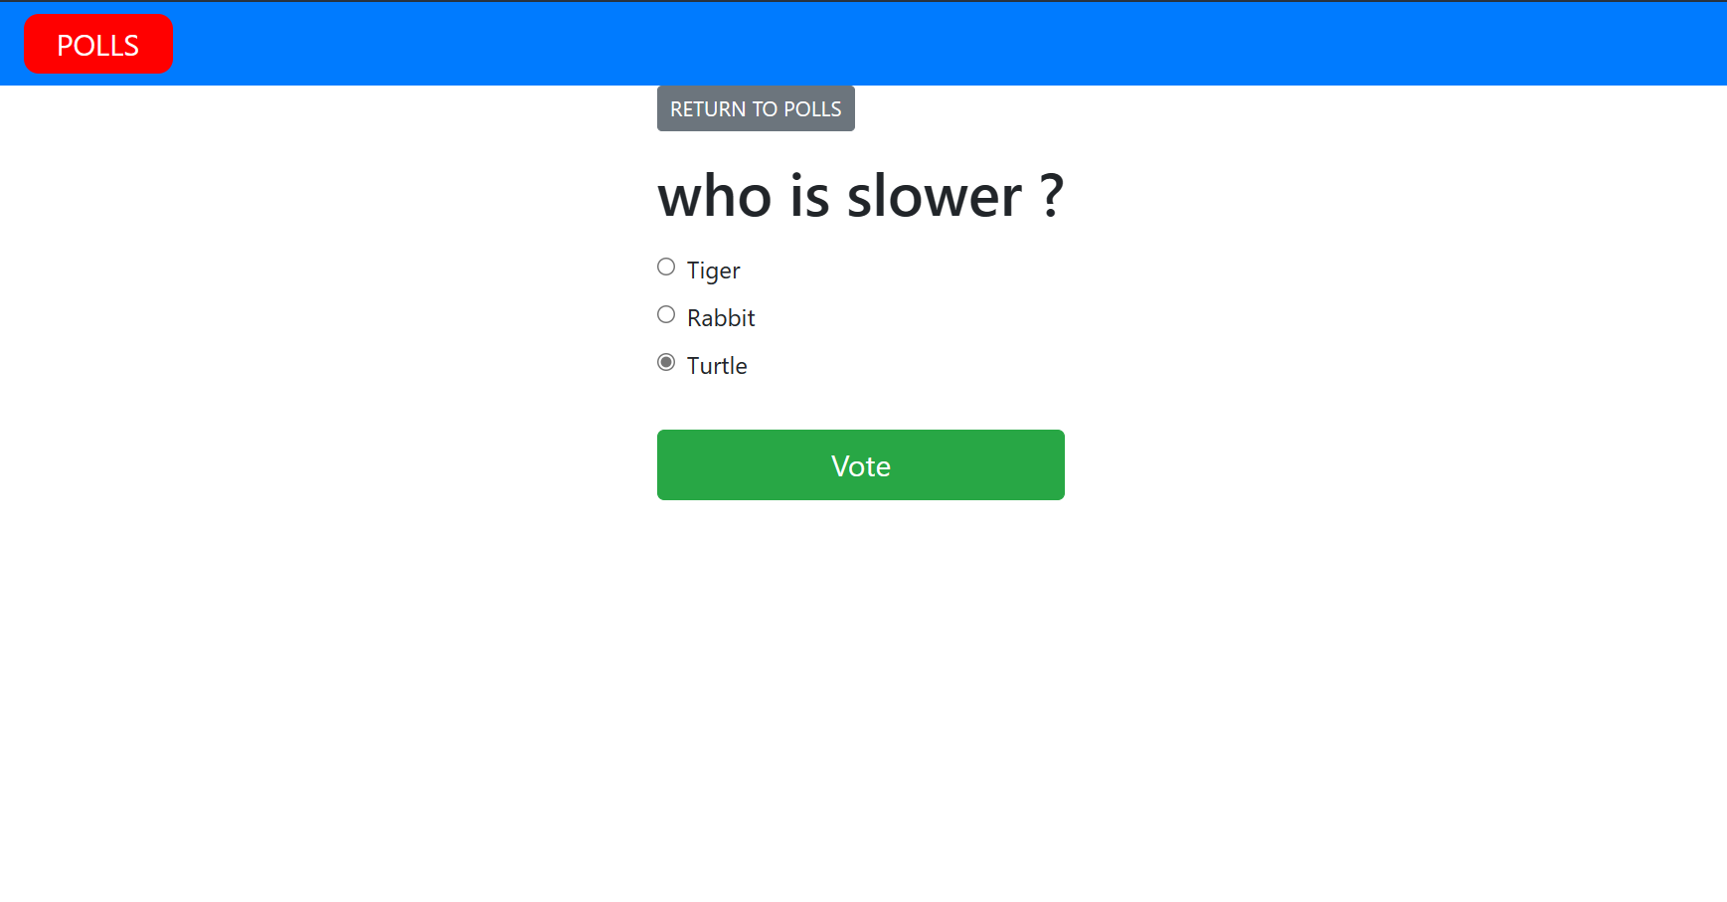
Voting Page

Slide 14
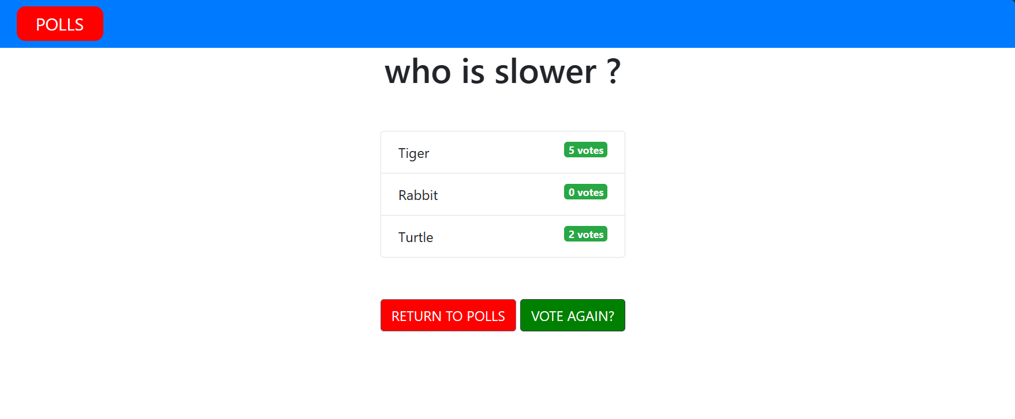
Vote Result Page

Slide 15
Future Enhancements:
Blockchain Integration: Exploring the integration of blockchain technology to enhance security, transparency, and immutability in the voting process, ensuring tamper-proof record-keeping and audit trails.
AI Integration: Incorporating artificial intelligence algorithms for advanced analytics, sentiment analysis, and personalized voting recommendations, enriching the voting experience and providing valuable insights for administrators.
Mobile Application Development: Extending the voting platform with dedicated mobile applications for iOS and Android devices, improving accessibility and enabling users to participate in polls conveniently on-the-go.
Gamification Elements: Introducing gamification elements such as badges, rewards, or leaderboards to incentivize participation, foster user engagement, and create a more interactive and enjoyable voting experience.

Slide 16
Conclusion
In conclusion, the proposed web-based voting application developed using the Django framework stands as a pivotal solution for organizations and communities seeking to streamline and fortify their voting processes. By harnessing Django's robust features and adhering to stringent security protocols, the application promises efficiency, transparency, and scalability. Through meticulous modeling, algorithmic design, and rigorous testing, it ensures reliability and accuracy in handling voting activities. Looking ahead, potential future enhancements such as blockchain integration, AI integration, mobile app development, and gamification elements offer avenues for further innovation and user engagement. Ultimately, this solution represents a significant stride towards fostering democratic participation and trust in the electoral process, paving the way for a more inclusive and empowered society.
Source :

Slide 17
Thank You!
Notes:
Thank You !!

